Slide 1

Back to the Basics: Part II
Soheil Abbasloo
Department of Computer Science
University of Toronto
Fall 2022

Slide 2
Outline
What is a network made of?
How is it shared?
How do we evaluate a network?
How is communication organized?
Network Adapters & Links

Slide 3
Performance Metrics
Delay
Loss
Throughput

Slide 4
Delay
How long does it take to send a packet
from its source to destination?

Slide 5
Delay
Consists of four components
  transmission delay
  propagation delay
  queuing delay
  processing delay
due to link properties
due to traffic mix and
switch internals

Slide 6
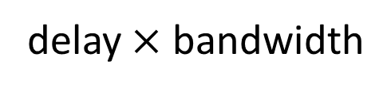
A network link
bandwidth
delay $×$ bandwidth
Propagation delay
Link bandwidth
  number of bits sent/received per unit time (bits/sec or bps)
Propagation delay
  time for one bit to move through the link (seconds)
Bandwidth-Delay Product (BDP)
  number of bits “in flight” at any time (when pipe is fully utilized)
  BDP = bandwidth × propagation delay

Slide 7
Examples
Same city over a slow link:
  bandwidth: ~100Mbps
  propagation delay: ~0.1msec
  BDP: 10,000bits (1.25KBytes)
Cross-country over fast link:
  bandwidth: ~10Gbps
  propagation delay: ~10msec
  BDP: 10⁸bits (12.5MBytes)

Slide 8

Packet Delay
Sending 100B packets from A to B?
A
B
1Mbps, 1ms
100Byte packet
time=0
Time to transmit
one bit = 1/10⁶s
Time when that
bit reaches B
= 1/10⁶+1/10³s
Time to transmit
800 bits=800x1/10⁶s
The last bit
reaches B at
(800x1/10⁶)+1/10³s
= 1.8ms
Time

Slide 9
Packet Delay
Sending 100B packets from A to B?
1GB file in 100B packets
1Gbps, 1ms?
A
B
1Mbps, 1ms
100Byte packet
10⁷ x 100B packets
The last bit in the file
reaches B at
(10⁷x800x1/10⁹)+1/10³s
= 8001ms
The last bit
reaches B at
(800x1/10⁹)+1/10³s
= 1.0008ms
The last bit
reaches B at
(800x1/10⁶)+1/10³s
= 1.8ms
Time

Slide 10

Packet Delay: The “pipe” view
Sending 100B packets from A to B?
A
B
100Byte packet
1Mbps, 10ms
pkt tx
time
100Byte packet
100Byte packet
BW →
time →
Time

Slide 11
Packet Delay: The “pipe” view
Sending 100B packets from A to B?
1Mbps, 10ms (BDP=10,000)
BW →
time →
1Mbps, 5ms (BDP=5,000)
10Mbps, 1ms (BDP=10,000)
BW →
BW →
time →
time →

Slide 12
Packet Delay: The “pipe” view
Sending 100B packets from A to B?
200B?
1Mbps, 10ms (BDP=10,000)
BW →
time →
1Mbps, 10ms (BDP=10,000)
BW →
time →

Slide 13
1. Transmission delay
How long does it take to push all the bits of a packet into a link?
Packet size / Link bandwidth
  e.g. 1000 bits / 100 Mbits per sec = 10 ⁻⁵ sec

Slide 14
2. Propagation delay
How long does it take to move one bit from one end of a link to the other?
Link length / propagation speed
  E.g. 30 kilometers / 3 10⁸ meters per sec = 10⁻⁴ sec

Slide 15
3. Queuing delay
How long does a packet have to sit in a buffer before it is processed?

Slide 16
Queuing delay: “pipe” view

Slide 17
Queuing delay: “pipe” view
No queuing delay!

Slide 18
Queuing delay: “pipe” view
Queue
Transient Overload
Not a rare event!

Slide 19
Queuing delay: “pipe” view
Queue

Slide 20
Queuing delay: “pipe” view
Queue

Slide 21
Queuing delay: “pipe” view
Queue

Slide 22
Queuing delay: “pipe” view
Queue

Slide 23
Queuing delay: “pipe” view
Queue
Queues absorb transient bursts but introduce queuing delay

Slide 24
Queuing delay: “pipe” view
What about persistent overload?
Will eventually drop packets (“loss”)

Slide 25
Queuing delay
If arrival rate > departure rate
  approaches infinity (assuming an infinite buffer)

Slide 26
Average queuing delay
arrival rate /departure rate
1
Notes:
This plot shows the average queuing delay experienced by a packet arriving at a buffer,
as a function of this entity here, which is the arrival rate divided by the departure rate.
As this entity approaches 1 (the arrival rate approaches the departure rate),
the average delay goes to infinity.
The important thing to note about this curve is the shape.
When we approach close to this area here, the curve goes up very fast.
This means that small changes in arrival rate can have a dramatic impact on delay.
This is what happens when you are driving in a congested highway.
The smallest disturbance (like one car braking) can significantly increase your delay.
When you design a queuing system, you want it to operate far from that point.

Slide 27
Queuing delay
If arrival rate > departure rate
  approaches infinity (assuming an infinite buffer)
  in practice, finite buffer → loss
If arrival rate < departure rate

Slide 28
Queue
e.g., arrival rate < departure rate

Slide 29
Queuing delay
If arrival rate > departure rate
  approaches infinity (assuming an infinite buffer)
  in practice, finite buffer → loss
If arrival rate < departure rate
  depends on burst size

Slide 30
Queuing Delay
How long does a packet have to sit in a buffer before it is processed?
Depends on traffic pattern

Slide 31
Queuing Delay
How long does a packet have to sit in a buffer before it is processed?
Depends on traffic pattern
Characterized with statistical measures
  average queuing delay
  average arrival rate
  average departure rate

Slide 32
Basic Queuing Theory Terminology
Arrival process: how packets arrive
  Average rate A
W: average time packets wait in the queue
  W for “waiting time”
L: average number of packets waiting in the queue
  L for “length of queue”

Slide 33
Little’s Law (1961)
L = A x W
Compute L: count packets in queue every second
  How often does a single packet get counted?
  W times!
Why do you care?
  Easy to compute L, harder to compute W
Notes:
Row vs column

Slide 34
4. Processing Delay
How long does the switch take to process a packet?
typically assume this is negligible

Slide 35
Delay
Consists of four components
  transmission delay
  propagation delay
  queuing delay
  processing delay
due to link properties
due to traffic mix and
switch internals

Slide 36
End-to-end delay
transmission
propagation
queuing
processing
transmission
propagation
queuing
processing
transmission
propagation

Slide 37
Loss
What fraction of the packets sent to a destination are dropped?

Slide 38
Throughput
At what rate is the destination receiving data from the source
  Data size / transfer time

Slide 39
transmission rate R bits/sec
file of size F bits
packets of size L bits
Transfer time =
F/R + propagation delay
Average throughput =
R

Slide 40
transmission rate R
transmission rate R’ > R
file of size F bits
packets of size L bits

Slide 41
transmission rate R
transmission rate R’ > R
file of size F bits
packets of size L bits
bottleneck link
Transfer time =
F/R + propagation delay +
L/R’
Average throughput =
min { R, R’ } = R

Slide 42
transmission rate R
transmission rate R’ > R
file of size F bits
packets of size L bits
bottleneck link
Average throughput =
min { R, R’ } = R

Slide 43
transmission rate R1
transmission rate R2
bottleneck link

Slide 44
transmission rate R1
transmission rate R2
bottleneck link

Slide 45
Throughput
At what rate is the destination receiving data from the source?
Later in the semester
  TCP throughput, application-level throughput, etc.
  throughput vs. “goodput”

Slide 46
What is a network made of?
How is it shared?
How do we evaluate a network?
How is communication organized?
Network Adapters & Links

Slide 47
How is communication organized?
Sara
Ali

Slide 48

Ali and Sara use a set of network protocols located at different logical layers to exchange data
Application
L5
Application
SMTP
HTTP
DNS
NTP
TCP
L4
Transport
TCP
UDP
IP
L3
Network
IP
Ethernet
L2
Data link
Ethernet
FDDI
PPP
L1
Physical
optical
copper
radio
PSTN

Slide 49
Network Protocol Stack
“Modularity, based on abstraction, is the way things get done”
“Layering” is an efficient way to organize/structure protocols
Every Layer has its own responsibility/task
Each layer provides a service to the layer above and uses the services of the layer directly below it
Each layer only communicates with its counterpart at the “other” side
L5
Application
Application
L5
L4
Transport
Transport
L4
L3
Network
Network
L3
L2
Data link
Data link
L2
L1
Physical
Physical
L1

Slide 50
What gets implemented where?
We have already seen that all layers should exist at the end-hosts
  Why?!
  What about switches and routers?
L5
Application
Application
L5
L4
Transport
Transport
L4
L3
Network
Network
L3
L2
Data link
Data link
L2
L1
Physical
Physical
L1
End-Host
End-Host

Slide 51
What gets implemented where?
  Switches process packets up to L2
L5
Application
Application
L5
L4
Transport
Transport
L4
L3
Network
Network
L3
L2
Data link
Data link
Data link
L2
L1
Physical
Physical
Physical
L1
Switch
L2 gateway
End-Host
End-Host

Slide 52
What gets implemented where?
Routers process packets up to L3
L5
Application
Application
L5
L4
Transport
Transport
L4
L3
Network
Network
Network
L3
L2
Data link
Data link
Data link
Data link
L2
L1
Physical
Physical
Physical
Physical
L1
Switch
L2 gateway
Router
L3 gateway
End-Host
End-Host

Slide 53
What gets implemented where?
Routers process packets up to L3
L5
Application
Application
L5
L4
Transport
Transport
L4
L3
Network
Network
Network
Network
L3
L2
Data link
Data link
Data link
Data link
Data link
L2
L1
Physical
Physical
Physical
Physical
Physical
L1
Switch
L2 gateway
Router
L3 gateway
Router
L3 gateway
End-Host
End-Host

Slide 54
What gets implemented where?
Routers process packets up to L3
The first really end-to-end layer is the Transport Layer!
L5
Application
Application
L5
L4
Transport
Transport
L4
L3
Network
Network
Network
Network
L3
L2
Data link
Data link
Data link
Data link
Data link
L2
L1
Physical
Physical
Physical
Physical
Physical
L1
Switch
L2 gateway
Router
L3 gateway
Router
L3 gateway
End-Host
End-Host

Slide 55
A Closer Look: End-Host
User-Space
Software
L5
Application
L4
Transport
Hardware
(typically) Operation System
L3
Network
L2
Data link
Hardware/Firmware/Driver
L1
Physical
End-Host

Slide 56
Throughout the semester, we will study these layers
and their specific responsibilities

Slide 57
Links
Application
Physical Layer and Data Link Layer
Transport
Network
L2
Data link
L1
Physical

Slide 58
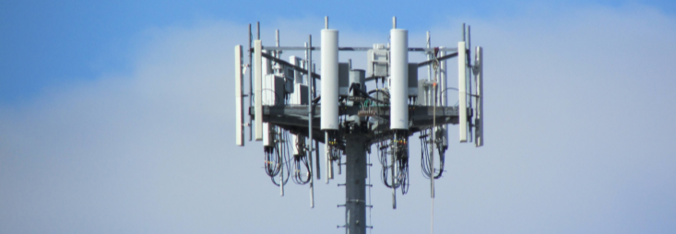
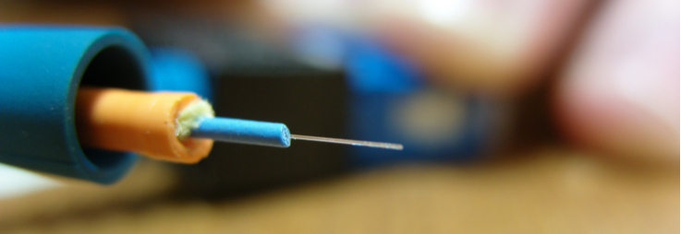
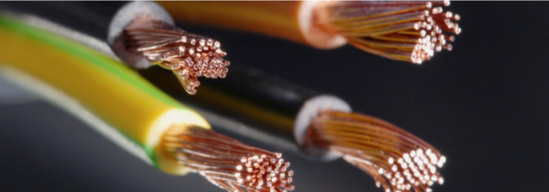
Communication Mediums
Generally, information is transferred using electromagnetic radiations propagating through a medium (or even through free space)
Wireless Links
Optical Fiber
Copper

Slide 59
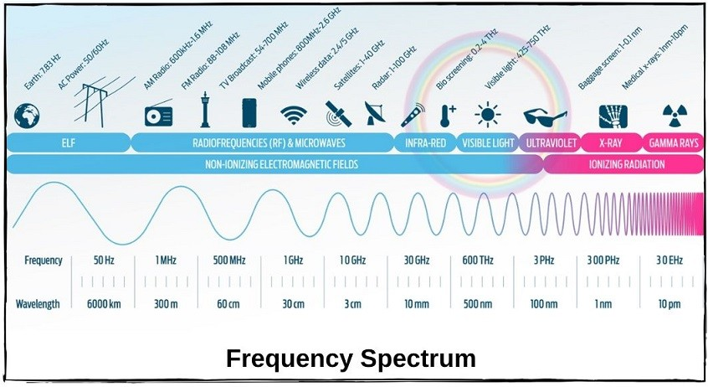
Range of Electromagnetic Waves
*https://ipcisco.com/lesson/wlan-frequency-bands/
Notes:
L -> low
M -> Medium
H -> High
V -> Very
U -> Ultra
S -> Super
E -> Extremely !

Slide 60
Bandwidth of a Channel
EE: bandwidth (B, in Hz) is the width of the pass-band in the frequency domain
CS: bandwidth (bps) is the information carrying capacity (C) of the channel
Shannon showed how they are related by noise
  Noise limits how many signal levels we can safely distinguish
  Geekspeak: “cannot distinguish the signal from the noise”

Slide 61
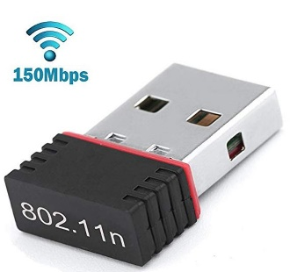

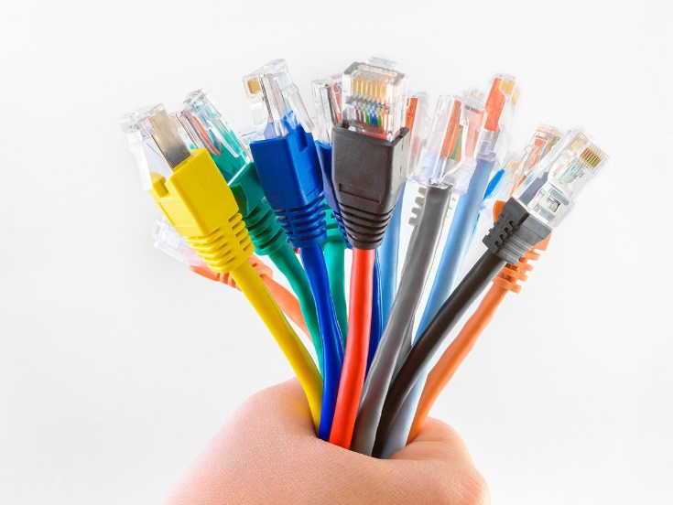
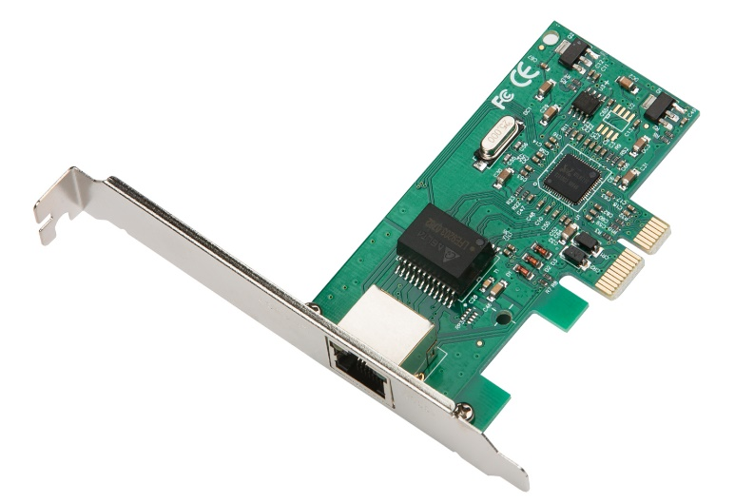
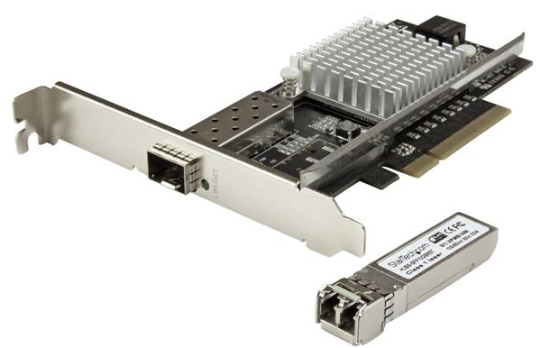
Network Link
a Communication Medium and a Network Adapter
or a NIC (Network Interface Card)

Slide 62
Physical Layer
a bit
adapter
adapter
Encoding
Transmission
Reception
Decoding
1
0
Encoding/Decoding:
  Generate analog waveform (e.g., voltage) from digital data at transmitter and sample to recover at receiver
We send/recover symbols that are mapped to bits
  There are different ways of mapping bits to signals
    E.g. NRZ, NRZI, MANCHESTER, 4B/5B

Slide 63
Link layer
Sending bits on links is good!
But two hosts connected on the same physical medium need to be able to exchange frames
packet
Data link layer protocol
packet
frame
frame
adapter
adapter
Sending node
Receiving node
Sending side
  Encapsulates packet
  in a frame
  Adds error checking bits, flow control, etc.
Receiving side
  Looks for errors, flow control, etc.
  Extracts datagram and passes to receiving node

Slide 64
Framing
Main challenge:
  When a receiver gets a sequence of bits, how should she know where the start and the end of a message/frame is?
Common solution: Sentinels
  Look for special control codes that mark start and end of frames
    What if this control code appears in the main message?
    How do you print a quotation mark in c ?!
  And “stuff” this code within the data region, E.g.
  Sender always inserts a 0 after five 1s in the frame contents
  Receiver always removes a 0 appearing after five 1s
01111110
Frame contents
01111111

Slide 65
How do we identify link adapters?

Slide 66
Medium Access Control addresses

Slide 67
MAC address
Any adaptor is “born” with a Unique MAC address
Flat name space of 48 bits (e.g., 00-15-C5-49-04-A9 in HEX)
Works like a Social Insurance Number!
Hierarchical Allocation
  Blocks: assigned to vendors (e.g., Dell) by the IEEE
    First 24 bits (e.g., 00-15-C5-**-**-**)
  Adapter: assigned by the vendor from its block
    Last 24 bits
Broadcast address (i.e., FF-FF-FF-FF-FF-FF)
  Send the frame to all adapters
Checkout your MAC address(es):
      Linux: ifconfig
  Windows: ipconfig \all | findstr “Physical”

Slide 68
Why Not Just Use IP Addresses?

Slide 69
Why Not Just IP?
Think about IP address as postal code
  IP address is kind of “location-dependent” (we’ll discuss this in detail later)
An adapter may move to a new location/network
  When you move to a new location:
    What happens to your postal code?
    What about your SIN?!
  Basically, when moved, the adapter’s IP address will be reconfigured
Links can support any protocol (not just IP)
Adapters must be identified during bootstrap
  Need to talk to the adapter to assign it an IP address

Slide 70


Bootstrapping …
Dynamic Host Configuration Protocol (DHCP)
        Broadcast “I need an IP address, please!”
Response “You can have IP address 192.168.1.22”
6C-A1-00-4E-CC-66
1A-F2-CC-76-09-AD
192.168.1.22
192.168.1.1
Where am I ?!
DHCP server
6C-A1-00-4E-DD-76
192.168.1.21

Slide 71
Discovering the Receiver …
Address Resolution Protocol (ARP)
Broadcast “who has IP address 192.168.1.21 ?”
Response “6C-A1-00-4E-DD-76 has 192.168.1.21 !”
ARP Table
IP | MAC
192.168.1.1 | 1A-F2-CC-76-09-AD
192.168.1.21 | 6C-A1-00-4E-DD-76
I have an IP packet for 192.168.1.21
But I don’t know her MAC address : (
How did we get this?!
6C-A1-00-4E-CC-66
1A-F2-CC-76-09-AD
192.168.1.22
192.168.1.1
6C-A1-00-4E-DD-76
192.168.1.21

Slide 72
How do we share a network medium?
Data Link Layer: Part II

Slide 73
Two classes for network mediums
point-to-point vs. broadcast
Point-to-point: dedicated pairwise communication
  E.g., long-distance fiber link
  E.g., Point-to-point link between an Ethernet switch and host
Broadcast: shared medium (wire or wireless)
  Traditional Ethernet (pre ~2000)
  802.11 wireless LAN
  Cellular network

Slide 74
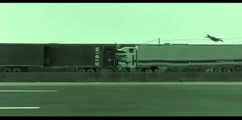
Collisions on shared broadcast medium
For a single shared broadcast channel
  We need to avoid having multiple nodes speaking at once
  Otherwise, collisions lead to garbled data
  We need distributed algorithm for sharing the channel

Slide 75
Dealing with Multiple Access Control (MAC) problem
Three main techniques . . .
  Channel partitioning: divide channel into pieces (in time or in frequency)
  Taking turns: Pass a token for the right to transmit
  Random access: allow collisions, and then recover
    More in the Internet style!
    So, let’s focus on this . . .

Slide 76
Let’s design a simple distributed MAC protocol!

Slide 77



How do we do it in this setting ?
Our receivers!
Our transmitters!

Slide 78

Key three steps . . .
Carrier sense
  Listen before speaking
  …and don’t interrupt!
Collision detection
  Detect simultaneous talking
  … and be quiet!
Random access
  Wait for a random period of time
  … before trying to talk again!
  How should we choose the time period?
    a fixed duration?

Slide 79
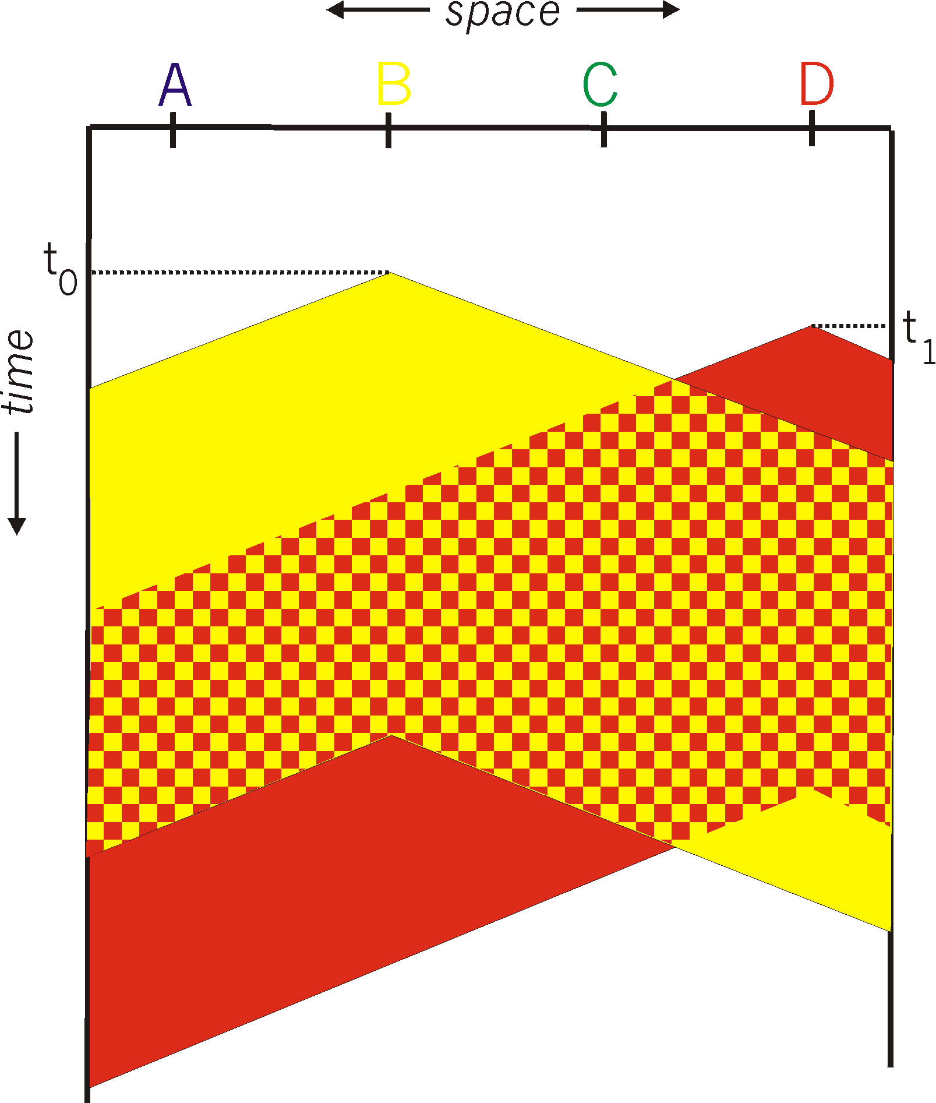
Carrier Sense Multiple Access (CSMA)
Listen for other senders
  Then transmit your data
Collisions can still occur
  Propagation delay
  Wasted transmission

Slide 80
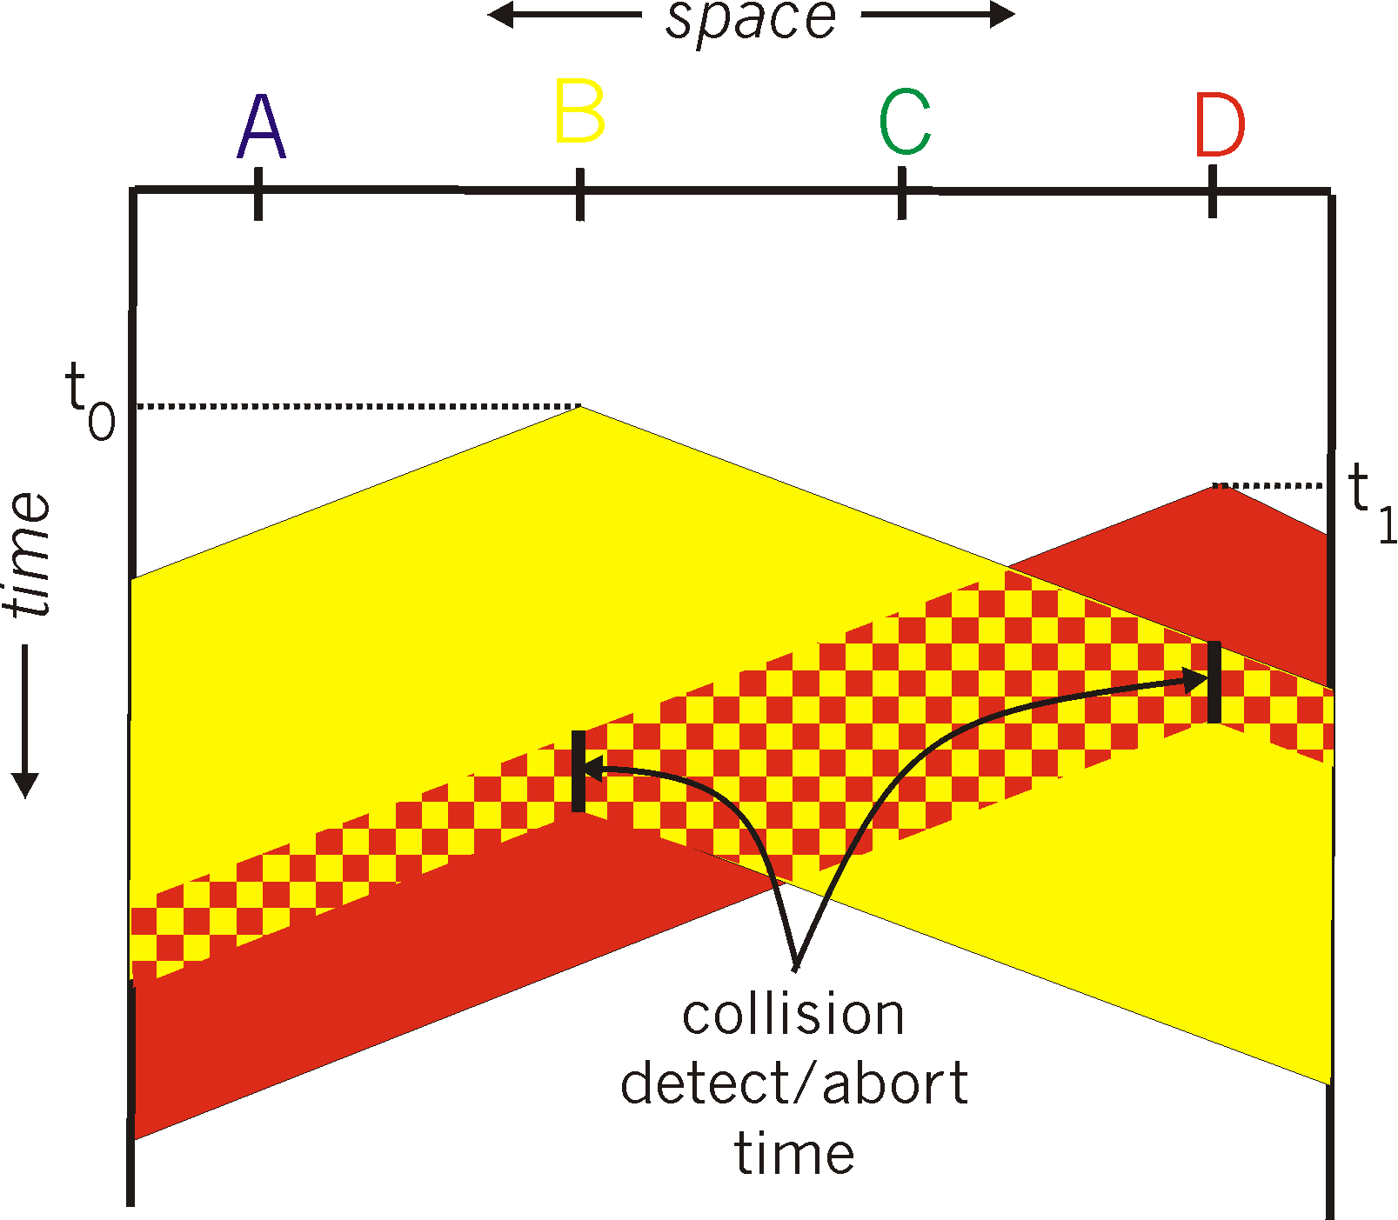
CSMA with Collision Detection CSMA/CD
Detect collision
  Abort transmission
  Jam the link (signal the other end)
Wait random time
  Transmit again

Slide 81
Ethernet

Slide 82
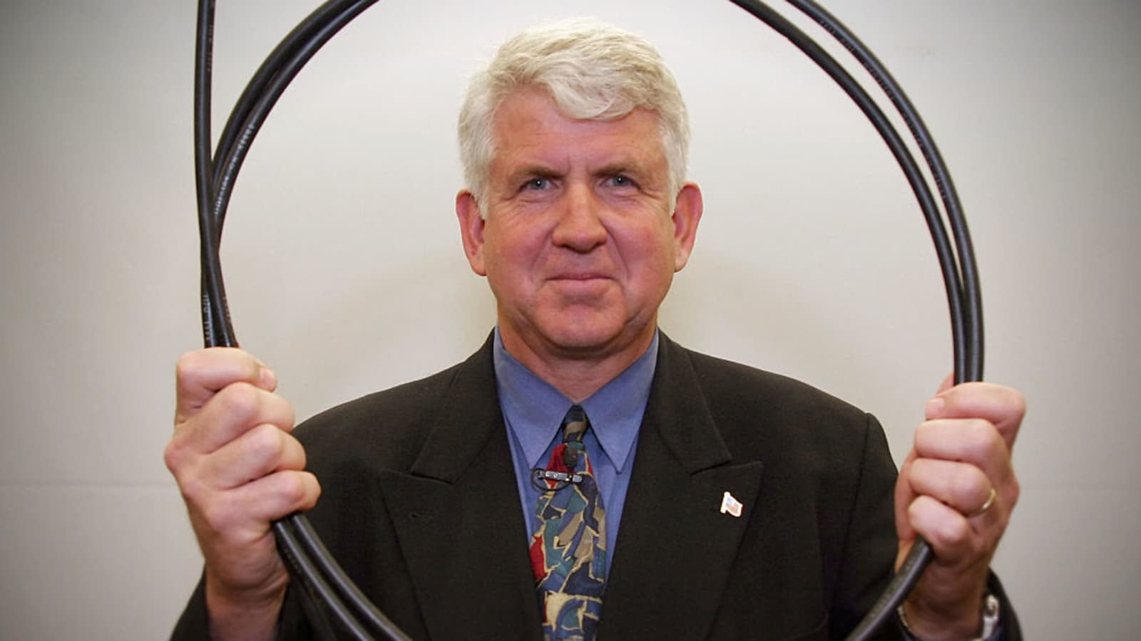
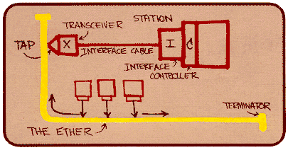
Ethernet
Is the Dominant wired LAN technology
First and by far the most widely used LAN technology
Kept up with speed race: 10 Mbps – 400 Gbps
Metcalfe’s Ethernet sketch
LAN: local area network

Slide 83
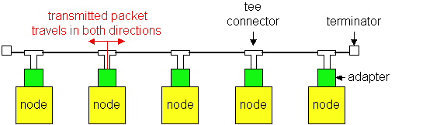
Ethernet’s Evolution
Ethernet was invented as a broadcast technology
  Hosts share channel
  Each packet received by all attached hosts
  CSMA/CD for media access control
Current Ethernets are “switched” (next lecture)
  Point-to-point links between switches; between a host and switch
  No sharing, no CSMA/CD
  Uses “self learning” and “spanning tree” algorithms for routing

Slide 84
Ethernet offers an unreliable,
connectionless service
Unreliable Receiving adapter does not acknowledge anything
Connectionless No handshaking between the send and receive adapter

Slide 85
Traditional Ethernet Uses CSMA/CD
Carrier Sense: wait for link to be idle
  Channel idle: start transmitting
  Channel busy: wait until idle
Collision Detection: listen while transmitting
  No collision: transmission is complete
  Collision: abort transmission, and send jam signal
Random Access: exponential back-off
  After collision, wait random time before trying again
  After m^{th} collision, choose K randomly from {0, …, 2^{m}-1}
  … and wait for K*512 bit times before trying again

Slide 86
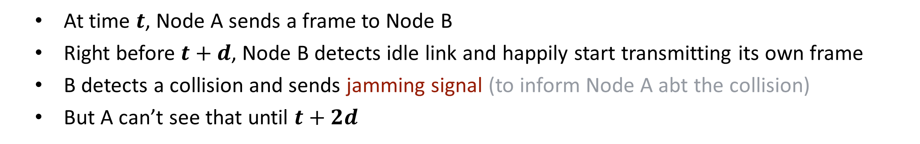
CSMA/CD and its restrictions
Latency $d$
Node A
Node B
  At time $t$, Node A sends a frame to Node B
  Right before $t+d$, Node B detects idle link and happily start transmitting its own frame
  B detects a collision and sends jamming signal (to inform Node A abt the collision)
    But A can’t see that until $t+2d$

Slide 87
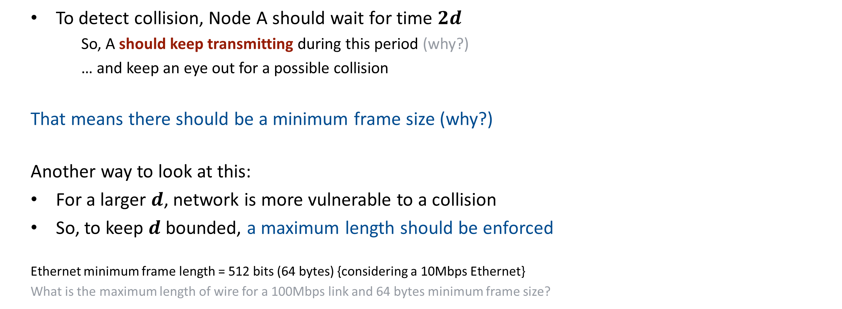
Node A
Node B
Latency $d$
  To detect collision, Node A should wait for time $2d$
      So, A should keep transmitting during this period (why?)
      … and keep an eye out for a possible collision
      That means there should be a minimum frame size (why?)
      Another way to look at this:
      For a larger $d$, network is more vulnerable to a collision
      So, to keep $d$ bounded, a maximum length should be enforced
    Ethernet minimum frame length = 512 bits (64 bytes) {considering a 10Mbps Ethernet}
    What is the maximum length of wire for a 100Mbps link and 64 bytes minimum frame size?

Slide 88
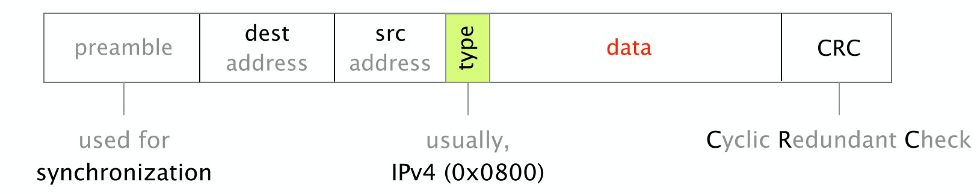
The Ethernet header is simple,
composed of 6 fields only
What is the Ethernet efficiency (payload/frameSize)?

Slide 89
Next time: Switched Ethernet

