Slide 1

Transport Layer
Soheil Abbasloo
Department of Computer Science
University of Toronto
Fall 2022

Slide 2
Outline
Transport Layer
  Why?
  UDP
  TCP
Info abt midterm

Slide 3
Transport Layer
The first end-to-end layer!
L5
Application
Application
L5
L4
Transport
Transport
L4
L3
Network
Network
Network
Network
L3
L2
Data link
Data link
Data link
Data link
Data link
L2
L1
Physical
Physical
Physical
Physical
Physical
L1
Switch
L2 gateway
Router
L3 gateway
Router
L3 gateway
End-Host
End-Host

Slide 4
Why Transport Layer?
Network Layer (L3) delivered packets to the host, so why transport layer?!
End-to-end com. is b.w. application processes at hosts
  Need a way to decide which packets go to which applications
1 - multiplexing/demultiplexing
Server host 128.100.20.20
Service request for
128.100.20.20:80
(i.e., the Web server)
Client host
Web server
(port 80)
Client
OS
Echo server
(port 7)

Slide 5
Why Transport Layer?
IP provides a weak service model (best-effort)
  Packets can be corrupted, delayed, dropped, reordered, duplicated
  No guidance on how much traffic to send and when
  Dealing with this is tedious for application developers
2 - reliability, in-order delivery, etc.

Slide 6
Role of the Transport Layer
Communication between application processes
  Mux and demux from/to application processes
  Implemented using ports

Slide 7
Role of the Transport Layer
Communication between application processes
Provide common end-to-end services for app layer [optional]
  Reliable, in-order data delivery
  Well-paced data delivery
    too fast may overwhelm the network
    too slow is not efficient

Slide 8
Role of the Transport Layer
Communication between application processes
Provide common end-to-end services for app layer [optional]
TCP and UDP are the common transport protocols
  also SCTP, MTCP, SST, RDP, DCCP, …

Slide 9
Role of the Transport Layer
Communication between application processes
Provide common end-to-end services for app layer [optional]
TCP and UDP are the common transport protocols
UDP is a minimalist, no-frills transport protocol
  only provides mux/demux capabilities & optional error checking on packet data

Slide 10
Role of the Transport Layer
Communication between application processes
Provide common end-to-end services for app layer [optional]
TCP and UDP are the common transport protocols
UDP is a minimalist, no-frills transport protocol
TCP is the whole-hog protocol
  offers apps a reliable, in-order, bytestream abstraction
  with congestion control, Flow control, …
  provides “Connection” set-up & teardown
  but no performance guarantees (delay, bw, etc.) on a general Internet scenario
    why?!

Slide 11
Multiplexing and Demultiplexing

Slide 12
Context: Applications and Sockets
Socket: software abstraction by which an application process exchanges network messages with the (transport layer in the) operating system
  socketID = socket(…, socket.TYPE)
  socketID.sendto(message, …)
  socketID.recvfrom(…)
Two important types of sockets
  UDP socket: TYPE is SOCK_DGRAM
  TCP socket: TYPE is SOCK_STREAM

Slide 13
Ports
Problem: deciding which app (socket) gets which packets
Solution: port as a transport layer identifier (16 bits)
    Packet carries source/destination port numbers in transport header (e.g., ssh:22, http:80)
    This is not a port on a switch (which is an interface)
    Think of it as a logical interface on a host
OS stores mapping between sockets and ports
  Port: in packets
  Socket: in OS

Slide 14
4 bits
version | header length | Type of service (TOS) | Total Length
Identification |  |  | Flags | Fragment offset
Time to Live |  | Protocol | Header Checksum
Source IP Address
Destination IP Address
Options (if any)
Payload

Slide 15
4 bits
version | header length | Type of service (TOS) | Total Length
Identification |  |  | Flags | Fragment offset
Time to Live |  | 6 = TCP 17 = UDP | Header Checksum
Source IP Address
Destination IP Address
Payload

Slide 16
4 bits
version | header length | Type of service (TOS) | Total Length
Identification |  |  | Flags | Fragment offset
Time to Live |  | 6 = TCP 17 = UDP | Header Checksum
Source IP Address
Destination IP Address
16-bit Source Port |  |  | 16-bit Destination Port
More Transport Header field …
Payload

Slide 17
Recap: Multiplexing and Demultiplexing
Host receives IP packets
  Each IP header has source and destination IP address
  Each Transport Layer header has source and destination port number
Host uses IP addresses and port numbers to direct the message to appropriate socket
  UDP maps local destination port and address to socket
  TCP maps address pair and port pair to socket

Slide 18
UDP
User Datagram Protocol

Slide 19
UDP: User Datagram Protocol
Lightweight communication between processes
  Avoid overhead and delays of ordered, reliable delivery
UDP described in RFC 768 – (1980!)
  Destination IP address and port to support demultiplexing
  Optional error checking on the packet contents
    (checksum field = 0 means “don’t verify checksum”)
16-bit Src Port | 16-bit Dst Port
Checksum | Length
Payload
Why do UDP packets carry the sender’s port?

Slide 20
Why Would Anyone Use UDP?
Fine-grain control
  UDP sends as soon as the application writes
No connection set-up delay
  UDP sends without establishing a connection
No connection state
  No buffers, parameters, sequence #s, etc.
Small header overhead
  UDP header is only eight-bytes long

Slide 21
Popular Applications That Use UDP
Interactive real-time multimedia applications
  E.g., phone calls, video conferencing, gaming
  why?
Simple query-response protocols
  E.g., Domain Name System (DNS), DHCP, etc.
  why?
Notes:
Retransmitting packets is not always worthwhile
Overhead of connection establishment is overkill

Slide 22


Thought Experiment
Enemy
When to attack?
When to attack?
They win if they both attack at the same time
  But their messengers must pass the enemy’s territory
  Messengers can be captured by the enemy
Design a protocol
that guarantees their win

Slide 23
TCP: Transmission Control Protocol
Reliability Over a Best-Effort Network

Slide 24

Reliable Transport
In a perfect world, reliable transport is easy
Sender
send packets
Receiver
wait for packets

Slide 25
Reliable Transport
In a perfect world, reliable transport is easy
All the bad things best-effort can do
  a packet is corrupted (bit errors)
  a packet is lost (why?)
  a packet is delayed (why?)
  packets are reordered (why?)
  a packet is duplicated (why?)

Slide 26
Reliable Transport
Mechanisms for coping with bad events
  Checksums: to detect corruption
  ACKs: receiver tells sender that it received packet
  NACK: receiver tells sender it did not receive packet
  Sequence numbers: a way to identify packets
  Retransmissions: sender resends packets
  Timeouts: a way of deciding when to resend a packet
  …

Slide 27
E.g., Dealing with Packet Corruption
1
ack
☑
2
nack
☒
2
Sender
Receiver
Time

Slide 28
E.g., Dealing with Packet Corruption
1
P(1)
☑
☒
ack(1)
1
P(1)
Packet
#1 or #2?
ack(1)
2
P(2)
Data and ACK packets carry sequence numbers
What if the ACK/NACK is corrupted?
Sender
Receiver
Time

Slide 29
E.g., Dealing with Packet Loss
1
P(1)
☒
Timeout
1
P(1)
ack(1)
P(2)
Sender
Receiver
Timer-driven loss detection
Set timer when packet is sent; retransmit on timeout
Time

Slide 30
E.g., Dealing with Packet Loss (of ack)
1
P(1)
Timeout
☒
1
P(1)
duplicate!
ack(1)
P(2)
Sender
Receiver
Time

Slide 31
E.g., Dealing with Packet Loss
1
Timeout
P(1)
1
ack(1)
P(1)
.
.
.
duplicate!
ack(1)
P(2)
Sender
Receiver
Timer-driven retx. can lead to duplicates
Time

Slide 32
Components of a Solution (so far)
checksums (to detect bit errors)
timers (to detect loss)
acknowledgements (positive or negative)
sequence numbers (to deal with duplicates)
But how to put them together into a coherent design?
TCP is an answer to this question

Slide 33
TCP Support for Reliable Delivery
Sequence numbers
  Used to detect missing data
  ... and for putting the data back in order
Retransmission and Timeout
  Sender retransmits lost or corrupted data
  Timeout based on estimates of round-trip time
  Fast retransmit algorithm for rapid retransmission
Checksum
  Used to detect corrupted data at the receiver
  …leading the receiver to drop the packet

Slide 34
1- TCP provides a Stream-of-Bytes service
TCP Segments and Sequence Numbers

Slide 35
TCP “Stream of Bytes” Service
Host A
Byte 0
Byte 1
Byte 2
Byte 3
Byte 80
Host B
Byte 0
Byte 1
Byte 2
Byte 3
Byte 80

Slide 36
…Emulated Using TCP “Segments”
Host A
Byte 0
Byte 1
Byte 2
Byte 3
Byte 80
Segment sent when:
Segment full (Max Segment Size),
Not full, but times out, or
“Pushed” by application.
TCP Data
TCP Data
Host B
Byte 0
Byte 1
Byte 2
Byte 3
Byte 80

Slide 37
TCP Segment
IP Data
TCP Data (segment)
TCP Hdr
IP Hdr
IP packet
  No bigger than Maximum Transmission Unit (MTU)
  E.g., up to 1500 bytes on an Ethernet link
TCP packet
  IP packet with a TCP header and data inside
  TCP header is typically 20 bytes long
TCP segment
  No more than Maximum Segment Size (MSS) bytes
  E.g., up to 1460 consecutive bytes from the stream
  MSS = MTU – (IP header) – (TCP header)

Slide 38
Sequence Numbers
ISN (initial sequence number)
k bytes
Host A
Sequence number
= 1st byte in segment = ISN + k

Slide 39
Sequence Numbers
ISN (initial sequence number)
k
Host A
Sequence number
= 1st byte in segment = ISN + k
TCP Data
TCP
HDR
ACK sequence number
= next expected byte
TCP Data
TCP
HDR
Host B

Slide 40
TCP Header
Starting byte offset of data carried in this segment
Source port
Destination port
Sequence number
Acknowledgment
HdrLen
0
Flags
Advertised window
Checksum
Urgent pointer
Options (variable)
Data
Notes:
Number of first byte

Slide 41
ACKing and Sequence Numbers
Sender sends packet
  Data starts with sequence number X
  Packet contains B bytes [X, X+1, X+2, ….X+B-1]
Upon receipt of packet, receiver sends an ACK
  If all data prior to X already received:
    ACK acknowledges X+B (because that is next expected byte)
  If highest in-order byte received is Y s.t. (Y+1) < X
    ACK acknowledges Y+1
    Even if this has been ACKed before

Slide 42
Normal Pattern
Sender: seqno=X, length=B
Receiver: ACK=X+B
Sender: seqno=X+B, length=B
Receiver: ACK=X+2B
Sender: seqno=X+2B, length=B
Seqno of next packet is same as last ACK field

Slide 43
TCP Header
Source port
Destination port
Acknowledgment gives seqno just beyond highest seqno received in order (“What Byte is Next”)
Sequence number
Acknowledgment
HdrLen
0
Flags
Advertised window
Checksum
Urgent pointer
Options (variable)
Data

Slide 44
2- TCP provides a connection-oriented service
Establishing and terminating TCP connections

Slide 45
Initial Sequence Number (ISN)
Sequence number for the very first byte
Why not just use ISN = 0?
Practical issue
  IP addresses and port #s uniquely identify a connection
  Eventually, though, these port #s do get used again
  … small chance an old packet is still in flight
  … and associated with the new connection
  Also, others might try to spoof your connection
  Why does using ISN help?
TCP therefore requires changing ISN
Hosts exchange ISNs when they establish a connection

Slide 46
Establishing a TCP Connection
A
B
SYN
Three-way handshake to establish connection
  Host A sends a SYN (open; “synchronize sequence numbers”) to host B
  Host B returns a SYN acknowledgment (SYN ACK)
  Host A sends an ACK to acknowledge the SYN ACK
SYN ACK
Each host tells its ISN to the other host.
ACK
Data
Data

Slide 47
TCP Header
Source port
Destination port
Sequence number
Flags:
SYN
ACK
FIN
RST
PSH
URG
Acknowledgment
HdrLen
0
Flags
Advertised window
Checksum
Urgent pointer
Options (variable)
Data

Slide 48
Step 1: A’s Initial SYN Packet
A’s port
B’s port
A’s Initial Sequence Number
Flags:
SYN
ACK
FIN
RST
PSH
URG
(Irrelevant since ACK not set)
5
Flags
Advertised window
0
Checksum
Urgent pointer
Options (variable)
A tells B it wants to open a connection…

Slide 49
Step 2: B’s SYN-ACK Packet
B’s port
A’s port
B’s Initial Sequence Number
Flags:
SYN
ACK
FIN
RST
PSH
URG
ACK = A’s ISN plus 1
5
Flags
Advertised window
0
Checksum
Urgent pointer
Options (variable)
B tells A it accepts, and is ready to hear the next byte…
… upon receiving this packet, A can start sending data

Slide 50
Step 3: A’s ACK of the SYN-ACK
A’s port
B’s port
A’s Initial Sequence Number
Flags:
SYN
ACK
FIN
RST
PSH
URG
B’s ISN plus 1
5
Flags
Advertised window
0
Checksum
Urgent pointer
Options (variable)
A tells B it’s likewise okay to start sending
… upon receiving this packet, B can start sending data

Slide 51
Timing Diagram: 3-Way Handshaking
Passive
Open
Active
Open
Server
Client (initiator)
listen()
connect()
SYN, SeqNum = x
SYN + ACK, SeqNum = y, Ack = x + 1
ACK, Ack = y + 1

Slide 52
What if the SYN Packet Gets Lost?
Suppose the SYN packet gets lost
  Packet is lost inside the network, or:
  Server discards the packet (e.g., it’s too busy)
Eventually, no SYN-ACK arrives
  Sender sets a timer and waits for the SYN-ACK
  … and retransmits the SYN if needed
How should the TCP sender set the timer?
  Sender has no idea how far away the receiver is
  Hard to guess a reasonable length of time to wait
  SHOULD (RFCs 1122 & 2988) use default of 3 seconds
    Some implementations instead use 6 seconds

Slide 53
SYN Loss and Web Downloads
User clicks on a hypertext link
  Browser creates a socket and does a “connect”
  The “connect” triggers the OS to transmit a SYN
If the SYN is lost…
  3-6 seconds of delay: can be very long
  User may become impatient
  … and click the hyperlink again, or click “reload”
User triggers an “abort” of the “connect”
  Browser creates a new socket and another “connect”
  Essentially, forces a faster send of a new SYN packet!
  Sometimes very effective, and the page comes quickly

Slide 54
Tearing Down the Connection
B
Closing (each end of) the connection
  Finish (FIN) to close and receive remaining bytes
  And other host sends a FIN ACK to acknowledge
  Reset (RST) to close and not receive remaining bytes
ACK
SYN
SYN ACK
Data
ACK
FIN
ACK
FIN
ACK
A
time

Slide 55
3- TCP provides a Reliable Communication
Timeout, Retransmission, Flow Control, & Sliding Window

Slide 56
Automatic Repeat request (ARQ)
ACK and timeouts
  Receiver sends ACK when it receives packet
  Sender waits for ACK and times out
Simplest ARQ protocol
  Stop and wait
  Send a packet, stop and wait until ACK arrives
How do we pick a timeout value?
Sender
Receiver
Packet
Timeout
ACK
Time

Slide 57
Timing Illustration
1
1
Timeout
RTT
RTT
1
Timeout
1
Timeout too long → inefficient
Timeout too short → duplicate packets

Slide 58
Retransmission Timeout (RTO)
If haven’t received ack by timeout, retransmit the packet
How to set timeout?
  Too long: connection has low throughput
  Too short: retransmit packet that was just delayed
Solution: make timeout proportional to RTT
But how do we measure RTT?

Slide 59


Smoothed RTT
Use Exponentially Weighted Moving Average (EWMA)
$$sample_{RTT}$$
$$sample_{RTT}=AckRcvdTime −SendPacketTime$$
$$sRTT=α×sRTT+\left(1−α\right)×sample_{RTT}$$
$(0<α≤1$)
sRTT
Time
sRTT = Smoothed RTT

Slide 60
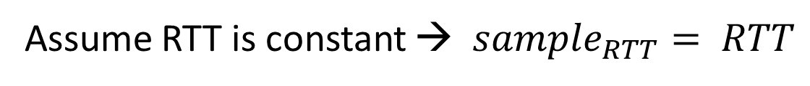
EWMA Example
$$sRTT = α×sRTT + \left(1 – α\right)×sample_{RTT}$$
Assume RTT is constant → $sample_{RTT}= RTT$
sRTT (α = 0.5)
RTT
sRTT (α = 0.8)
0
1
2
3
4
5
6
7
8
9
time

Slide 61
Problem: Ambiguous Measurements
How do we differentiate between the real ACK, and ACK of the retransmitted packet?
Sender
Receiver
Sender
Receiver
Original Transmission
Original Transmission
SampleRTT
ACK
SampleRTT
Retransmission
Retransmission
ACK

Slide 62
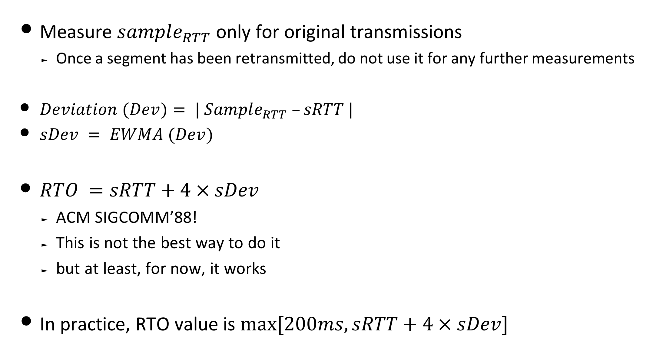
Retransmission Timeout (RTO)
Measure $sample_{RTT}$ only for original transmissions
  Once a segment has been retransmitted, do not use it for any further measurements
$Deviation (Dev)= | Sample_{RTT} –sRTT |$
$sDev = EWMA (Dev)$
$RTO =sRTT+4×sDev$
  ACM SIGCOMM’88!
  This is not the best way to do it
  but at least, for now, it works
In practice, RTO value is $max⁡[200ms, sRTT+4×sDev]$

Slide 63
We got a Reliable Transport!
  What is wrong with this approach?
Sender
send packets(i);
(re)set the timer & wait for ack
  If (ACK)
    I++; repeat
  If ( TIMEOUT)
    repeat
Receiver
wait for packet
if packet is OK, send ACK
repeat

Slide 64
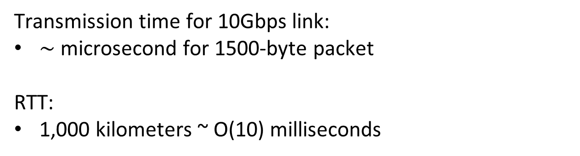
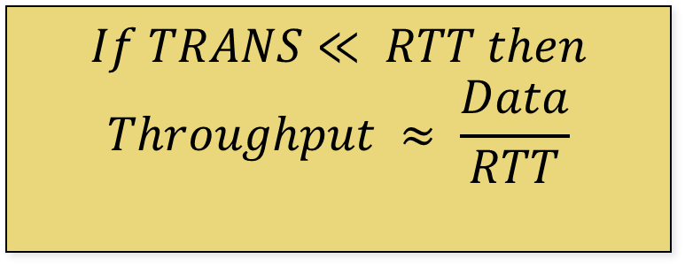
Stop & Wait is Inefficient
TRANS
$$If TRANS≪ RTT then$$
$$Throughput ≈ \frac{Data}{RTT}$$
DATA
RTT
ACK
Transmission time for 10Gbps link:
$\sim$ microsecond for 1500-byte packet
RTT:
1,000 kilometers ~ O(10) milliseconds
Sender
Receiver

Slide 65
Sliding Window
Allow a larger amount of data “in flight”
  Allow sender to get ahead of the receiver

Slide 66
Sliding Window at Sender
Allow a larger amount of data “in flight”
  Allow sender to get ahead of the receiver
Sending process
TCP
Buffer size (B)
Last byte written
Previously
ACKed bytes
First unACKed byte
Last byte
can send

Slide 67
Sliding Window at Receiver
Receiving process
Last byte read
Buffer size (B)
Received and
ACKed
Sender might overrun
the receiver’s buffer
Next byte needed
(1st byte not received)
Last byte received

Slide 68
Solution: Advertised Window (Flow Control)
Receiver uses an “Advertised Window” (W) to prevent sender from overflowing its window
  Receiver indicates value of W in ACKs
  Sender limits number of bytes it can have in flight <= W
Source port
Destination port
Sequence number
Acknowledgment
HdrLen
0
Flags
Advertised window
Checksum
Urgent pointer
Options (variable)
Data

Slide 69
Sliding Window at Sender
Sending process
TCP
W
Last byte written
First unACKed byte
Last byte can send

Slide 70
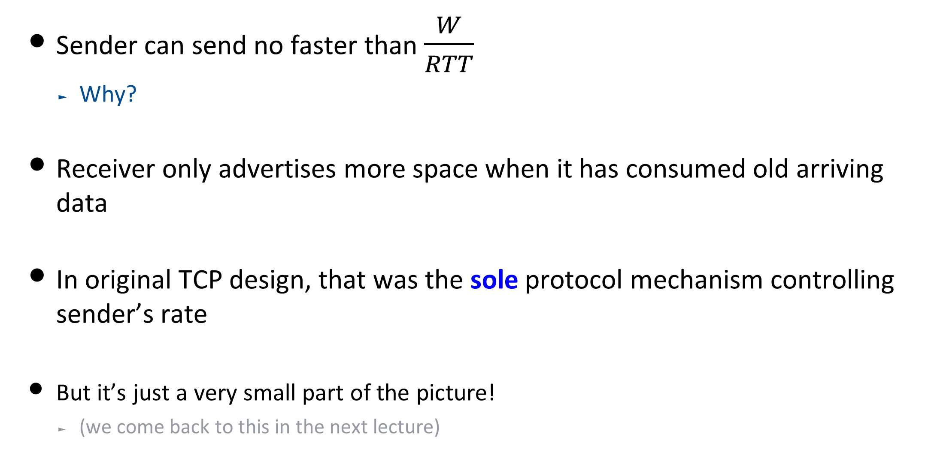
Advertised Window Limits Sending Rate
Sender can send no faster than $\frac{W}{RTT}$
  Why?
Receiver only advertises more space when it has consumed old arriving data
In original TCP design, that was the sole protocol mechanism controlling sender’s rate
But it’s just a very small part of the picture!
  (we come back to this in the next lecture)

Slide 71
So Far …
TCP provides:
  A stream-of-bytes service
  A connection-oriented service
To bring reliability, TCP:
  Uses Sliding window algorithm (Flow Control)
  Sets RTO values proportional to network RTT
  Detects loss when it sees a timeout

Slide 72
Can we do better?
An example . . .
Sender sends packets with 100B and seqnos.:
  100, 200, 300, 400, 500, 600, 700, 800, 900, …
Assume the fifth packet (seqno 500) is lost, but no others
Stream of ACKs will be:
  200, 300, 400, 500, 500, 500, 500,…
Can we exploit this to retransmit fifth packet (even before timeout)?
Any ideas?

Slide 73
Loss with cumulative ACKs
“Duplicate ACKs” are a sign of an isolated loss
  The lack of ACK progress means 500 hasn’t been delivered
  Stream of ACKs means some packets are being delivered
Therefore, could trigger resend upon receiving k duplicate ACKs
  TCP uses k=3

Slide 74
Effectiveness of Fast Retransmit
When does Fast Retransmit work best?
  High likelihood of many packets in flight
  Long data transfers, large window size, …
Implications for Web traffic
  Most Web transfers are short (e.g., 10 packets)
    So, often there aren’t many packets in flight
  Making fast retransmit is less likely to “kick in”
    Forcing users to click “reload” more often …

Slide 75
Putting them together: TCP
Stream-of-bytes service
  Sends and receives a stream of bytes
Connection oriented
  Explicit set-up and tear-down of TCP connection
Flow control
  Prevent overflow of the receiver’s buffer space
  Sliding windows
Reliable, in-order delivery
  Detect Corruption: checksums
  Detect loss/reordering: timers, sequence numbers
  Reliable delivery: acknowledgments and retransmissions

Slide 76
Recap
The concepts underlying TCP are simple
  acknowledgments (feedback)
  timers
  sliding windows
  buffer management
  sequence numbers

Slide 77
Recap
The concepts underlying TCP are simple
But tricky in the details
  How do we set timers?
  What is the seqno for an ACK-only packet?
  What if the advertised window is half an MSS?
  Should receiver acknowledge packets right away?
  What if the application generates data in units of 0.1 MSS?
  What happens if I get a duplicate SYN? Or a RST while I’m in FIN_WAIT, etc., etc., etc.

Slide 78
Next Time
Congestion Control

Slide 79
Midterm: Logistics
Location/Time:
  Next week, same room and time as the lecture!
  We will start with 10min delay
  Both undergrad and grad students
Closed book, closed notes, etc.
Single two-sided “cheat sheet”, handwritten
  Not bigger than an A4 paper!
No calculators, electronic devices, etc.
  Test does not require any complicated calculation

Slide 80
General Guidelines (1)
Test only assumes material covered in our lectures
  Text: only to clarify details and context for the above
  The test doesn’t require you to do complicated calculations
  Use this as a hint to whether you are on the right track!
Everything covered excluding today’s lecture
You don’t need to memorize packet headers
  We’ll provide the IP header for your reference on the exam sheet
You do need to understand how things work
  not for the sake of knowing gory details but to understand pros/cons, when a solution is applicable/useful/useless, etc.

Slide 81
General Guidelines (2)
Be prepared to:
Weigh design options outside of the context we studied them in
  e.g., I had a TCP connection, then BGP went nuts …”
Contemplate new designs we haven’t talked about
  e.g., I introduce a new IP address format; how does this affect …”
Don’t let this daunt you. Reason from what you know about the pros/cons of solutions we did study
      e.g., circuit switching is inefficient when …

Slide 82
General Guidelines (3)
Exam format (tentative!)
  Q1) Multiple-choice questions
  Q2) Design questions: A set of “here’s a scenario, tell me if the following is true/false”-style questions
  Q3+ more traditional short/long questions

