Slide 1

Congestion Control
Soheil Abbasloo
Department of Computer Science
University of Toronto
Fall 2022

Slide 2
Outline
Let’s Talk abt Midterm!
Overview of TCP
Congestion Control
  What?
  How?

Slide 3
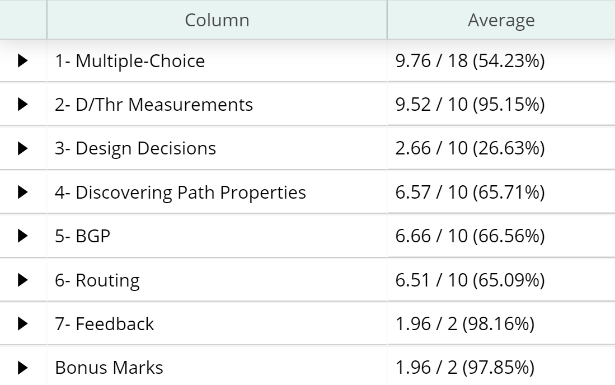
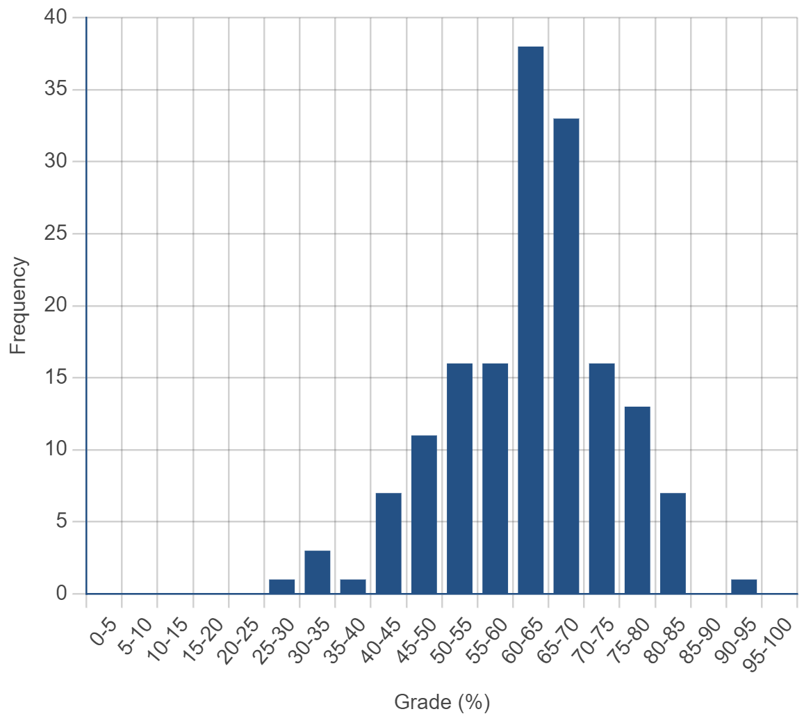
Midterm Stats
Average
  45.6 / 72 (63.33%)
Median
  46 / 72 (63.89%)
Standard dev.
  8.16 (11.33%)

Slide 4
Your Final Grade
Programming Assignments
Problem Sets
Midterm Exam
Final Exam
30%
20%
20%
30%
Midterm:
  About 10% of students were absent due to diff. issues (sickness, etc.)

Slide 5
Your Final Grade
Programming Assignments
Problem Sets
Midterm Exam
Final Exam
30%
20%
20%
50%
Midterm:
  About 10% of students were absent due to diff. issues (sickness, etc.)
Might not be fair!

Slide 6
Your Final Grade
Programming Assignments
30%
Problem Sets
20%
Max {v1, v2}
v1
Midterm Exam
20%
Final Exam
30%
v2
Final Exam
50%

Slide 7
Your Feedback!
Top ranked suggestions (based on #students):
  Sample questions for final
  A break after 1st hour!
Some other ones:
  pptx plus pdf
  Making slides easier to review later
  Starting at XX:10
  Better Seats!

Slide 8
Last time …
TCP provides:
  A stream-of-bytes service
  A connection-oriented service
To bring reliability, TCP:
  Uses Sliding window algorithm (Flow Control)
  Sets RTO values proportional to network RTT
  Detects loss when it sees a timeout
L5
Application
L4
Transport
L3
Network
L2
Data link
L1
Physical
End-Host

Slide 9
Last time: Sliding Window
Allow a larger amount of data “in flight”
  Allow sender to get ahead of the receiver

Slide 10
Last time: Sliding Window at Sender
Allow a larger amount of data “in flight”
  Allow sender to get ahead of the receiver
Sending process
TCP
Buffer size (B)
Last byte written
Previously
ACKed bytes
First unACKed byte
Last byte
can send

Slide 11
Last time: Sliding Window at Receiver
Receiving process
Last byte read
Buffer size (B)
Received and
ACKed
Sender might overrun
the receiver’s buffer
Next byte needed
(1st byte not received)
Last byte received

Slide 12
Last time: Advertised Window (Flow Control)
Receiver uses an “Advertised Window” (W) to prevent sender from overflowing its window
  Receiver indicates value of W in ACKs
  Sender limits number of bytes it can have in flight <= W
Source port
Destination port
Sequence number
Acknowledgment
HdrLen
0
Flags
Advertised window
Checksum
Urgent pointer
Options (variable)
Data

Slide 13
Sliding Window at Sender
Sending process
TCP
W
Last byte written
First unACKed byte
Last byte can send

Slide 14
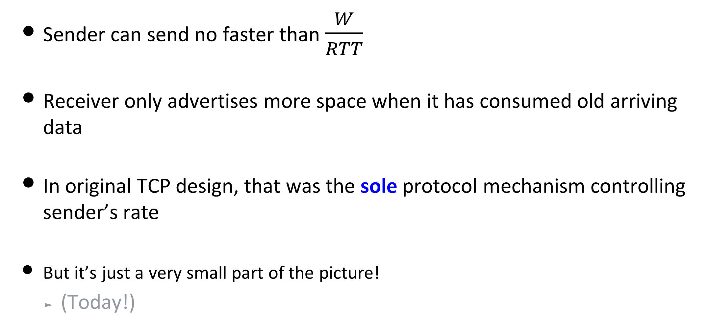
Last time: Advertised Window Limits Sending Rate
Sender can send no faster than $\frac{W}{RTT}$
Receiver only advertises more space when it has consumed old arriving data
In original TCP design, that was the sole protocol mechanism controlling sender’s rate
But it’s just a very small part of the picture!
  (Today!)

Slide 15
Congestion Control

Slide 16
What is Congestion?

Slide 17
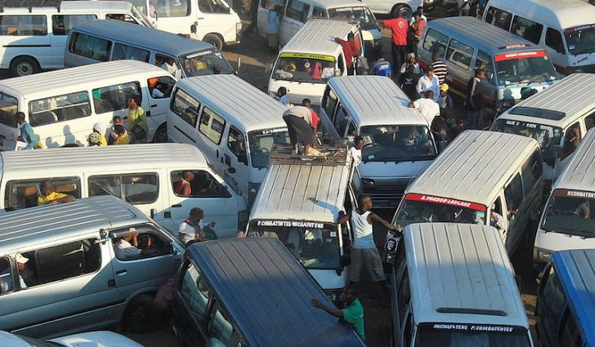

Slide 18
In mid-1980s, Similar thing happened in Internet!
Network was fully utilized but no useful work was being done.
About 1000x throughput reduction
Flow Control was not enough!

Slide 19
Statistical Multiplexing
Leads to Congestion
Internet is based on packet switching
  No BW reservation
  Using buffers to absorb transient load
If two packets arrive at a switch at the same time
  Switch will transmit one and buffer/drop the other
Internet traffic is bursty
If many packets arrive close in time
  the switch cannot keep up and it gets congested
  causes packet delays and drops

Slide 20
Congestion Collapse
Definition: Increase in network load results in a decrease of useful work done
Many possible causes
  Spurious retransmissions of packets still in flight
    E.g., congestion collapses in 1980s
  Undelivered packets
    Packets consume resources and are dropped elsewhere in network

Slide 21
What Users Want?
High throughput
  Throughput: measured performance of a system
  E.g., number of bits/second of data that get through
Low delay
  Delay: time required to deliver a packet or message
  E.g., number of msec to deliver a packet
These two metrics are sometimes at odds

Slide 22
Load, Delay, and Power
Typical behavior of queuing
systems with random arrivals:
A simple old metric of how well the
network is performing:
Average
Packet delay
Power
Load
Load
“optimal
load”

Slide 23
Useful Work
Demand

Slide 24
Bytes transferred by TCP
Number of TCP connections

Slide 25

Experiment
Network
Sub Net 1
10Mbps
Sub Net 2
100Mbps
1Gbps
Sender
Receiver
Delay: 10ms
Let’s forget abt reliability, what is the best sending rate?

Slide 26
Network
Sub Net 1
10Mbps
Sub Net 2
100Mbps
1Gbps
Sender
Receiver
Delay: 10ms
How abt when we want reliability? What is the best sending rate?

Slide 27
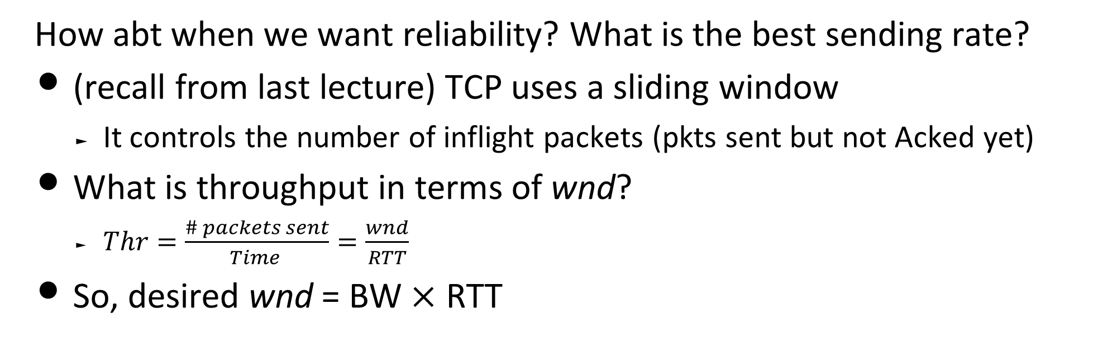
wnd
Network
Sub Net 1
10Mbps
Sub Net 2
100Mbps
1Gbps
Sender
Receiver
Delay: 10ms
How abt when we want reliability? What is the best sending rate?
(recall from last lecture) TCP uses a sliding window
  It controls the number of inflight packets (pkts sent but not Acked yet)
What is throughput in terms of wnd?
  $Thr=\frac{\# packets sent}{Time }=\frac{wnd}{RTT}$
So, desired wnd = BW $×$ RTT

Slide 28
wnd
Network
Sub Net 1
10Mbps
Sub Net 2
100Mbps
1Gbps
Sender
Receiver
Delay: 10ms
How abt when we want reliability? What is the best sending rate?
But what if ?
✓

Slide 29

wnd
Delay: 10ms
Sub Net 1
10Mbps
Sub Net 2
100Mbps
1Gbps
Sender
Receiver
How abt now?!
We don’t know the bottleneck BW
We don’t know how many other users are there
But we should come up with an acceptable sending rate!

Slide 30
Congestion Control (CC) on the Internet is about . . .
Maximizing your performance objective
  I want Higher throughput
  I want Lower delay
  I want no lost packets
While being a good citizen
  Be fair to others and respect them!
All that without having any prior knowledge of the network or other users!

Slide 31
Let’s design a CC scheme
A Simple One!

Slide 32
Probe
Do Some Basic Measurements
Network
Sub Net 1
10Mbps
Sub Net 2
Sender
Receiver
We need at least to know two things: RTT and bottleneck BW
How to find RTT?
  Use sRTT estimations from older (like SYN) packets
How to find bottleneck link bandwidth?
  Try and Error!
  Start from a small number, If everything is fine, increase your guess & If something is wrong, decrease your guess
  How much increase at each step?
    Linearly? Exponentially?
  How much decrease at each step?
    Linearly? Exponentially?

Slide 33

(2) Use your best guess
and update it
Network
Sub Net 1
10Mbps
Sub Net 2
Sender
Receiver
After knowing congestion window (cwnd = BW$×$RTT), keep using it!
Do we need to update value of cwnd?
  Bottleneck link BW may change!
  So, oscillate around your best guess

Slide 34
(3) Don’t hug the links forever!
Fairness
Network
Sub Net 1
10Mbps
Sub Net 2
Sender
Receiver
What does it mean if you detect a packet loss?
  Someone else is in the network?
  Backoff and let others probe/use the network

Slide 35
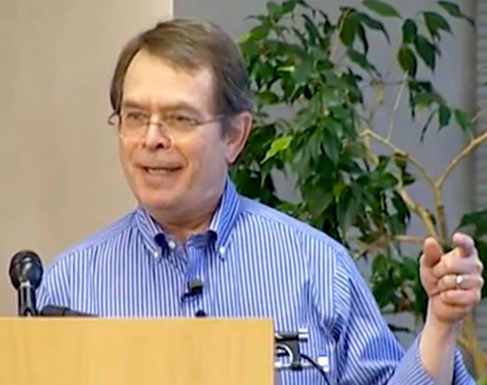
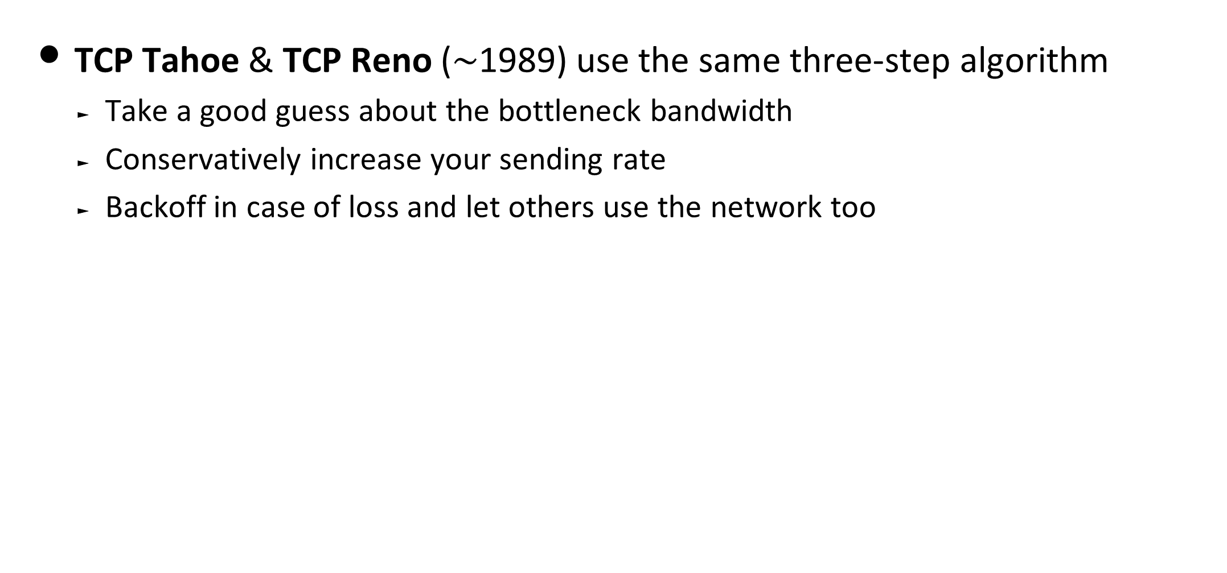
First TCP CC schemes were born more than 30 years ago
TCP Tahoe & TCP Reno ($\sim$1989) use the same three-step algorithm
  Take a good guess about the bottleneck bandwidth
  Conservatively increase your sending rate
  Backoff in case of loss and let others use the network too
Van Jacobson

Slide 36
In more technical terms . . .
Step 1) Slow Start: take a good guess
  Each RTT, Double your cwnd, until you detect loss of packets
Step 2) Congestion Avoidance: see if bandwidth is changed (but cautiously)
  Each RTT, Increase your cwnd by only one packet
Step 3) Loss Detection: be a good citizen and backoff!
  E.g., If you detect packet loss, divide your 1st guess by 2
AIMD:
Additive Increase Multiplicative Decrease

Slide 37

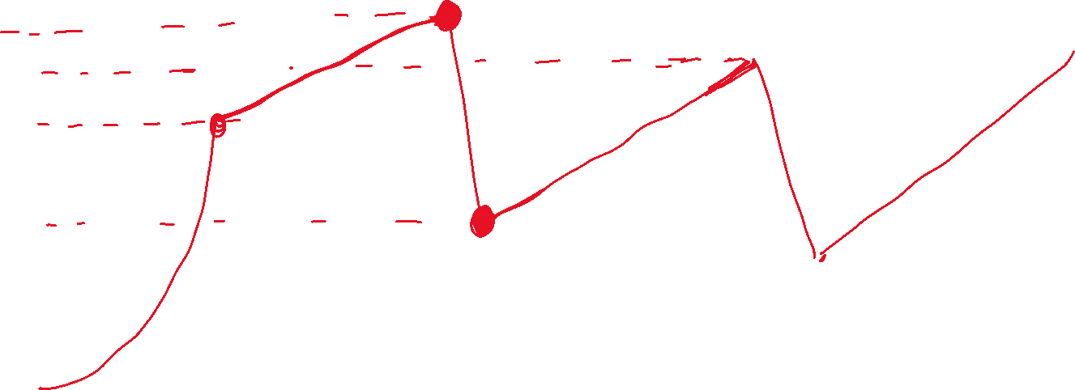
A classic set of solutions {Reno, Tahoe, New Reno, etc.}
Cwnd
2
3
3
2
2
1
Time

Slide 38
More Details . . .

Slide 39
Not All Losses Are the Same
Duplicate ACKs: isolated loss
  Still getting ACKs
Timeout: much more serious
  Not enough dupacks
  Must have suffered several losses
Will adjust rate differently for each case
Duplicate ACK: cwnd = cwnd/2
Timeout: cwnd = 1

Slide 40
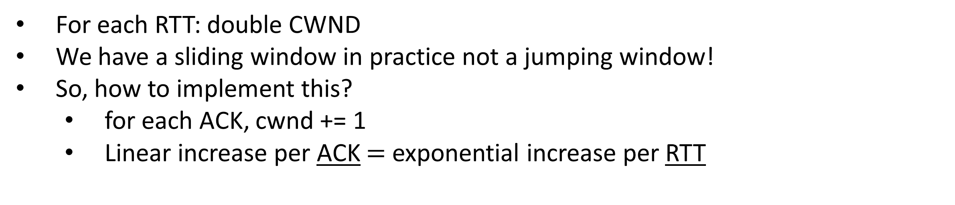
Slow Start in Action
For each RTT: double CWND
We have a sliding window in practice not a jumping window!
So, how to implement this?
  for each ACK, cwnd += 1
  Linear increase per ACK $=$ exponential increase per RTT
1
2
3
4
8
Src
D
A
D
D
A
A
D
D
D
D
A
A
A
A
Dest

Slide 41
Why AIMD?
Some rate adjustment options: Every RTT, we can
  Multiplicative increase or decrease: CWND→ a*CWND
  Additive increase or decrease: CWND→ CWND + b
Four alternatives:
  AIAD: gentle increase, gentle decrease
  AIMD: gentle increase, drastic decrease
  MIAD: drastic increase, gentle decrease
  MIMD: drastic increase and decrease

Slide 42
Simple Model of Congestion Control
1
Efficiency line
(x₁+x₂ = 1)
Fairness line
(x₁ =x₂)
Two users
  rates x₁ and x₂
Congestion when
x₁+x₂ > 1
Unused capacity when x₁+x₂ < 1
Fair when x₁ =x₂
User 2’s rate (x₂)
congested →
← inefficient
User 1’s rate (x₁)
1

Slide 43
Example
1
fairness
line
Efficient: x₁+x₂=1
Fair
Congested: x₁+x₂=1.2
(0.2, 0.5)
(0.7, 0.5)
User 2: x₂
(0.5, 0.5)
Inefficient: x₁+x₂=0.7
congested →
(0.7, 0.3)
← inefficient
Efficient: x₁+x₂=1
Not fair
efficiency
line
User 1: x₁
1

Slide 44
AIAD
(x₁-a_{D}+a_{I}),
x₂-a_{D}+a_{I}))
fairness
line
Increase: x + a_{I}
Decrease: x - a_{D}
Does not converge to fairness
(x₁,x₂)
User 2: x₂
(x₁-a_{D},x₂-a_{D})
congested →
← inefficient
efficiency
line
User 1: x₁

Slide 45
AIAD Sharing Dynamics
x₁
A
B
x₂
50 pkts/sec
D
E

Slide 46
MIMD
fairness
line
Increase: x*b_{I}
Decrease: x*b_{D}
Does not converge to fairness
(x₁,x₂)
(b_{I}b_{D}x₁,
b_{I}b_{D}x₂)
User 2: x₂
(b_{d}x₁,b_{d}x₂)
congested →
← inefficient
efficiency
line
User 1: x₁

Slide 47
AIMD
fairness
line
Increase: x+a_{I}
Decrease: x*b_{D}
Converges to fairness
(x₁,x₂)
(b_{D}x₁+a_{I},
b_{D}x₂+a_{I})
User 2: x₂
(b_{D}x₁,b_{D}x₂)
congested →
← inefficient
efficiency
line
User 1: x₁

Slide 48
AIMD Sharing Dynamics
x₁
A
B
x₂
50 pkts/sec
D
E
Rates equalize → fair share

Slide 49
Do we still use a CC protocol from 1989?!
Short answer: No!

Slide 50
The march of congestion control mechanisms
DUAL
EBCC
Binomial
Reminis
CARD
SACK
Westwood
FAST
PCC
C2TCP
Orca
?
DECbit
Vegas
Eifel
Veno
Compound
LEDBAT
Verus
BBR
DeepCC
?
Tahoe
Reno
New Reno
BIC
H-TCP
Cubic
PRR
Sprout
PCC-Vivace
?
1980s
1990s
2000s
2010s
2020s
GPS
RED
ECN
CHOKe
XCP
DCTCP
PDQ
FCP
ABC
?
?
WFQ
BLUE
AVQ
RCP
VCP
DeTail
pFabric
NATCP
?
CoDel
NACubic
?

Slide 51




Why is that and why it matters?
Stadia
Discontinued!

Slide 52
Deployed TCP CC schemes . . .
The latest Linux Kernel alone includes more than 15 different TCP CC flavors!
  TCP Cubic (the default TCP)
  Vegas
  BBR
  TCP Reno
  BIC
  CDG
  DCTCP
  Westwood
  Highspeed TCP
  Illinois
  Veno
  …
You can change your CC algorithm. e.g., in Linux:
sudo sysctl -w net.ipv4.tcp_congestion_control=“vegas"

Slide 53
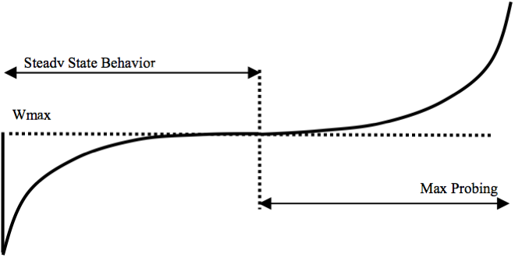

TCP Cubic (2008)
The default TCP CC algorithm in macOS, Linux, Windows, and Android.
Cubic follows the three-step algorithm but changes each part a little bit!
E.g., it replaces the AI (additive increase) part with a cubic function of time
K is updated when a packet is lost
cwnd
$$K=\sqrt[3]{W_{max}×β/C}$$
time

Slide 54
TCP Cubic
Less wasted bandwidth due to fast ramp up
Stable region and slow acceleration help maintain fairness
Slowly accelerate to probe for bandwidth
CUBIC Function
Timeout
cwnd_{max}
cwnd
Stable
Region
Slow Start
Fast ramp up
Time

Slide 55
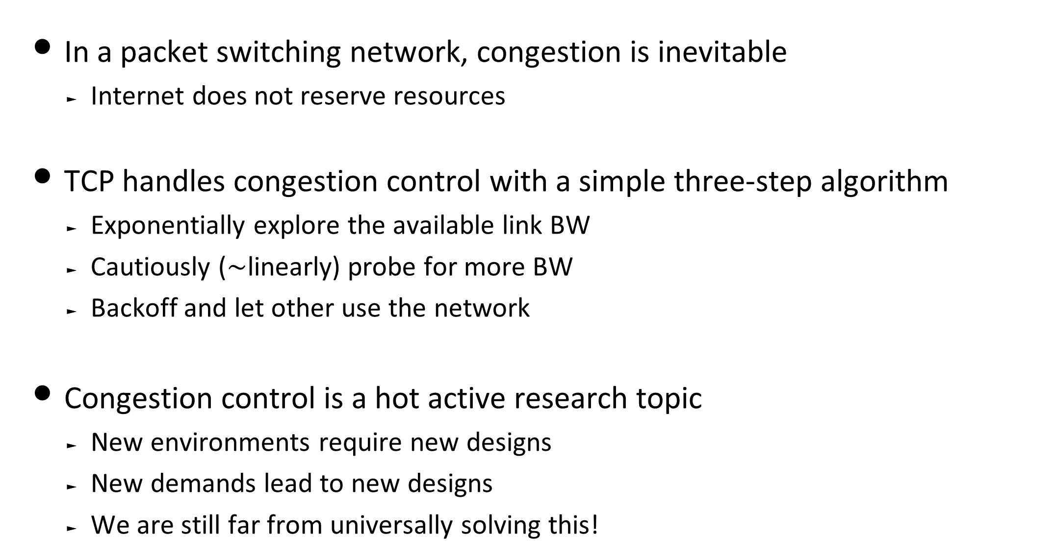
Putting all together
In a packet switching network, congestion is inevitable
  Internet does not reserve resources
TCP handles congestion control with a simple three-step algorithm
  Exponentially explore the available link BW
  Cautiously ($\sim$linearly) probe for more BW
  Backoff and let other use the network
Congestion control is a hot active research topic
  New environments require new designs
  New demands lead to new designs
  We are still far from universally solving this!

