Slide 1

Queue Management + Middleboxes
Soheil Abbasloo
Department of Computer Science
University of Toronto
Fall 2022

Slide 2
Outline
Queue Management
  Queues
  Early Congestion Detection
  Link Scheduling
  QoS
Middlebox
  Firewall
  NAT
  Load Balancer
  Tunneling

Slide 3
Announcement …
Final Exam
  December 14th
  For exact location and time, check this:
    https://www.artsci.utoronto.ca/current/faculty-registrar/exams-assessments/exam-assessment-schedule#exam-assessments-schedule-accordion-1

Slide 4


Last Time: Congestion Control
What can the end-points do to collectively make good use of shared underlying resources?
session
?
?
path

Slide 5

Today: Queue Management
What can the individual links do to make good use of shared underlying resources?
session
?
?
?
path

Slide 6
Packet Queues

Slide 7
Router
Processor
control plane
data plane
Switching
Fabric
Line card
Line card
Line card
Line card
Line card
Line card

Slide 8
Line Cards (Interface Cards, Adaptors)
to/from link
Packet handling
  Packet forwarding
  Buffer management
  Link scheduling
  Packet filtering
  Rate limiting
  Packet marking
  Measurement
Receive
lookup
Transmit
to/from switch

Slide 9
Packet Switching and Forwarding:
An Output Queue Structure
“4”
Link 1, ingress
Choose
Egress
Link 1, egress
Link 2
Link 2, ingress
Choose
Egress
Link 2, egress
R1
“4”
Link 1
Link 3
Link 3, ingress
Choose
Egress
Link 3, egress
Link 4
Link 4, ingress
Choose
Egress
Link 4, egress

Slide 10
Queue Management Issues
Scheduling discipline
  Which packet to send?
  Some notion of fairness? Priority?
Drop policy
  When should you discard a packet?
  Which packet to discard?
Goal: balance throughput and delay
  Huge buffers minimize drops, but add to queuing delay (thus higher RTT, longer slow start, …)

Slide 11
FIFO Scheduling and Drop-Tail
Access to the bandwidth: first-in first-out queue
  Packets only differentiated when they arrive
Access to the buffer space: drop-tail queuing
  If the queue is full, drop the incoming packet
✗

Slide 12
Bursty Loss From Drop-Tail Queuing
Most Current congestion control algorithms depend on packet loss
  Packet loss is indication of congestion
  TCP additive increase drives network into loss
Drop-tail leads to bursty loss
  Congested link: many packets encounter full queue
  Synchronization: many connections lose packets at once

Slide 13
Slow Feedback from Drop Tail
Feedback comes when buffer is completely full
  … even though the buffer has been filling for a while
Plus, the filling buffer is increasing RTT
  … making detection even slower

Slide 14
Any suggestions to resolve the Slow Feedback issue of Drop-Tail?

Slide 15
Early Detection of Congestion

Slide 16
Slow Feedback from Drop Tail
Feedback comes when buffer is completely full
  … even though the buffer has been filling for a while
Plus, the filling buffer is increasing RTT
  … making detection even slower
Better to give early feedback
  Get 1-2 connections to slow down before it’s too late!

Slide 17
Sally Floyd and Van Jacobson’s
Random Early Detection (RED)
1993
An example algorithm for how we can better manage packets drops
Router notices that queue is getting full
  … and randomly drops packets to signal congestion
Packet drop probability
  Drop probability increases as queue length increases
  Set drop probability f(avg queue length)
Drop
Probability
0 1
Average Queue Length

Slide 18
Properties of RED
Drops packets before queue is full
  In the hope of reducing the rates of some flows
Drops packet in proportion to each flow’s rate
  High-rate flows selected more often
Drops are spaced out in time
  Helps desynchronize the TCP senders
Tolerant of burstiness in the traffic
  By basing the decisions on average queue length

Slide 19
Synchronization of Sources
RTT
A
B
C
D
Source A

Slide 20
Synchronization of Sources
RTT
A
B
C
D
Aggregate Flow
Avg

Slide 21
Desynchronized Sources
RTT
A
B
C
D
Source A

Slide 22
Desynchronized Sources
RTT
A
B
C
D
Aggregate Flow
Avg

Slide 23
Problems With RED
Hard to get tunable parameters just right
  How early to start dropping packets?
  What slope for increase in drop probability?
  What time scale for averaging queue length?
This issue was big enough for most people to go and use other solutions!
  If parameters aren’t set right, RED doesn’t help
Many other variations in research community
  Names like “Blue”, “FRED”, …

Slide 24
Feedback: From Loss to Notification
Early dropping of packets
  Good: gives early feedback
  Bad: has to drop the packet to give the feedback
Explicit Congestion Notification (ECN) (2001)
  Router marks the packet with an ECN bit
  Sending host interprets as a sign of congestion
  Requires participation of hosts and the routers
Is it a good idea to use ECN on the Internet?
How about a private network?

Slide 25
Link Scheduling

Slide 26


First-In First-Out Scheduling
First-in first-out scheduling
  Simple, but restrictive
Example: two kinds of traffic
  Voice over IP needs low delay
  E-mail is not that sensitive about delay
Voice traffic waits behind e-mail

Slide 27
Strict Priority
Multiple levels of priority
  Always transmit high-priority traffic, when present
Isolation for the high-priority traffic
  Almost like it has a dedicated link
  Except for (small) delay for packet transmission
What is the problem with this?
  Lower priority traffic may starve

Slide 28
Weighted Fair Scheduling
Weighted fair scheduling
  Assign each queue a fraction of the link bandwidth
  Rotate across queues on a small time scale
Work-conserving
  Send extra traffic from one queue if others are idle
50% red, 25% blue, 25% green

Slide 29
Implementation Trade-Offs
FIFO
  One queue, trivial scheduler
Strict priority
  One queue per priority level, simple scheduler
Weighted fair scheduling
  One queue per class, and more complex scheduler

Slide 30
Quality of Service Guarantees

Slide 31
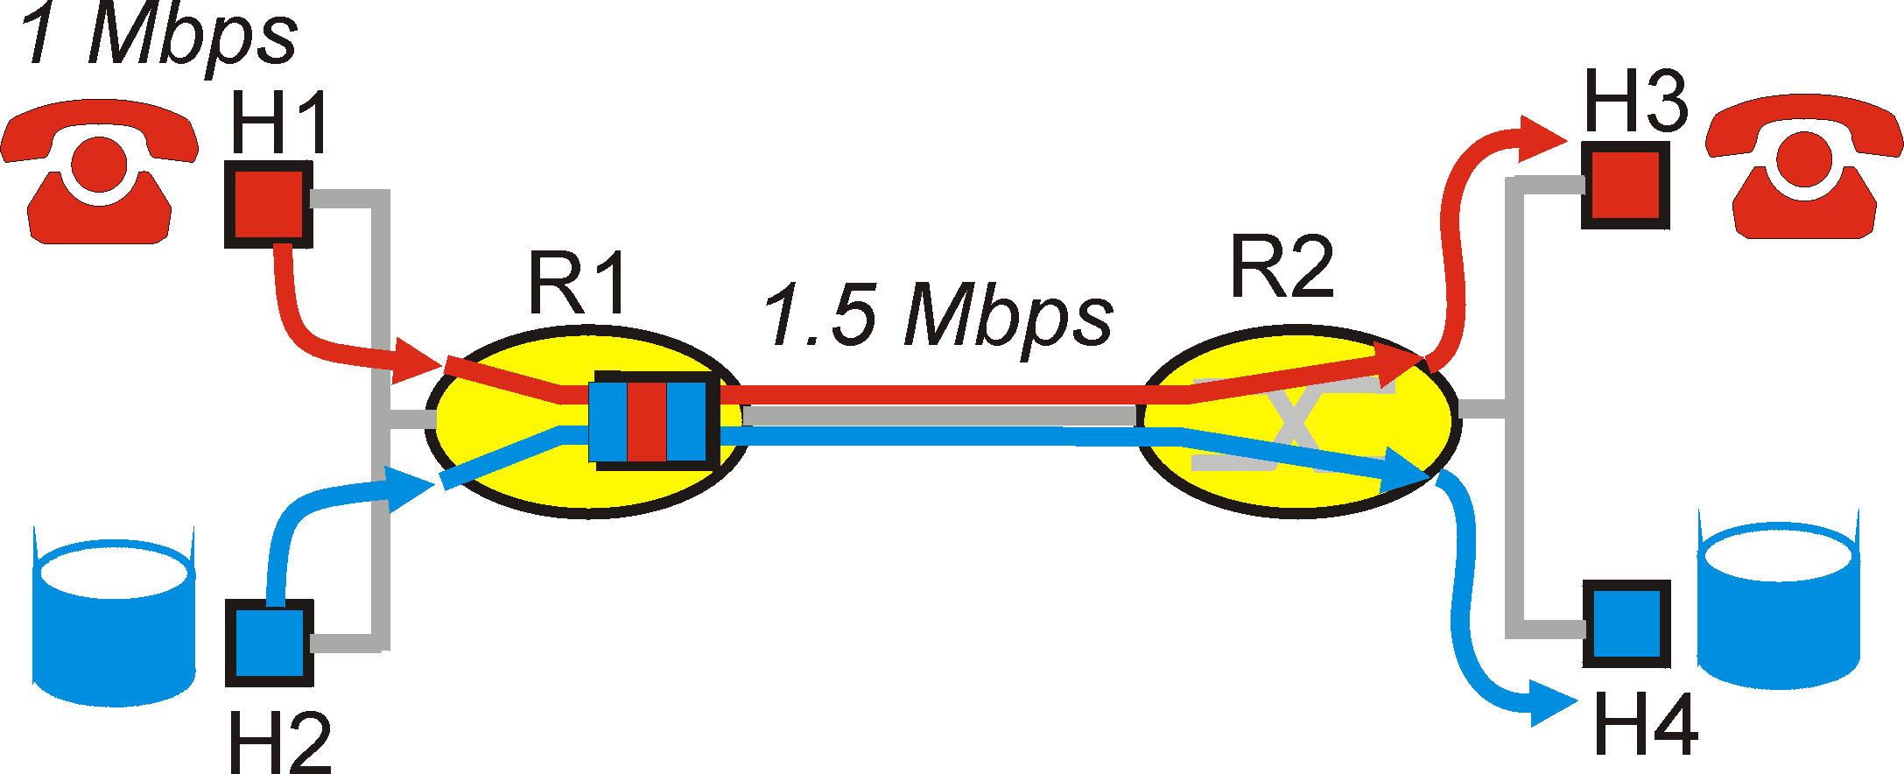

Distinguishing Traffic
Applications compete for bandwidth
  VoIP and email sharing a link
  E-mail traffic can cause congestion and losses
Principle 1: Packet marking
  So router can distinguish between classes
  E.g., Type of Service (ToS) bits in IP header
What if someone marks
her email packets with ToS of VoIP?!

Slide 32
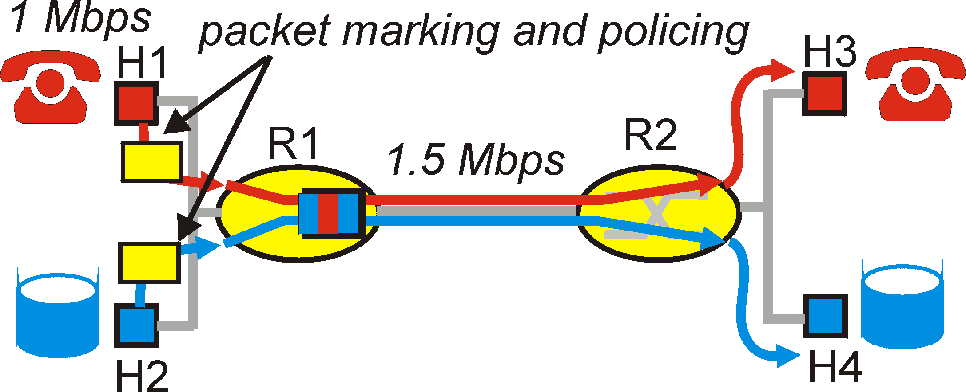
Preventing Misbehavior
Applications misbehave
  VoIP sends packets faster than 1 Mbps

Slide 33
Preventing Misbehavior
Applications misbehave
  VoIP sends packets faster than 1 Mbps
Principle 2: Policing
  Protect one traffic class from another
  By enforcing a rate limit on the traffic

Slide 34
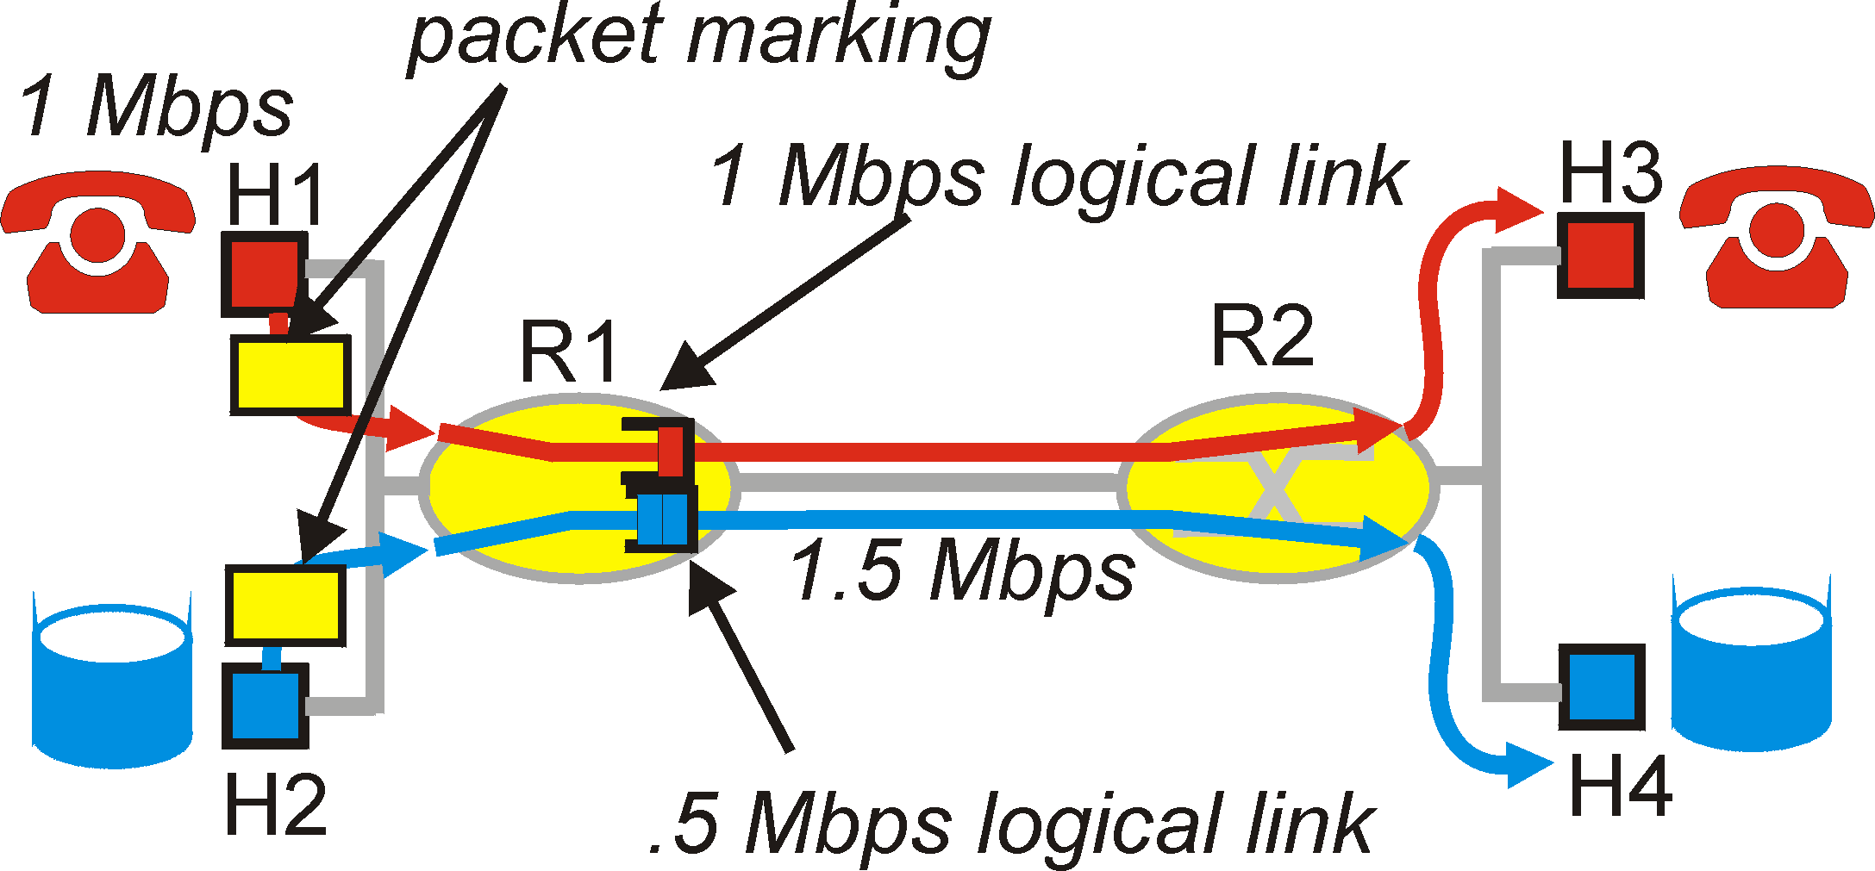
Subdividing Link Resources
Principle 3: Link scheduling
  Ensure each application gets its share
  … while (optionally) using any extra bandwidth
  E.g., weighted fair scheduling

Slide 35
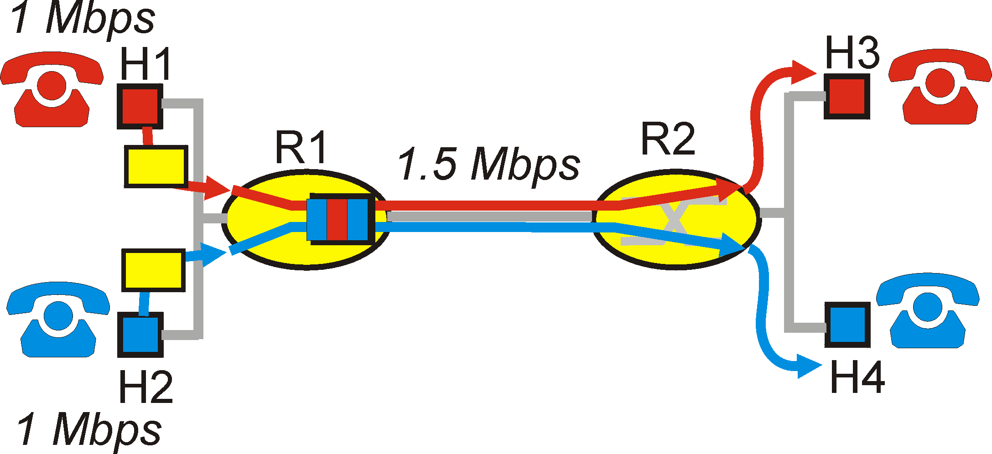
Reserving Resources, and Saying No
Traffic cannot exceed link capacity
  Deny access, rather than degrade performance
Principle 4: Admission control
  Application declares its needs in advance
  Application denied if insufficient resources available

Slide 36
Quality of Service (QoS)
Guaranteed performance
  Alternative to best-effort delivery model
QoS protocols and mechanisms
  Packet classification and marking
  Traffic shaping
  Link scheduling
  Resource reservation and admission control
  Identifying paths with sufficient resources

Slide 37
5-min Break!

Slide 38
Internet Ideal: Simple Network Model
Globally unique identifiers
  Each node has a unique, fixed IP address
  … reachable from everyone and everywhere
Simple packet forwarding
  Network nodes simply forward packets
  … rather than modifying or filtering them
source
destination
IP network

Slide 39
Internet Reality
Host mobility
  Host changing address as it moves
IP address depletion
  Multiple hosts using the same address
Security concerns
  Detecting and blocking unwanted traffic
Replicated services
  Load balancing over server replicas
Performance concerns
  Allocating bandwidth, caching content, …
Incremental deployment
  New technology deployed in stages

Slide 40
Middleboxes
Middleboxes are intermediaries
  Interposed between communicating hosts
  Often without knowledge of one or both parties
Myriad uses
  Address translators
  Firewalls
  Traffic shapers
  Intrusion detection
  Transparent proxies
  Application accelerators
“An abomination!”
  Violation of layering
  Hard to reason about
  Responsible for subtle bugs
“A practical necessity!”
  Solve real/pressing problems
  Needs not likely to go away

Slide 41
Firewalls

Slide 42
Firewalls
Should arriving packet be allowed in? Departing packet let out?
Firewall filters packet-by-packet, based on:
  Source and destination IP addresses and port numbers
  TCP SYN and ACK bits; ICMP message type
  Deep packet inspection on packet contents (DPI)
administered
network
public
Internet
firewall

Slide 43
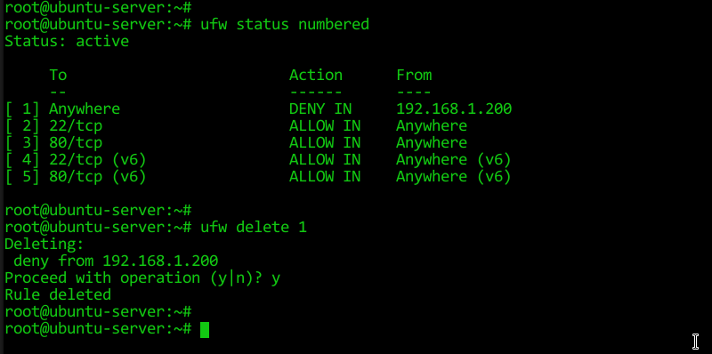
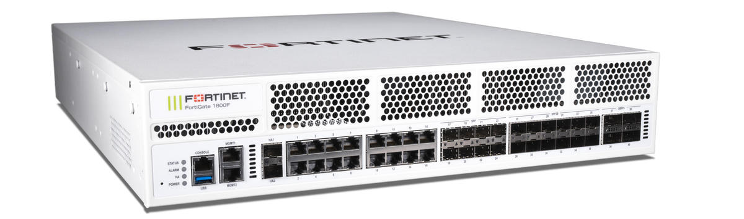
Firewalls
Software
Hardware
A simple Linux-based firewall
UFW: Uncomplicated Firewall!
  For some details check this: https://ubuntu.com/server/docs/security-firewall

Slide 44
Packet Filtering Examples
Block all packets with IP protocol field = 17 and with either source or dst port = 23
  All incoming and outgoing UDP flows blocked
  All Telnet connections are blocked
Block all packets with TCP/UDP ports used for Call of Duty
Question:
  Prevent external clients from making TCP connections with internal clients
  But allow internal clients to connect to outside
  How?
Notes:
Block inbound TCP packets with SYN but no ACK

Slide 45
Firewall Configuration
Firewall applies a set of rules to each packet
  To decide whether to permit or deny the packet
Each rule is a test on the packet
  Comparing IP and TCP/UDP header fields
  … and deciding whether to permit or deny
Order matters
  Once packet matches a rule, the decision is done

Slide 46
Firewall Configuration Example
Ali runs a network in 222.22.0.0/16
Wants to let Bao’s school access certain hosts
  Boa is on 111.11.0.0/16
  Ali’s special hosts on 222.22.22.0/24
Ali doesn’t trust Donald, inside Bao’s network
  Donald is on 111.11.11.0/24
Ali doesn’t want any other Internet traffic

Slide 47
Firewall Configuration Rules
#1: Allow Bao’s network in to special dsts
  ALLOW (src=111.11.0.0/16, dst = 222.22.22.0/24)
#2: Don’t let Donald’s machines in
  DENY (src = 111.11.11.0/24, dst = 222.22.0.0/16)
#3: Block the rest of the world
  DENY (src = 0.0.0.0/0, dst = 0.0.0.0/0)
Order?
  #2, #1, #3

Slide 48

Stateful Firewall
Stateless firewall:
  Treats each packet independently
Stateful firewall
  Remembers connection-level information
  E.g., client initiating connection with a server
  … allows the server to send return traffic
SYN
SYN
SYN-ACK
SYN-ACK

Slide 49
A Variation: Traffic Management
Permit vs. deny is too binary a decision
  Classify the traffic based on rules
  … and handle each class differently
Traffic shaping (rate limiting)
  Limit the amount of bandwidth for certain traffic
Separate queues
  Use rules to group related packets
  And then do weighted fair scheduling across groups

Slide 50
Clever Users Subvert Firewalls
Example: filtering dorm access to a server
  Firewall rule based on IP addresses of dorms
  … and the server IP address and port number
  Problem: users may log in to another machine
Example: filtering P2P based on port #s
  Firewall rule based on TCP/UDP port numbers
    E.g., allow only port 80 (e.g., Web) traffic
  Problem: software using non-traditional ports
    E.g., write P2P client to use port 80 instead

Slide 51
Network Address Translation

Slide 52
History of NATs
IP address space depletion
  Clear in early 90s that 2³² addresses not enough
  Work began on a successor to IPv4
In the meantime…
  Share addresses among numerous devices
  … without requiring changes to existing hosts
Meant as a short-term remedy
  Now: NAT is widely deployed, much more than IPv6

Slide 53

Network Address Translation
10.0.0.1
  Outbound: Rewrite the src IP addr
  Inbound: Rewrite the dest IP addr
138.76.29.7
Problem: Local address not globally addressable
outside
NAT
NAT rewrites the IP addresses
  Make “inside” look like single IP addr
  Change header checksums accordingly
inside
10.0.0.2

Slide 54
Port-Translating NAT
Two hosts communicate with same destination
  Destination needs to differentiate the two
Map outgoing packets
  Change source address and source port
Maintain a translation table
  Map of (src addr, port #) to (NAT addr, new port #)
Map incoming packets
  Map the destination address/port to the local host

Slide 55
Network Address Translation Example
NAT translation table
WAN side addr LAN side addr
138.76.29.7, 5001 10.0.0.1, 3345 ……
S: 10.0.0.1, 3345
D: 128.119.40.186, 80
10.0.0.1
1
2
S: 138.76.29.7, 5001
D: 128.119.40.186, 80
10.0.0.2
138.76.29.7
S: 128.119.40.186, 80
D: 138.76.29.7, 5001
S: 128.119.40.186, 80
D: 10.0.0.1, 3345
4
3
10.0.0.3

Slide 56
Maintaining the Mapping Table
Create an entry upon seeing an outgoing packet
  Packet with new (source addr, source port) pair
Eventually, need to delete entries to free up #’s
  When? If no packets arrive before a timeout
  (At risk of disrupting a temporarily idle connection)
Yet another example of “soft state”
  I.e., removing state if not refreshed for a while

Slide 57
Where is NAT Implemented?
Home router (e.g., Linksys box)
  Integrates router, DHCP server, NAT, etc.
  Use single IP address from the service provider
Campus or corporate network
  NAT at the connection to the Internet
  Share a collection of public IP addresses
  Avoid complexity of renumbering hosts/routers when changing ISP (w/ provider-allocated IP prefix)

Slide 58
Practical Objections Against NAT
Port numbers are meant to identify sockets
  Yet, NAT uses them to identify end hosts
  Makes it hard to run a server behind a NAT
138.76.29.7
Requests to 138.76.29.7 on port 80
10.0.0.1
NAT
Which host should get the request???
Explicit config at NAT for incoming conn’s
10.0.0.2

Slide 59
Principled Objections Against NAT
Routers are not supposed to look at port #s
  Network layer should care only about IP header
  … and not be looking at the port numbers at all
NAT violates the end-to-end argument
  Network nodes should not modify the packets
IPv6 is a cleaner solution
  Better to migrate than to limp along with a hack
Notes:
That’s what happens when network puts power in hands of end users! :D

Slide 60
Load Balancers

Slide 61

Replicated Servers
One site, many servers
  E.g., www.youtube.com

Slide 62
Load Balancer
Dedicated IP addresses
10.0.0.1
Splits load over server replicas
  At the connection level
Apply load balancing policies
Virtual IP address
208.65.153.238
10.0.0.2
10.0.0.3

Slide 63
Tunneling

Slide 64
IP Tunneling
IP tunnel is a virtual point-to-point link
  Illusion of a direct link between two nodes
Encapsulation of the packet inside IP datagram
  Node B sends a packet to node E
  … containing another packet as the payload
A
B
E
F
Logical view:
tunnel
A
B
E
F
Physical view:

Slide 65
6Bone: Deploying IPv6 over IP4
A testbed for IPv6 (1996-2006)
A
B
E
F
Logical view:
tunnel
A
B
E
F
Physical view:
IPv6
IPv6
IPv4
IPv4
IPv6
IPv6
Flow: X
Src: A
Dest: F
data
Src:B
Dest: E
Src:B
Dest: E
Flow: X
Src: A
Dest: F
data
Flow: X
Src: A
Dest: F
data
Flow: X
Src: A
Dest: F
data
A-to-B:
IPv6
B-to-C:
IPv6 inside
IPv4
B-to-C:
IPv6 inside
IPv4
E-to-F:
IPv6

Slide 66

Remote Access Virtual Private Network
VPN server
12.1.1.73
Internet
Tunnel from user machine to VPN server
  A “link” across the Internet to the local network
Encapsulates packets to/from the user
  Packet from 12.1.1.73 to 12.1.1.100
  Inside a packet from 1.2.3.4 to 12.1.1.1
12.1.1.0/24
12.1.1.1
1.2.3.4

Slide 67


Commercial VPNs
VPN server + proxy
12.1.1.1
12.1.1.X
Internet
3.4.5.6
Tunnel from user machine to VPN server
VPN server NATs or TCP proxies traffic to origin sites
  Traffic between client and VPN encrypted
  VPN “anonymizes” the IP of client to rest of Internet, and can circumvent censorship on client-side
  Client must fully trust VPN provider!
    Why?!
1.2.3.4

Slide 68
Wrap up
Middleboxes address important problems
  Getting by with fewer IP addresses
  Blocking unwanted traffic
  Making fair use of network resources
  Improving end-to-end performance
Middleboxes cause problems of their own
  No longer globally unique IP addresses
  Cannot assume network simply delivers packets!

