Slide 1

Network Security
Soheil Abbasloo
Department of Computer Science
University of Toronto
Credit for some slides goes to Dan Boneh @ Stanford
Fall 2022

Slide 2
Outline
Why Security?
Internet Design vs. Security
Attacks
  DoS
  Amplification
Defenses

Slide 3
Connectivity: Good vs. Evil
Network have improved significantly
  In terms of bandwidth and latency
Good: We can communicate
  Exchange information
  Transfer data
  …
Evil: It’s easier to do harm
  Harmful code can propagate faster
  Information collection, violating privacy
  …

Slide 4
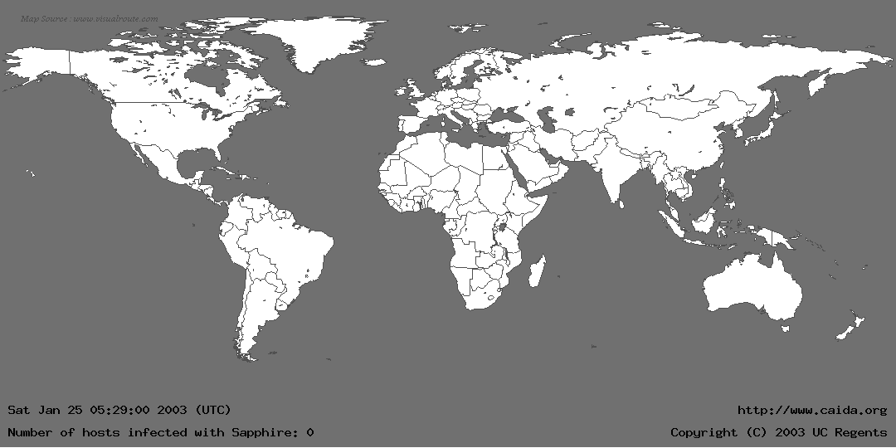
Life Just Before SQL Slammer
Notes:
Worm:
Self-replicating/self-propagating code
Spreads across a network by exploiting flaws in open services
- As opposed to viruses, which require user action to quicken/spread

Slide 5
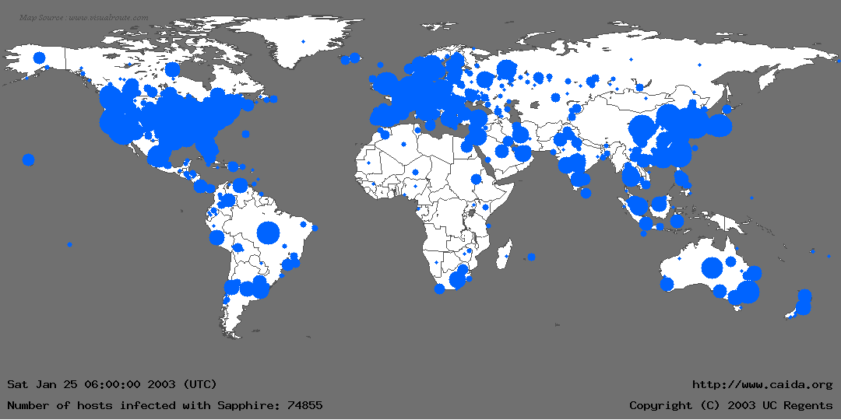
Life Just After SQL Slammer

Slide 6
SQL Slammer
Affects Microsoft SQL 2000
Exploits known buffer overflow vulnerability
  Server Resolution service vulnerability reported June 2002
  Patched released in July 2002 Bulletin MS02-39
Vulnerable population (75,000+) infected in less than 10 minutes
  At its peak, doubled every 8.5 seconds.
Entire worm fits in a single packet! (376 bytes)

Slide 7
Slammer’s code is 376 bytes!
This byte signals the SQL Server to store the contents of the packet in the buffer
0000: 4500 0194 b6db 0000 6d11 2e2d 89e5 0a9c E...¶Û..m..-.å..
0010: cb08 07c7 1052 059a 0180 bda8 0401 0101 Ë..Ç.R....½¨....
0020: 0101 0101 0101 0101 0101 0101 0101 0101 ................
0030: 0101 0101 0101 0101 0101 0101 0101 0101 ................
0040: 0101 0101 0101 0101 0101 0101 0101 0101 ................
0050: 0101 0101 0101 0101 0101 0101 0101 0101 ................
0060: 0101 0101 0101 0101 0101 0101 0101 0101 ................
0070: 0101 0101 0101 0101 0101 0101 01dc c9b0 .............ÜÉ°
0080: 42eb 0e01 0101 0101 0101 70ae 4201 70ae Bë........p®B.p®
0090: 4290 9090 9090 9090 9068 dcc9 b042 b801 B........hÜÉ°B¸.
00a0: 0101 0131 c9b1 1850 e2fd 3501 0101 0550 ...1É±.Pâý5....P
00b0: 89e5 5168 2e64 6c6c 6865 6c33 3268 6b65 .åQh.dllhel32hke
00c0: 726e 5168 6f75 6e74 6869 636b 4368 4765 rnQhounthickChGe
00d0: 7454 66b9 6c6c 5168 3332 2e64 6877 7332 tTf¹llQh32.dhws2
00e0: 5f66 b965 7451 6873 6f63 6b66 b974 6f51 _f¹etQhsockf¹toQ
00f0: 6873 656e 64be 1810 ae42 8d45 d450 ff16 hsend¾..®B.EÔP..
0100: 508d 45e0 508d 45f0 50ff 1650 be10 10ae P.EàP.EðP..P¾..®
0110: 428b 1e8b 033d 558b ec51 7405 be1c 10ae B....=U.ìQt.¾..®
0120: 42ff 16ff d031 c951 5150 81f1 0301 049b B...Ð1ÉQQP.ñ....
0130: 81f1 0101 0101 518d 45cc 508b 45c0 50ff .ñ....Q.EÌP.EÀP.
0140: 166a 116a 026a 02ff d050 8d45 c450 8b45 .j.j.j..ÐP.EÄP.E
0150: c050 ff16 89c6 09db 81f3 3c61 d9ff 8b45 ÀP...Æ.Û..óa...E
0160: b48d 0c40 8d14 88c1 e204 01c2 c1e2 0829 ´..@...Áâ..ÂÁâ.)
0170: c28d 0490 01d8 8945 b46a 108d 45b0 5031 Â....Ø.E´j..E°P1
0180: c951 6681 f178 0151 8d45 0350 8b45 ac50 ÉQf.ñx.Q.E.P.E¬P
0190: ffd6 ebca .ÖëÊ
This is the first instruction to get executed. It jumps control to here.
UDP packet header
The 0x01 characters overflow the buffer and spill into the stack right up to the return address
Main loop of Slammer: generate new random IP address, push arguments onto stack, call send method, loop around
Restore payload, set up socket structure, and get the seed for the random number generator
NOP slide
This value overwrites the return address and points it to a location in sqlsort.dll which effectively calls a jump to %esp
Notes:
The register ESP (literally "extended stack pointer") holds the top of the stack

Slide 8
Why Security?
First victim at 12:45 am
By 1:15 am, transcontinental links starting to fail
300,000 access points downed in Portugal
All cell and Internet in Korea failed (27 million people)
Five root name servers were knocked offline
911 didn’t respond (Seattle)
Flights canceled!

Slide 9
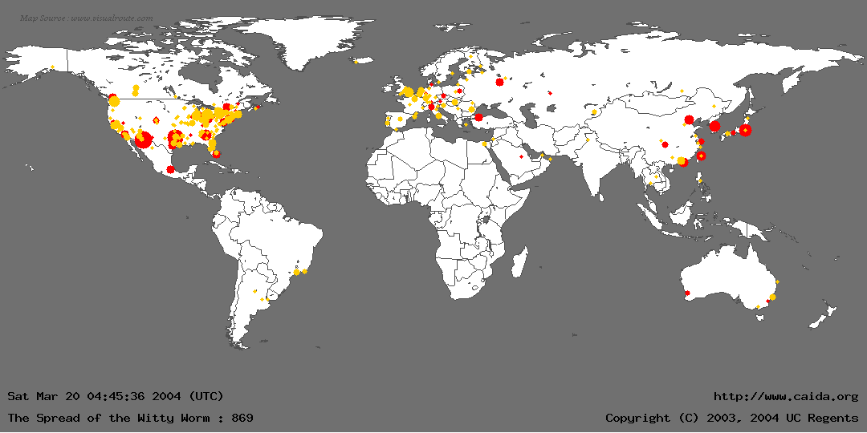
Witty Worm

Slide 10
Witty Worm
Attacks firewalls and security products (of ISS {Internet Security Systems} company)
First to use vulnerabilities in security software
ISS announced a vulnerability
  buffer overflow problem
  Attack in just one day!
Attack started from a small number of compromised machines
In 30 minutes, 12,000 infected machines
  90 Gb/s of UDP traffic

Slide 11
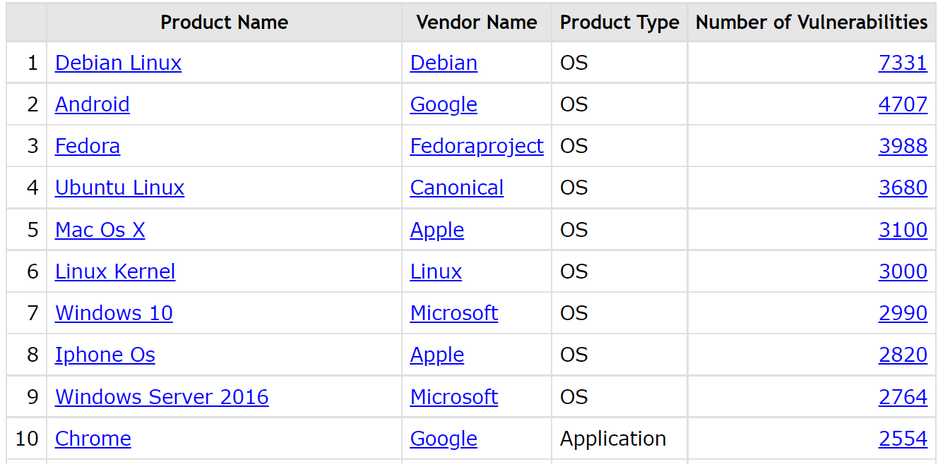
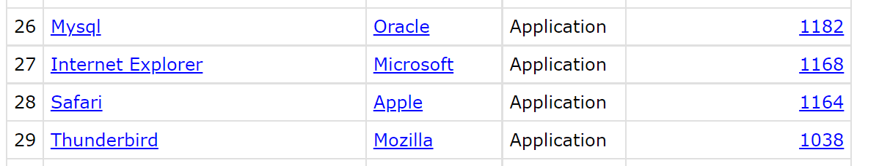
Top 10 products by total number of “distinct” vulnerabilities in 2022
https://www.cvedetails.com/top-50-products.php?year=2022

Slide 12
Internet Design vs. Security

Slide 13
Basic Security Properties
Availability
  Ability to use desired information/resource
Protection
  protect users from interactions they don’t want
Authenticity
  Identification & assurance of origin of info
Confidentiality
  Concealment of information or resources
Data Integrity
  Trustworthiness of data/resources; preventing improper/unauthorized changes

Slide 14
Basic Security Properties
Availability
  Ability to use desired information/resource
Protection
  protect users from interactions they don’t want
Authenticity
  Identification & assurance of origin of info
Confidentiality
  Concealment of information or resources
Data Integrity
  Trustworthiness of data/resources; preventing improper/unauthorized changes

Slide 15
Internet Design
Destination routing
Packet based (statistical multiplexing)
Global addressing (IP addresses)
Simple to join (as infrastructure)
Power at end hosts (end-to-end argument)

Slide 16
Internet Design vs. Security
Destination routing
  Keeps forwarding tables small
  Simple to maintain forwarding tables
  How do we know where packets are coming from?
    Probably simple fix to spoofing, why isn’t it in place?
Packet based (statistical multiplexing)
Global addressing (IP addresses)
Simple to join (as infrastructure)
Power in end hosts (end-to-end argument)

Slide 17
Internet Design vs. Security
Destination routing
Packet Based (statistical multiplexing)
  Simple + Efficient
  Difficult resource bound per-communication
    How to keep someone from hogging?
    (remember, we can’t rely on source addresses)
Global Addressing (IP addresses)
Simple to join (as infrastructure)
Power in End Hosts (end-to-end argument)

Slide 18
Internet Design vs. Security
Destination routing
Packet based (statistical multiplexing)
Global Addressing (IP addresses)
  Very democratic
  Even people who don’t necessarily want to be talked to
    “every psychopath is your next door neighbor” – Dan Geer
Simple to join (as infrastructure)
Power in end hosts (end-to-end argument)

Slide 19
Internet Design vs. Security
Destination routing
Packet based (statistical multiplexing)
Global addressing (IP addresses)
Simple to join (as infrastructure)
  Very democratic
  Misbehaving routers can do very bad things
    No model of trust between routers
Power in End Hosts (end-to-end argument)

Slide 20
Internet Design vs. Security
Destination routing
Packet based (statistical multiplexing)
Global addressing (IP addresses)
Simple to join (as infrastructure)
Power in end-hosts (end-to-end argument)
  Decouple hosts and infrastructure = innovation at the edge!
  Giving power to least trusted actors!
    How to guarantee good behavior?

Slide 21
Attacks
Don’t Try These at Home!

Slide 22


Attack on Confidentiality
Eavesdropping - Message Interception
Unauthorized access to information
Packet sniffers and wiretappers (e.g. tcpdump)
Illicit copying of files and programs
Eavesdropper

Slide 23
Attack on Integrity
Tampering
Stop the flow of the message
Delay and optionally modify the message
Release the message again
Perpetrator

Slide 24
Attack on Authenticity
Fabrication
Unauthorized assumption of other’s identity
Generate and distribute objects under identity
Masquerader

Slide 25


Attack on Availability
Denial of Service
Destroy hardware (cutting fiber) or software
Modify software in a subtle way
Corrupt packets in transit
Blatant denial of service (DoS):
  Crashing the server
  Overwhelm the server (use up its resource)

Slide 26
Denial of Service (DoS)

Slide 27
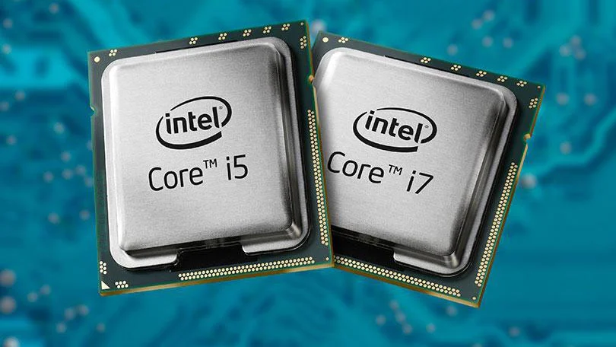
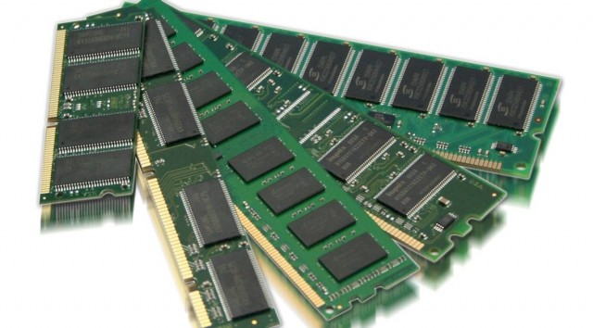
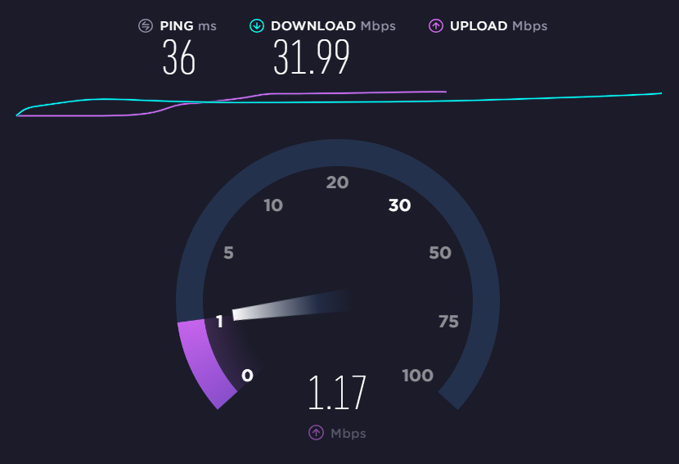
DoS
Via Resource Exhaustion
CPU
Bandwidth
Memory
  E.g., TCP connections require state

Slide 28
DoS Attacks
Goal: take large site offline by overwhelming it with network traffic such that they can’t process real requests
How: find mechanism where attacker doesn’t have to spend a lot of effort, but requests are difficult/expensive for victim to process

Slide 29
DoS
Possible at Every Layer!
Link Layer: send too much traffic for switches/routers to handle
TCP/UDP: require servers to maintain large number of concurrent connections or state
Application Layer: require servers to perform expensive queries or cryptographic operations
Notes:
Any example for link later?!
ARP

Slide 30
TCP Handshake
C
S
SYN_{C}
Listening
Store data
SYN_{S}, ACK_{C}
Wait
ACK_{S}
Connected
TCB (transmission control block) contains information about the connection state per connection
Notes:
End-host stores all flow state.
For TCP this is done per connection using a TCB (transmission control block)

Slide 31
Example: SYN Flooding
C
S
SYN_{C1}
Listening
Single machine:
  SYN packets with random source IP addr
  Fills up backlog queue
  No further connection possible!
SYN_{C2}
Store data
SYN_{C3}
SYN_{C4}
SYN_{C5}
How to resolve that?!

Slide 32
Core Problem
Problem: server commits resources (memory) before confirming identify of client (when client responds)
Bad Solution:
  Increase backlog queue size
  Decrease timeout
Real Solution: Avoid state until 3-way handshake completes!
A useful strategy to remember!

Slide 33
Protection against SYN Attacks
Bernstein, Schenk’1996
Don't create the TCB until the ACK comes back!
Use SYN Cookies
  Make a one-way hash of the incoming information!
Client sends SYN
Server responds to Client with SYN-ACK cookie
    sqn = f(src addr, src port, dest addr, dest port, key, rand(time))
    Server does not save state
  Honest client responds with ACK(sqn)
  Server checks response
  If matches SYN-ACK, establishes connection and allocates space
See if it is enabled on your system! sysctl net.ipv4.tcp_syncookies
Notes:
“… To prevent ACK floods, create the outgoing sequence number as a one-way hash of the incoming information (IP addresses, port number, and sequence number), followed by a secret key, followed by a counter that changes every minute. When the handshake comes back, compute the same hash using the last few counters, and throw away the packet if it doesn't match one of the results. Otherwise, set up the TCB, if it doesn't already exist. Now, if someone can't see your outgoing packets, he'll have only a one-in-a-billion chance of creating a false connection. Surely he doesn't have enough bandwidth to sustain a denial-of-service attack this way…” D.J. Bernstein
https://cr.yp.to/syncookies.html

Slide 34
DoS
Another Example
Congestion control DoS attack!
  Generate TCP flow to force target to repeatedly enter retransmission timeout state
  Difficult to detect because packet rate is low
Congestion
Congestion
Congestion
RTO
2*RTO

Slide 35
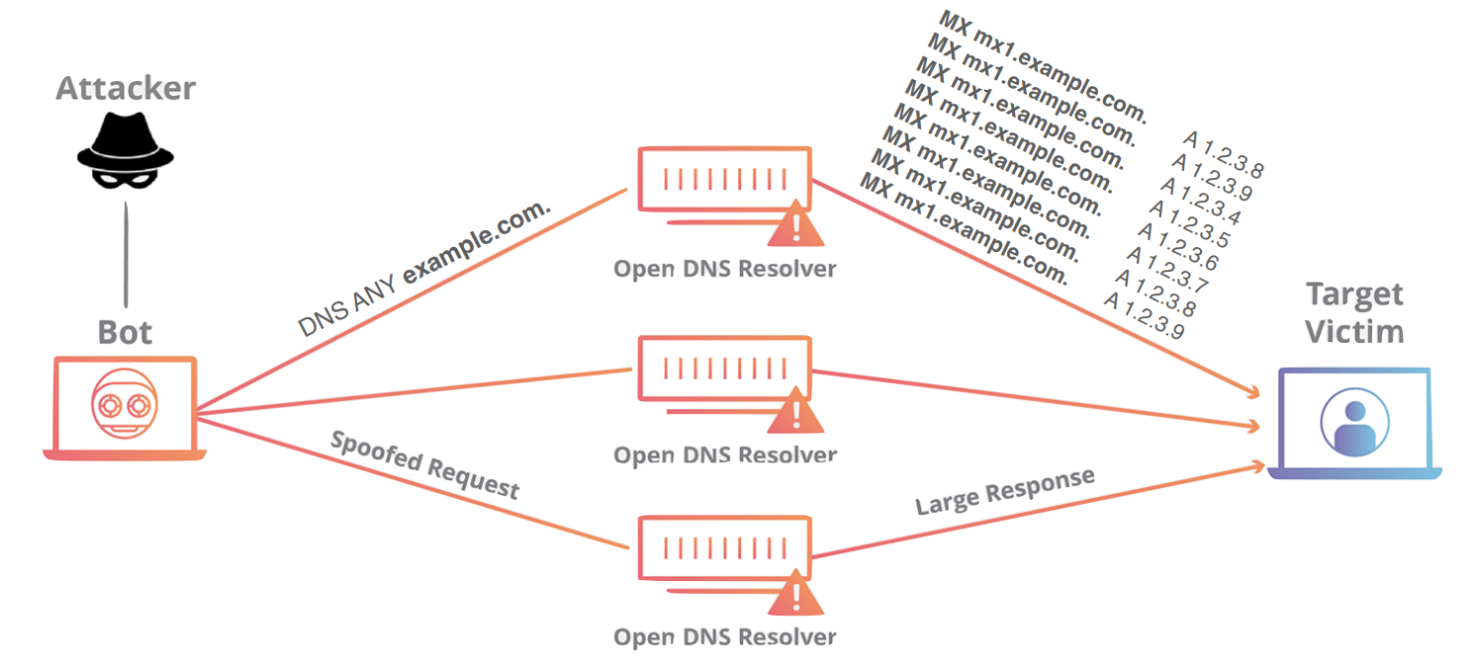
Amplification Attacks

Slide 36
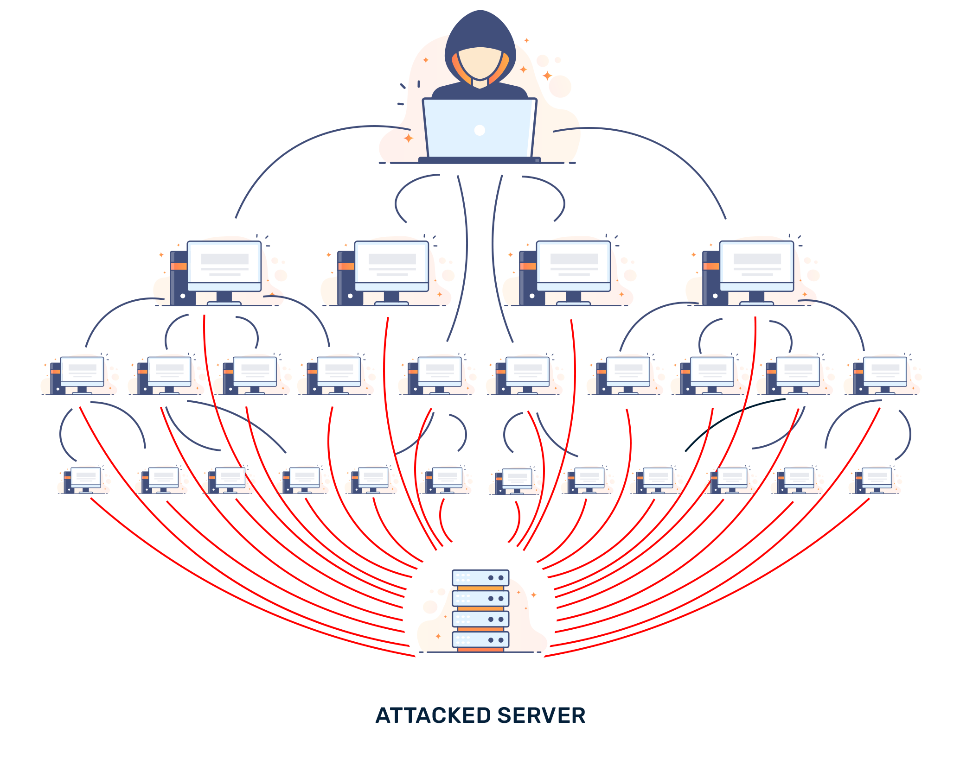
Distributed DoS (DDoS)
Another form of Amplification
Bot-networks of 80k to 100k have been seen in the wild

Slide 37
Amplification Attacks
A simple example!
TCP SYN-ACK amplification!
Attacker pretends to be from the target’s network IP address
Sends SYN packet to a preselected reflection IP addresses or services
Now, lots of SYN-ACK packet go toward the target network!
Target hosts unaware of these connections, drop the SYN-ACKs
But the retransmission of the SYN-ACKs continuous!

Slide 38
Common UDP Amplifiers
DNS: ANY query returns all records server has about a domain
NTP: MONLIST (a debugging command!) returns list of last 600 clients who asked for the time recently
Only works if you can receive a big response by sending a single packet
  otherwise spoofing doesn’t help you!
DNS: Domain Name Server
NTP: Network Time Protocol

Slide 39
Amplification Attacks
2013: DDoS attack generated 300 Gbps (DNS)
  31,000 misconfigured open resolvers, each at 10 Mbps
  Source: 3 networks that allowed IP spoofing
2014: 400 Gbps DDoS attacked used 4500 NTP servers

Slide 40
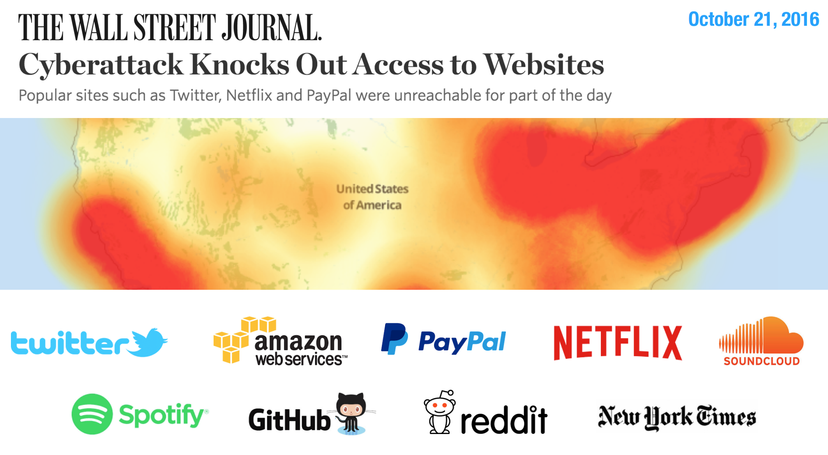
https://www.wsj.com/articles/denial-of-service-web-attack-affects-amazon-twitter-others-1477056080

Slide 41
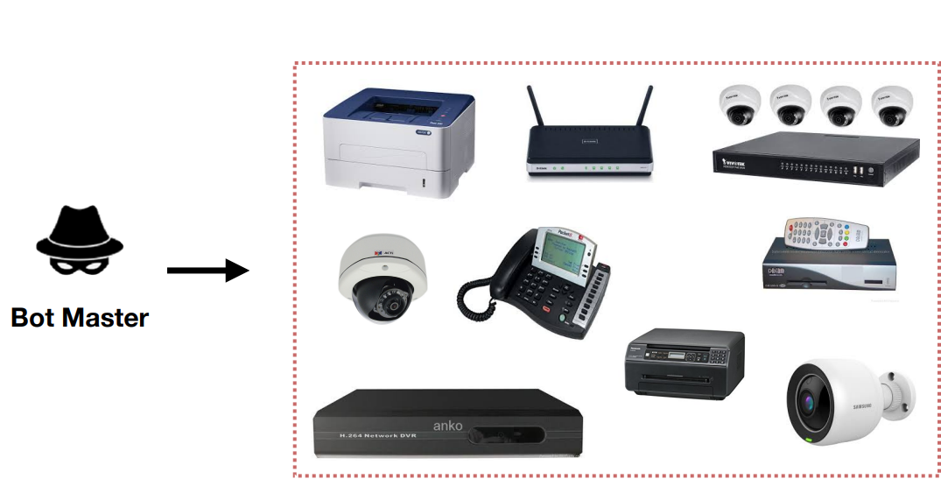
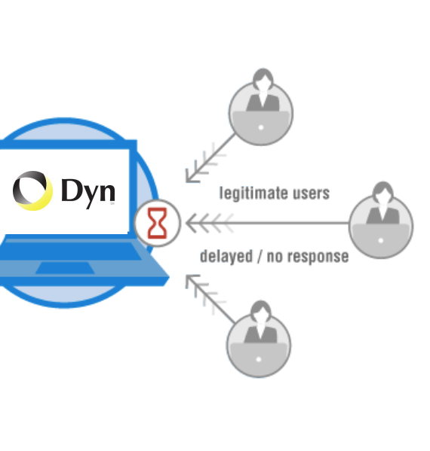
Cause:
DNS Amplification Attack
A Botnet of IoT Devices
Attack came from “tens of millions” of addresses on infected machines (with Mirai malware)
Caused an attack with a magnitude of 1.2 Tbps!

Slide 42
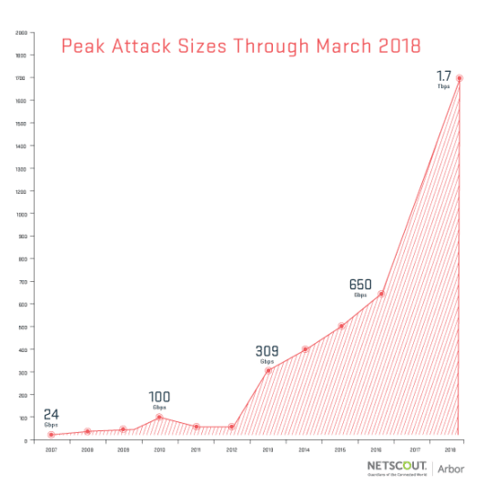
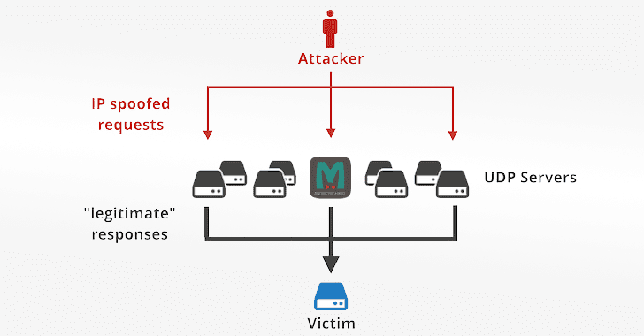
Amplification Attacks
Memcached
Record of amplification!
  1.7 Tbps amplification attack
An amplification by a factor of 51,000 using thousands of misconfigured Memcached servers exposed on the Internet
Notes:
“memcached is a high-performance, distributed memory object caching system, generic in nature, but originally intended for use in speeding up dynamic web applications by alleviating database load.“
You can think of it as a short-term memory for your applications.

Slide 43
Moving Up Stack: GET Floods
Command bot army to:
  Complete real TCP connection
  Complete TLS Handshake
  GET large image or other content
Will bypass flood protections…. but attacker can no longer use random source IPs
Victim site can block or rate limit bots

Slide 44
Reconnaissance
To attack a victim, first discover available resources
Many commonly used reconnaissance techniques
  Port scanning
  Host/application fingerprinting
  Traceroute
  DNS (reverse DNS scanning, Zone transfer)
  SNMP
These are meant for use by admins to diagnose network problems!
  Trade-off between the ability to diagnose a network and reveal security sensitive information
Notes:
For host/application fingerprinting, mention SYN fingerprinting

Slide 45
Anecdotes …
Large bot networks exist that scan the Internet daily looking for vulnerable hosts
Old worms still endemic on Internet
  Seem to come and go in mass
  Surreptitious scanning effort?
Notes:
Ssh trolling

Slide 46
Network Defenses

Slide 47
Assume network is malicious!
The network is out to get you!
Solution: Always use TLS if you want any protection against large-scale eavesdropping (e.g., intelligence agencies), or guarantee that data hasn’t been modified or corrupted by an on-path attacker
Note! HTTPS and TLS aren’t just for sensitive material! There have been attacks where malicious Javascript or malware is injected into websites.
  E.g., 1.35 Tbps attack against Github
HTTP
Transport Layer Security
TCP

Slide 48

HTTPS
What is that lock?
  Securely binds domain name to public key (PK)
  If PK is authenticated, then any message signed by that PK cannot be forged by non-authorized party

Slide 49
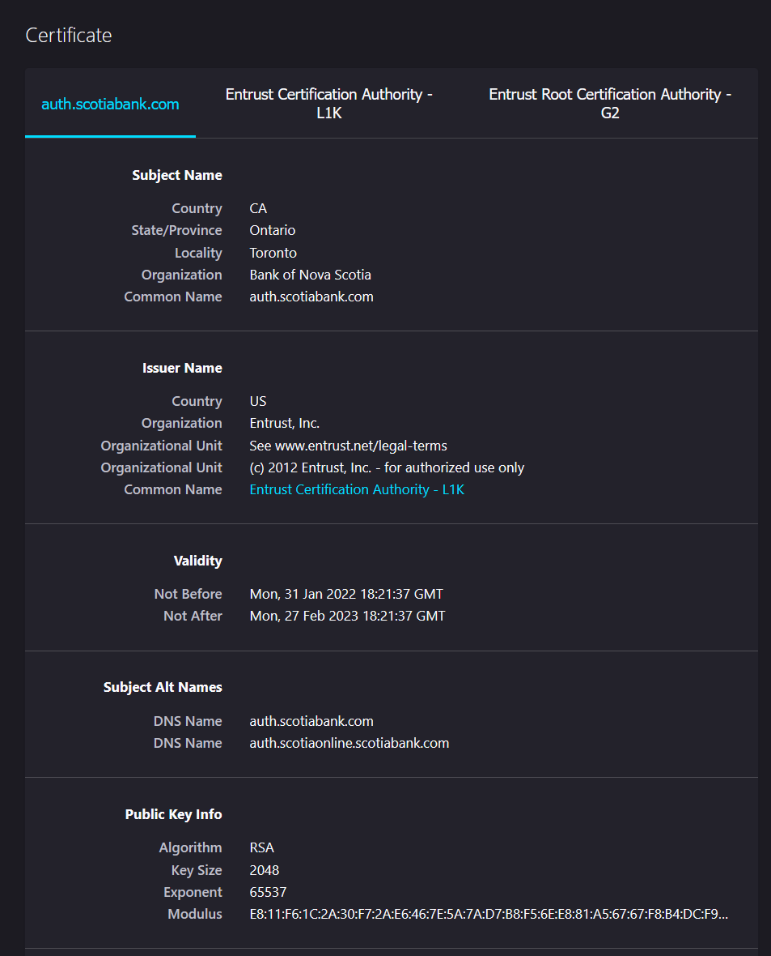
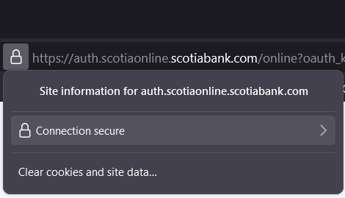
PK Certificate

Slide 50
Building a network protocol
Don’t build network proto from scratch
  Never roll your own crypto
  Many opportunities to mess up parsing network packets
gRPC: http2 + TLS 1.3 RPC framework
  Safe parsing in 11 languages
  Efficient
  Streaming/Sync/Async
  TLS-based authentication
Or, REST on top of HTTP/2 + TLS 1.3

Slide 51

Port Scanning
Send a SYN or application-specific UDP packet to a port to see if any service is listening
Vertical Scan: Try large number of ports on a single host. Typically use Nmap.
Horizontal Scan: Try a single port on a large number of hosts. Typically ZMap

Slide 52
Firewalls
Keep out unwanted traffic
Can be done in the network (e.g., network perimeter) or at the host
Many mechanisms
  Packet filters (discussed last time)
  Stateful packet filters (discussed last time)
  Proxies, gateways

Slide 53
Stateful Packet Filter
Idea: Only allow traffic initiated by client
  For each flow request (e.g., SYN or DNS req) keep a little state
  Ensure packets received from Internet belong to an existing flow
  To be effective must keep around sequence numbers per flow

Slide 54
Proxies
Want to look “deeper” into packets
  Application type
  Content
Full TCP termination in the network
Often done transparently (e.g., HTTP proxies)
Allows access to objects passed over network
  E.g., files, streams etc.
  Can do lots of other fun things
    E.g., content caching
Proxies duplicate per-flow state held by clients
How does this break end-to-end semantics of TCP?
  E.g., what if proxy crashes right after reading from client?
    lost data!

Slide 55
Intrusion Detection Systems (IDS)
Software/device to monitor network traffic for attacks or policy violations
Violations are reported to a central security information and event management (SIEM) system where analysts can later investigate
Signature Detection: maintains long list of traffic patterns (rules) associated with attacks
Anomaly Detection: attempts to learn normal behavior and report deviations

Slide 56



Open Source IDS
Three Major Open Source IDS (and lots of commercial products)
Snort
Zeek
Suricata

Slide 57
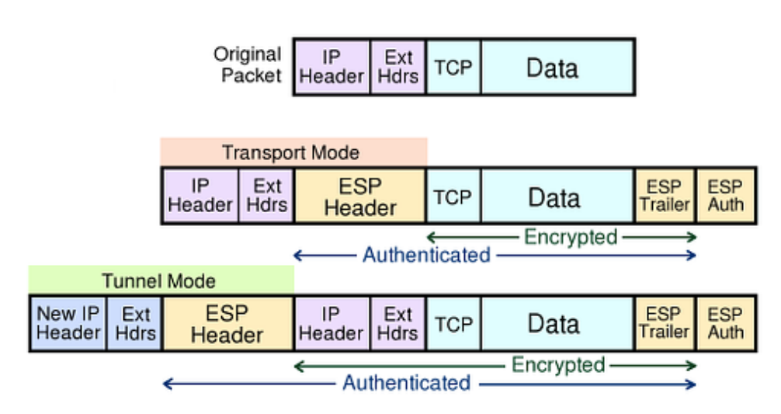
Virtual Private Networks (VPNs)
Several VPN protocols exist (PPTP, L2TP, IPsec, OpenVPN)
Most popular is IPsec.
General IP Security framework
Allows one to provide Access control, integrity, authentication, originality, and confidentiality
Applicable to different settings
ESP: Encapsulating Secure Payload Protocol

Slide 58
Cisco AnyConnect
UofT and many other organizations use Cisco AnyConnect
Encapsulates traffic in TLS!
Initial handshake uses normal TCP-based TLS for initial handshake and then DTLS (UDP-based TLS) to transport data

Slide 59
Gooey Middle
VPNs support the idea of having a secure internal network and untrusted public Internet.
Attacker has a ton of access once the network perimeter is breached.
Internal networks aren’t that secure. Computers are compromised all the time and attackers have free rein.

Slide 60
Zero Trust Security (BeyondCorp)
Google: assume internal network is also out to get you.
Remove privileged intranet and put all corporate applications on the Internet.
Access depends solely on device and user credentials, regardless of a user’s network location
Protect applications, not the network
Enable secure remote work without the need for a traditional VPN

Slide 61
Wrapping Up
Internet not designed for security!
Many, many attacks
  Defense is difficult
  Attackers are smart; Broken network aids them!
Retrofitting solutions often break original design principles
  Some of these solutions work, some of the time
  Some make the network inflexible, brittle
Time for new designs/principles?

