Slide 1

Software-Define Networking
Soheil Abbasloo
Department of Computer Science
University of Toronto
Fall 2022

Slide 2
Outline
Innovation: Computers vs. Networks
SDN
OpenFlow

Slide 3
Innovation
Computers vs. Networks
How difficult is it to create/modify a computer application?
How difficult is it to create/modify a network feature?
What is the difference?
What are the tools available for each?

Slide 4
Innovation in Applications
Application
Application
Application
OS
Computer
Computer
OS abstracts hardware substrate
→ Innovation in applications

Slide 5
Innovation in OS and Applications
Application
Application
Application
Application
Windows
(OS)
Windows
(OS)
Linux
Mac
OS
or
or
x86
(Computer)
x86
(Computer)
Simple, common, stable, hardware substrate below
+ Programmability
+ Competition
→ Innovation in OS and applications

Slide 6
Innovation in Infrastructure
App
App
App
Application
Application
Windows
(OS)
Linux
Mac
OS
Windows
(OS)
Linux
Mac
OS
Windows
(OS)
Linux
Mac
OS
Windows
(OS)
Linux
Mac
OS
or
or
Virtualization
x86
(Computer)
x86
(Computer)
Simple, common, stable, hardware substrate below
+ Programmability
+ Strong isolation model
+ Competition above
→ Innovation in infrastructure

Slide 7
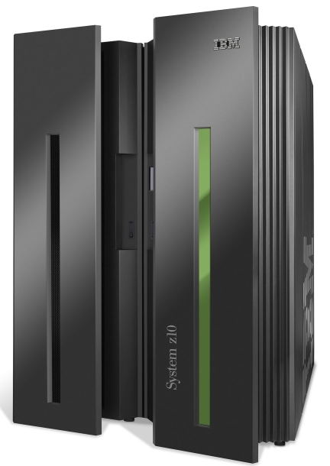
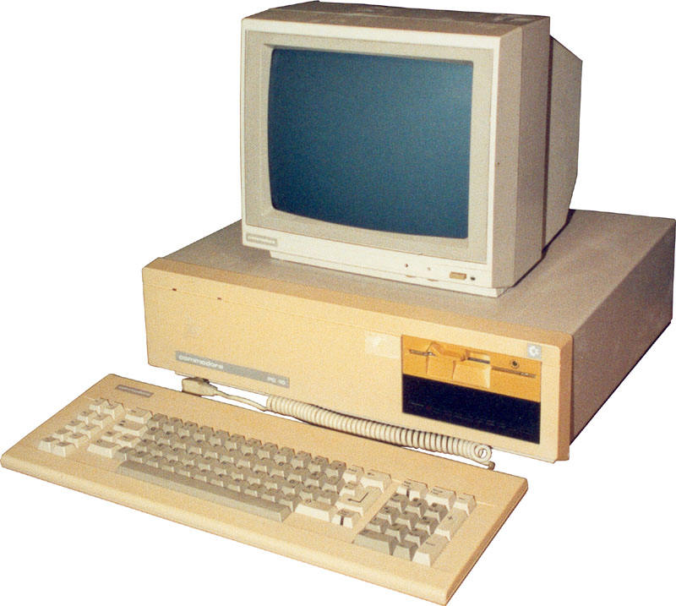
App
App
App
App
App
App
App
App
App
App
App
Specialized
Applications
Open Interface
Windows
(OS)
Linux
Mac
OS
Specialized
Operating
System
or
or
Open Interface
Specialized
Hardware
Microprocessor
Vertically integrated
Closed, proprietary
Slow innovation
Small industry
Horizontal
Open interfaces
Rapid innovation
Huge industry
Notes:
The mainframe industry in the 1980s was vertical and closed: it consisted of specialized hardware, operating system and applications --- all from the same company.
A revolution happened when open interfaces started to appear. The industry became horizontal. Innovation exploded.

Slide 8
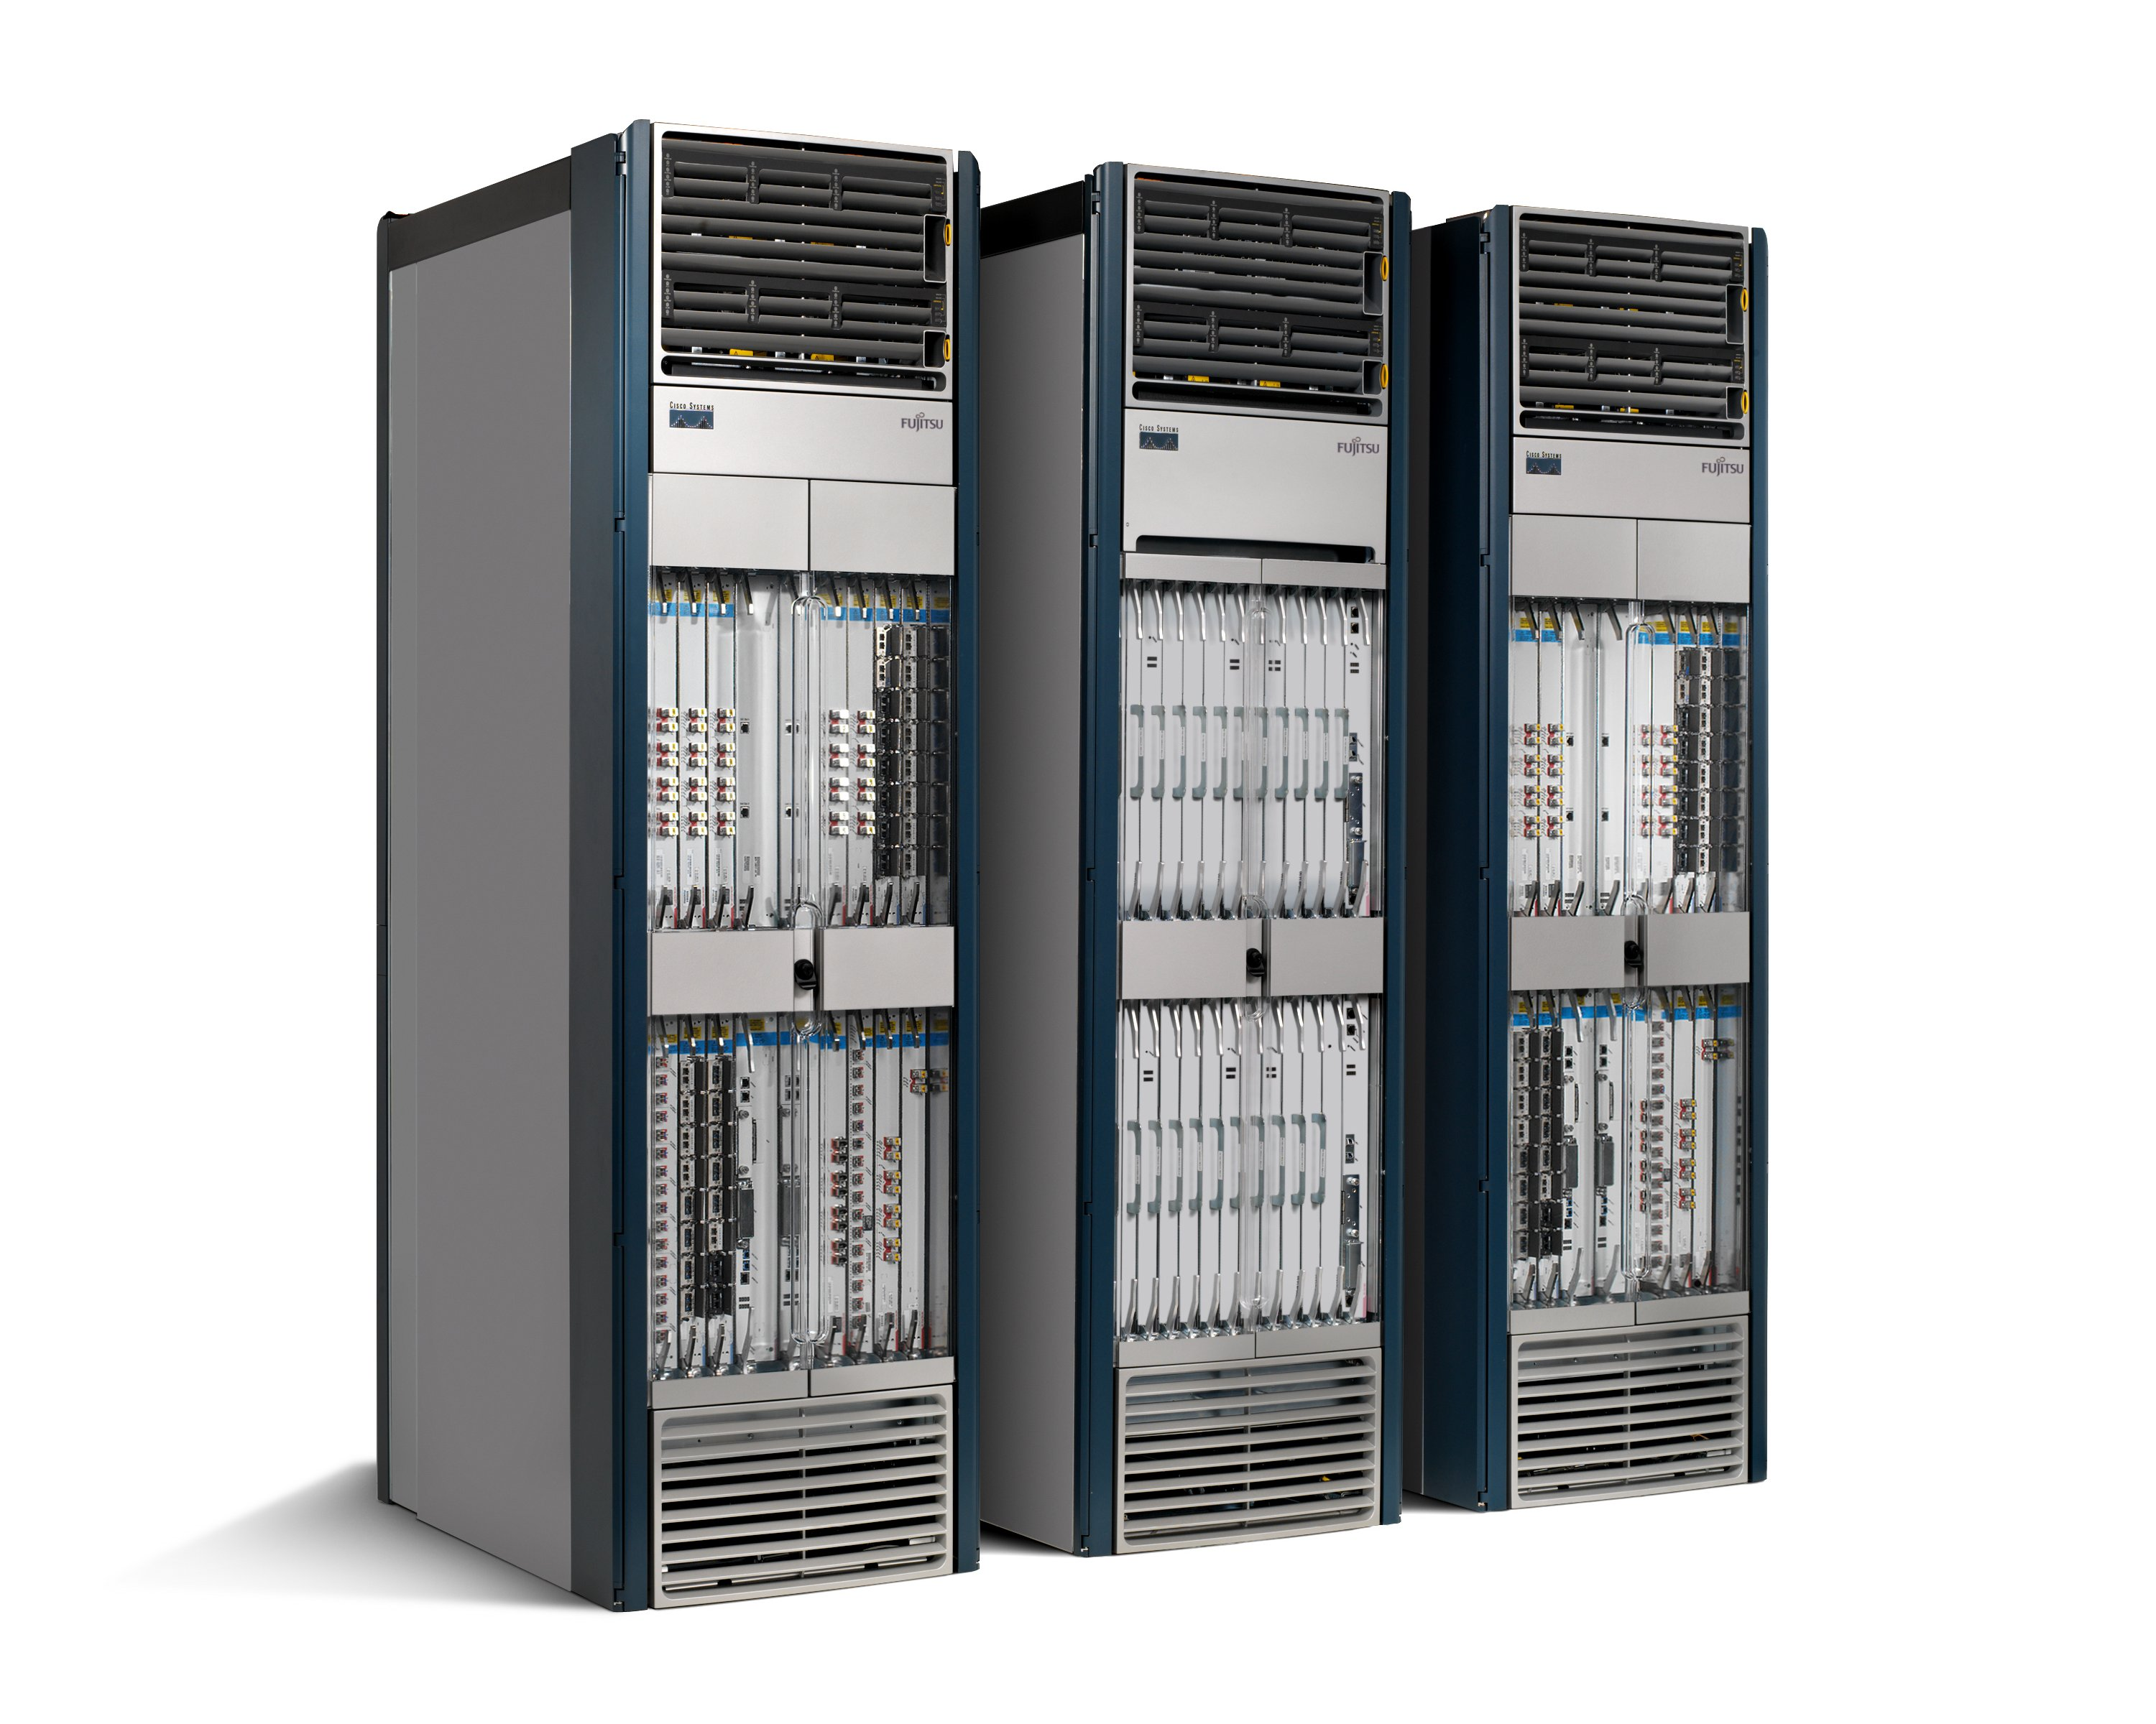
We Have Lost Our Way
Routing, management, mobility management,
access control, VPNs, …
Feature
Feature
Million of lines
of source code
6,000 RFCs
OS
Custom Hardware
Billions of gates
Bloated
Power Hungry
Vertically integrated, complex, closed, proprietary
Networking industry with “mainframe” mind-set

Slide 9
Reality is Even Worse
App
App
App
App
App
Operating
System
App
Operating System
Specialized Packet Forwarding Hardware
Specialized Packet Forwarding Hardware
Lack of competition means glacial innovation
Closed architecture means blurry, closed interfaces

Slide 10
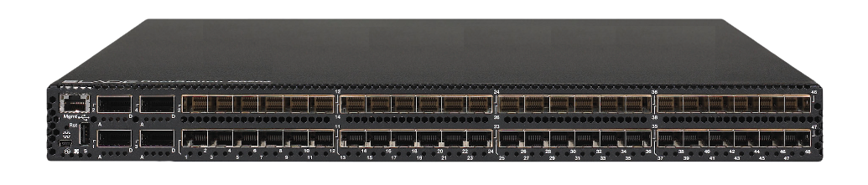
App
App
App
App
App
App
App
App
App
App
App
Specialized
Features
Open Interface
Control
Plane
Control
Plane
Control
Plane
or
or
Specialized
Control
Plane
Open Interface
Specialized
Hardware
Merchant
Switching Chips
Vertically integrated
Closed, proprietary
Slow innovation
Horizontal
Open interfaces
Rapid innovation

Slide 11
What we need …

Slide 12

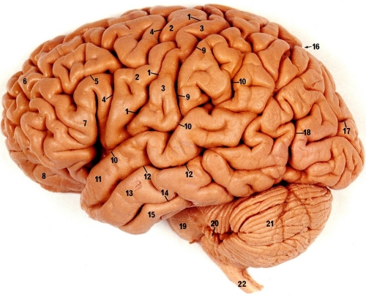
1) Separate Intelligence from Datapath
Operators, users, 3rd party developers, researchers, …
New function!

Slide 13
2) Cache Decisions
In minimal flow-based datapath
“If header = x, send to port 4”
“If header = y, overwrite header with z, send to ports 5,6”
“If header = ?, send to me”
Flow
Table

Slide 14
How Can We Do This?
Feature
Feature
Network OS
Feature
Feature
OS
Custom Hardware
Feature
Feature
OS
Feature
Feature
Custom Hardware
OS
Feature
Feature
Custom Hardware
OS
Custom Hardware
Feature
Feature
OS
Custom Hardware

Slide 15
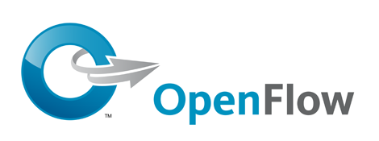
Software Defined Network (SDN)
3. Consistent, up-to-date global network view
2. At least one Network OS
probably many.
Open- and closed-source
Feature
Feature
Network OS
1. Open interface to packet forwarding
Packet
Forwarding
Packet
Forwarding
Packet
Forwarding
Packet
Forwarding
Packet
Forwarding

Slide 16
Consequences
More innovation in network services
  Owners, operators, 3rd party developers, researchers can improve the network
  E.g. energy management, data center management, policy routing, access control, denial of service, mobility
Lower barrier to entry for competition
  Healthier market place, new players
Lower cost
  Infrastructure
  Management

Slide 17
Example: Routing
OSPF
  RFC 2328: 245 pages
Distributed System
  Builds consistent, up-to-date map of the network: 101 pages
Dijkstra’s Algorithm
  Operates on map: 4 pages

Slide 18
Example: Routing
OSPF = Dijkstra
IS-IS
OSPF
IS-IS
Network OS
Distributed System
Distributed
System
Distributed
System
OS
Packet
Forwarding
Custom Hardware
Packet
Forwarding
Packet
Forwarding
Packet
Forwarding

Slide 19
Back to the main storyline …

Slide 20
Software Defined Network (SDN)
Control Program A
Control Program B
Network OS
Packet
Forwarding
Packet
Forwarding
Packet
Forwarding
Packet
Forwarding
Packet
Forwarding

Slide 21
1) Network OS
Network OS: distributed system that creates a consistent, up-to-date network view
  Runs on servers (controllers) in the network
  NOX, ONIX, HyperFlow, Kandoo, Floodlight, Trema, Beacon, Maestro, Beehive, OpenDayLight, … + more
Uses forwarding abstraction to:
  Get state information from forwarding elements
  Give control directives to forwarding elements

Slide 22
Software Defined Network (SDN)
Control Program A
Control Program B
Network OS
Packet
Forwarding
Packet
Forwarding
Packet
Forwarding
Packet
Forwarding
Packet
Forwarding

Slide 23
2) Control Program
Control program operates on view of network
  Input: global network view (graph/database)
  Output: configuration of each network device
Control program is not a distributed system
  Abstraction hides details of distributed state

Slide 24
Software Defined Network (SDN)
Control Program A
Control Program B
Network OS
Packet
Forwarding
Packet
Forwarding
Packet
Forwarding
Packet
Forwarding
Packet
Forwarding

Slide 25
3) Forwarding Abstraction
Purpose: Abstract away forwarding hardware
  Flexible
    Behavior specified by control plane
    Built from basic set of forwarding primitives
  Minimal
    Streamlined for speed and low-power
    Control program not vendor-specific
OpenFlow is an example of such an abstraction

Slide 26
4) Forwarding Substrate
Flow-based (next slides)
Small number of actions for each flow
  Plumbing: Forward to port(s)
  Control: Forward to controller
  Routing between flow-spaces: Rewrite header
  Bandwidth isolation: Min/max rate
External open API to flow-table

Slide 27
What is a flow?
Application flow
All http
Jim’s traffic
All packets to Canada
…
Types of action
Allow/deny flow
Route & re-route flow
Isolate flow
Make flow private
Remove flow

Slide 28
Flowspace
Ethernet
DA, SA, etc
IP
DA, SA, etc
TCP
DP, SP, etc
Payload
Collection of bits to plumb flows
(of different granularities)
between end points
Header
User-defined flowspace
Payload

Slide 29

Open standard to run experimental protocols in production networks
  API between the forwarding elements and the network OS
Based in Stanford, supported by various companies (Cisco, Juniper, HP, NEC, …)
Used by universities to deploy innovative networking technology

Slide 30
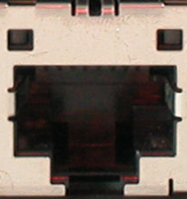
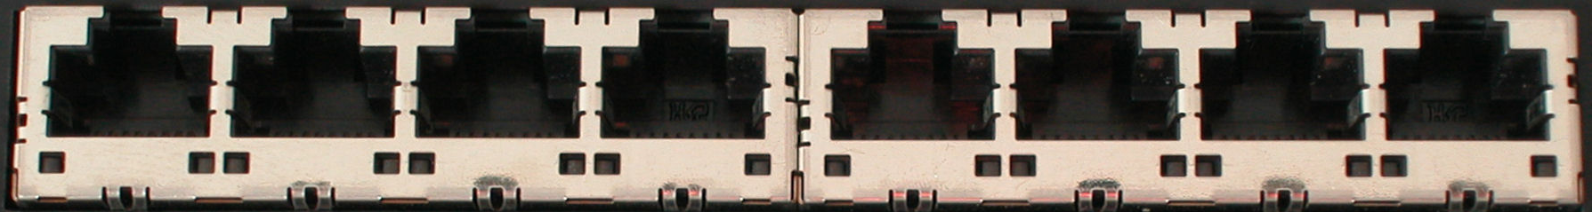
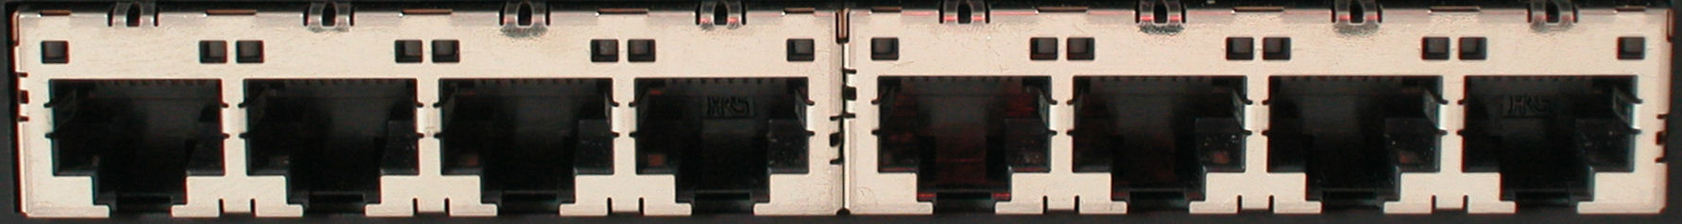
Traditional Switch
Ethernet Switch

Slide 31
Traditional Switch
Control Path
Control Path (Software)
Data Path (Hardware)

Slide 32
OpenFlow Switch
Control Program A
Control Program B
Network OS
OpenFlow Protocol (SSL,TLS)
Ethernet Switch
OpenFlow
Data Path (Hardware)

Slide 33
OpenFlow Rules
Control Program A
Control Program B
Network OS
“If header = p, send to port 4”
Packet
Forwarding
“If header = q, overwrite header with r,
add header s, and send to ports 5,6”
“If header = ?, send to me”
Flow
Table(s)
Packet
Forwarding
Packet
Forwarding

Slide 34
Plumbing Primitives
<Match, Action>
Match arbitrary bits in headers:
  Match on any header, or new header
  Allows any flow granularity
Action
  Forward to port(s), drop, send to controller
  Overwrite header with mask, push or pop
  Forward at specific bit-rate
Match: 1000x01xx0101001x
Header
Data

Slide 35
OpenFlow Rules – Cont’d
Exploit the flow table in switches, routers, and chipsets
Flow 1.
Rule
(exact & wildcard)
Action
Statistics
Flow 2.
Rule
(exact & wildcard)
Action
Statistics
Flow 3.
Rule
(exact & wildcard)
Action
Statistics
Rule
(exact & wildcard)
Flow N.
Default Action
Statistics
Notes:
35

Slide 36
Flow Table Entry
OpenFlow Protocol Version 1.0
Rule
Action
Stats
Packet + byte counters
Forward packet to port(s)
Encapsulate and forward to controller
Drop packet
Send to normal processing pipeline
Switch
Port
MAC
src
MAC
dst
Eth
type
VLAN
ID
IP
Src
IP
Dst
IP
Prot
TCP
sport
TCP
dport
+ mask what fields to match

Slide 37
Examples
Switching
Switch
Port
MAC
src
MAC
dst
Eth
type
VLAN
ID
IP
Src
IP
Dst
IP
Prot
TCP
sport
TCP
dport
Action
*
*
00:1f:..
*
*
*
*
*
*
*
port6
Flow Switching
Switch
Port
MAC
src
MAC
dst
Eth
type
VLAN
ID
IP
Src
IP
Dst
IP
Prot
TCP
sport
TCP
dport
Action
port3
00:2e..
00:1f..
0800
vlan1
1.2.3.4
5.6.7.8
4
17264
80
port6
Firewall
Switch
Port
MAC
src
MAC
dst
Eth
type
VLAN
ID
IP
Src
IP
Dst
IP
Prot
TCP
sport
TCP
dport
Forward
*
*
*
*
*
*
*
*
*
22
drop

Slide 38
Examples
Routing
Switch
Port
MAC
src
MAC
dst
Eth
type
VLAN
ID
IP
Src
IP
Dst
IP
Prot
TCP
sport
TCP
dport
Action
*
*
*
*
*
*
5.6.7.8
*
*
*
port6
VLAN
Switch
Port
MAC
src
MAC
dst
Eth
type
VLAN
ID
IP
Src
IP
Dst
IP
Prot
TCP
sport
TCP
dport
Action
port6,
port7,port9
*
*
*
*
vlan1
*
*
*
*
*

Slide 39
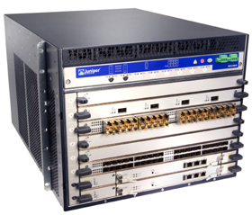
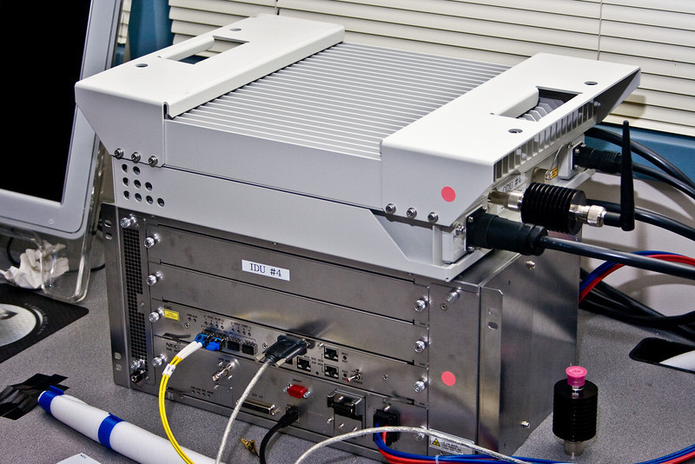
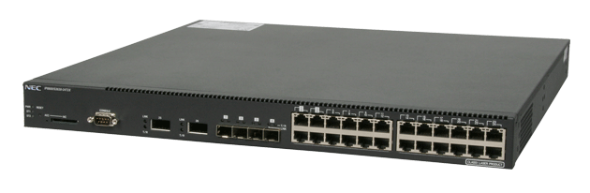
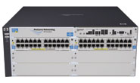
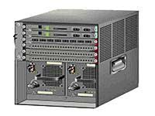
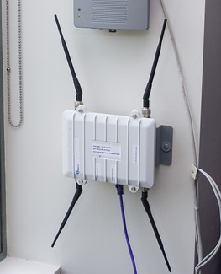

OpenFlow Hardware
Juniper MX-series
NEC IP8800
WiMax (NEC)
HP Procurve 5400
Cisco Catalyst 6k
PC Engines
More ...
Quanta LB4G

Slide 40
Some fun facts …
VMware purchased Nicira for $1.26 billion in 2012
  VMware Purchased VeloCloud Networks in 2017 (amount unknown!)
Orion (2022)
  Google’s 2nd generation SDN control plane
  Responsible for configuration, management, real-time network control
  In all their data center, campus, and private Wide Area (B4) networks
  In production for over 4 years
Notes:
A startup SDN company that was made by a grad @ Stanford, Martin Casado, same student that came up with the idea of a centralized controller for the network!

Slide 41



OpenFlow Usage Example
Controller
Dedicated OpenFlow Network
Peter’s code
OpenFlow
Switch
PC
Rule
Action
Statistics
OpenFlow
Protocol
OpenFlow
Switch
OpenFlow
Switch
Rule
Action
Statistics
Rule
Action
Statistics
Peter
OpenFlowSwitch.org
Notes:
41

Slide 42
Usage examples
Peter’s code:
  Static “VLANs”
  His own new routing protocol: unicast, multicast, multipath, load-balancing
  Network access control
  Home network manager
  Mobility manager
  Energy manager
  Packet processor (in controller)
  IPvPeter
  Network measurement and visualization
  …
Notes:
42

Slide 43

Another Example:
Production networks as Research Test-beds!
Controller
Research Slice
Flow Table
Production Slice
Normal L2/L3 Processing

Slide 44

Virtualize OpenFlow Switch
Controller A
Researcher A Slice
Controller B
Flow Table
Researcher B Slice
Controller C
Flow Table
Researcher C Slice
Flow Table
Production Slice
Normal L2/L3 Processing

Slide 45
Virtualizing OpenFlow
FlowVisor OSDI’10
B’s
Controller
A’s
Controller
C’s
Controller
OpenFlow
Protocol
OpenFlow
Switch
FlowVisor & Policy Control
OpenFlow
Protocol
Policy Check:
Who can control certain packets?
Is this rule allowed?
OpenFlow
Switch
OpenFlow
Switch
Notes:
Hypervisor ->FloVisor

Slide 46
Virtualizing OpenFlow
FlowVisor OSDI’10
Multicast
http
Load-balancer
Broadcast
OpenFlow
Protocol
OpenFlow
Switch
FlowVisor & Policy Control
OpenFlow
Protocol
Policy Check:
Who can control certain packets?
Is this rule allowed?
OpenFlow
Switch
OpenFlow
Switch
Notes:
Hypervisor ->FloVisor

Slide 47
Food for Thought
What are the challenges in switching from traditional networks to OpenFlow networks?
What are the opportunities?

