Slide 1
A Framework For Efficient Valuation of Large Portfolios of Unit-linked Insurance Products
Presenter: amir Hejazi
Supervisor: Kenneth R. Jackson

Slide 2
Outline
Variable Annuity
Research Questions & Existing Solutions
Spatial Interpolation Framework
Interpolation Techniques
  Kriging
  Inverse Distance Weighting
  Radial Basis Function
Performance Results
Conclusion & Future Work

Slide 3
Variable Annuity (VA)
Unit-linked life and savings insurance product (segregated funds)
Guarantee types
  GMIB: guarantees stream of income for life
  GMWB: guarantees ability to withdraw up to a pre-determined percentage of benefit base for several years
  GMDB: guarantees a lump-sum payment upon death
  GMAB: guarantees a lump-sum payment on the maturity of contract
Source of revenue for writers
  Rider Charge
  Administrative Expense Charge
  Surrender Charge
  Insurance Charge
  Investment Management Charge

Slide 4
Variable Annuity (VA)
Consists of two phases
  Accumulation Phase
  Withdrawal Phase

Slide 5
Research Questions
Policy holder’s view
  Optimal strategy to maximize the value of contract
  Fair valuation of contract
Insurer’s view
  Hedging and Risk Management
    Individual Contract
    Portfolio of contracts
  Of Interest to Academia
  Of Interest to Industry
Notes:
We are interested in industrial problems

Slide 6
Existing Solutions
Extending methodologies of individual VA contracts
Replicating Portfolios
Nested Monte Carlo (MC) Simulations
  Suggested payoffs, mostly, have no closed-form formulas
  Almost all suggested methods are computationally expensive
  Results on one VA cannot be re-used for another VA
  Computationally expensive
  Accuracy/computational complexity trade-off
  Computationally expensive
Notes:
Replicating Portfolios: -comp exp (requires cash flow of portfolio at each time step)
- accuracy requires many sample contracts

Slide 7
Reducing Nested Simulations Time
Reducing outer loop scenarios
Reducing inner loop scenarios (e.g. LSMC)
Reducing inputs to the simulation
  Representative contracts
  Meta-modelling via Spatial Interpolation methods (e.g. Kriging)
  Accuracy/computational complexity trade-off
  Pre-processing by an actuarial system (manual input)
Notes:
We focus on meta-modelling framework

Slide 8
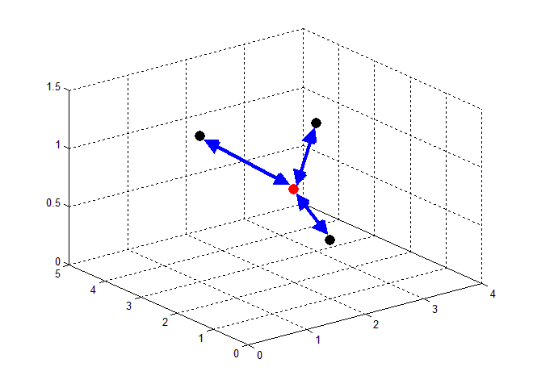
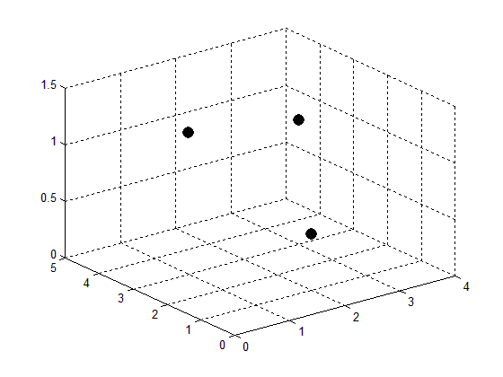
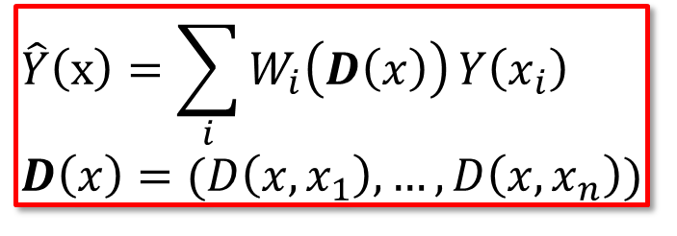
Spatial Interpolation Framework
Framework
Sample VA Space
Find value of interest at each sample point via MC simulations
Interpolate value of interest for the portfolio
$$\hat{Y}\left(x\right)=\sum_{i}{W_{i}\left(D\left(x\right)\right)}Y\left(x_{i}\right) \\ D\left(x\right)=(D\left(x, x_{1}\right), …, D\left(x, x_{n}\right))$$
Notes:
We focus on GMDB

Slide 9
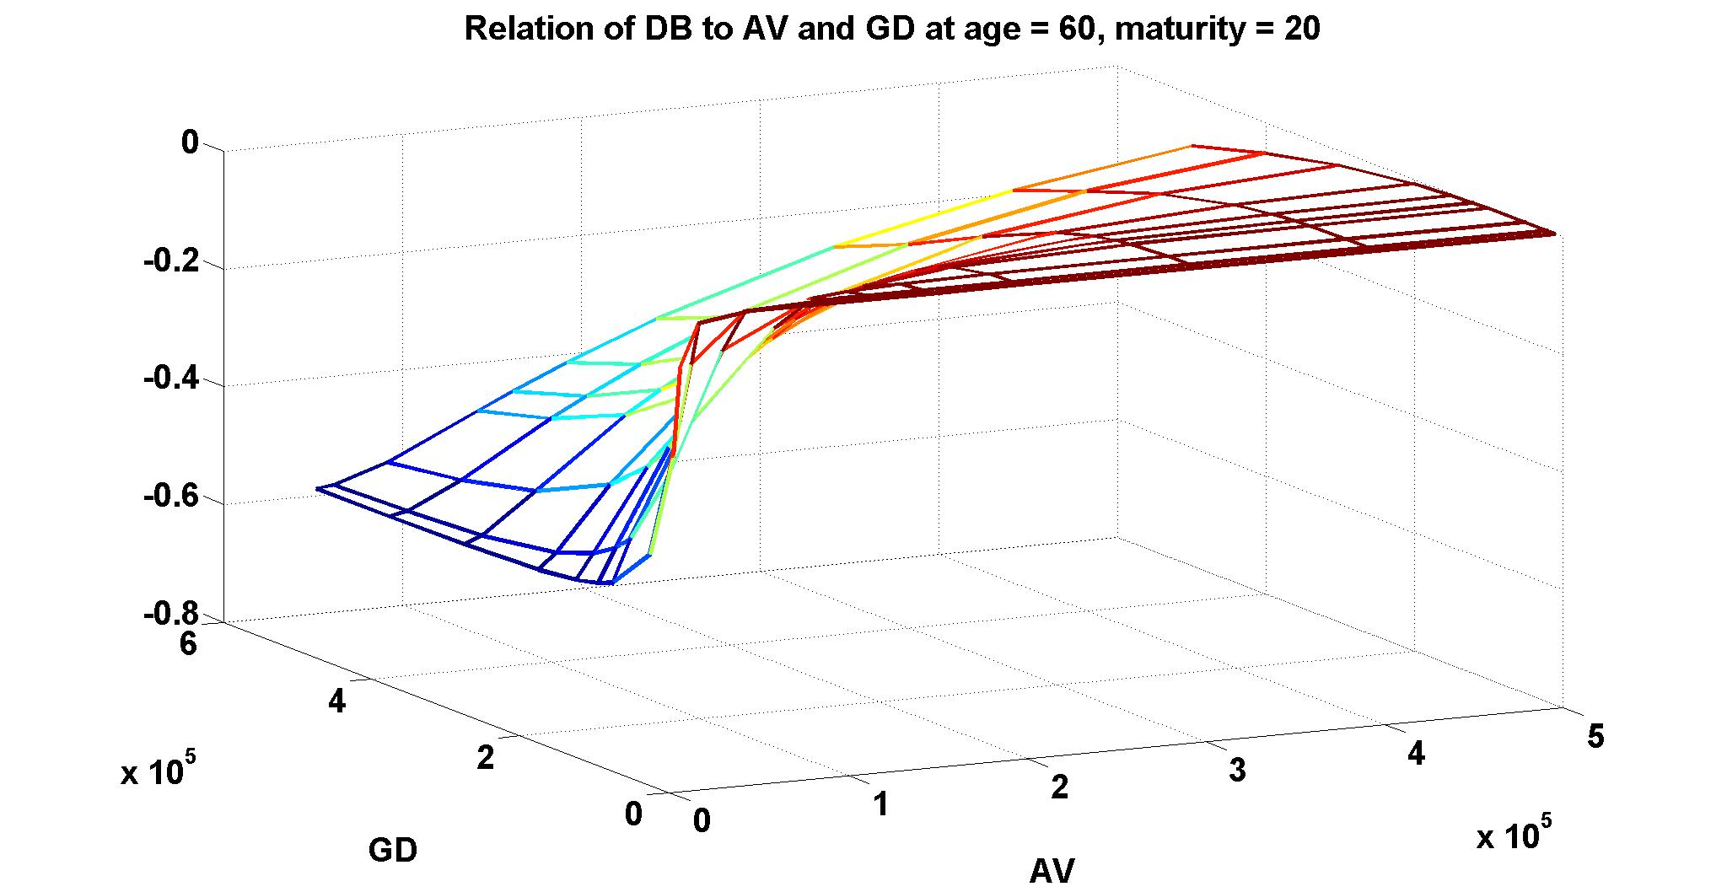
Spatial Interpolation Framework
Main Factors
Sampling method (e.g. K-means, LHS)
Distance function (e.g. K-prototype)
Interpolation method
  Stochastic Interpolation (Kriging)
  Deterministic Interpolation (IDW, RBF)
Notes:
We focus on GMDB

Slide 10
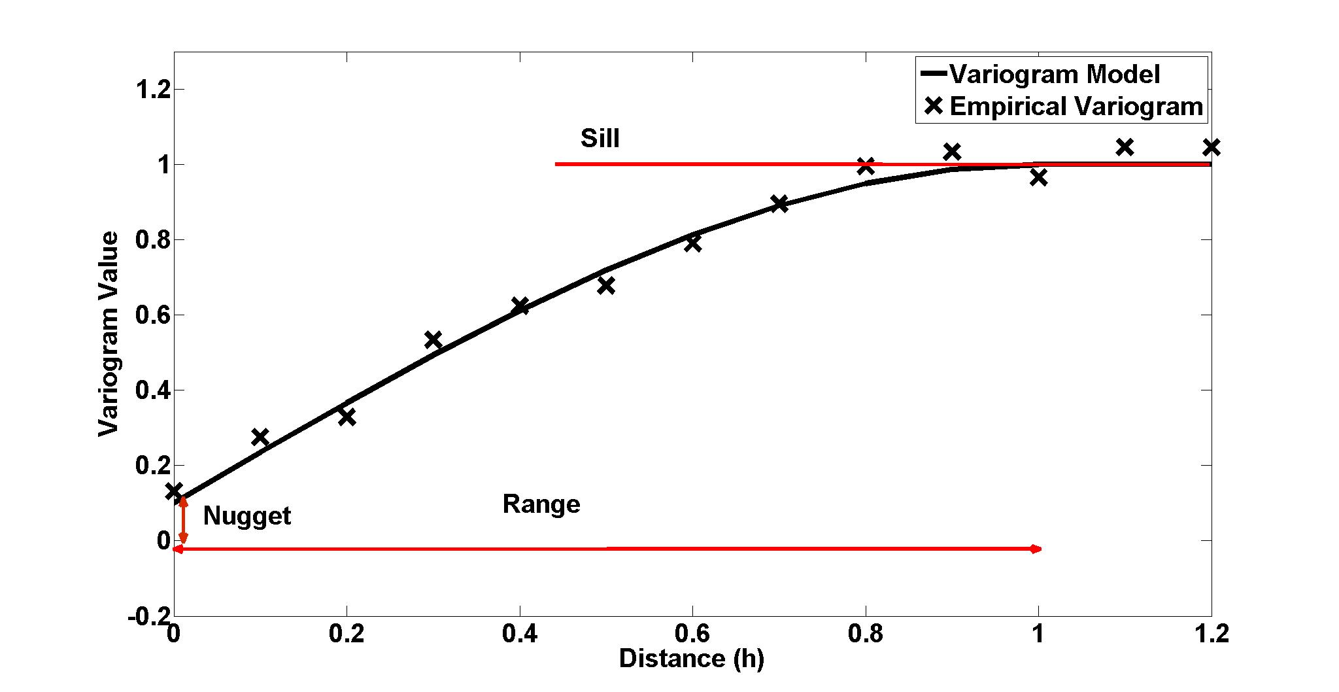
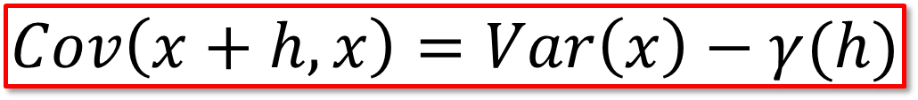
Interpolation Techniques
Kriging
Stochastic
Second Order Stationary
Best MSE Linear Estimator
$$Cov\left(x+h, x\right)=Var\left(x\right)−γ(h)$$
Notes:
Effect of boundary VAs (look at GD in experiment 2)

Slide 11
Interpolation Techniques
Ordinary Kriging
Notes:
Effect of boundary VAs (look at GD in experiment 2)

Slide 12
Interpolation Techniques
Inverse Distance Weighting
Deterministic
Notes:
Effect of boundary VAs (look at GD in experiment 2)

Slide 13
Interpolation Techniques
Radial Basis Function
Deterministic
Notes:
Effect of boundary VAs (look at GD in experiment 2)

Slide 14
Performance
Setup
Portfolio
Sampling
Distance Function
Notes:
Effect of boundary VAs (look at GD in experiment 2)

Slide 15
Performance
Result
Accuracy
Notes:
Effect of boundary VAs (look at GD in experiment 2)

Slide 16
Performance
Result
Efficiency
Notes:
Effect of boundary VAs (look at GD in experiment 2)

Slide 17
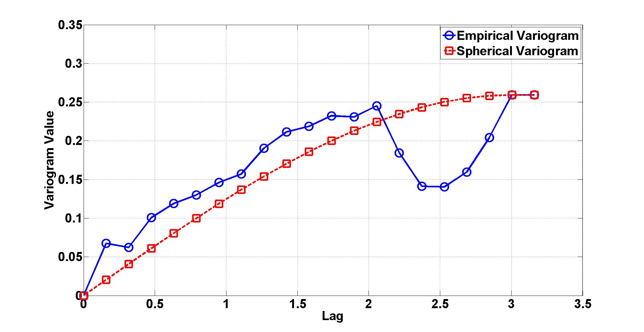
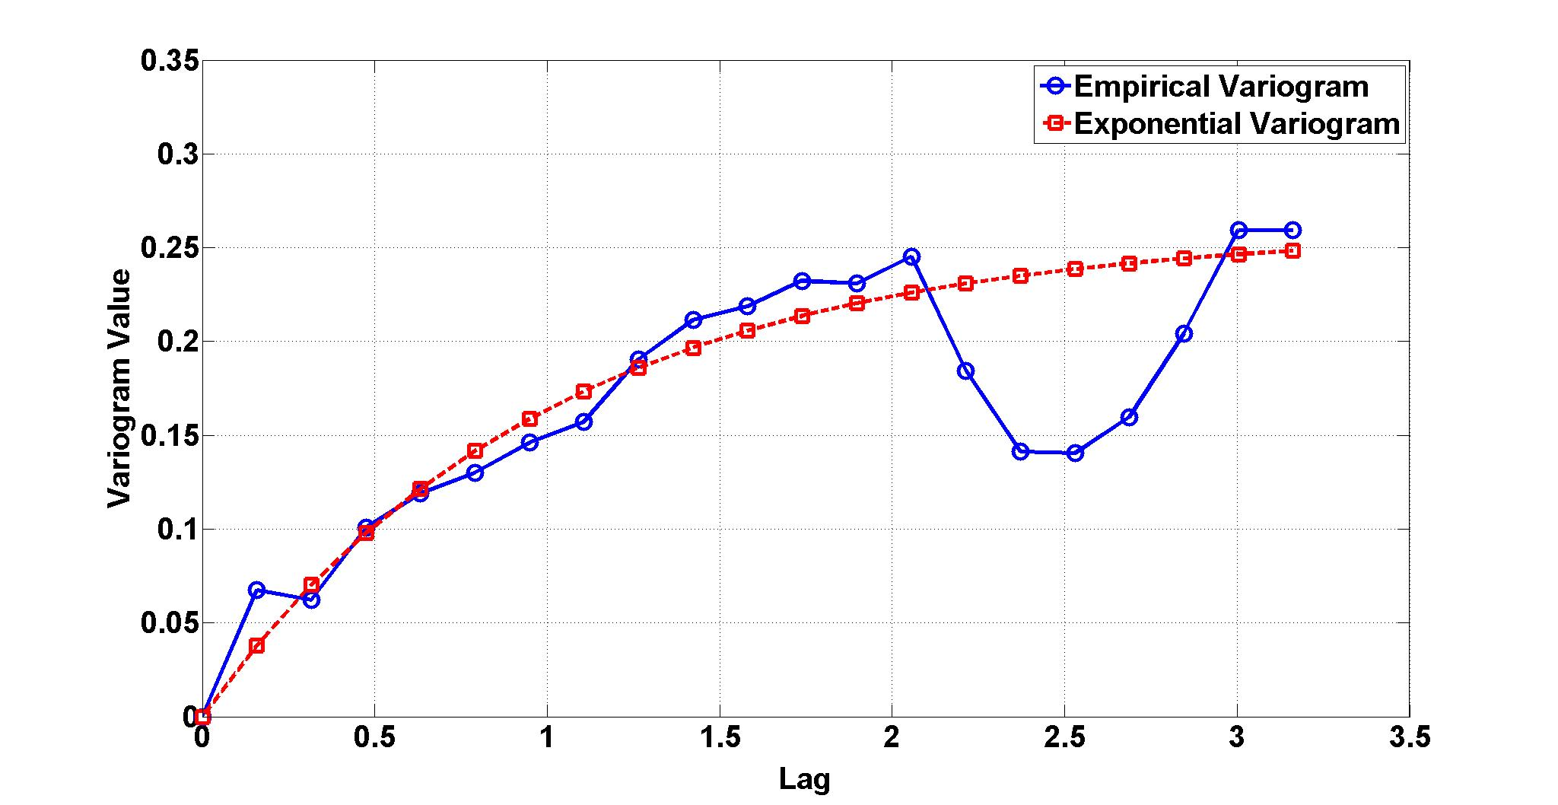
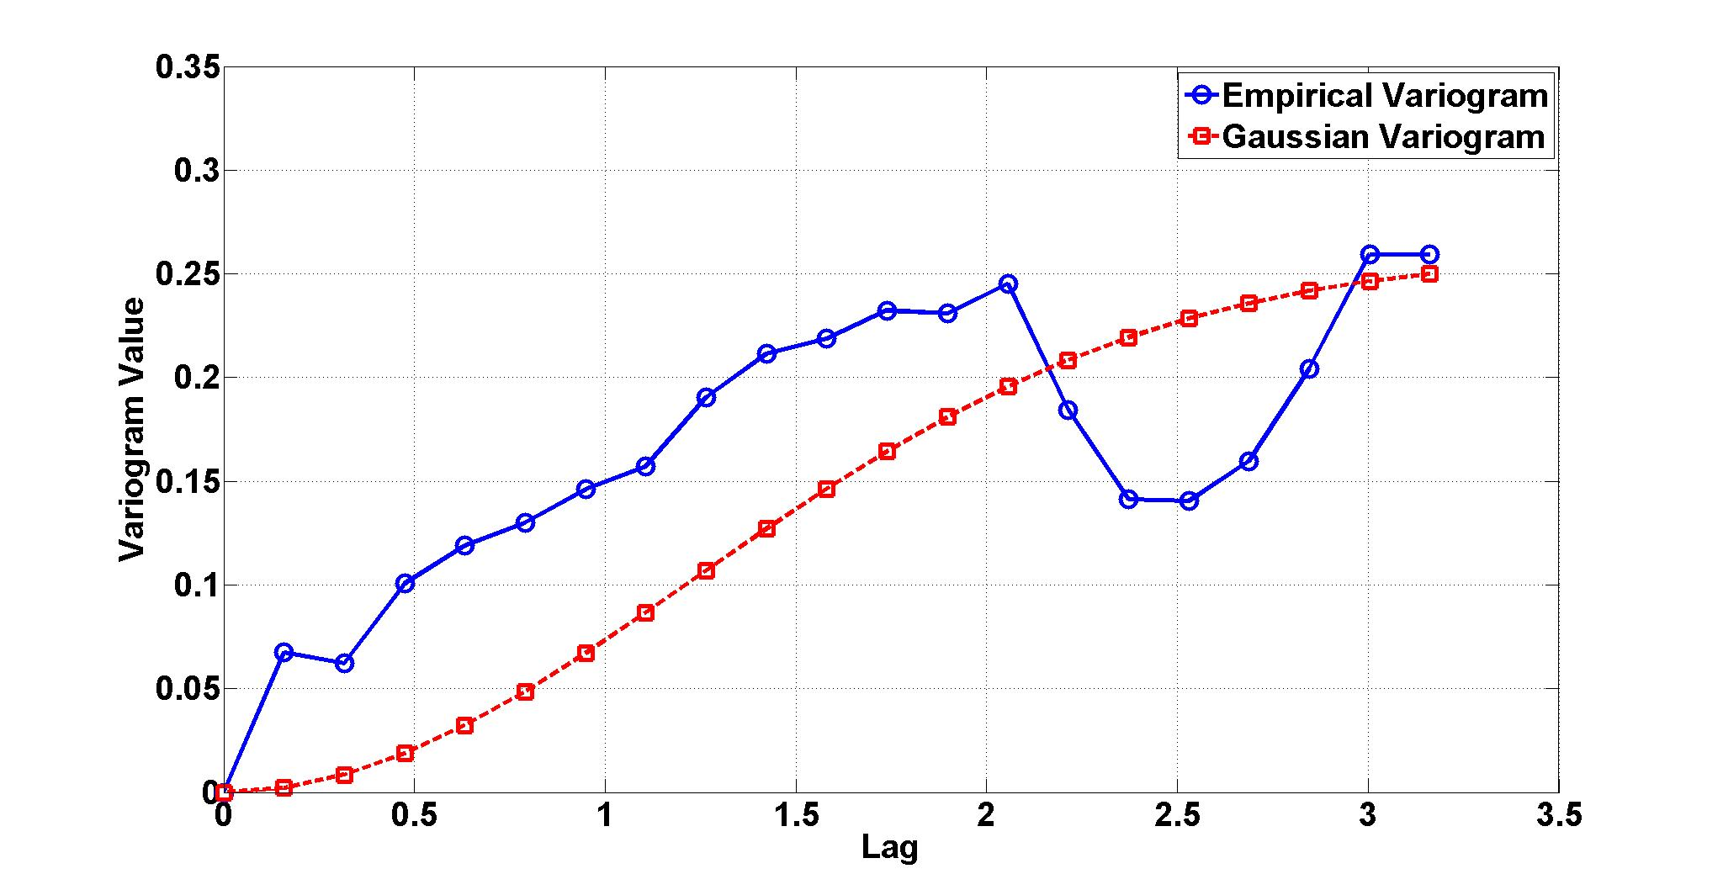
Variogram
Setup

Slide 18
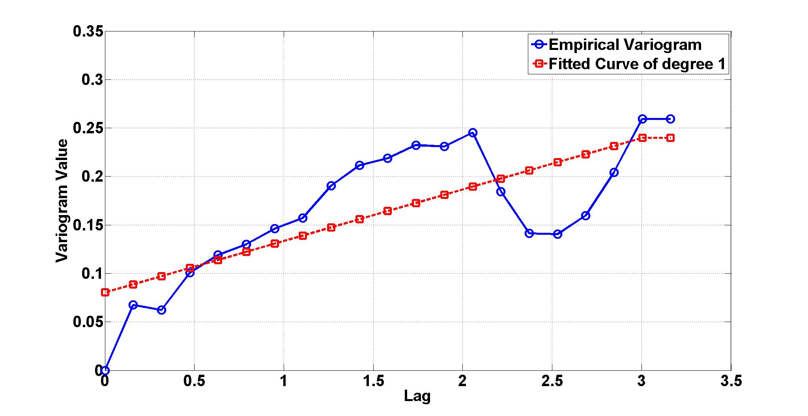
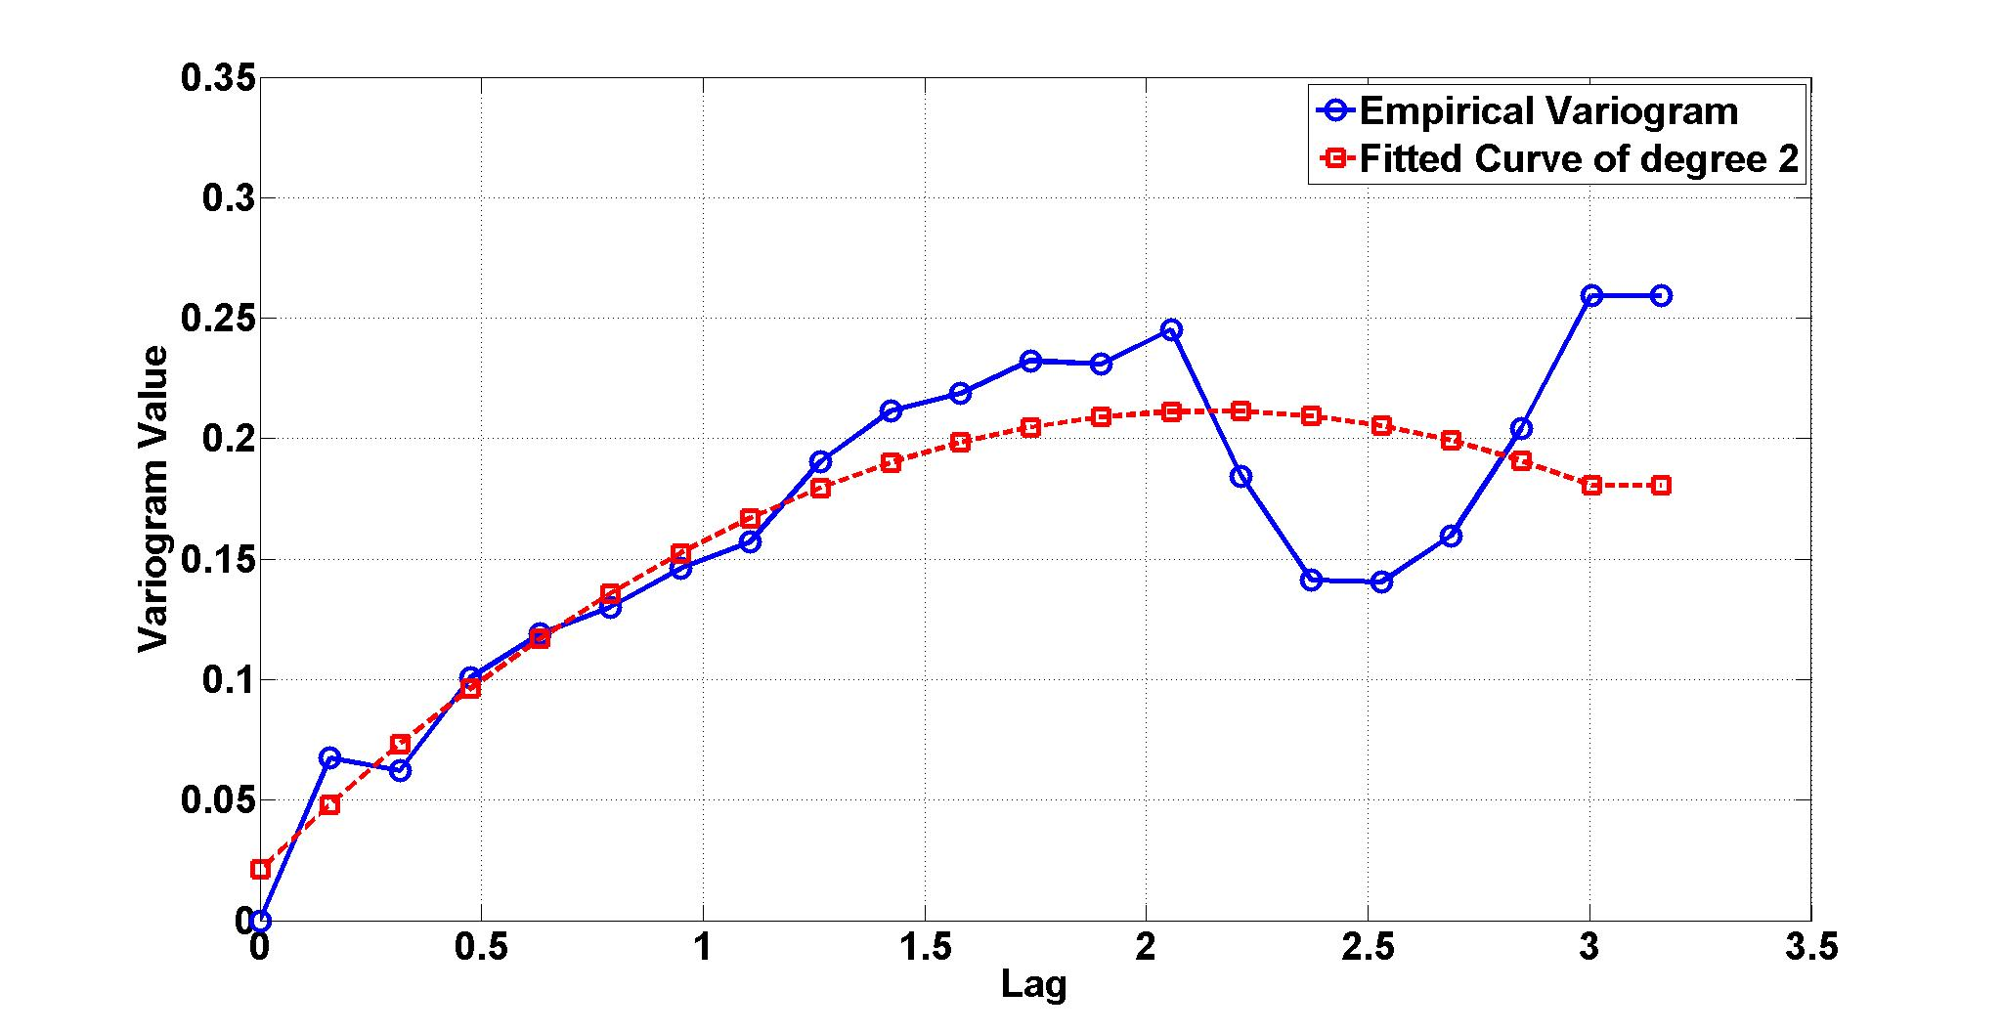
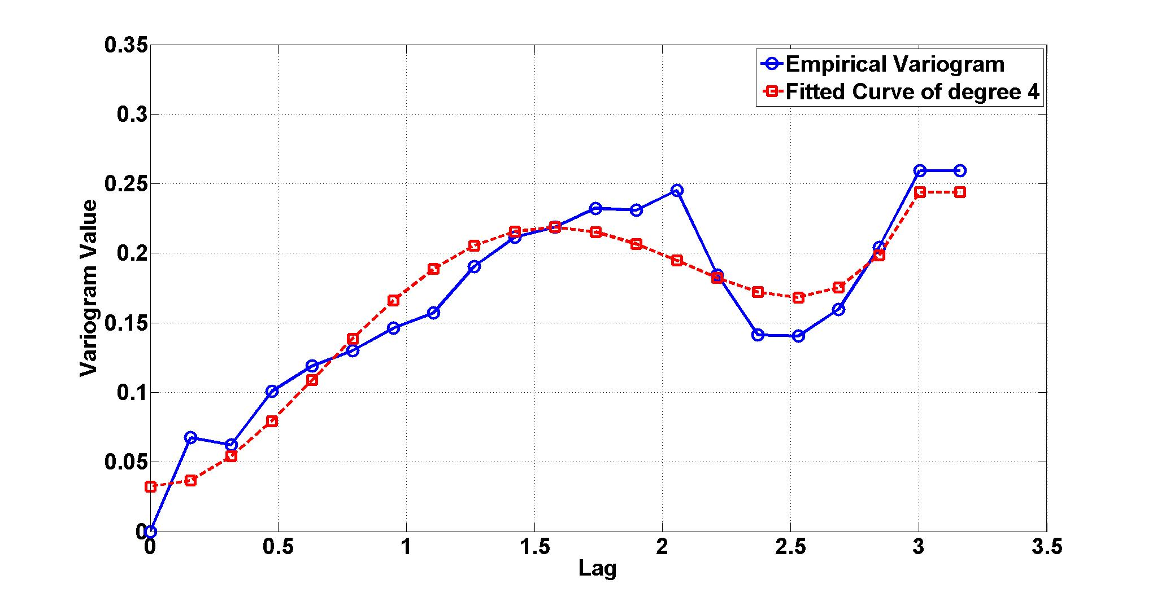
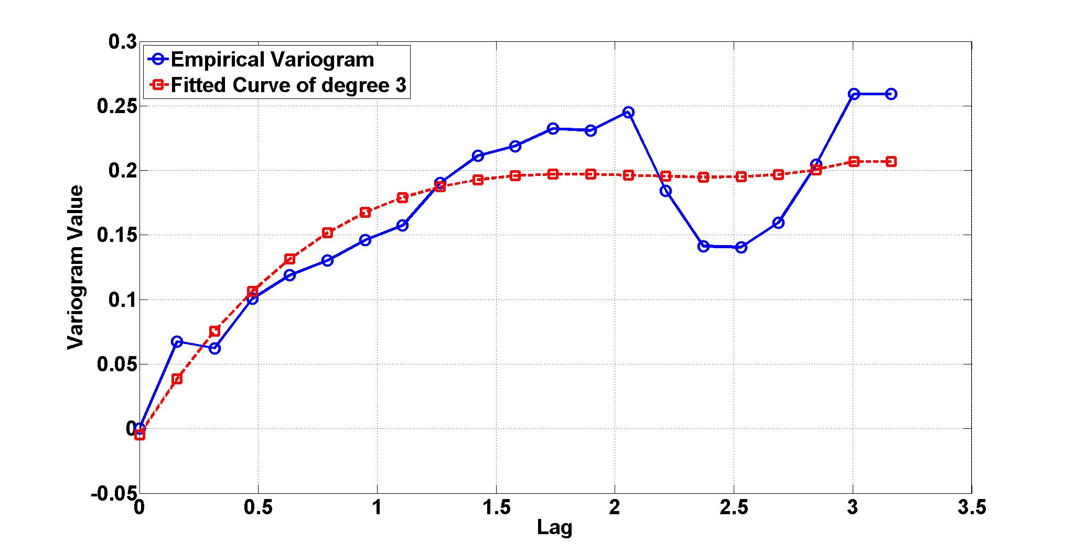
Variogram
Setup

Slide 19
Variogram
Result

Slide 20
Variogram
No immediate dependency on distance!
Notes:
Second order stationarity doesn’t hold
Kriging is not appropriate

Slide 21
Distance Function
Experiment 1
Experiment 2

Slide 22
Distance Function
Result

Slide 23
Conclusion and Future Work
Conclusions
Linear estimators with distance dependent weights are accurate
Choice of sampling method and distance function significantly affects accuracy
Future Work
Use Neural Networks to learn the distance function
  Powerful tools to learn highly non-linear functions
  Require one time training
  Allow simple generalization to other types of VAs

Slide 24
Thank You, Any Questions?

