Slide 1
The Impact of Optional Group Work on the Student Experience
Jonathan Calver, Michelle Craig, Jennifer Campbell
Department of Computer Science
14th Annual University of Toronto Teaching and Learning Symposium:
Teacher-as-Learner/Learner-as-Teacher
Inquiry on Teaching and Learning Poster + Talk
2:30-3:30pm Wednesday, May 12th, 2021

Slide 2
Research Question
How does optional group work impact students?
What is the impact on their grades?
What are the students’ perceptions?
Notes:
Group formation factors?
Who is choosing to be in a group?

Slide 3
Our Study
Data from 1354 undergraduate students taking CS theory courses in Winter 2021: 832 in CSC165 and 522 in CSC263
Grade breakdown by question on assessments and prerequisite course grades.
Survey + group information for each assignment.
Grades
Surveys
Groups
Notes:
Students hand in assignments as a group (1-2 for 263 or 1-3 for 165) and complete tests individually.
Survey asks a variety of questions – gender, timezone, how they worked on the assignment as a group, factors of groups formation, time spent, satisfaction on their answers (by question), when they started working on the assignment
www.cs.toronto.edu/~calver/igg.html
- Online learning setting

Slide 4
Six Preliminary Results for CSC263
1. Students work in groups to manage their workload.
75% felt encouraged to work in a group because of their overall workload
Notes:
What should our response to this be?

Slide 5
Six Preliminary Results for CSC263
2. Students who worked in pairs on assignments scored better on assignments and about the same on tests compared to those who worked individually on assignments.
Assessment | Group Mean | Individual Mean | P-value
Test | 54.6% | 52.2% | 0.14
Assignment | 84.4% | 74% | 7e-9
Notes:
Should we be concerned that group work is skewing grades?
What is the narrative?

Slide 6
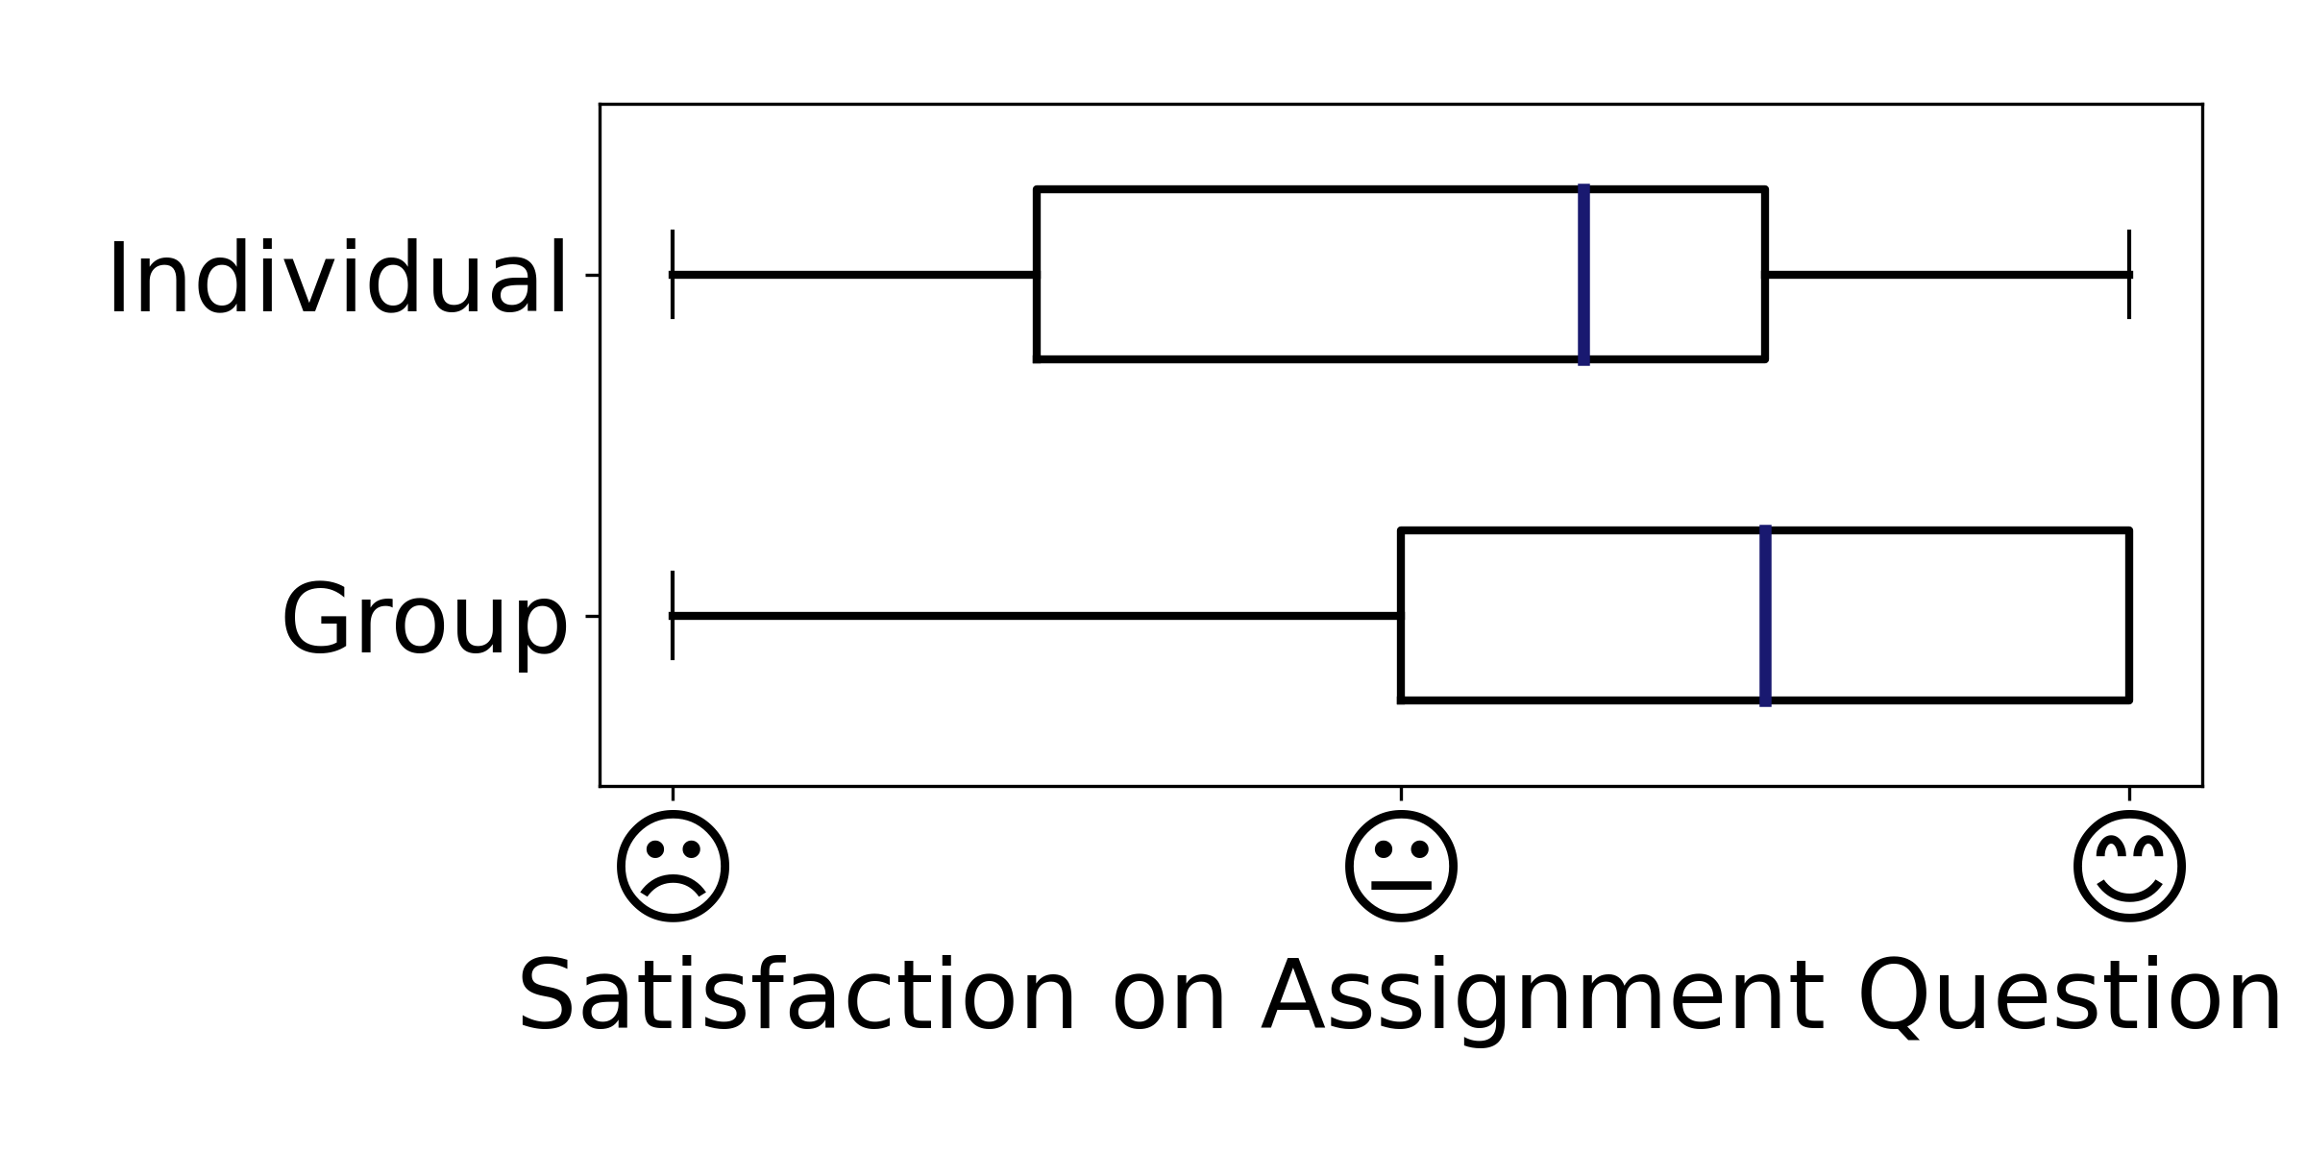
Six Preliminary Results for CSC263
3. Students working in pairs were more satisfied with their answers on assignment questions than individuals.

Slide 7
Six Preliminary Results for CSC263
4. Students recognize that working in groups on problem sets can raise their grades.
66% agree that students in groups achieve higher assignment grades.
39% agree that students in groups achieve higher overall course grades.
Notes:
- Suggests some students are assuming that students in groups will perform sufficiently worse on individual coursework to outweigh the higher assignment grade.

Slide 8
Six Preliminary Results for CSC263
5. Students working alone are 2.5 times as likely to drop.
Group Drop Rate | Non-Group Drop Rate
2% | 5%
Notes:
Groups (pairs) provide a support mechanism
Interestingly, some students report not wanting to be in a group – for fear of bringing down their partner due to procrastination or falling behind.

Slide 9
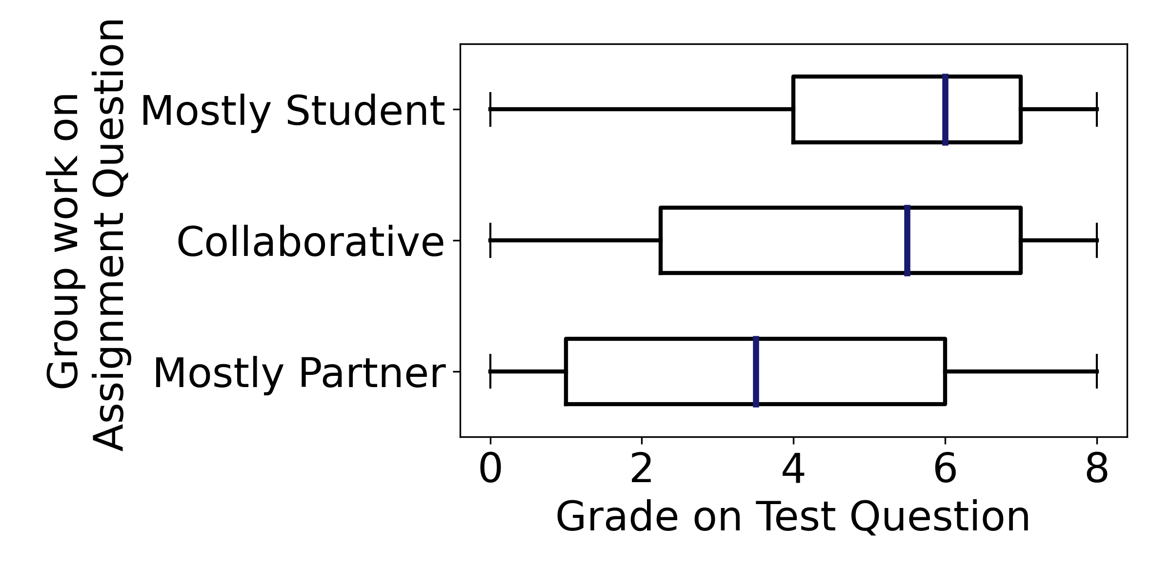
Six Preliminary Results for CSC263
6. Groups splitting the work can lead to worse performance on related test questions.
Notes:
- don’t have results of how non-group students performed handy (they are roughly the “average” of these)

Slide 10
Discussion (1 of 2)
Are students who don't know anyone at a disadvantage?
How has online learning impacted group formation?
How can we help students find compatible groupmates?
Notes:
What can be done to encourage students to work in groups? (studies like this / other evidence)
Thoughts from anyone about online environment impact?
Students did report not knowing anyone as a barrier to working with a partner – and the online learning prevented them from finding a student they felt they could trust to work well with.

Slide 11
Discussion (2 of 2)
What is the impact of groups on grades used for program admission?
Do we need to revisit why we give students the option to work in groups?
Any thoughts? (general discussion is next)
Notes:
Any thoughts about potential concerns related to program admissions (disadvantaged if can’t find a group?)
Why do we give students the option?
Peer instruction / collaboration / learning

Slide 12
Summary
Research Question:
How does optional group work impact students?
Methods:
Survey of students crossed with grades on assessments
Some Preliminary Results:
Students choosing to be in groups tend to get higher grades overall and are less likely to drop
Analysis of the data we have collected is ongoing – ideas welcome!
Notes:
Surveys through time – did anything change over the course of the term?
First year vs second year?
- Impact across courses?

Slide 13
Thanks for Listening
Additional Information about the data collected + results:
www.cs.toronto.edu/~calver/igg.html
Questions or comments? (Will switch to a copy of the poster shortly)
Contact: calver@cs.toronto.edu
Notes:
The link above includes full list of the survey questions we asked students + a reference to a similar study at another university

Slide 14
The Impact of Optional Group Work on the Student Experience
Jonathan Calver, Michelle Craig, Jennifer Campbell
Department of Computer Science
Research Question
Six Preliminary Results for CSC263
Discussion
CS education has widely accepted pair programming.
75% felt encouraged to work in a group because of their overall workload
How has online learning impacted group formation?
Students work in groups to manage their workload.
What is the impact of groups on grades used for program admission?
What about group work in theory courses?
Assessment | Group Mean | Individual Mean | P-value
Test | 54.6% | 52.2% | 0.14
Assignment | 84.4% | 74% | 7e-9
The CS department has adopted optional group work in two of its 1st and 2nd year intro theory courses.
Group members scored better on assignments and about the same on tests.
Are students who don't know anyone at a disadvantage?
Are we helping or hurting students by giving them the option to work in groups on assignments?
Group members were more satisfied with their answers than individuals.
Methods / Data
Students recognize that working in groups can raise their grades.
66% agree that students in groups achieve higher assignment grades.
39% agree that students in groups achieve higher overall course grades.
How can we help students find compatible groupmates?
Grades
Surveys
Groups
Students working alone are 2.5 times as likely to drop.
Data from 1354 undergraduate students: 832 CSC165 + 522 CSC263
Grade breakdown by question on assessments and prerequisite course grades.
Survey + group information for each assignment.
Group Drop Rate | Non-Group Drop Rate
2% | 5%
Do we need to revisit why we give students the option to work in a group?
Groups splitting the work can lead to worse performance on related test questions.
Acknowledgements
Special thanks to Maryam Majedi for advice on the poster design
Additional results will appear at: www.cs.toronto.edu/~calver/igg.html Project contact: calver@cs.toronto.edu

Slide 15
Some Discussion Points (only if needed)
Survey done on an individual basis, so how best to handle inconsistent reporting by group members? E.g. all members report they did more work than the others…
Can grades in pre-requisite courses help us control for the “quality” of students?
Do weaker or stronger students benefit more from groups?
What strategies have others used to help facilitate (optional) group formation?
Are the TA hours saved by grading fewer assignments being put to good use? Could the same number of graded assignments be supported with current TA hours if they were done individually?

Slide 16
Word Cloud (“what influenced you to work alone”)
Notes:
Worked in a larger group in another course (e.g. 3 people in CSC165) and were the odd one out.

Slide 17
Word Cloud (“what influenced you to work in a group”)
Notes:
A lot of positives – recognizing the benefit of bouncing ideas off of each other

Slide 18
Blank Slide

