Slide 1
Language-Based Replay via Data Flow Cut
Microsoft Research Asia
Ming Wu, Haoxiang Lin, Xuezheng Liu, Zhenyu Guo, Huayang Guo, Lidong Zhou, Zheng Zhang
MIT
Fan Long, Xi Wang, Zhilei Xu

Slide 2
Outline
Motivation
Observation
Challenges
Modeling Replay Interface
Generating Replay Interface
Record and Replay
Evaluation
Conclusion

Slide 3
Motivation
Replay is important due to non-determinism
Caused by time, user input, network I/O, thread interleaving
Makes postmortem debug hard
Existing replay tools
Incurs significant overhead: interposition & logging
Hard to be adopted, especially for deployed system
How to mitigate recording overhead?
Using efficient way to find the necessary information to log

Slide 4
Observation
Replay interface between program and environment
Only part of the program needs to be replayed
struct ne_request {
ne_status status;
char respbuf[];
};
status->code
neon’s
routine
req->respbuf
int read_status_line(
ne_request *req,
ne_status *status, ...)
{
ne_sock_readline(…, req->respbuf, …);
if (...) status->code = atoi(buffer + 4);
else if (ne_parse_statusline(buffer, status))
{...}
}
return value
4B
recv
1MB
atoi
*respbuf
(1MB)

Slide 5
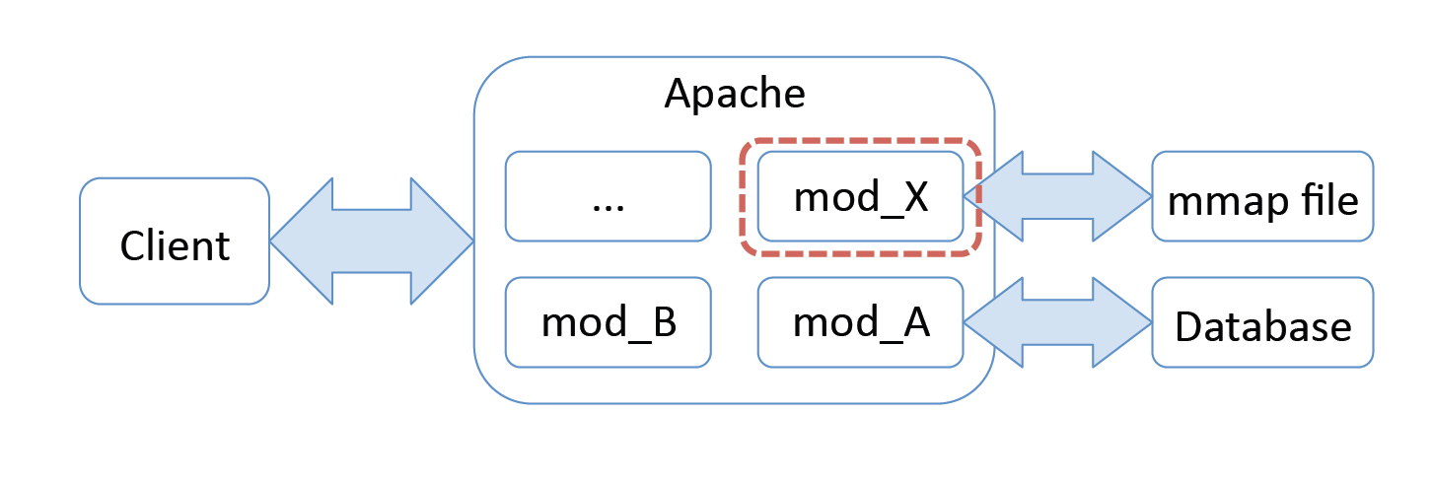
Challenges
Finding a complete replay interface
Finding a replay interface incurring low recording overhead

Slide 6
Outline
Motivation
Observation
Challenges
Modeling Replay Interface
Generating Replay Interface
Record and Replay
Evaluation
Conclusion

Slide 7
Execution Flow Graph(EFG)
f() {
cnt = 0;
g(&cnt);
printf("%d\n", cnt);
g(&cnt);
printf("%d\n", cnt);
}
g(int *p) {
a = random(); *p += a;
}
replay target
Inst1
cnt₁
Inst2
a₁
deterministic
Cut 1
Inst3
Inst4
cnt₂
// execution
1 cnt₁ <- 0
2 a₁ <- random()
3 cnt₂ <- cnt₁ + a₁
4 print cnt₂
5 a₂ <- random()
6 cnt₃ <- cnt₂ + a₂
7 print cnt₃
Cut 2
non-deterministic
Inst5
a₂
Inst6
Inst7
cnt₃

Slide 8
Outline
Motivation
Observation
Challenges
Modeling Replay Interface
Generating Replay Interface
Record and Replay
Evaluation
Conclusion

Slide 9
Static Flow Graph
Replay interface on EFG only optimal for specific run
Sound approximation of execution flow graph
Scan whole program
Operation node for function, value node for variable
Interpret instruction as read/write
y = x + 1 → read x and write y
Alias analysis
cnt
f
g
a

Slide 10
Functions without Source Code
Conservatively consider them as non-deterministic by default
recv(fd, buf, len, flags)
Annotate functions to provide write edge
recv([in]fd, [out, bsize(return)] buf, [in]len, [in]flags)
Annotate functions as deterministic
Math functions: abs(), sqrt()
Memory and string: memcpy(), strcat()

Slide 11
Outline
Motivation
Observation
Challenges
Modeling Replay Interface
Generating Replay Interface
Record and Replay
Evaluation
Conclusion

Slide 12
Replay Runtime
Calls
Record call from function in non-replay space to function which may be in replay space
Replay callee if it does belong to replay space
Writes
Where to issue writes
When to issue writes
Replayed
f
x
i
Downcall
Upcall
g
h
Non-replayed

Slide 13
Other Subtle Non-determinisms
Memory Management
Address of variables in replay space should not change
Separated deterministic memory pool for replay space
Separate stacks for replay and non-replay functions
Thread Interleaving
Synchronization log
Deterministic multi-threading

Slide 14
Evaluation
Implemented iTarget for C program on Windows
Using Phoenix compiler framework for instrumentation
Benchmarks:
Apache HTTP Server, Berkeley DB, neon HTTP client, wget, SPEC CINT2000
Modular and monolithic programs
Compared to R2 (OSDI 2008)

Slide 15
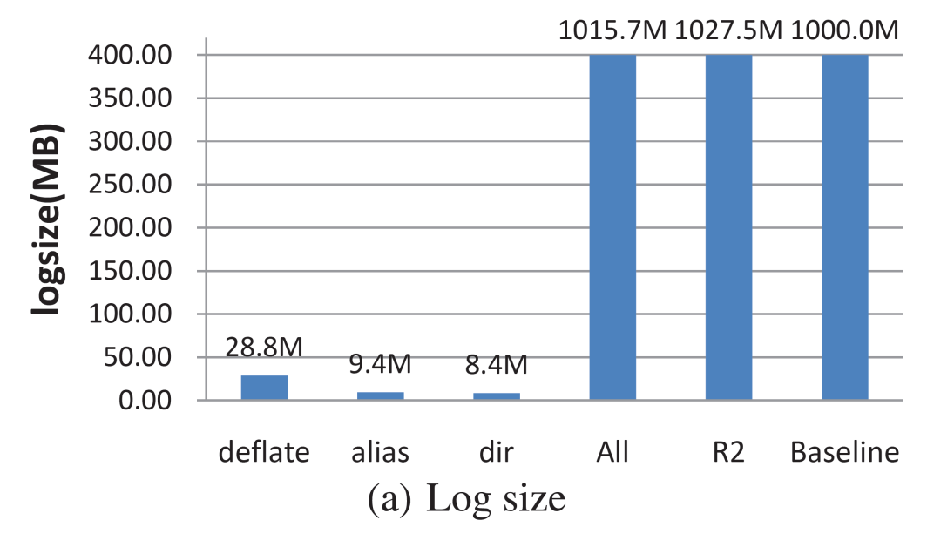
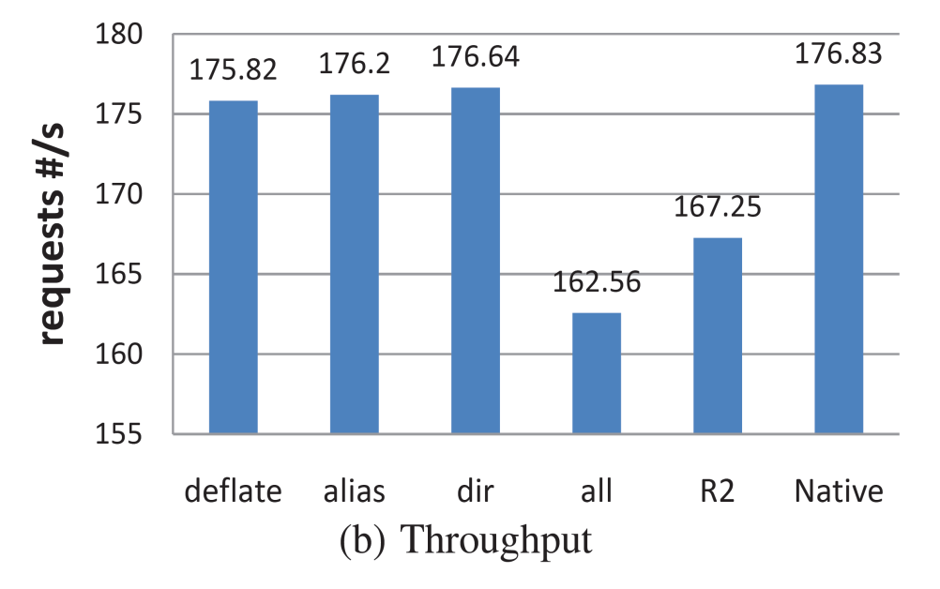
Apache HTTP server
less than 1% slowdown

Slide 16
Conclusion
A model
Reduce the problem of finding an optimal replay interface to that of finding the minimum cut in a data flow graph
A system: iTarget
employ programming language techniques to achieve both correctness and low recording overhead

Slide 17
Thanks! Q&A

Slide 18
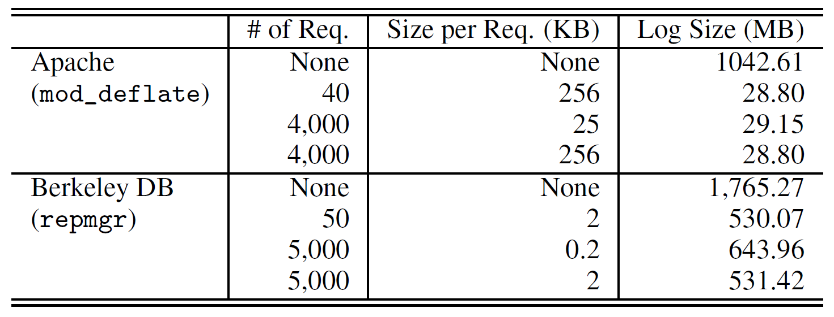
Profiling
Results tend not to be sensitive to the profiling workload scale

Slide 19
Related Work
Library-based replay tools:
RecPlay (TOCS 1999)
Flashback (USENIX ATC 2004)
Liblog (USENIX ATC 2006)
R2 (OSDI 2008)
Instruction level replay
iDNA (VEE 2006)
Other language runtime
Java, ML, MPI

Slide 20
Memory Management
Address of variables in replay space should not change
Variables allocated in heap
Non-replay space function may allocate memory
Separate deterministic memory pool for replay space
Variables allocated on stack
Record ESP at a call from
non-replay to replay space
Reset the ESP during replay
lower address
i
i
ESP
Recorded ESP
h
Run-time
g
f
f
higher address
Recording stack
Replay stack

Slide 21
Memory Management
Address of variables in replay space should not change
Variables allocated in heap
Non-replay space function may allocate memory
Separate deterministic memory pool for replay space
Variables allocated on stack
Record ESP at a call from
non-replay to replay space
Reset the ESP during replay
Current ESP
lower address
i
i
ESP
Recorded ESP
h
Run-time
g
f
f
higher address
Recording stack
Replay stack

Slide 22
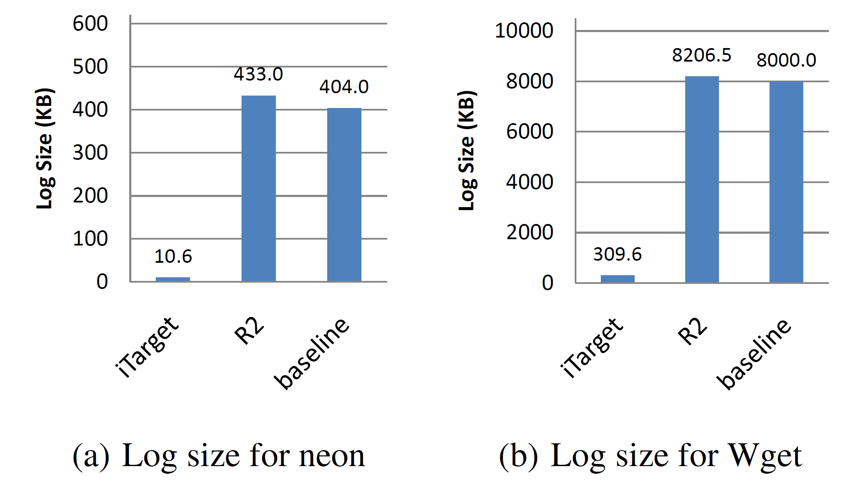
Monolithic Program
Neon and Wget

Slide 23
Functions without Source Code
Conservatively consider them as non-deterministic by default
recv(fd, buf, len, flags)
System global variable: errno
Annotate functions to provide write edge
recv([in]fd, [out, bsize(return)] buf, [in]len, [in]flags)
Annotate functions as deterministic
Math functions: abs(), sqrt()
Memory and string: memcpy(), strcat()

Slide 24
Memory Management
Address of variables in replay space should not change
Variables allocated in heap
Non-replay space function may allocate memory
Separate deterministic memory pool for replay space
Variables allocated on stack
Record ESP at a call from
non-replay to replay space
Reset the ESP during replay

Slide 25
Thread Management
Thread interleaving introduce another source of non-determinism
Guarantee same write order during replay as recording run
Synchronization log
Track causal dependency
Utilize deterministic multi-threading model

Slide 26
Execution Flow Graph(EFG)
f() {
cnt = 0;
g(&cnt);
printf("%d\n", cnt);
g(&cnt);
printf("%d\n", cnt);
}
g(int *p) {
a = random(); *p += a;
}
cnt₁
g₁
a₁
f
cnt₂
Cut 2
// execution
1 cnt₁ <- 0
2 a₁ <- random()
3 cnt₂ <- cnt₁ + a₁
4 print cnt₂
5 a₂ <- random()
6 cnt₃ <- cnt₂ + a₂
7 print cnt₃
g₂
a₂
cnt₃

