Slide 1
Automatic Runtime Error Repair and Containment via Recovery Shepherding
Fan Long, Stelios Sidiroglou, and Martin Rinard
MIT EECS&CSAIL
Notes:
I want to start my talk with a demo.
- open the demo -
Here is chromium, an open source web-browser. It serves as the code base for the popular google chrome browser. This is chromium version 19.
- open the webpage -
Clearly the chrome crashes because of a segmentation fault. I am sure everyone in the audience has this experience, and I am willing to bet this was not a pleasant experience for you. After investigation, it turns out that this segmentation fault is caused by a null-dereference error.

Slide 2

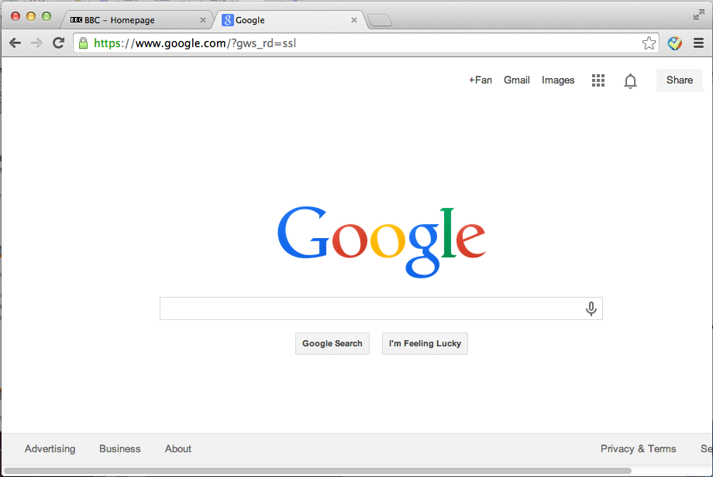
Chromium Example
Chromium is a open source browser
Input: webpages
Output: rendered content in GUI
Web pages
Notes:
Let’s talk about another program, wireshark. Wirshark is a network protocol analyzer program.
Animation: Pages => Rendered pages

Slide 3
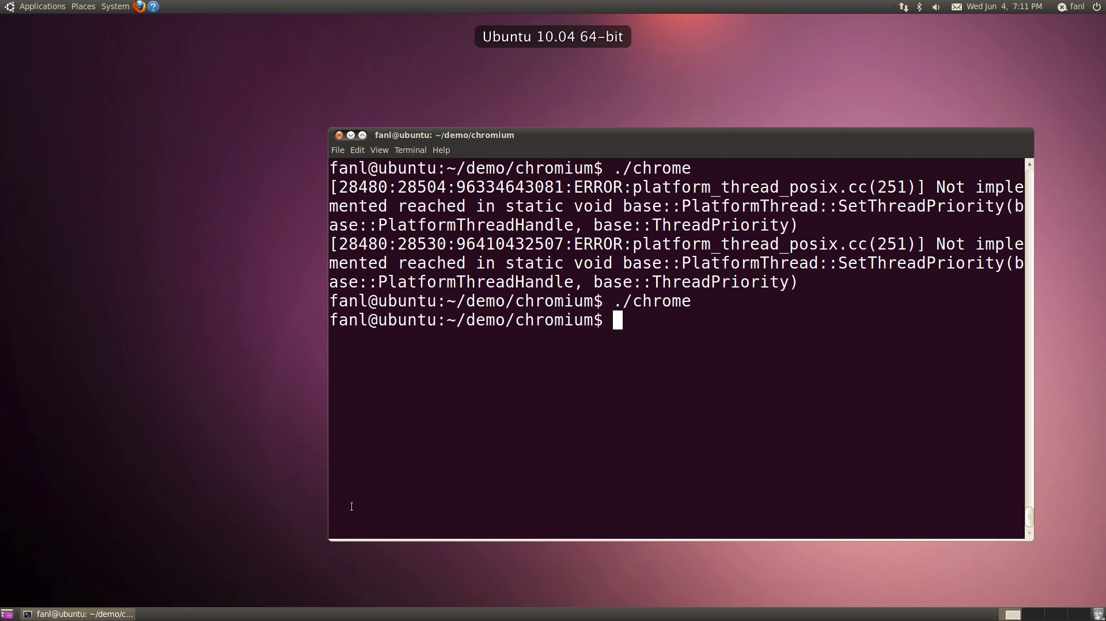
Chromium Example

Slide 4
CVE-2011-3083
Demo
<hl style=“font-size:48px”>Hello world</hl>
<video width=“150” height=“50” src=ftp://1>
Html page
void URLRequestFtpJob::StartTransaction() {
...
transaction_.reset(
request_->context()->ftp_transaction_factory()
->CreateTransaction());}
Code snippet
Call to a method of NULL object!!!
Return NULL

Slide 5

RCV
Lightweight Library
Recovery Shepherding System
Application

Slide 6
RCV
RCV enables applications to recover from program crashes that are caused by:
  Divide-by-zero errors
  Null-dereference errors
Goal: enables the applications to continue productively
  Avoid losing unsaved data
  Provide better user experience

Slide 7
Chromium Example
void URLRequestFtpJob::StartTransaction() {
...
transaction_.reset(
request_->context()->ftp_transaction_factory()
->CreateTransaction());
... // code that does not change transaction_
int rv;
if (transaction_.get()) {
rv = transaction_->Start(...)
...
} else {
rv = ERR_FAILED;
}
...
}
html code
…
<video width=“250” height=“150” src=ftp://1>
Empty FTP link causes ftp_transaction_factory() to return NULL
Notes:
Here is the code snippet that shows what’s going on. The black box on the right side of the slide shows the html code of the web page that triggers the error. The second line of the html file asks chromium to open a video stream with an empty FTP link. This empty FTP link causes ftp_transaction_factory() function to return NULL.

Slide 8
Chromium Example
void URLRequestFtpJob::StartTransaction() {
...
transaction_.reset(
request_->context()->ftp_transaction_factory()
->CreateTransaction());
... // code that does not change transaction_
int rv;
if (transaction_.get()) {
rv = transaction_->Start(...)
...
} else {
rv = ERR_FAILED;
}
...
}
Call a method of a NULL object
Null-dereference error!!!
Notes:
Then the program calls a method createTransaction() of this NULL object, which triggers a null-dereference error. This kind of null dereference errors has been around for a long time. It has been a constant problem.We are tired of it and we decide to eliminate null-dereference crashes forever!

Slide 9

RCV
Lightweight Library
RCV Recovery System
Application

Slide 10
Eliminating Null-Dereference Crashes
Write to null address: Ignore
Read from null address: Set 0 + Skip
Call to null function: Skip + Set 0 as return value
mov $0, %rsi
…
mov %rax, 8(%rsi)
ip←next inst
mov $0, %rsi
…
mov 8(%rsi), %rdx
%rdx ← 0
ip←next inst
mov $0, %rbx
…
call %rbx
%rax ← 0
ip←next inst
Notes:
Here is how we are going to do it. For write to null address instructions, it is simple. We just discard it and skip the instruction. For read from null instructions, it is a little complicated. The program needs a value to continue. So we just give them a value 0. We set the result of the read to 0 and skip the read instruction. For a call to null function, we simply skip the call and set the return value to 0. For example, in this example we set register value rax to 0, which holds the return value of the function. We then change ip to the start of the next instruction.

Slide 11
How to make the computer do it?
Catch signals from null-dereferences
  Write our own signal handler of SIGSEGV in a library
  Use LD_PRELOAD to register with the operating system at the start of the program
  Negligible overhead during normal execution
Lightweight Library
RCV Recovery System
Signal Handler
Notes:
How to make the computer to do it? Fortunately , we can use the signal handler mechanisms from the operating system. We write our own signal handler for SIGSEGV that triggered by null-dereference errors. We register the handler at the start of the program. In this way, we can catch null-dereference errors with negligible overhead during normal executions.

Slide 12
How to make the computer do it?
When the signal handler is invoked:
  Load our PIN tool that implements the recovery strategies
  Attach the PIN tool to the application process
Lightweight Library
RCV Recovery System
SIGSEGV!!!
Signal Handler
Notes:
When the signal handler is invoked, we load our PIN tool that does binary instrumentation into the application address space, and apply the recovery strategy above.

Slide 13
How to make the computer do it?
When the signal handler is invoked:
  Load our PIN tool that implements the recovery strategies
  Attach the PIN tool to the application process
Lightweight Library
RCV Recovery System
Signal Handler
Notes:
Let’s see how it works for the chromium error.
- use rcv with chrome-
So our tool catches the signal and chrome recovers from the null-dereference errors. It shows part of the webpage. It uses a black box to represent the video that it cannot open. More importantly, chromium GUI remains fully functional. We are pretty happy about it. Let’s just see why RCV enables this recovery.

Slide 14
Apply RCV to Chromium
Lightweight Library
Recovery Shepherding System
Demo

Slide 15
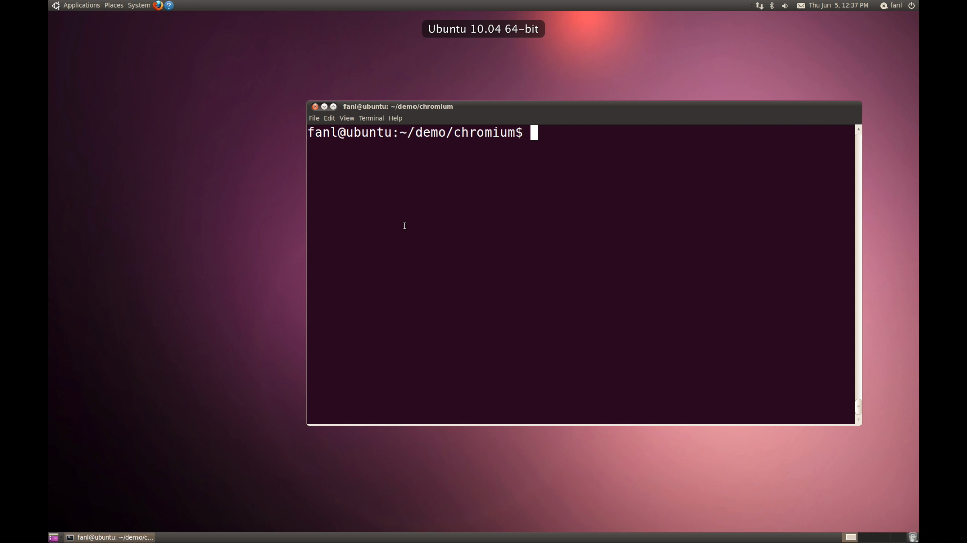
Chromium Example

Slide 16
Chromium Example
void URLRequestFtpJob::StartTransaction() {
...
transaction_.reset(
request_->context()->ftp_transaction_factory()
->CreateTransaction());
... // code that does not change transaction_
int rv;
if (transaction_.get()) {
rv = transaction_->Start(...)
...
} else {
rv = ERR_FAILED;
}
...
}
RCV ignores the call and set the return value of the ignored call to 0.
Notes:
When the error occurs, RCV ignores the call to null function and set return value to 0.

Slide 17
Chromium Example
void URLRequestFtpJob::StartTransaction() {
...
transaction_.reset(
request_->context()->ftp_transaction_factory()
->CreateTransaction());
... // code that does not change transaction_
int rv;
if (transaction_.get()) {
rv = transaction_->Start(...)
...
} else {
rv = ERR_FAILED;
}
...
}
transaction_
ref_cnt
undef
transaction_ is a reference counting pointer object
Notes:
Just to note that Transaction_ is a reference counting pointer object. After executing reset(), it will gets NULL(0) value, which is returned by RCV.

Slide 18
Chromium Example
void URLRequestFtpJob::StartTransaction() {
...
transaction_.reset(
request_->context()->ftp_transaction_factory()
->CreateTransaction());
... // code that does not change transaction_
int rv;
if (transaction_.get()) {
rv = transaction_->Start(...)
...
} else {
rv = ERR_FAILED;
}
...
}
transaction_
ref_cnt
0
transaction_ now contains NULL(0) after reset()

Slide 19
Chromium Example
void URLRequestFtpJob::StartTransaction() {
...
transaction_.reset(
request_->context()->ftp_transaction_factory()
->CreateTransaction());
... // code that does not change transaction_
int rv;
if (transaction_.get()) {
rv = transaction_->Start(...)
...
} else {
rv = ERR_FAILED;
}
...
}
transaction_
ref_cnt
0
Hit an anticipated failure check in chromium code.
Notes:
As the program continues, we hit an anticipated failure check in chromium code. It checks whether the content in transaction_ is NULL or not. It goes to else branch, and sets a failure error code that will be handled by the higher level.

Slide 20
Chromium Example
void URLRequestFtpJob::StartTransaction() {
...
transaction_.reset(
request_->context()->ftp_transaction_factory()
->CreateTransaction());
... // code that does not change transaction_
int rv;
if (transaction_.get()) {
rv = transaction_->Start(...)
...
} else {
rv = ERR_FAILED;
}
// notify higher level class via MessageLoop
MessageLoop::current()->PostTask(
FROM_HERE,base::Bind(..., rv));
}
transaction_
ref_cnt
0
Set error code that will be handled later

Slide 21

Chromium Example
void URLRequestFtpJob::StartTransaction() {
...
transaction_.reset(
request_->context()->ftp_transaction_factory()
->CreateTransaction());
... // code that does not change transaction_
int rv;
if (transaction_.get()) {
rv = transaction_->Start(...)
...
} else {
rv = ERR_FAILED;
}
// notify higher level class via MessageLoop
MessageLoop::current()->PostTask(
FROM_HERE,base::Bind(..., rv));
}
transaction_
ref_cnt
0
Set error code that will be handled later

Slide 22
Chromium Example: Patch
void URLRequestFtpJob::StartTransaction() {
...
transaction_.reset(
request_->context()->ftp_transaction_factory()
->CreateTransaction());
... // code that does not change transaction_
int rv;
if (transaction_.get()) {
rv = transaction_->Start(...)
...
} else {
rv = ERR_FAILED;
}
...
}
transaction_
ref_cnt
undef
Changed initialization code, so that empty link causes this expression to return a dummy object instead of triggering the error.
Notes:
We can actually compare this with the official patch of the error. Chromium developers have patched this error. They changed the initialization code so that the empty link will cause this expression that highlighted in red color to return a dummy object instead of null object. So transaction_ gets the dummy object.

Slide 23
Chromium Example: Patch
void URLRequestFtpJob::StartTransaction() {
...
transaction_.reset(
request_->context()->ftp_transaction_factory()
->CreateTransaction());
... // code that does not change transaction_
int rv;
if (transaction_.get()) {
rv = transaction_->Start(...)
...
} else {
rv = ERR_FAILED;
}
...
}
transaction_
ref_cnt
dummy
Hit the check, not NULL.
Notes:
As we continue, we hit the check. This time we go to the other branch. It calls start method of the dummy object. For dummy object, this method simply returns failure error code. Therefore, we have identical behavior to RCV in high level.

Slide 24
Chromium Example: Patch
void URLRequestFtpJob::StartTransaction() {
...
transaction_.reset(
request_->context()->ftp_transaction_factory()
->CreateTransaction());
... // code that does not change transaction_
int rv;
if (transaction_.get()) {
rv = transaction_->Start(...)
...
} else {
rv = ERR_FAILED;
}
...
}
transaction_
ref_cnt
dummy
Dummy object simply returns failure error code

Slide 25
Chromium Example: Patch
void URLRequestFtpJob::StartTransaction() {
...
transaction_.reset(
request_->context()->ftp_transaction_factory()
->CreateTransaction());
... // code that does not change transaction_
int rv;
if (transaction_.get()) {
rv = transaction_->Start(...)
...
} else {
rv = ERR_FAILED;
}
...
}
transaction_
ref_cnt
dummy
Identical behavior to RCV in high level!
Notes:
This actually represents a common pattern we have observed. The RCV allows the program execution to continue. The execution then hits an anticipated error check and recovers from the error. It has identical or similar behavior to the human patch in high level.

Slide 26
CVE-2011-3083
Official patch modifies the initialization code:
  If the FTP link is empty or malformed
  ftp_transaction_factory() returns a dummy object.
The dummy object simply returns failure
  Does not cause null-dereference error
Identical behavior to RCV repair in high-level

Slide 27
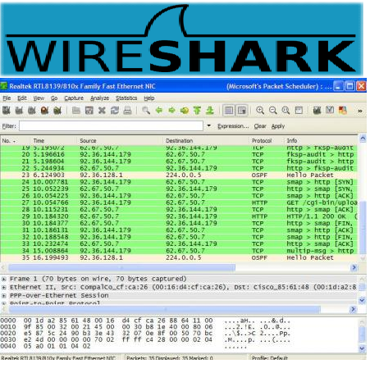

Wireshark Example
Wireshark is a network protocol analysis tool
Input: the network traffic capture
Output: parsed packet information in GUI
Packet1
Packet2
Packet3
Packet…
Notes:
Let’s talk about another program, wireshark. Wirshark is a network protocol analyzer program.

Slide 28
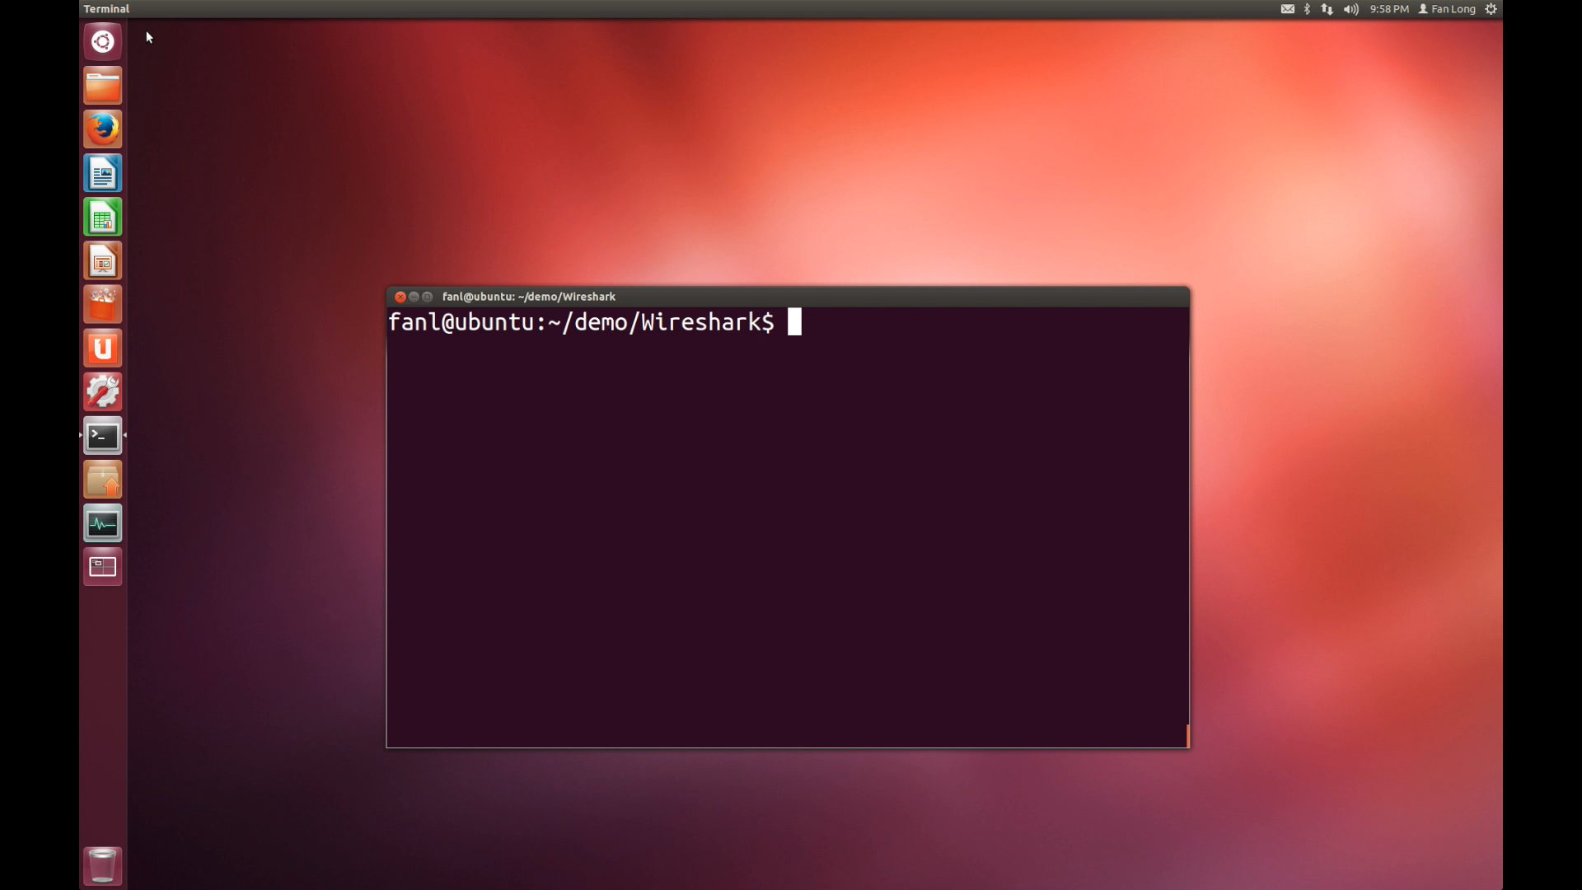
Wireshark Example

Slide 29
Wireshark Example
switch (D) {
...
case ACN_DMP_ADT_D_RS:
// calculate data size
data_size = adt->data_length/adt->count;
data_address = adt->address;
// process each fragment
for (x=0; x<adt->count; x++) {
...
}
break;
...
}
Zero fragment count input field causes that adt->count equals 0.
Notes:
ACN packet

Slide 30
Eliminating Divide-by-Zero Crashes
Divide-by-zero: Skip + Set result registers to 0
movl $0, %ebx
…
idivl %ebx
%eax ← 0
%edx←0
ip←next inst
Notes:
Remember we have eliminated all null dereference errors. We may also eliminate all divide by zero errors too.

Slide 31
How to make the computer do it?
Catch signals from divide-by-zero
  Write our own signal handler of SIGFPE
  Register with the operating system at the start of the program
  Negligible overhead during normal execution
When the signal handler is invoked:
  Load our PIN tool that implements the recovery strategies
  Attach the PIN tool to the application process

Slide 32
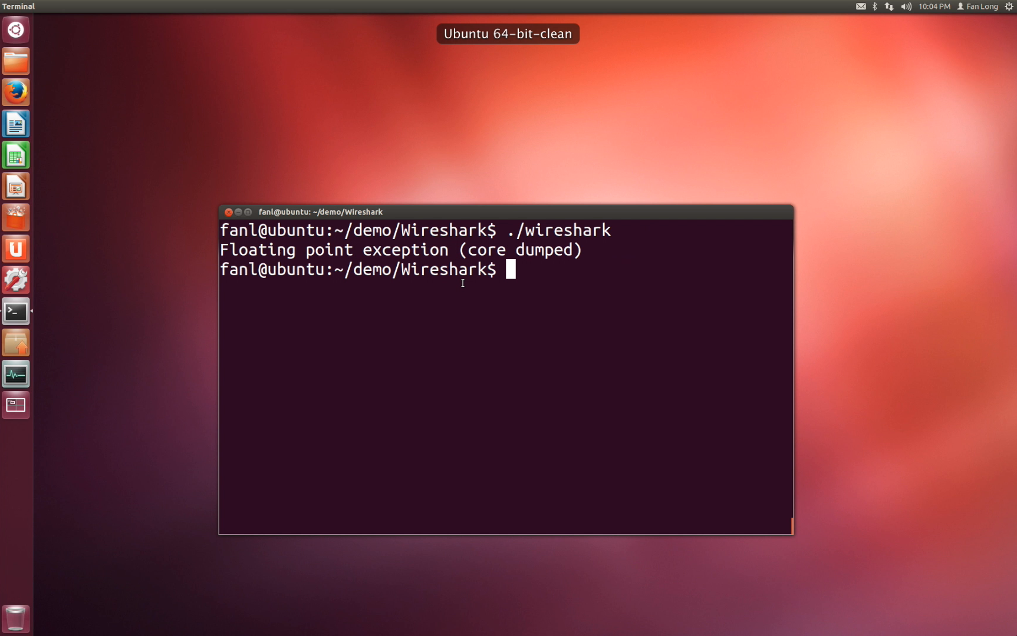
Wireshark Example

Slide 33
Wireshark Example
switch (D) {
...
case ACN_DMP_ADT_D_RS:
// calculate data size
data_size = adt->data_length/adt->count;
data_address = adt->address;
// process each fragment
for (x=0; x<adt->count; x++) {
...
}
break;
...
}
RCV continues the execution and sets data_size to 0.

Slide 34
Wireshark Example
switch (D) {
...
case ACN_DMP_ADT_D_RS:
// calculate data size
data_size = adt->data_length/adt->count;
data_address = adt->address;
// process each fragment
for (x=0; x<adt->count; x++) {
...
}
break;
...
}
The actual processing loop is skipped because adt->count is 0.
Notes:
It has to be zero, because this is the reason we have divide by zero error in first place.

Slide 35
Wireshark Example
switch (D) {
...
case ACN_DMP_ADT_D_RS:
// calculate data size
data_size = adt->data_length/adt->count;
data_address = adt->address;
// process each fragment
for (x=0; x<adt->count; x++) {
...
}
break;
...
}
The actual processing loop is skipped because adt->count is 0.
Notes:
This is the code that process each fragment. For the error triggering input unit, it just turns it into a no-op. Again, this is a common pattern we have seen. In many applications that process input units, what RCV does error. It turns it into a no-op.

Slide 36
Wireshark Example: Patch
switch (D) {
...
case ACN_DMP_ADT_D_RS:
// calculate data size
data_size = adt->data_length/adt->count;
data_address = adt->address;
// process each fragment
for (x=0; x<adt->count; x++) {
...
}
break;
...
}
The patch skips the process of this input part if adt->count is 0.
Identical behavior to RCV.
Notes:
Turn it to no-op. This is the right thing to do.

Slide 37
Does this work in practice?

Slide 38
Evaluation Benchmark
We collected 14 null-dereference errors and 4 divide-by-zero errors
  All null-dereference and divide-by-zero errors in CVE database from Jan 2011 to March 2013
  That we can reproduce in our environment
From 7 large applications
  Wireshark, the Freetype library, Claws Mail, Libre Office, GIMP, the PHP interpreter, and Chromium.

Slide 39
Experimental Results
Applied RCV to each collected error with the collected error triggering input :
CVE-2013-2483 | Wireshark | ✔ | CVE-2012-1128 | Freetype | ✔
CVE-2012-4286 | Wireshark | ✖ | CVE-2012-0781 | PHP | ✔
CVE-2012-4285 | Wireshark | ✔ | CVE-2011-4153 | PHP | ✔
CVE-2012-1143 | Freetype | ✔ | CVE-2011-3182 | PHP | ✔
CVE-2012-5668 | Freetype | ✔ | CVE-2011-3083 | Chromium | ✔
CVE-2012-4507 | ClawsMail | ✔ | CVE-2011-2849 | Chromium | ✔
CVE-2012-4233 | LibreOffice | ✔ | CVE-2011-1956 | Wireshark | ✔
CVE-2012-3236 | GIMP | ✔ | CVE-2011-1691 | Chromium | ✔
CVE-2012-1593 | Wireshark | ✔ | CVE-2011-0421 | PHP | ✔
Blue: divide-by-zero errors Green: null-dereference errors
✔:survived the error ✖:failed to recover
Notes:
CVE-2012-4286 failed because an assertion failure. This error is not purely a divide-by-zero. It interprets an union data structure. It causes data corruption first.
Divide-by-zero the first exposed error.
We have disabled this assertion. More assertions come. If disable all, get different results.

Slide 40
Experimental Results
Compared to the patches on the collected input:
CVE-2013-2483 | Wireshark | ★ | CVE-2012-1128 | Freetype | ★
CVE-2012-4286 | Wireshark | ✖ | CVE-2012-0781 | PHP | ★
CVE-2012-4285 | Wireshark | ○ | CVE-2011-4153 | PHP | ○
CVE-2012-1143 | Freetype | ★ | CVE-2011-3182 | PHP | ○
CVE-2012-5668 | Freetype | ★ | CVE-2011-3083 | Chromium | ★
CVE-2012-4507 | ClawsMail | ★ | CVE-2011-2849 | Chromium | ★
CVE-2012-4233 | LibreOffice | ★ | CVE-2011-1956 | Wireshark | ★
CVE-2012-3236 | GIMP | ○ | CVE-2011-1691 | Chromium | ★
CVE-2012-1593 | Wireshark | ○ | CVE-2011-0421 | PHP | ★
★:identical ✖:different
:equivalent, differ only in error messages

Slide 41
Code Analysis Results
We manually analyzed source code of each error to understand the repair effect of RCV.
Compared to the patched versions on all inputs:
Identical behavior on 9
Equivalent behavior on 2
Acceptable behavior on 3
Different behavior on 3
Source code is not available for the last one
Notes:
N/A is no sourcecode.

Slide 42
Code Analysis Results
We manually analyzed source code of each error to understand the repair effect of RCV.
Compared to the patched versions on all inputs:
Identical behavior on 9
Equivalent behavior on 2
Acceptable behavior on 3
Different behavior on 3
Source code is not available for the last one
Notes:
N/A is no sourcecode.

Slide 43
Evaluation
These collected errors are:
  All null-dereference and divide-by-zero errors in CVE database from Jan 2011 to March 2013
  That we can reproduce in our environment
From 7 large applications
  Wireshark, the Freetype library, Claws Mail, Libre Office, GIMP, the PHP interpreter, and Chromium.

Slide 44
Experimental Results
Reproduce each error with the collected error triggering input.
Apply RCV to repair each reproduced error.
RCV repairs 17 errors
Notes:
Add a pie graph

Slide 45
Experimental Results
We compared with the patched version for each error on the collected error triggering input.
Identical output on 12
Equivalent on the rest
  Outputs differ only in error message for the offending input unit.

Slide 46
Performance
RCV incurs negligible overhead during normal executions in our experiments (less than 1%).

Slide 47
Why does this work?

Slide 48
Computation Pattern
Applications process input in units:
Little or no interaction between computations of different input units.
Web pages
Packet1
Packet2
Packet3
Packet4

Slide 49
Error Pattern
Errors are triggered by bad input units that applications are not supposed to process
  8 of 18 errors are missing sanity checks
Skipping the computation of the offending input units is typically the correct behavior.
  For 12 of 18 errors, the patches skip the computation of the offending input units.

Slide 50
RCV Recovery Pattern
RCV recovery nullifies the computation of the input unit for 14 of 18 errors, because:
  Discard updates via null-write to data structures
  Discard calls to null-address
  Hit anticipated error checks
  Zero input fields in the error triggering input unit
Often identical behavior to the patch

Slide 51
RCV Overview
Lightweight Library
Recovery Shepherding System
Application

Slide 52
Recovery Shepherding

Slide 53
Concerns about RCV
RCV manufactures zero values for null-read, null-call, and divide-by-zero instructions as results
  How these values influence the execution?
Does the error-triggering process influences other good processes during recovery?

Slide 54
Intercept Signals
Intercept Signals
Lightweight Library
Recovery Shepherding System
Application

Slide 55
Intercept Signals
Design choice: Minimize the normal execution overhead
Use LD_PRELOAD to load a lightweight library that registers signal handlers to intercept signals:
  SIGFPE (divide-by-zero error)
  SIGSEGV (null-dereference error)
Recovery shepherding system that uses binary instrumentation is not running during normal execution.

Slide 56
Intercept Signals
Register signal handlers to intercept signals:
  SIGFPE (divide-by-zero error)
  SIGSEGV (null-dereference error)
Detect null-dereference and divide-by-zero errors
  Prevent program crashes
  Invoke recovery shepherding system

Slide 57
Attach
Intercept Signals
Lightweight Library
Recovery Shepherding System
Attach
Application

Slide 58
Attach
Intercept Signals
Lightweight Library
Recovery Shepherding System
Attach
Application

Slide 59
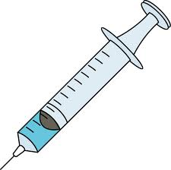
Repair Strategies
Intercept Signals
Lightweight Library
Recovery Shepherding System
Attach
Application
Repair

Slide 60
Repair Strategies
Multiple cascading errors may occur, RCV repairs each of them.
Null-dereference errors in a loop
  The same error occurs more than 5 times
  Jump out of the loop
Notes:
Add example for this slide

Slide 61

Error Containment
Intercept Signals
Lightweight Library
Recovery Shepherding System
Attach
Application
Repair
Containment
Other Process 1
Other Process 2

Slide 62
Track Manufactured Values
Recovery shepherding system uses dynamic taint analysis to track how manufactured values influence the continued execution.
a = new int[n];
for (int i=0;i<n;i++)
a[i] = call_null(i);
...
memcpy(tmp, a, n*4);
...
memset(tmp, 0, n*4);
delete a;
…
a
…
tmp
…

Slide 63
Track Manufactured Values
Recovery shepherding system uses dynamic taint analysis to track how manufactured values influence the continued execution.
a = new int[n];
for (int i=0;i<n;i++)
a[i] = call_null(i);
...
memcpy(tmp, a, n*4);
...
memset(tmp, 0, n*4);
delete a;
…
a
…
tmp
…

Slide 64
Track Manufactured Values
Flag registers or memory addresses that are influenced by manufactured value.
a = new int[n];
for (int i=0;i<n;i++)
a[i] = call_null(i);
...
memcpy(tmp, a, n*4);
...
memset(tmp, 0, n*4);
delete a;
…
a
…
tmp
…

Slide 65
Track Manufactured Values
Flag registers or memory addresses that are influenced by manufactured value.
a = new int[n];
for (int i=0;i<n;i++)
a[i] = call_null(i);
...
memcpy(tmp, a, n*4);
...
memset(tmp, 0, n*4);
delete a;
…
a
…
tmp
…

Slide 66
Track Manufactured Values
Unflag if:
  The place is over-written by other values.
  Memory block gets de-allocated in stack or heap.
a = new int[n];
for (int i=0;i<n;i++)
a[i] = call_null(i);
...
memcpy(tmp, a, n*4);
...
memset(tmp, 0, n*4);
delete a;
…
a
…
tmp
…

Slide 67
Track Manufactured Values
Unflag if:
  The place is over-written by other values.
  Memory block gets de-allocated in stack or heap.
a = new int[n];
for (int i=0;i<n;i++)
a[i] = call_null(i);
...
memcpy(tmp, a, n*4);
...
memset(tmp, 0, n*4);
delete a;
…
a
…
tmp
…

Slide 68
Track Manufactured Values
Unflag if:
  The place is over-written by other values.
  Memory block gets de-allocated in stack or heap.
a = new int[n];
for (int i=0;i<n;i++)
a[i] = call_null(i);
...
memcpy(tmp, a, n*4);
...
memset(tmp, 0, n*4);
delete a;
…
a
…
tmp
…

Slide 69
Track Manufactured Values
Recovery shepherding system uses dynamic taint analysis to track how manufactured values influence the continued execution.
Flag registers or memory addresses that are influenced by manufactured value.
Unflag if:
  The place is over-written by other values.
  Memory block gets de-allocated in stack or heap.

Slide 70
Error Containment
Before the manufactured values are flushed away from the process
RCV blocks system calls that cause externally visible side effect to other processes.
a = new int[n];
for (int i=0;i<n;i++)
a[i] = call_null(i);
...
memcpy(tmp, a, n*4);
...
syscall_send(fd,buf,...)
...
memset(tmp, 0, n*4);
delete a;
…
a
…
tmp
…
Other Process
Notes:
Add an example to show this taint analysis and block system call

Slide 71

Error Containment
Before the manufactured values are flushed away from the process
RCV blocks system calls that cause externally visible side effect to other processes.
a = new int[n];
for (int i=0;i<n;i++)
a[i] = call_null(i);
...
memcpy(tmp, a, n*4);
...
syscall_send(fd,buf,...)
...
memset(tmp, 0, n*4);
delete a;
…
a
…
tmp
…
Other Process
ERR_IO
Notes:
Add an example to show this taint analysis and block system call

Slide 72
Recovery Shepherding
Pro: contains the effect of recovery
  Track manufactured values.
  Prevent collateral damage to other processes during recovery.
Cons: overhead, but only during recovery
  Close to 80x overhead when enabled
  Recovery takes less than 1 min even with recovery shepherding enabled in our experiments.
Notes:
One summary slide before this slide.
Add an example to show this taint analysis and block system call

Slide 73
Error Containment
Before the manufactured values are flushed away from the process
RCV blocks system calls that cause externally visible side effect to other processes.
  Skip the system call
  Return an error code that indicates IO error
  Special case: RCV allows system calls that output to console or update GUI
Notes:
Add an example to show this taint analysis and block system call

Slide 74
Error Containment
Manufactured values may corrupt persistent data or other processes.
RCV uses a dynamic taint analysis to track how manufactured values propagate.
RCV blocks system calls that cause externally visible side effect to other processes.
RCV detaches from the application after the manufactured values are flushed away.
Notes:
Add an example to show this taint analysis and block system call

Slide 75
Detach
Intercept Signals
Lightweight Library
Recovery Shepherding System
Attach
Application
Repair
Containment
Detach

Slide 76
Implementation
We implemented recovery shepherding system as an instrumentation tool using PIN.
  Works with off-the-shelf stripped x86 binary
We implemented a lightweight shared library to intercept signals.
  Load into the application space with LD_PRELOAD
  Negligible overhead during normal execution

Slide 77
Related Work
Memory and null-dereference errors:
  Failure Oblivious Computing. Rinard et.al. [OSDI 2004]
  SRS. Nagarajan et.al. [ISMM’09]
  DieHard. Berger et.al. [PLDI’06]
  APPEND. Dobolyi and Weimer. [ISSRE’08]
Infinite loop:
  Bolt. Kling et.al. [OOPSLA’12]
  Jolt. Carbin et.al. [ECOOP’11]

Slide 78
Related Work
Error virtualization
  ASSURE. Sidiroglou et.al. [ASPLOS’09]
Constraint enforcing
  Input Rectification. Long et.al. [ICSE’12]
  ClearView. Perkins et.al. [SOSP’09]
  Data Structure Repair. Demsky et.al. [OOPSLA’03]
Language to support recovery
  Self-Stabilizing Java. Eom and Demsky. [PLDI’12]

Slide 79


Conclusion

Slide 80
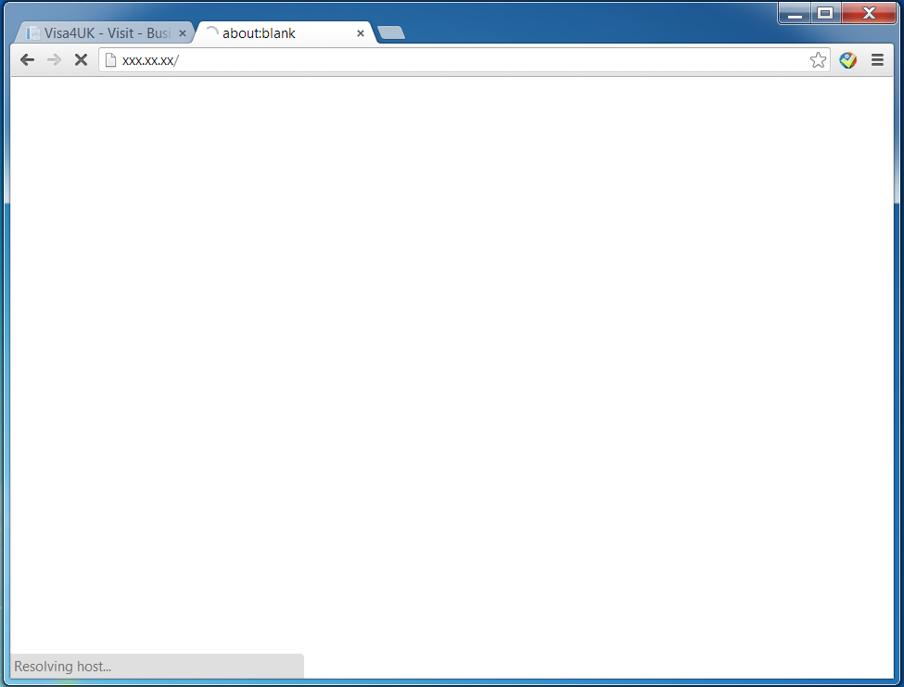

Conclusion

Slide 81
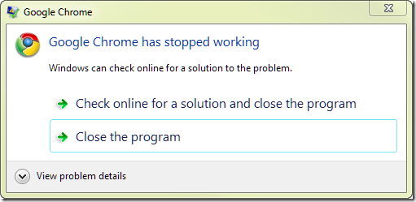

Conclusion

Slide 82
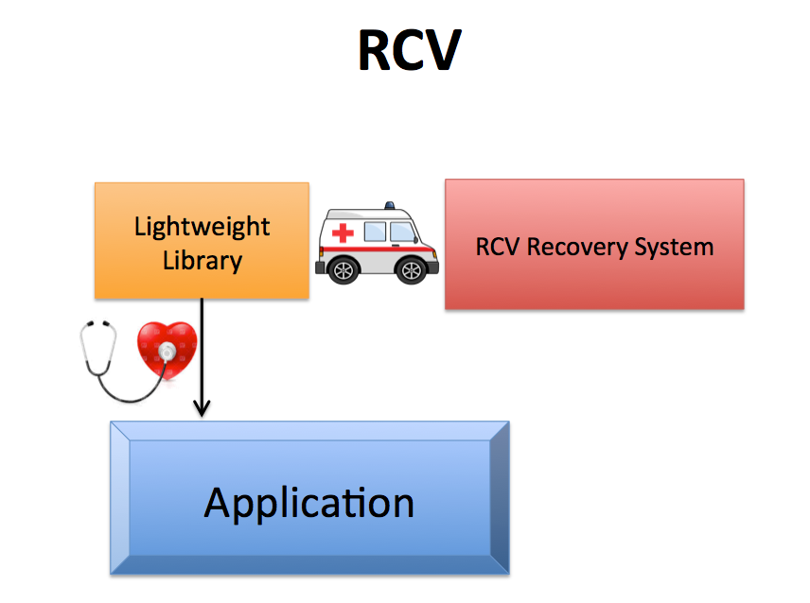
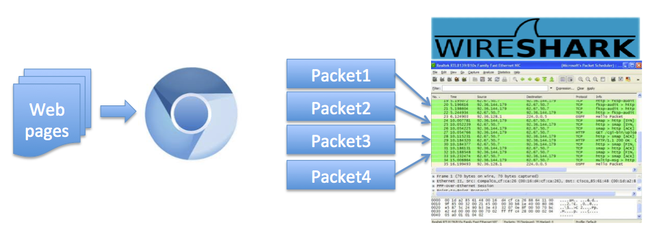
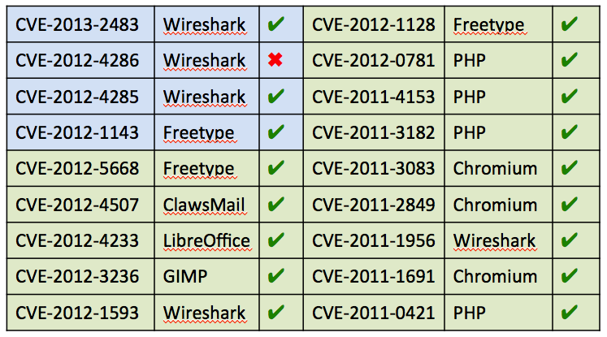
Conclusion
Applications process input in units
RCV nullifies the computation of the error triggering input.
Which is typically the right thing to do

Slide 83
Error Flush Time
No
No
N/A
N/A
N/A

Slide 84
Number of Cascading Errors

