Slide 1
Towards a Formal Framework for
Normative Requirements Elicitation
Nick Feng, Lina Marsso, Sinem Getir Yaman, Beverley Townsend, Ana Cavalcanti, Radu Calinescu, Marsha Chechik September 13, 2023

Slide 2
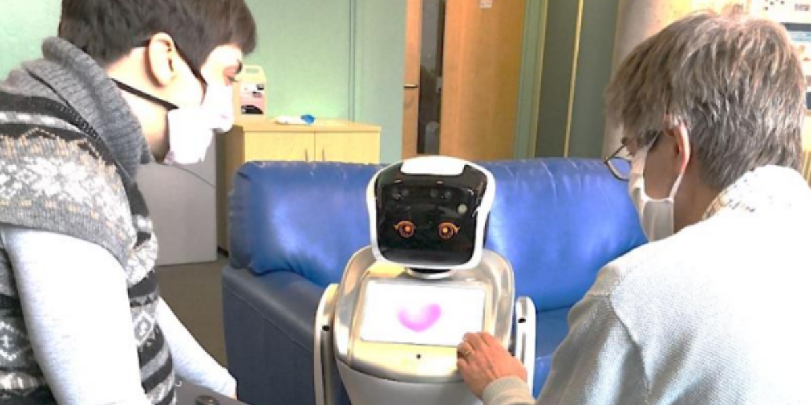
Normative Requirements
Capture social, legal, ethical, empathetic, cultural aspects of systems
Specified by stakeholders with non-technical expertise
Designers, regulators, ethicists, etc.
Hard to get right
Stakeholders from different fields, different vocabularies
Their views are often conflicting or redundant
DAISY robot from RoboStar University of York, UK

Slide 3
Contribution: FormaTive
A tool-supported Formal framework for normaTive requirements elicitation for non-technical stakeholders
Preliminary requirements elicitation
B. Requirements
sanitization
D. SLEEC concerns identification
diagnosis
normative requirements
diagnosis
C. Requirements refinement
Specification of normative rules for a software system in SLEEC DSL
Automates: (i) the identification of conflicts, redundancies, and concerns
(ii) the synthesis of feedback helping to understand/resolve problems

Slide 4
Outline
Background: SLEEC DSL
Requirement sanitization
SLEEC concerns identification
Implementation
Preliminary evaluation
Future research directions

Slide 5
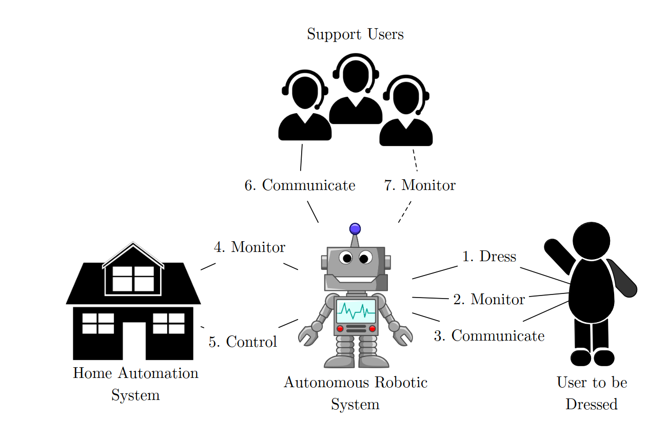
Background: SLEEC DSL [GYBJCC23]
Definitions event DressingStarted
event CurtainOpenRqst event CurtainsOpened measure userUnderdressed: Bool
measure roomTemperature: numeric
Rules Rule1 when DressingStarted then DressingComplete within 2 minutes unless (roomTemperature < 19) then DressingComplete within 60 seconds
Rule2 when CurtainOpenRqst and not UserUnderdressed then CurtainsOpened within 2 minutes unless (roomTemperature < 19)
[GYBJCC23] S. Getir-Yaman, C. Burholt, M. Jones, R. Calinescu, and A. Cavalcanti. "Specification and Validation of Normative Rules for Autonomous Agents", FASE 2023.

Slide 6
Requirements Sanitization
Redundant rule is a logical consequence of other rules
Conflicting rule cannot be triggered together with other rules Checking r5 redundancy in the rule set R via satisfiability:
¬ r5 ∩ (R \ r5)

Slide 7
Redundancy Diagnosis
<==>
==>
Notes:
Maybe help reader to better understand the diagnose. Explain why the default response and the first unless of r1 is not necessary (only the second unless is necessary) to make r5 redundant.

Slide 8
SLEEC Concerns Identification
A SLEEC concern specifies a behavior to avoid (e.g., a failure to protect user privacy)
Contextualize high-level SLEEC concerns (operating environment and normative capabilities)
C: when a user open curtains then the user is underdressed
Checking whether C is raised while respecting the rule set R via satisfiability: R ∩ C

Slide 9
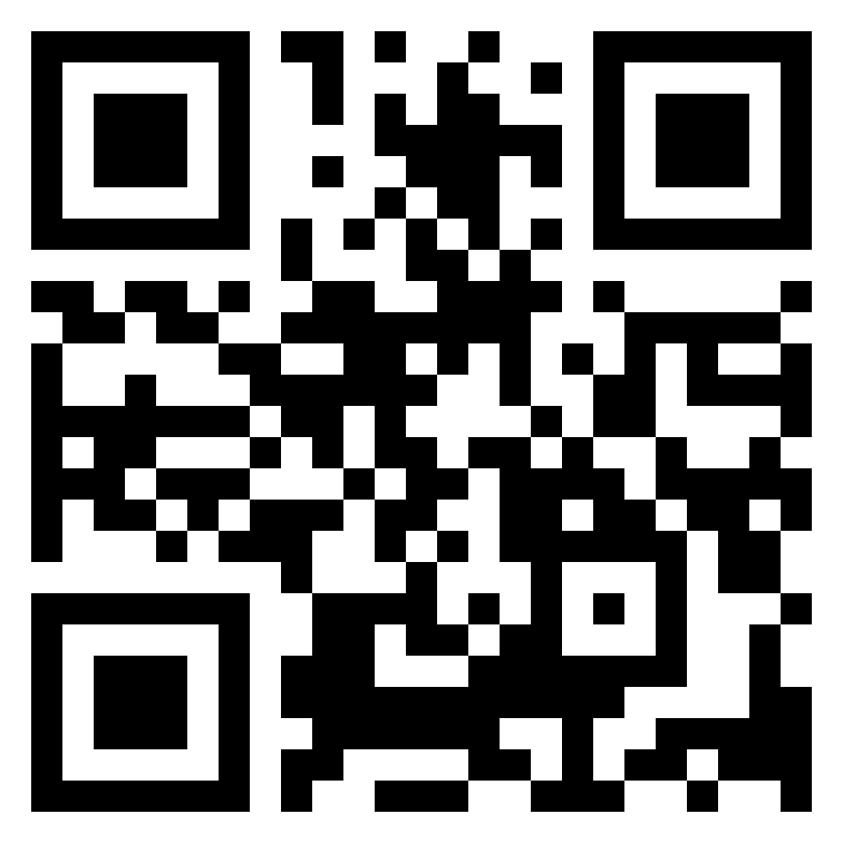
Implementation
Automated reasoning tool
B. Requirement sanitization
D. SLEEC concerns identification
Compiles each SLEEC DSL rule into FOL*
Interprets redundancy, conflict, concerns definitions as FOL* constraints
Uses LEGOS (the FOL* satisfiability checker [FMSC23]) to identify the problems
Provides a user-friendly diagnosis
[FMSC23] N. Feng, L. Marsso, M. Sabetzadeh, and M. Chechik. "Early verification of legal compliance via bounded satisfiability checking", CAV 2023.

Slide 10
Preliminary Evaluation 1/3
Case studies:
ERA: Elderly robot assistant
DR: Dressing robot
Six stakeholders:
- Philosopher - Computer Vision expert
- Robotists - Sociologist - AI expert

Slide 11
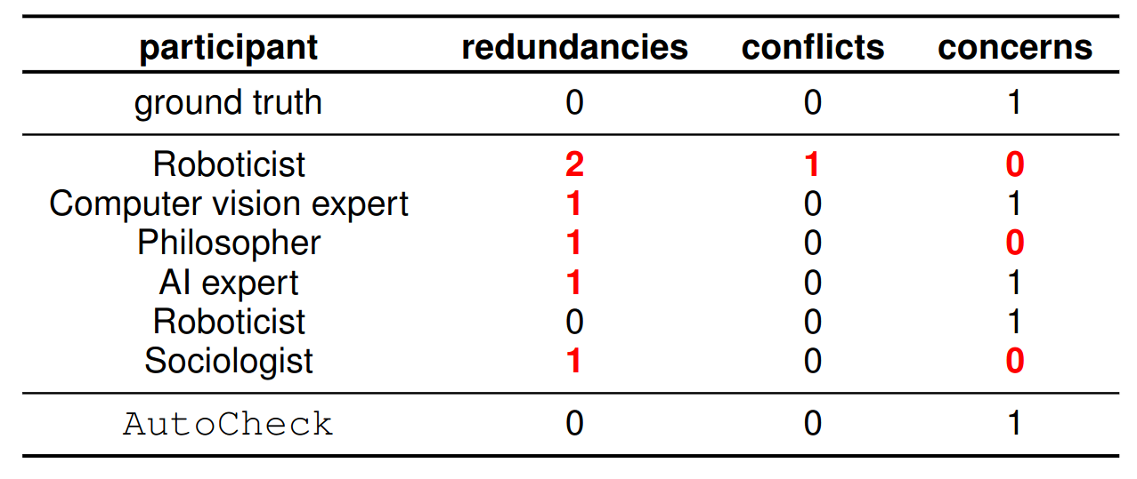
Preliminary Evaluation 2/3
RQ1: How effective is our framework in detecting redundancies, conflicts, and concerns compared to manual analysis?
FormaTive

Slide 12
Preliminary Evaluation 3/3
RQ2: How effective is the diagnosis produced by our framework in helping the user understand the causes of redundancies, conflicts, and concerns?
29 out of 30 cases (96%) the participants correctly explain the causes given the diagnosis produced by FormaTive

Slide 13
Summary
Early results:
Formal analysis provided by FormaTive is usable by non-technical stakeholders and more effective than manual analysis! Remaining research question: RQ3: How efficient and effective is the FormaTive framework in eliciting redundant-, conflict-, and concern-free normative requirements?

Slide 14
Future Research Directions
Conduct an extensive study to assess the efficiency of the overall framework (evaluating iterations for eliciting requirements and quality)
Generate and suggest patches to resolve the identified issues.
Provide more detailed diagnoses for raised concerns (e.g., information on requirements that partially address concerns)

Slide 15
Thank you!
Nick Feng
Lina Marsso
Sinem Getir Yaman
Beverley Townsend
Ana Cavalcanti
Radu Calinescu
Marsha Chechik
Preliminary requirement elicitation
B. Requirement sanitization
D. SLEEC concerns identification
diagnosis
normative requirements
diagnosis
FormaTive
C. Requirement refinement
Automated reasoning tool support for:
the identification of conflicts, redundancies, and concerns
the synthesis of feedback helping non-technical stakeholders to understand/resolve problems

Slide 16
Contribution: FormaTive
A tool-supported Formal framework for normaTive requirements elicitation
Specification of normative rules for a software system in SLEEC DSL
Automates: (i) the identification of conflicts, redundancies, and concerns
(ii) the synthesis of feedback helping to understand/resolve problems

