Slide 1


Early Verification of Legal Compliance via Bounded Satisfiability Checking
Nick Feng, Lina Marsso, Mehrdad Sabetzadeh, Marsha Chechik
CAV 2023

Slide 2
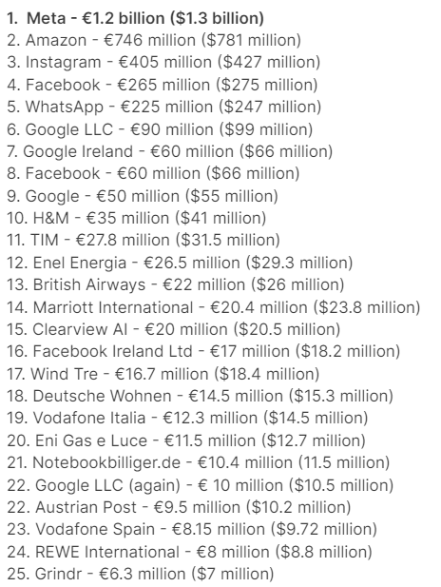

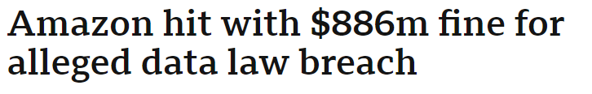

Context: Regulatory Compliance
Comply
System
Regulations (e.g., GDPR)
Violations lead to consequences …
GDPR: General Data Protection Regulation
https://www.enzuzo.com/blog/biggest-gdpr-fines

Slide 3
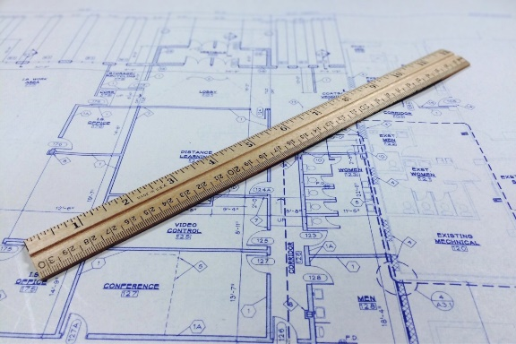



Motivation: Verification on System Design
System Design
Formal Specifications
(Requirements)
Formal Specification
(Property)
Check:
Requirements $⇒$ Property
Compliant
A violation scenario

Slide 4
Motivation: Verification on System Design
Time and data constraints
System Design
MFOTL Specifications
(Requirements)
MFOTL Specification
(Property)
Check MFOTL finite satisfiability :
¬(Requirements ⇒ Property)
UNSAT
SAT
Safety properties
Compliant
A finite violation scenario
MFOTL: Metric First-order Temporal Logic

Slide 5
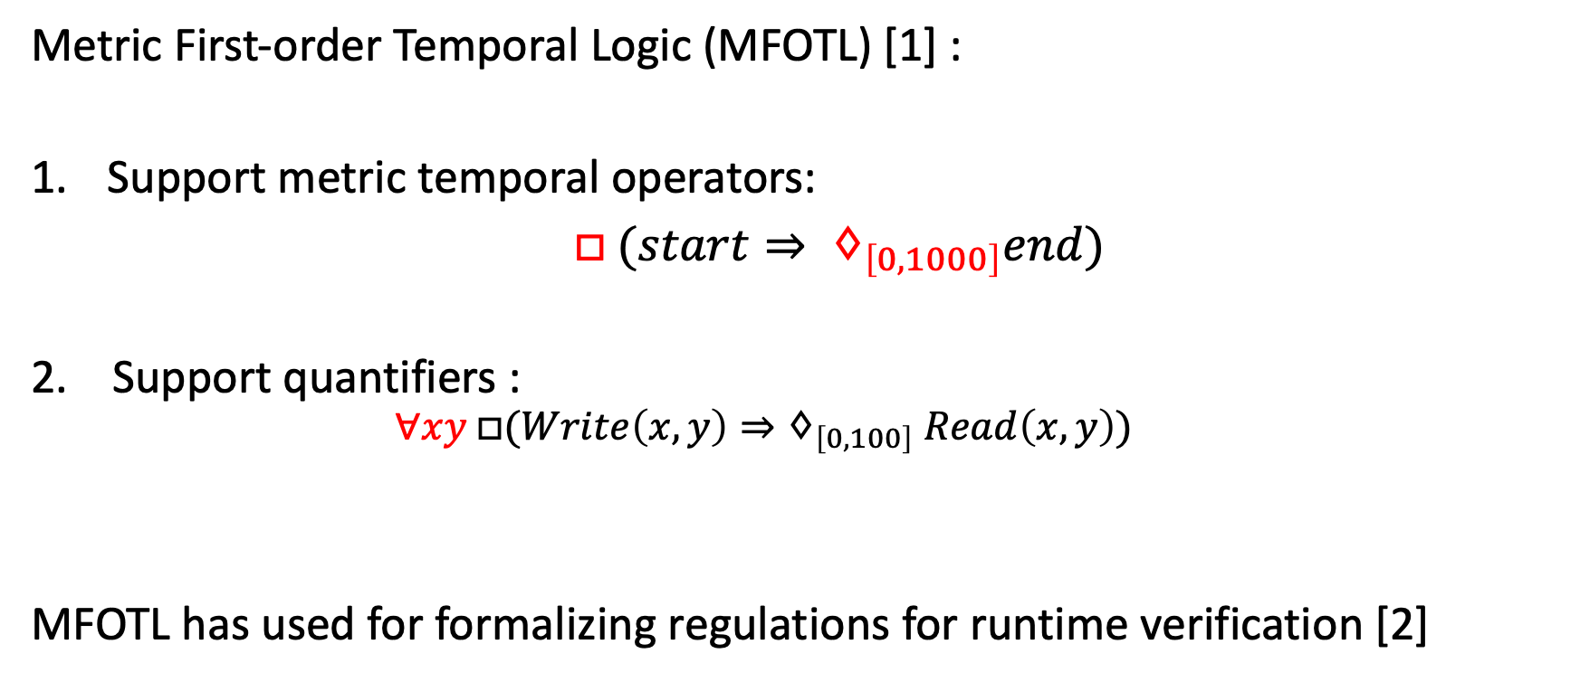
Background: Metric First-order Temporal Logic
Metric First-order Temporal Logic (MFOTL) [1] :
Support metric temporal operators:
$□ (start⇒ ♢_{\left[0, 1000\right]}end)$
2. Support quantifiers :
  $$∀xy □(Write\left(x, y\right)⇒♢_{\left[0,100\right]} Read\left(x, y\right))$$
MFOTL has used for formalizing regulations for runtime verification [2]
Allow specification of both data and time constraints
[1] MONPOLY: Monitoring usage-control policies. D. Basin, M. Harvan, F. Klaedtke, E. Zălinescu, RV 2012.
[2] Monitoring the GDPR. A. Emma, D. Basin, and S. Debois, ESORICS 2019.

Slide 6
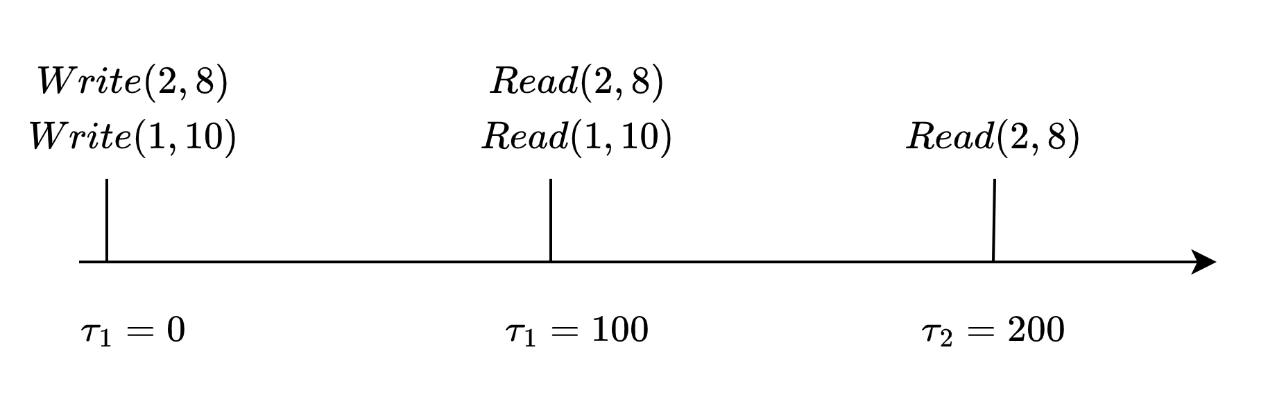
Problem: MFOTL Finite Satisfiability
An MFTOL formula is finitely satisfiable if and only if there exists a finite trace that satisfies the MFTOL formula.
  $$∀xy □(Read\left(x, y\right)⇒♢_{\left[0,100\right]} Write\left(x, y\right))$$
What values that hold for what relations at which time point?
Number of time point?
Undecidable*
Time value each time point?
Notes:
Even if we guard the quantification

Slide 7
Problem: Bounded MFOTL Satisfiability
A MFTOL formula is k-bounded satisfiable If and only if there exists a trace of volume at most k that satisfies the MFTOL formula.
  $$∀xy □(Read\left(x, y\right)⇒♢_{\left[0,100\right]} Write\left(x, y\right))$$
The trace of the volume is bounded by k
Volume =5
Notes:
Bound MFOTL

Slide 8
Problem: Bounded MFOTL Satisfiability
Our focus
System Design
MFOTL Specifications
(Requirements)
MFOTL Specification
(Property)
Check MFOTL k-bounded satisfiability of:
¬(Requirements ⇒ Property)
UNSAT
K-bounded UNSAT
SAT
Compliant
K-bounded compliant
A K-bounded violation scenario

Slide 9
Contributions
1. MFOTL bounded satisfiability
2. Decision procedure for MFOTL bounded satiability
a. Reducing to FOL* bounded satisfiability
b. Determining FOL* bounded satisfiability via incremental approximation

Slide 10
Outline
Problem: Bounded MFOTL satisfiability
Approach: MFOTL bounded satisfiability checking
  Reducing to FOL* bounded satisfiability
  Determine FOL* bounded satisfiability by incremental approximation
Evaluation
Conclusion

Slide 11

What is FOL*?
First-order Logic with quantifiers over relational objects
  R1: Every value written must be eventually read within 100 seconds.
  R1 = $∀w :Write\left(loc, value, time\right) ∃r:Read\left(loc, value, time\right)$
  $$r.loc=w.loc∧r.value=w.value∧$$
  $$w.time<r.time≤w.time+100$$
Relational Object Signature
Write:
loc : Nat
value: Int
time: Nat
Ext:Bool
Read:
loc : Nat
value: Int
time: Nat
Ext: Bool
background theory: LIA

Slide 12
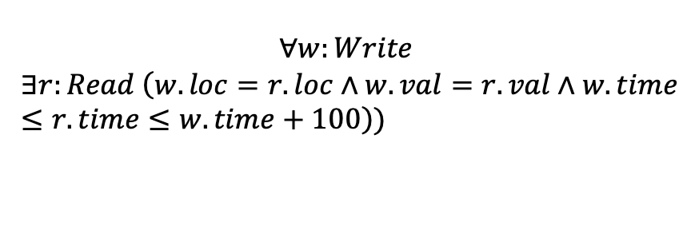
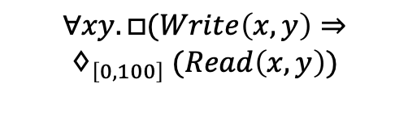
MFOTL to FOL*
$$∀xy.□(Write\left(x, y\right)⇒$$
$$♢_{\left[0, 100\right]} (Read\left(x, y\right))$$
Please check our paper
$$∀w:Write$$
$$∃r:Read \left(w.loc=r.loc∧w.val=r.val∧w.time≤r.time≤w.time+100\right))$$
$$write_{1} (loc=2, value=8, time=0, ext=⊤)$$
$$write_{2} (loc=1, value=10, time=0, ext=⊤)$$
$$read_{1}(loc=2, value=8, time=100, ext=⊤)$$
$$read_{2} (loc=1, value=10, time=100, ext=⊤)$$
$$read_{3} (loc=2, value=8, time=200, ext=⊤)$$

Slide 13
Outline
Problem: Bounded MFOTL satisfiability
Approach: MFOTL bounded satisfiability checking
  Reducing to FOL* bounded Satisfiability
  Determine FOL* bounded Satisfiability by incremental approximation
Evaluation
Conclusion

Slide 14
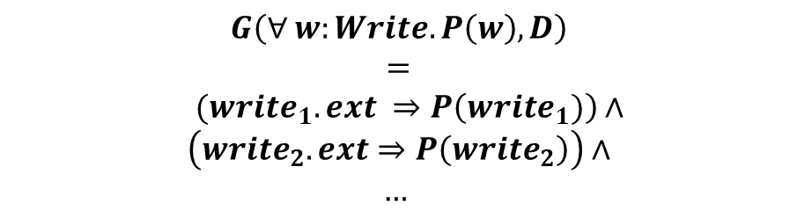
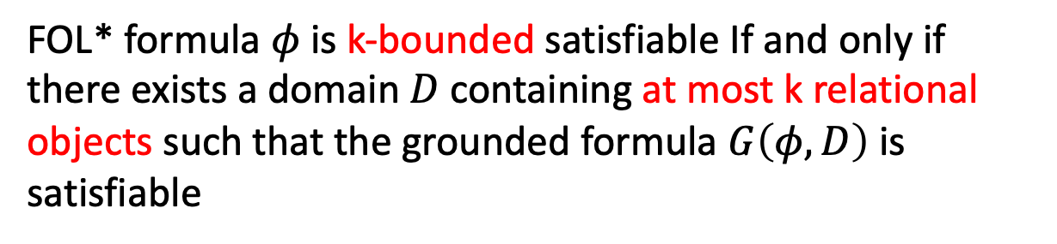

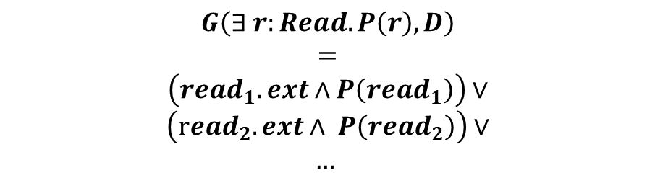
FOL* Bounded Satisfiability
Satisfiable?
Domain D
How to find the domain?
read1
$$G\left(∀ w:Write. P\left(w\right), D\right)$$
$$=$$
$$(write_{1}.ext ⇒P\left(write_{1})\right)∧$$
$$\left(write_{2}.ext⇒P\left(write_{2}\right)\right)∧$$
$$…$$
write1
read2
write2
read3
write3
…
…
Ground
FOL* formula $φ$
$$G\left(∃ r:Read. P\left(r\right), D\right)$$
$$=$$
$$\left(read_{1}.ext∧P\left(read_{1}\right)\right)∨$$
$$\left(read_{2}.ext∧ P\left(read_{2}\right)\right)∨$$
$$…$$
FOL* formula $φ$is k-bounded satisfiable If and only if there exists a domain $D$ containing at most k relational objects such that the grounded formula $G\left(φ, D\right)$ is satisfiable

Slide 15
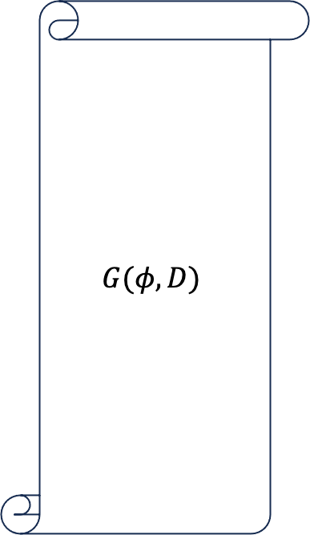

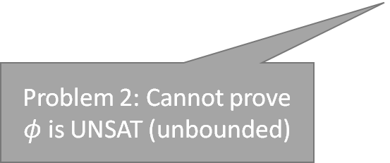
Bounded Satisfiability: Naive Approach
Problem 1: Grounded formula too large, expansive to check
Try the largest domain with k relational object?
Domain D
read1
$$G(φ, D)$$
write1
read2
write2
K bounded-UNSAT
read3
write3
…
…
Ground
SAT
UNSAT
FOL* formula $φ$
Problem 2: Cannot prove $φ$ is UNSAT (unbounded)

Slide 16
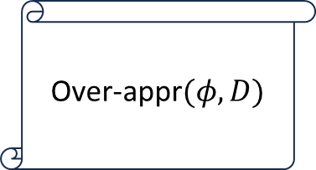


Our Approach: Incremental Approximation
Stopping condition, please check our paper
UNSAT
UNSAT
FOL* formula $φ$
Over-appr$(φ, D)$
1
K Bounded-UNSAT
SAT
Ground’
Domain
Expansion
3
UNSAT
Under-appr$(φ, D)$
2
Current Domain D (Under-approx.)
SAT
New Domain D
SAT

Slide 17
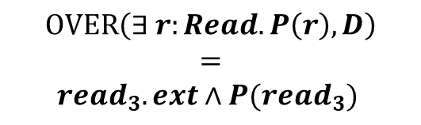
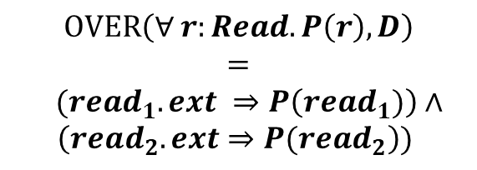


Over-approximation
$$OVER\left(∀ r:Read. P\left(r\right), D\right)$$
$$=$$
$$(read_{1}.ext ⇒P\left(read_{1})\right)∧$$
$$\left(read_{2}.ext⇒P(read_{2}\right))$$
Domain D
read1
$read_{3}$ not included
read2
Over-approximation
New Instantiation
$$OVER\left(∃ r:Read. P\left(r\right), D\right)$$
$$=$$
$$read_{3}.ext∧P(read_{3})$$
FOL* formula $φ$
Domain D
read1
read3
read2

Slide 18
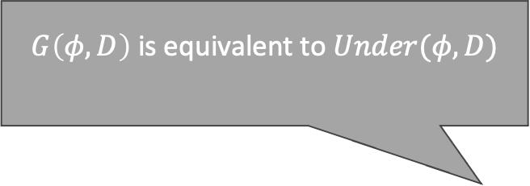



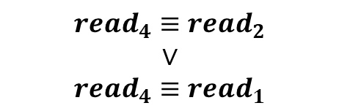
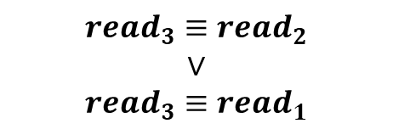
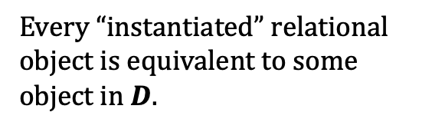
Under-approximation
$G\left(φ, D\right)$is equivalent to $Under(φ, D)$
Domain D
read1
$$OVER\left(φ, D\right)$$
$$∧$$
read2
Under-approximation
Every “instantiated” relational object is equivalent to some object in $D$.
FOL* formula $φ$
$$read_{3}≡read_{2}$$
$$∨$$
$$read_{3}≡read_{1}$$
$$read_{4}≡read_{2}$$
$$∨$$
$$read_{4}≡read_{1}$$
Domain D
$$∧$$
read4
read1
read3
read2

Slide 19
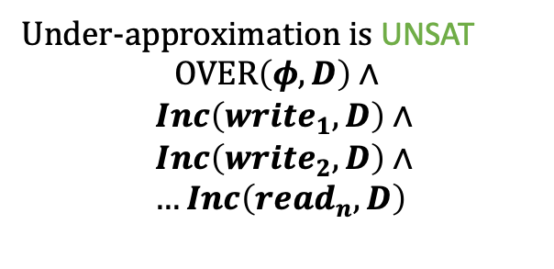
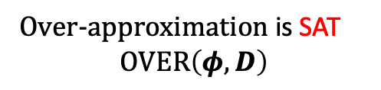
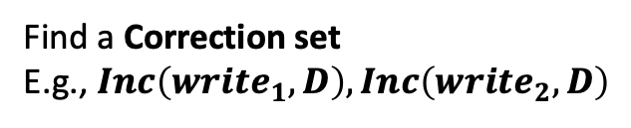
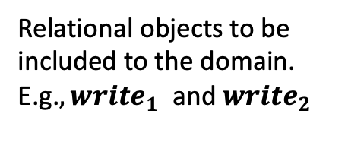
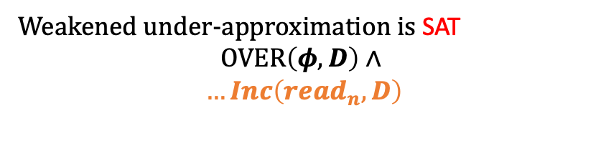
Domain Expansion
Expansion goal: Identify the causes of UNSAT and fix them
Over-approximation is SAT
$$OVER\left(φ, D\right)$$
Under-approximation is UNSAT
$$OVER\left(φ, D\right)∧$$
$$Inc\left({write}_{1}, D\right)∧$$
$$Inc\left({write}_{2}, D\right)∧$$
$$…Inc\left({read}_{n}, D\right)$$
Find a Correction set
E.g., $Inc\left({write}_{1}, D\right), Inc\left({write}_{2}, D\right)$
Can be fixed by dropping constraints
Weakened under-approximation is SAT
$$OVER\left(φ, D\right)∧$$
$$…Inc\left({read}_{n}, D\right)$$
Relational objects to be included to the domain. E.g.$, write_{1}$ and${write}_{2}$

Slide 20
Domain Expansion
A* search
If solution optimality and termination guarantee is required,
Compute Minimum correction set (MCS) over all objects
If solution optimality is not necessary,
Compute Minimum correction set (MCS) over only instantiated objects
MaxRes: Computing MSC by iteratively analyzing UNSAT cores and weaking assumptions
Greedy Best-first Search. More performant
[3] Maximum Satisfiability Using Core-Guided MaxSAT Resolution. Narodytska, N., Bacchus, F. AAAI 14

Slide 21
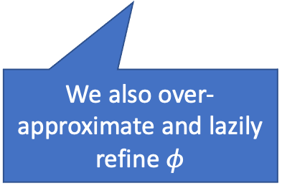
Beyond Domain Approximation
UNSAT
UNSAT
FOL* formula $φ$
Over-appr$(φ, D)$
1
K Bounded-UNSAT
We also over-approximate and lazily refine $φ$
SAT
Ground’
Domain
Expansion
3
UNSAT
Under-appr$(φ, D)$
2
Current Domain D (Under-approx.)
SAT
New Domain D
SAT

Slide 22
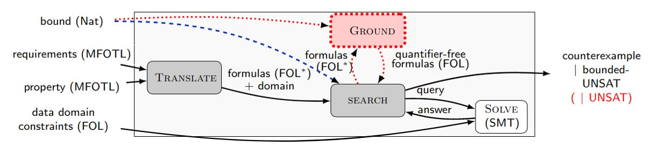

LEGOS: MFOTL Bounded Satisfiability Checker
LEGOS
LEGOS
Z3 [5]
Python API 3000 lines of code
PySMT [4]
[4] Pysmt: a solver-agnostic library for fast prototyping of smt-based algorithm. Marco Gario and Andrea Micheli.
SMT Workshop 2015
[5] An efficient SMT solver. Leonardo Mendonça de Moura and Nikolaj S. Bjørner. TACAS 2008

Slide 23
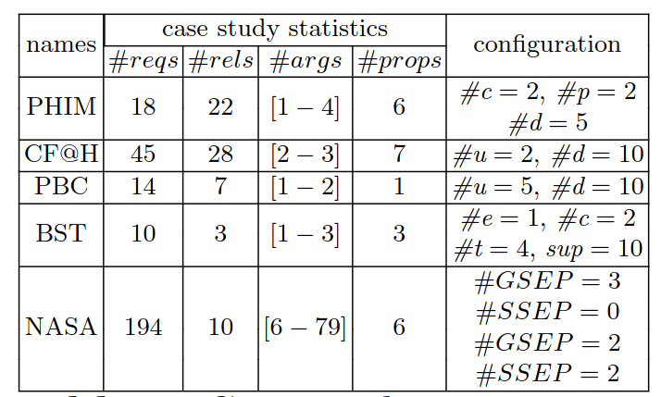
Case-studies
Data/ time constraints
(PBC, BST, PHIM, CF@H)
Complex data constraints
(PHIM, CF@H)
Notes:
Add annomation

Slide 24
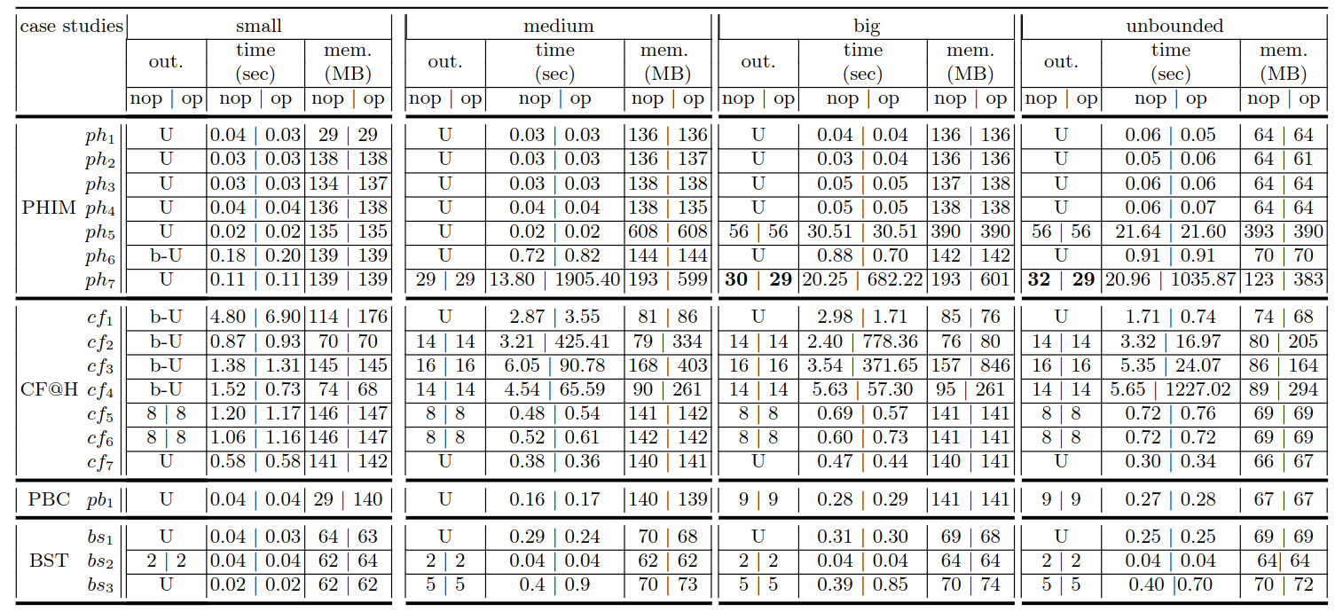
Efficiency of LEGOS with/without Optimality
Configurations
LEGOS output:
UNSAT (U)
b-UNSAT (b-U)
volume solution (N)
nop: no optimal guarantee
op: optimal guarantee

Slide 25
Efficiency of LEGOS with/without Optimality
PHIM requirements
and
legal properties (e.g., ph3)

Slide 26
Efficiency of LEGOS with/without Optimality

Slide 27

Efficiency of IBS with/without Optimality
Cost of the optimal guarantee!
13.80|1905.4
30|29
20.25|682.22
32|29
20.96|1035.87
2.40|778.36
3.54|371.65
4.54|65.59
5.63|57.3
0.48|0.54

Slide 28
Conclusion
Contributions
  MFOTL bounded satisfiability
  Decision procedure for MFOTL bounded satisfiability
    Reducing to FOL* bounded satisfiability
    Determining FOL* bounded satisfiability via incremental approximation
Future work
  Improve expressiveness (e.g., aggregations)
  Connect MFOTL and FOL* to front-end DSL
  Certify UNSAT and bounded UNSAT

Slide 29



Thank you
LEGOS
nick.feng@mail.utoronto.ca
PAPER
LEGOS checker + Artifacts

