Slide 1

Code-Level Functional Equivalence Checking of Annotative Software Product Lines
Shuolin (Alan) Wang, Nick Feng, Marsha Chechik

Slide 2





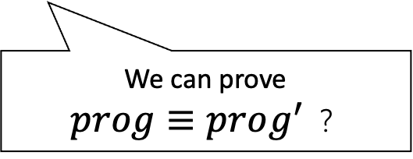
Motivation: Change Impact Analysis
Update
Unexpected functional impact?
$$prog$$
$$prog’$$
We can prove
$prog≡prog^{′}$ ？
Software Equivalence Checker: Reve, ModDiff, SymDiff, RVT, etc…

Slide 3



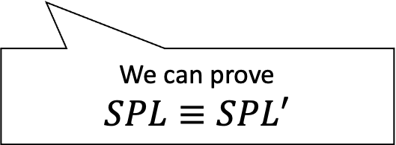


Motivation: Change Impact Analysis for Software Product-lines (SPLs)
Update
Unexpected functional impact?
$$SPL$$
$$SPL′$$
We can prove
$$SPL≡SPL′$$
How to check functional equivalence of SPLs?

Slide 4
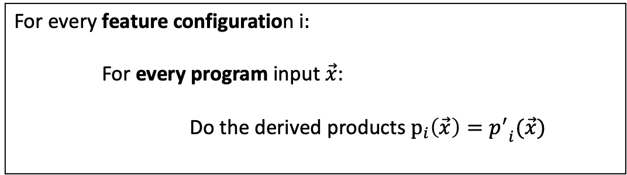
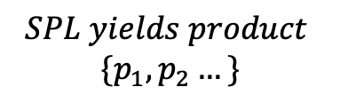

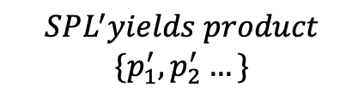
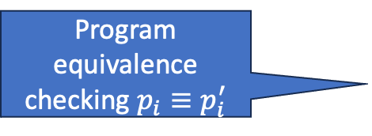
Problem: Functional Equivalence Checking of Annotative SPLs (VEQ)
$$≡$$
Challenge 2: How to concisely describe non-equivalent products and their counterexamples?
$$SPL yields product$$
$$\{p_{1}, p_{2}…\}$$
$$SPL^{′}yields product$$
$$\{p_{1}^{′}, p_{2}^{′}…\}$$
Challenge 1: enumerating every feature configuration is not scalable
For every feature configuration i$:$
For every program input $\vec{x}$:
Do the derived products $p_{i}\left(\vec{x}\right)={p^{′}}_{i}(\vec{x})$
Program equivalence checking $p_{i}≡p_{i}^{′}$

Slide 5
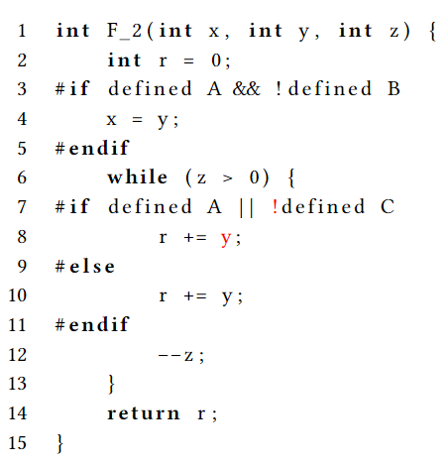
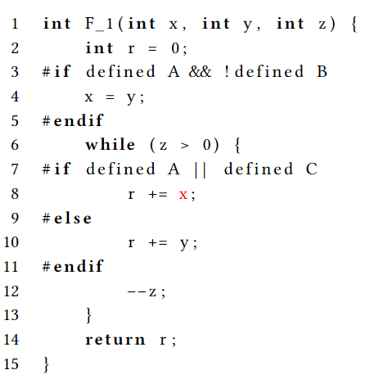
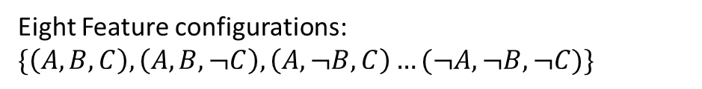
Example: VEQ Input
$$≡$$
Program update
Annotation update
Eight Feature configurations: $\{\left(A, B, C\right), \left(A, B,¬C\right), \left(A,¬B, C\right)…(¬A, ¬B, ¬C)\}$

Slide 6
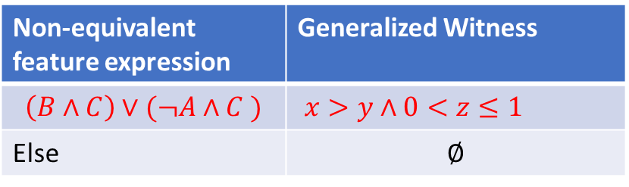
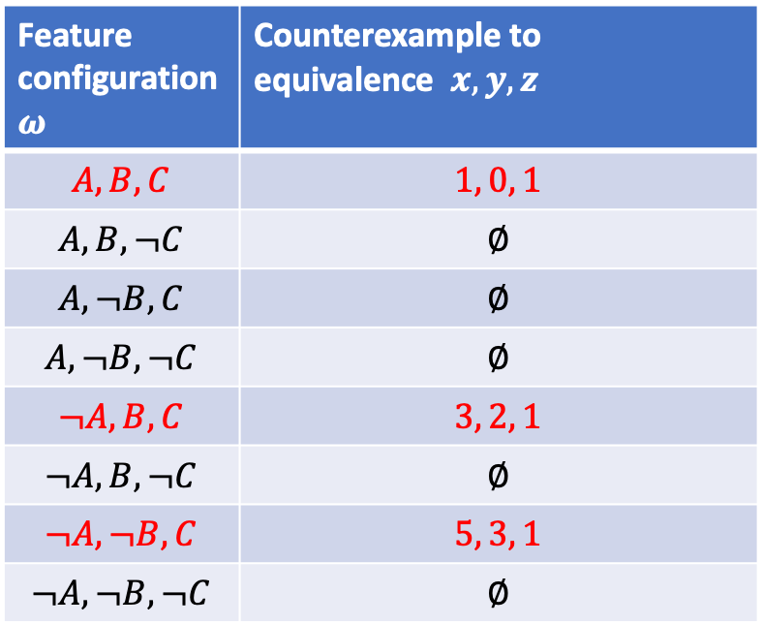
Example: VEQ Output
Computing the result is expensive (8 calls to EQ checkers)
Non-equivalence (NEQ) results
Group non-equivalent products with common counter-examples to equivalences
Feature configuration $ω$ | Counterexample to equivalence $x, y, z$
$$A, B, C$$ | $$1, 0, 1$$
$$A,B,¬C$$ | $$∅$$
$$A, ¬B, C$$ | $$∅$$
$$A, ¬B, ¬C$$ | $$∅$$
$$¬A,B,C$$ | $$3, 2, 1$$
$$¬A, B, ¬C$$ | $$∅$$
$$¬A, ¬B, C$$ | $$5, 3, 1$$
$$¬A, ¬B,¬C$$ | $$∅$$
NEQ summary
Non-equivalent feature expression | Generalized Witness
$$\left(B∧C\right)∨(¬A∧C )$$ | $x>y∧0<z≤1$
Else | $$∅$$
Integrate feature variability into programs’ control flow!
Therefore, we will compute NEQ summary directly without computing the full equivalence result

Slide 7


Approach:
Input
Step1
Step2
Parse
Transform
Step3
Step4
Output
$$SPL$$
NEQ-summary
Self-Compose
Verify & Generalize
Parse
Transform
$$SPL′$$

Slide 8
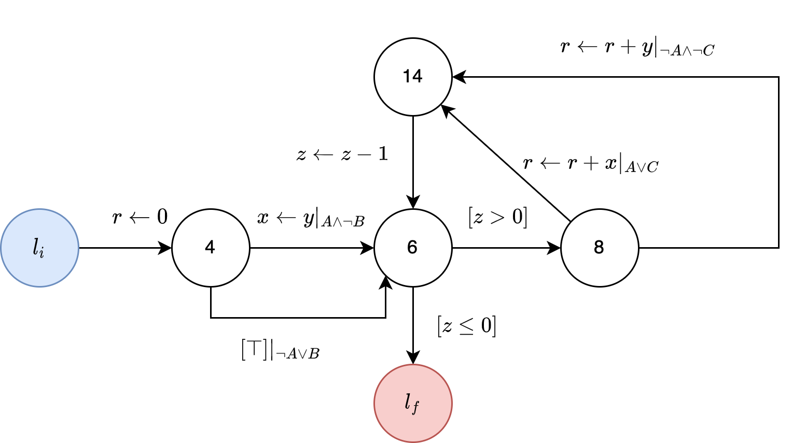
Step 1: Parse Feature Variability with Variability-aware CFAs
Program transitions are guarded by presence conditions
Parse
Variability-aware CFA (VaCFA)

Slide 9
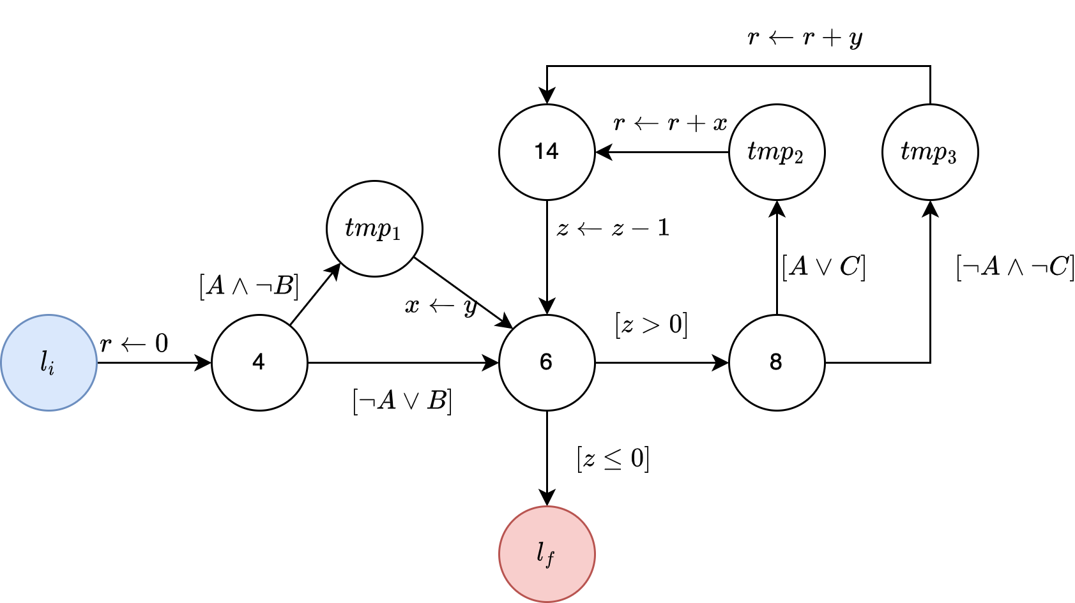
Step 2: Integrate Feature Variability with Metaproducts
Feature variables are integrated as program variables. Feature expression are converted to program assumption
Transform
Variability-aware CFA (VaCFA)
[1] Kästner, Christian, et al. "Toward variability-aware testing." Proceedings of the 4th International Workshop on Feature-Oriented Software Development. 2012.
Metaproduct[1]

Slide 10
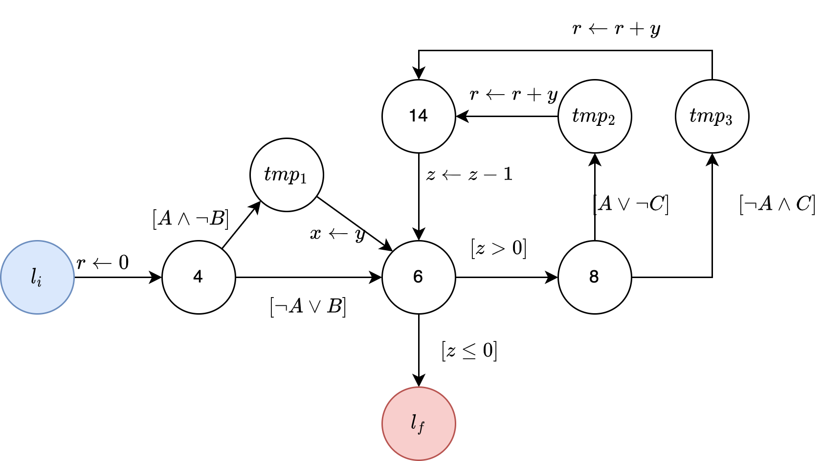
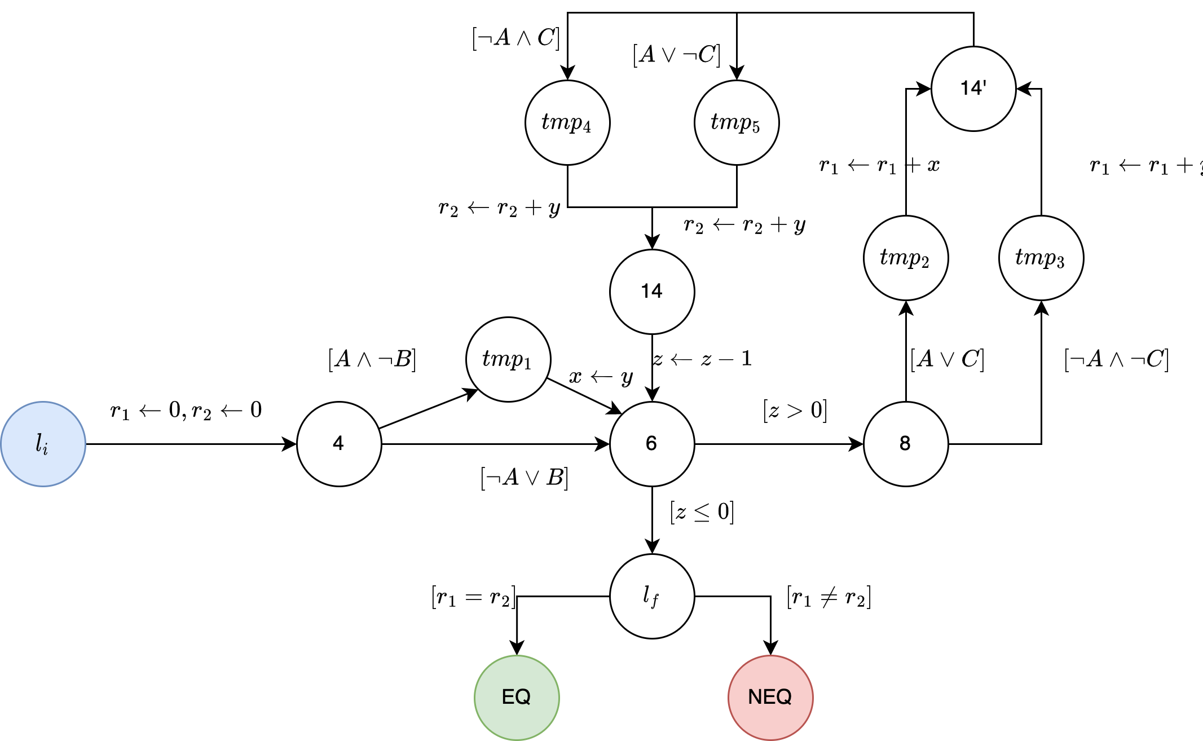


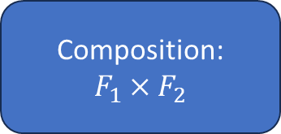

Step 3: Self-composition
Composition:
$$F_{1}×F_{2}$$
Metaproduct $F_{1}$
Metaproduct $F_{2}$
Create copies of program variables, and update them accordingly
Check if $F_{1}$ and $F_{2}$ returns the same value

Slide 11

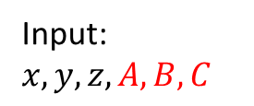
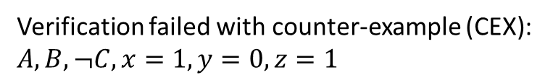

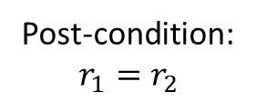

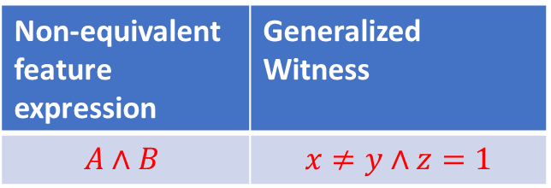
Step 4: Verification and Generalization (1)
Non-equivalent feature expression | Generalized Witness
$$A∧B$$ | $$x≠y∧z=1$$
Feature variables and now inputs
Post-condition:
$$r_{1}=r_{2}$$
Input:$x,y,z, A, B, C$
Optimization generalizeFCEX : We can further generalize FCEX by expanding the non-equivalent expressions while fixing the witness
Pre-condition:
$$⊤$$
Find an expression whose models are valid CEXs, and the seed CEX is a model
$$F_{1}×F_{2}$$
Featured counter-example (FCEX):
$$A∧B∧x≠y∧z=1$$
Verification failed with counter-example (CEX): $A, B, ¬C, x=1, y=0, z=1$
Generalize*
non-equivalent
feature expression
witness

Slide 12

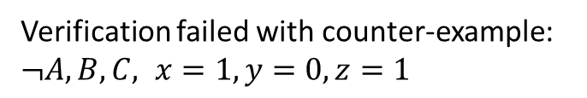
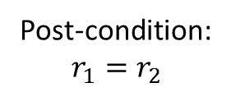
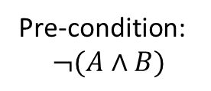
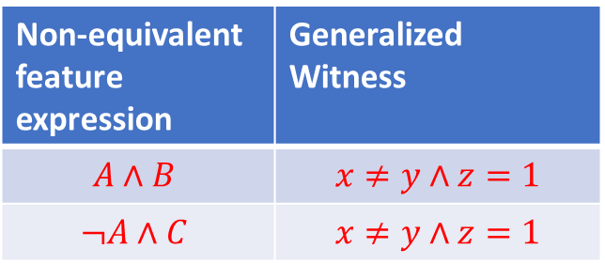
Step 4: Verification and Generalization (2)
Non-equivalent feature expression | Generalized Witness
$$A∧B$$ | $$x≠y∧z=1$$
$$¬A∧C$$ | $$x≠y∧z=1$$
Input:$x,y,z, A, B, C$
Post-condition:
$$r_{1}=r_{2}$$
Pre-condition:
$$¬(A∧B)$$
$$F_{1}×F_{2}$$
Featured counter-example (FCEX):
$$¬A∧C∧x≠y∧z=1$$
Verification failed with counter-example: $¬A, B, C, x=1, y=0, z=1$
Generalize*
non-equivalent
feature expression
witness

Slide 13
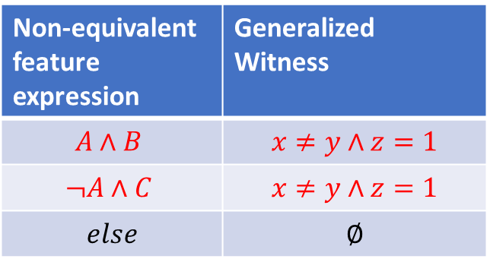
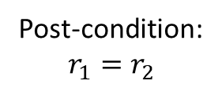
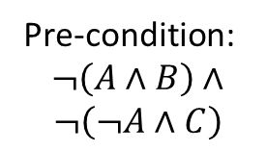
Step 4: Verification and Generalization (3)
Non-equivalent feature expression | Generalized Witness
$$A∧B$$ | $$x≠y∧z=1$$
$$¬A∧C$$ | $$x≠y∧z=1$$
$$else$$ | $$∅$$
Input:$x,y,z, A, B, C$
Pre-condition:
$$¬\left(A∧B\right)∧$$
$$¬\left(¬A∧C\right)$$
Post-condition:
$$r_{1}=r_{2}$$
$$F_{1}×F_{2}$$
Verification Succeed, no counter-example

Slide 14


Step 4: Verification and Generalization (4)
Non-equivalent feature expression | Generalized Witness
$$A∧B$$ | $$x≠y∧z=1$$
$$¬A∧C$$ | $$x≠y∧z=1$$
$$else$$ | $$∅$$
Reduce
Non-equivalent feature expression | Generalized Witness
$$\left(B∧C\right)∨(¬A∧C )$$ | $x>y∧0<z≤1$
Else | $$∅$$
Sound, Complete and Minimal

Slide 15
Implementation: CLEVER-V
We implemented the approach in a prototype, CLEVER-V, with 3000 lines of Scala code
Input
Step1
Step2
Parse
Transform
Step3
Step4
Output
$$SPL$$
NEQ-summary
Self-Compose
Verify & Generalize
Parse
Transform
SeaHorn[3]
$$SPL′$$
[2] Kenner, Andy, et al. "Typechef: Toward type checking# ifdef variability in c." Proceedings of the 2nd international workshop on feature-oriented software development. 2010.
TYPECHEF[2]
[3] Gurfinkel, Arie, et al. "The SeaHorn verification framework." International Conference on Computer Aided Verification. Cham: Springer International Publishing, 2015.

Slide 16
Evaluation
RQ1:
How effective is our approach at solving VEQ problem?
RQ2:
How does our approach scale compare to brute-force (enumeration) approach?

Slide 17
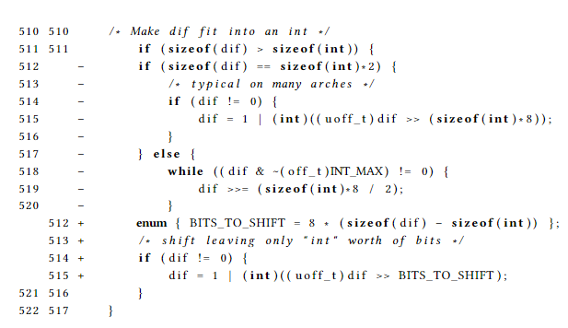
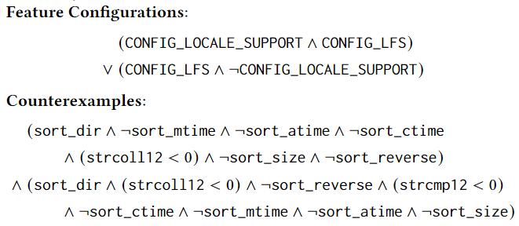
RQ1: Effectiveness
Case study: We use CLEVER-V to analyze commit: 6b01b71e on BUSYBOX
Input update:
CLEVER-V outputs :
RQ1 answer: Yes, the NEQ-summary returned by CLEVER-V is sound and complete

Slide 18
RQ2: Scalability
We generate a benchmark of 288 VEQ problem instances by:
Mutating the BUSYBOX case study and:
Increasing feature variabilities (ranging from 2 to 12 feature variables)
We compare three configurations on the benchmark:
Brute-force (enumeration) approach
CLEVER-V without optimization: FCEX generalization
Full featured CLEVER-V
Resource Limit: 10 minutes timeout, 16GB memory

Slide 19
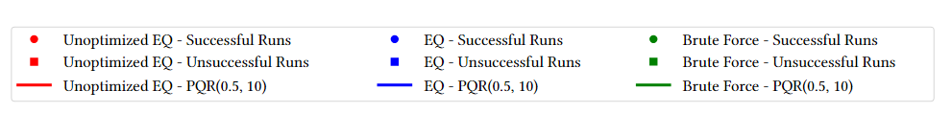
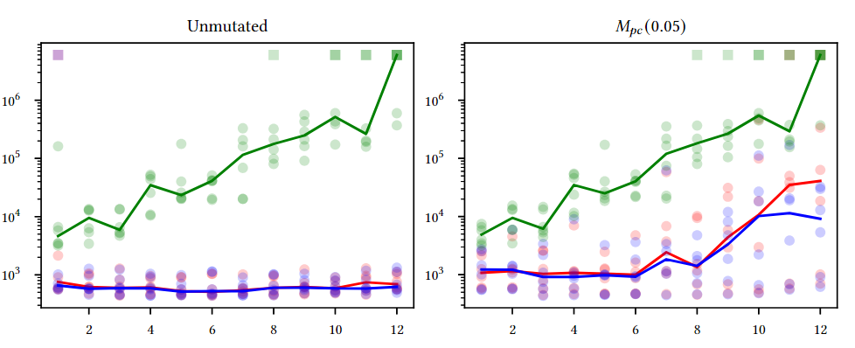
RQ2: Scalability Result (1)
OB2: FCEX generalization helps when updates are exclusively on program or on PC
Time Logscale (ms)
Mutation
OB1: Both Versions of CLEVER-V output perform brute-force
# of feature variables

Slide 20
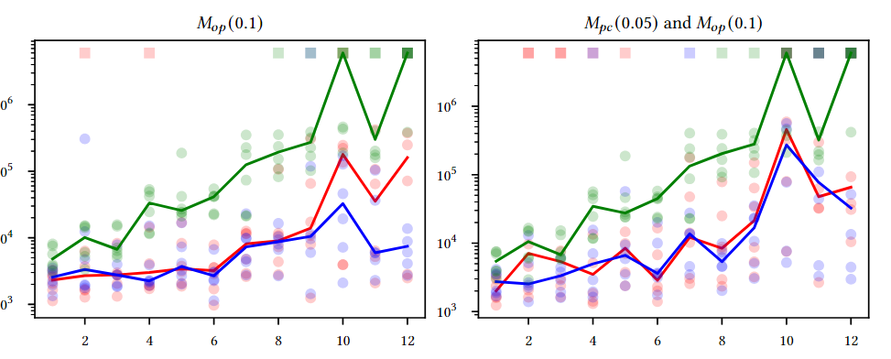
RQ2: Scalability Result (2)
OB2: FCEX generalization helps when updates are exclusively on program or on PC

Slide 21
Conclusion
We tackled the problem of functional equivalence checking for SPLs (VEQ) by integrating feature variability into programs’ control flow
We proposed an equivalence checking algorithm and implemented it in a tool CLEVER-V
We demonstrate CLEVER-V’s effectiveness and scalability
Future works:
Support other forms SPLs (e.g., compositional and delta-oriented SPLs)
Support more datatypes and recursive programs

Slide 22

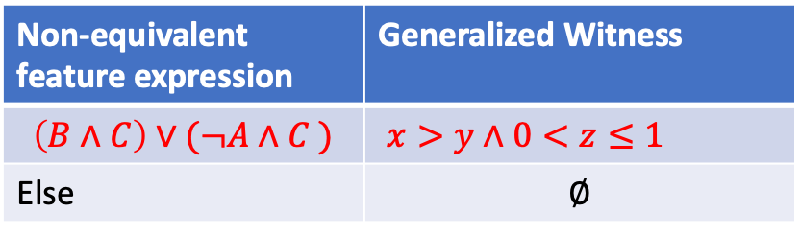
Questions
Input
Step1
Step2
Parse
Transform
Step3
Step4
Output
$$SPL$$
NEQ-summary
Self-Compose
Verify & Generalize
Parse
Transform
Non-equivalent feature expression | Generalized Witness
$$\left(B∧C\right)∨(¬A∧C )$$ | $x>y∧0<z≤1$
Else | $$∅$$
$$SPL′$$

