Slide 1
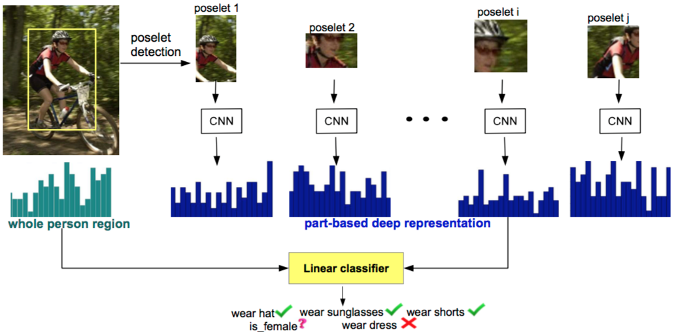
PANDA: Pose Aligned Networks for Deep Attribute Modeling
Ning Zhang^{1,2} Manohar Paluri¹ Marć Aurelio Ranzato ¹ Trevor Darrell² Lumbomir Boudev¹
¹ Facebook AI Research ² EECS, UC Berkeley
Presented by:
Sidharth Sahdev

Slide 2
Some of the material has been taken from the original CVPR’14 talk by Ning Zhang
http://techtalks.tv/talks/panda-pose-aligned-networks-for-deep-attribute-modeling/60280/

Slide 3
Lets talk about Attributes
Every Object has some Attributes associated with it.
For instance, A chair has 4 legs, a seat, may have a backrest
A monitor screen has attributes like its size (eg 27 inches), resolution
Animals have attributes like 4 legs usually (strips for zebra, black and white patches for panda, etc)
This research work focuses on inferring human attributes like gender, hair style, clothes style, expressions, etc.

Slide 4
Attribute modeling
Why is it cool?
You maybe able to recognize a person, chair, table, backpacks, etc.
But can you tell what are the features of the detected person which is apparent in the image but the conventional recognition tasks cannot quite do it.
This is where Attribute classification of an object comes in handy.
Facial verification (current techniques require a frontal pose more or less and face challenges against low image quality, occlusion and pose variations)
Visual search
Tagging suggestions
Notes:
What is attribute?

Slide 5
Why is attribute classification challenging…?

Slide 6
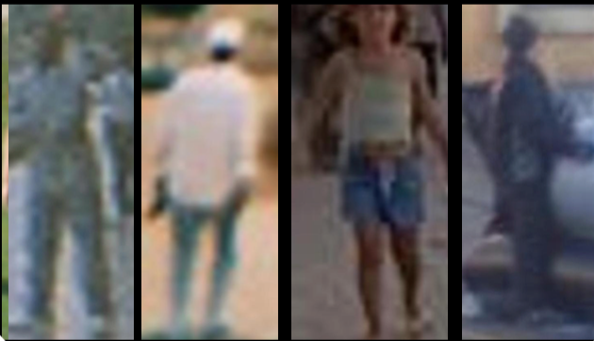
Low resolution
Notes:
There is often low resolution images in the dataset and it becomes difficult even for us to make out some attributes of the person.

Slide 7
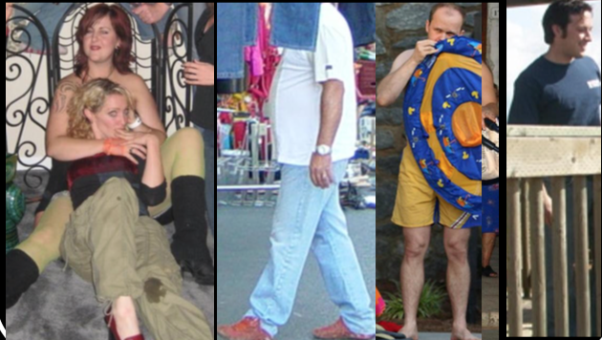
Occlusion
Notes:
Its often to find occlusion in real life and also in some challenging dataset.

Slide 8
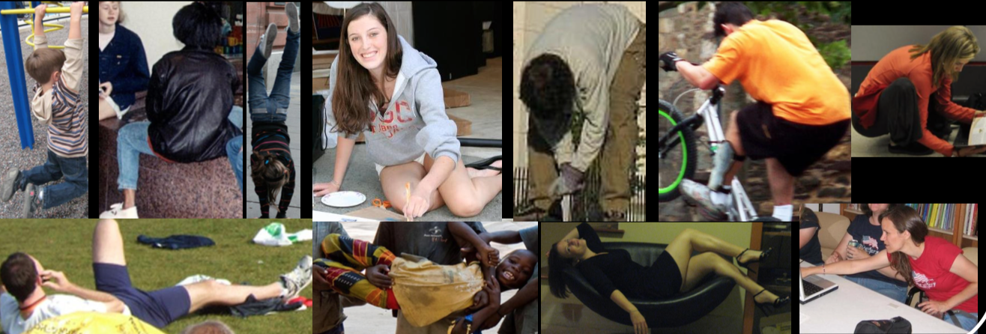
Pose Variations
Notes:
There are various poses a person can be in.

Slide 9
Some technical jargon
Notes:
Most of which you will be familiar with by now, so to refresh our memories from january

Slide 10
Before that – some technical jargon we need to know
Transfer learning
Poselets
Attribute Classification
Decaf
Notes:
Poselets captures part of the pose from a given view point
Decaf is an open-source implementation of these deep convolutional activation features, along with all associated network parameters to enable vision researchers to be able to conduct experimentation with deep representations across a range of visual concept learning paradigms

Slide 11
Existing Approaches
Notes:
Now I discuss some relevant work that has been done already

Slide 12
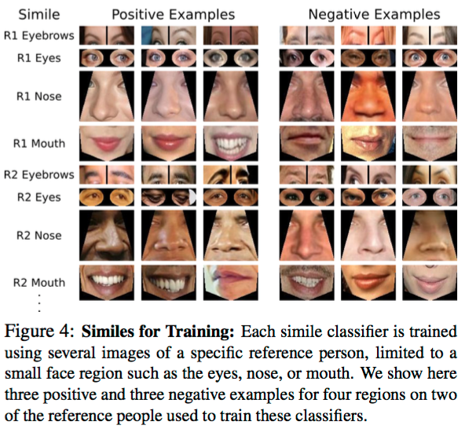
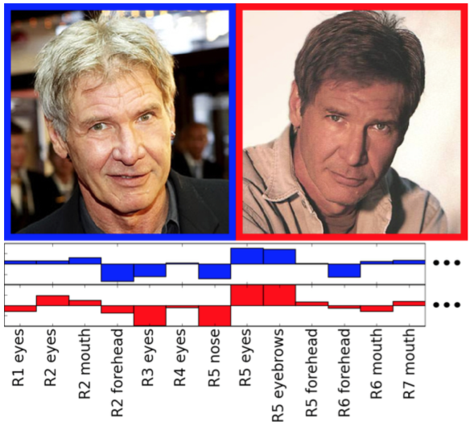
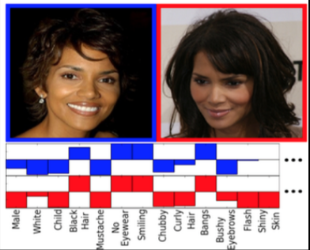
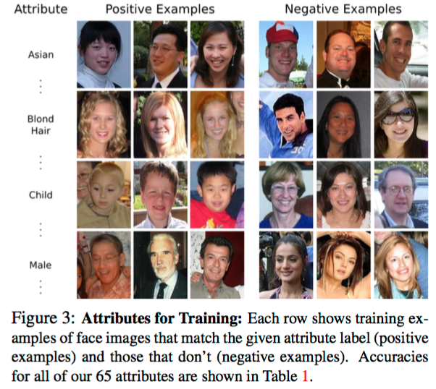
Facial attribute [ICCV’09 Kumar et al.]
Notes:
“attribute” classifiers – uses binary classifiers trained to recognize the presence or absence of de- scribable aspects of visual appearance (e.g., gender, race, and age). Our second method – “simile” classifiers – re- moves the manual labeling required for attribute classification and instead learns the similarity of faces, or regions of faces, to specific reference people.

Slide 13
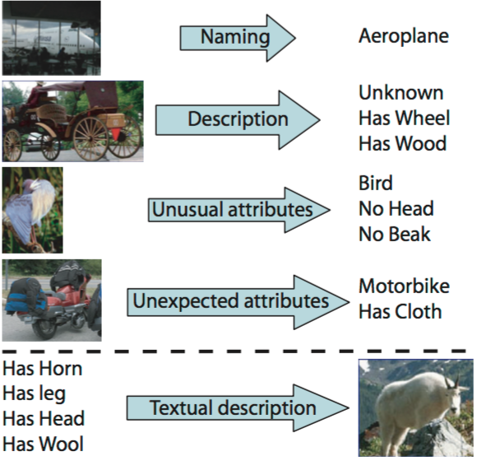
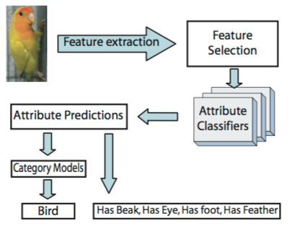
Describing Objects by their Attributes [CVPR’09 Ali et al.]

Slide 14
Human pose estimation [Toshev et al. CVPR 14]
Face verification [Taigman et al. CVPR 14]

Slide 15
Post 2012: lets add CNNs and see what happens…

Slide 16
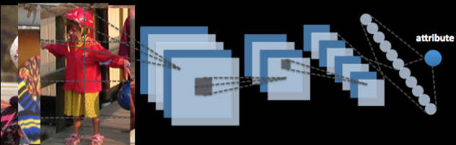

Can we train a CNN from scratch?
Lack of training data!
Notes:
A natural idea is that given a bounding box of an image, can we train a convnet for each of the annotated attribute

Slide 17
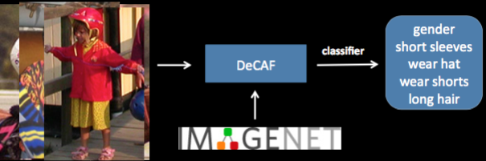

What if we finetune from ImageNet?
Can CNNs do better than this?
[Donahue et al. ICML 2014]
Notes:
What is Decaf? an open-source implementation of these deep convolutional activation features, along with all associated network parameters to enable vision researchers to be able to conduct experimentation with deep representations across a range of visual concept learning paradigms.
Given the same bounding box image, instead of training the CNN from scratch, we could extract features from a pre-trained imagenet model

Slide 18
Problem Revisited
Suppose I wear glasses
Occluded by hair
Affected by head pose
Glasses signal is weak at the scale of a full person
So we need to localize objects by parts to start predicting

Slide 19
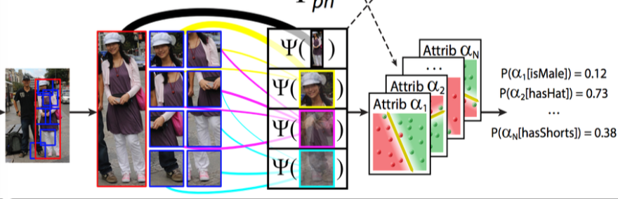
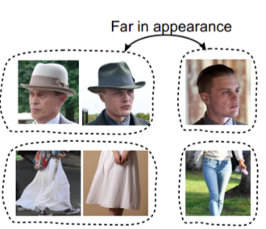
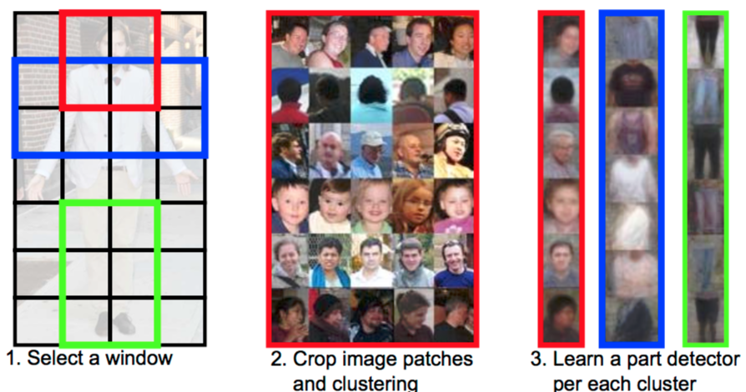

The then state-of-the-art
Part based approach [ICCV’11 Bourdev et al.] [ICCV’13 Zhang et al. & Joo et al.]
Notes:
Normalize the person images to inter-canonical poses
A successful method that we have learnt from this work is to try to localize objects by parts

Slide 20

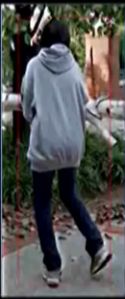
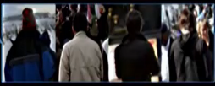

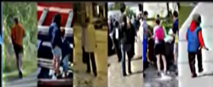
Decompose the image into parts
Gender
Long hair
Wear long pants
Wear jeans
Wear glasses
Is sitting
Is playing tennis
Is dancing
Notes:
If we can decompose the image into parts such as the back of the head, the upper body, the legs and the whole body. We can use this pose normalization representation to predict the attributes

Slide 21


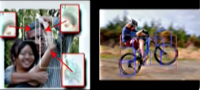
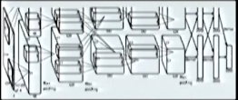
PANDA approach
Pose Aligned Network for
Deep Attribute Modelling
Part based models
CNNs

Slide 22
PANDA
Use CNNs to learn discriminative features
Use poselets for their ability to simplify the learning task by decomposing the object into their canonical poses.
Notes:
They use poselets as their part based model. Poselets captures part of the pose from a given view point. They use the open source poselet detectors.

Slide 23
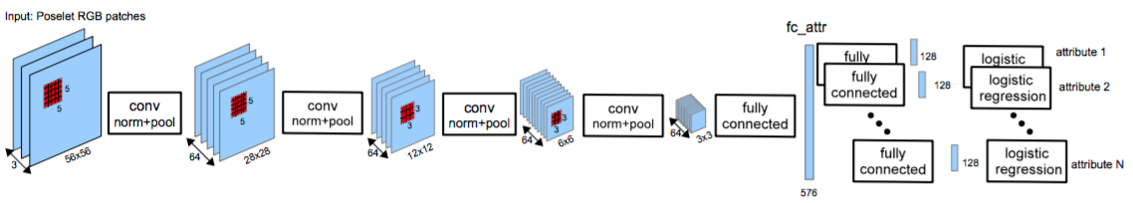
AlexNet type Architecture
Each poselet patch is resized to 64x64, randomly jittered and flipped horizontally to improve generalization.
The fc_attr is 576x150 dimension. After this, the network branches out one fc with 128 hidden units for each attribute.
Each of the branch outputs a binary classifier of the attribute.

Slide 24
What if there are only a few poselets detected
Solution – need to also incorporate the whole person bounding box region.
It turns out that a more complex net is needed to do that. Therefore the authors used a pre-trained ImageNet model as the deep representation of the full image patch.

Slide 25


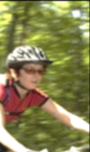
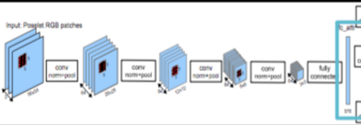

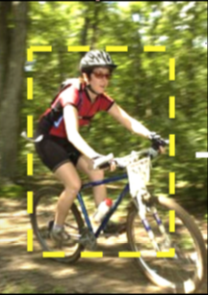


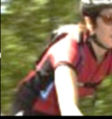

Holistic
Linear SVM
Gender
Short
Sleeves
Wear hat
Wear shorts
Long hair
Concatenate to give
the final representation
Notes:
Extract the generic attribute layer as the part based representation

Slide 26
Dataset
What is the ground truth
What is the attribute
How big is it
Is it big enough?

Slide 27
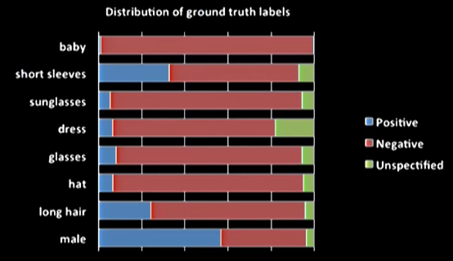
Dataset: Attribute 25k
On an average there are 2061 training examples for each poselet

Slide 28
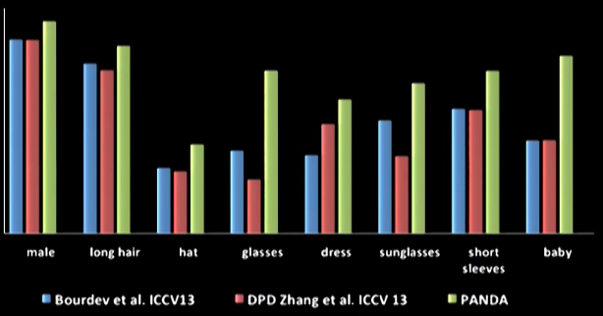
Evaluations
Average Precision on Attribute 25k

Slide 29
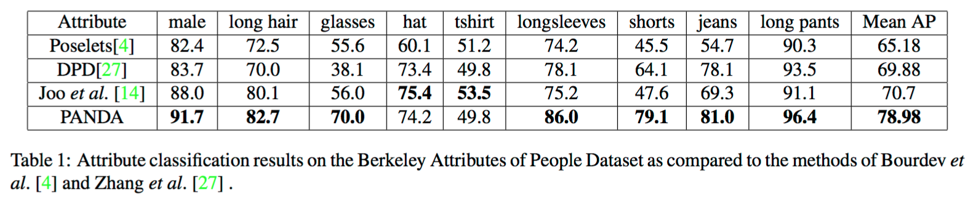
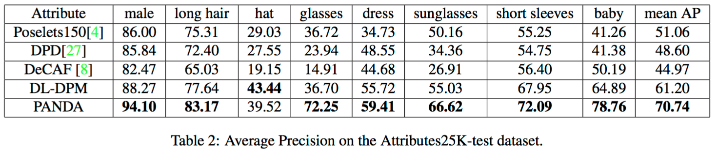

Slide 30
Top scoring examples

Slide 31
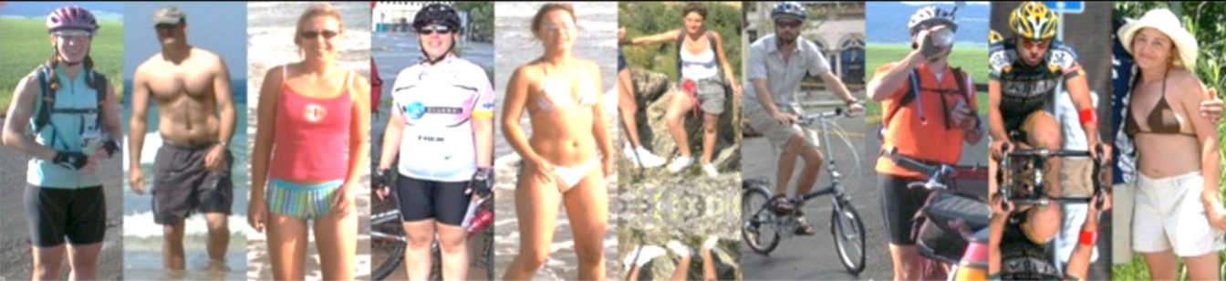
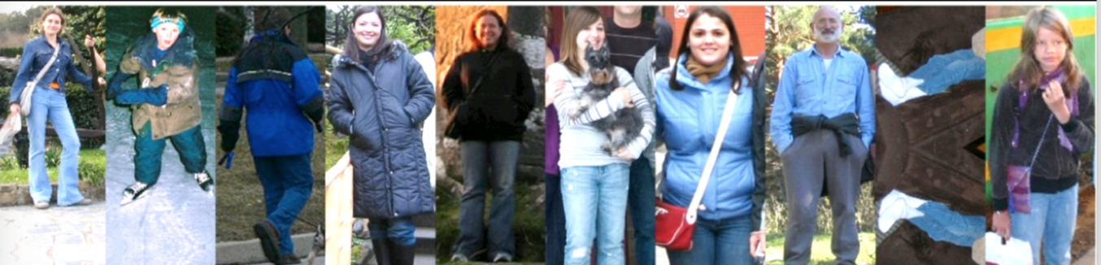
Wear shorts
Wear hat
Wear jeans

Slide 32
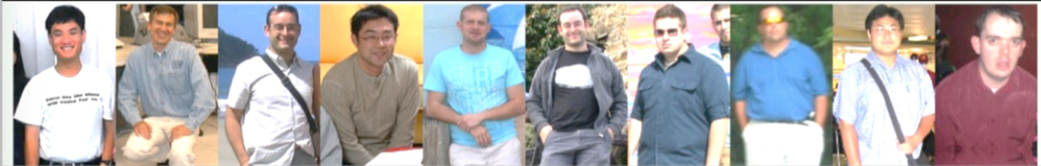
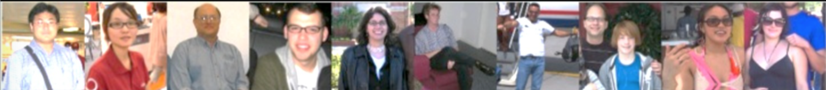
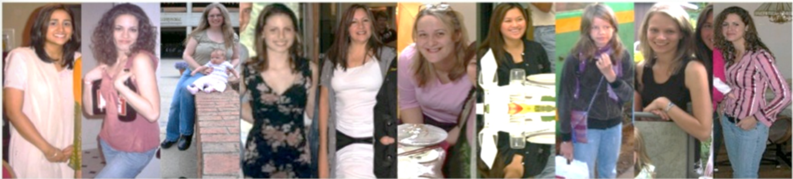
Short hair
Wear glasses
female

Slide 33
Failure cases

Slide 34
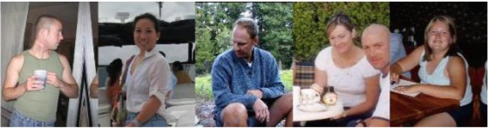
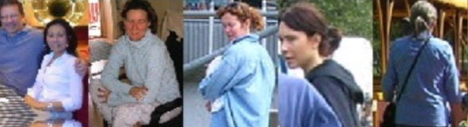
Incorrect predictions as wearing tshirts
Incorrect prediction for short hair

Slide 35
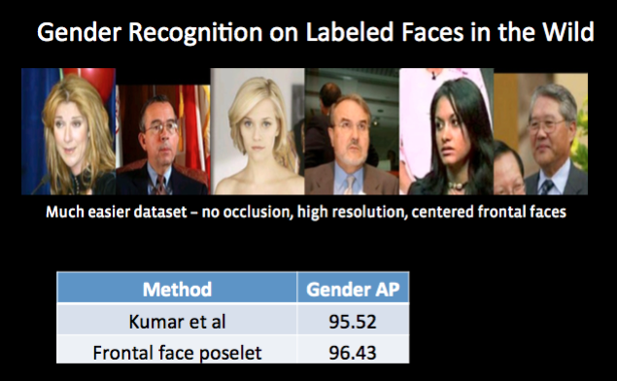
[Kumar et al, ICCV 2009]

Slide 36
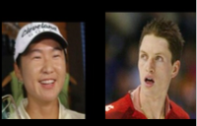
[Kumar et al, ICCV 2009]

Slide 37
PANDA: main contributions
Combine part based model and deep learning
Use of pose-normalized CNNs
Testing and beating the previous state-of-the-art on 3 datasets (training on their own Facebook dataset of 25K images)
Notes:
Now I discuss some relevant work that has been done already

