Slide 1
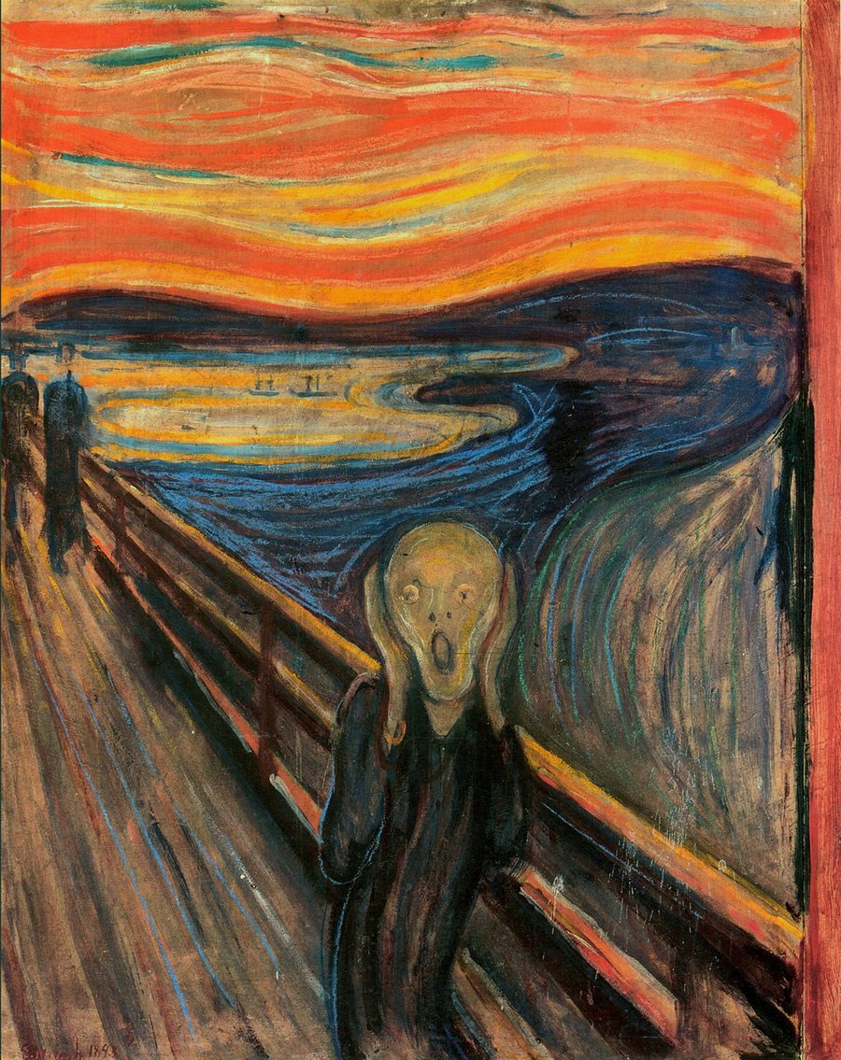
Image Morphing
Edvard Munch, “The Scream”
CSC320: Introduction to Visual Computing
Michael Guerzhoy
Many slides borrowed
from Derek Hoeim, Alexei Efros

Slide 2
Morphing Examples
Women in art
http://youtube.com/watch?v=nUDIoN-_Hxs
Aging
http://www.youtube.com/watch?v=L0GKp-uvjO0

Slide 3
Morphing = Object Averaging
The aim is to find “an average” between two objects
Not an average of two images of objects…
…but an image of the average object!
How can we make a smooth transition in time?
Do a “weighted average” over time t

Slide 4
Averaging Points
Q
What’s the average
of P and Q?
v = Q - P
P
Extrapolation: t<0 or t>1
P + 1.5v
= P + 1.5(Q – P)
= -0.5P + 1.5 Q (t=1.5)
P + 0.5v
= P + 0.5(Q – P)
= 0.5P + 0.5 Q
Linear Interpolation
New point: (1-t)P + tQ
0<t<1
P and Q can be anything:
points on a plane (2D) or in space (3D)
Colors in RGB (3D)
Whole images (m-by-n D)… etc.

Slide 5
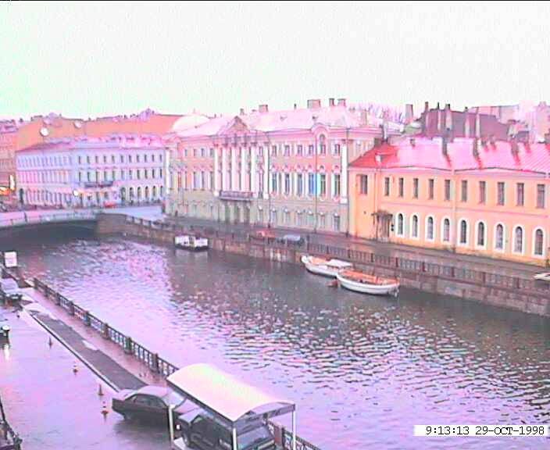
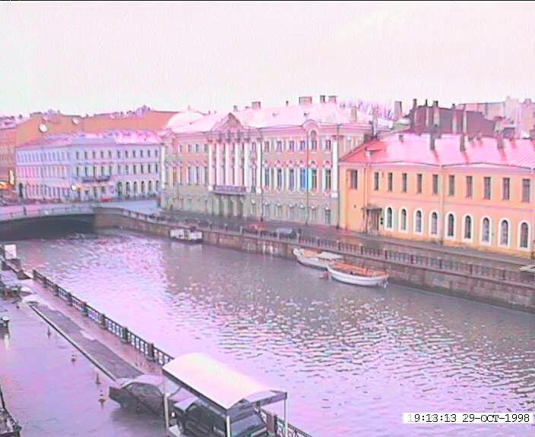
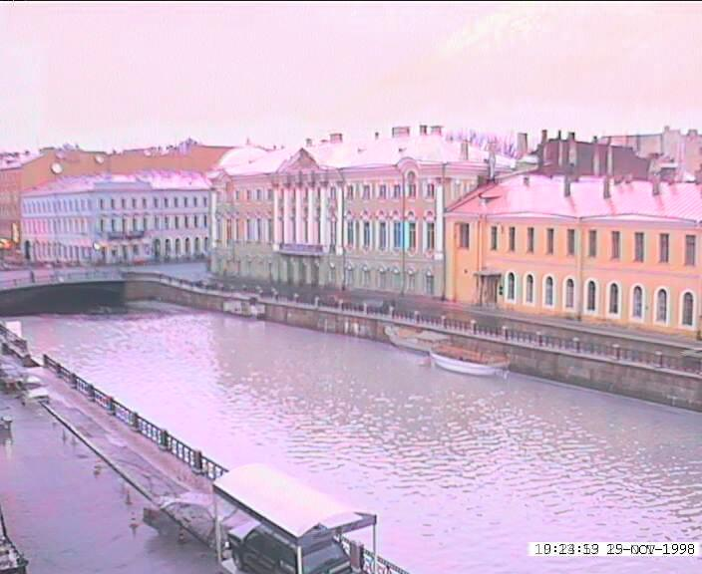
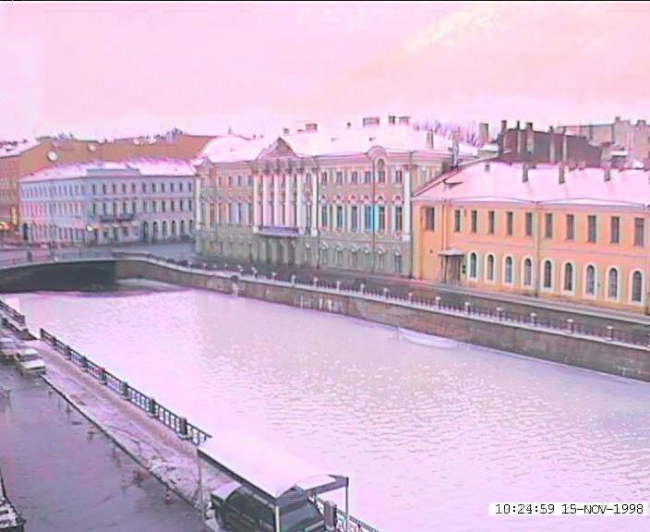
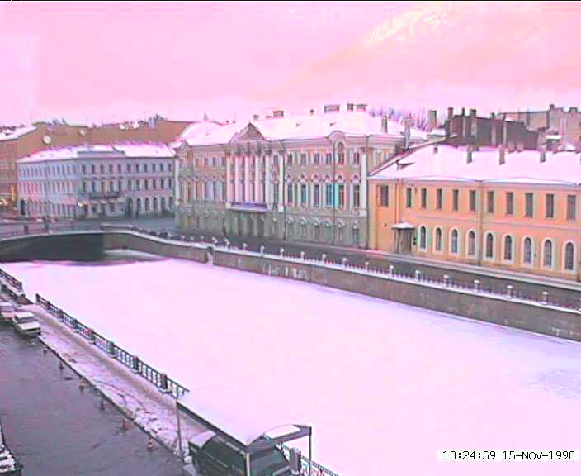
Idea #1: Cross-Dissolve
Interpolate whole images:
Image_{halfway} = (1-t)*Image₁ + t*image₂
This is called cross-dissolve in film industry
But what if the images are not aligned?

Slide 6
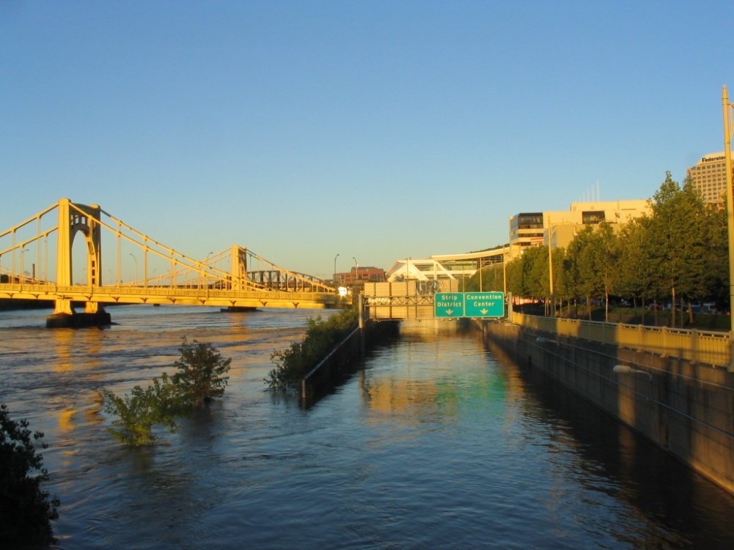
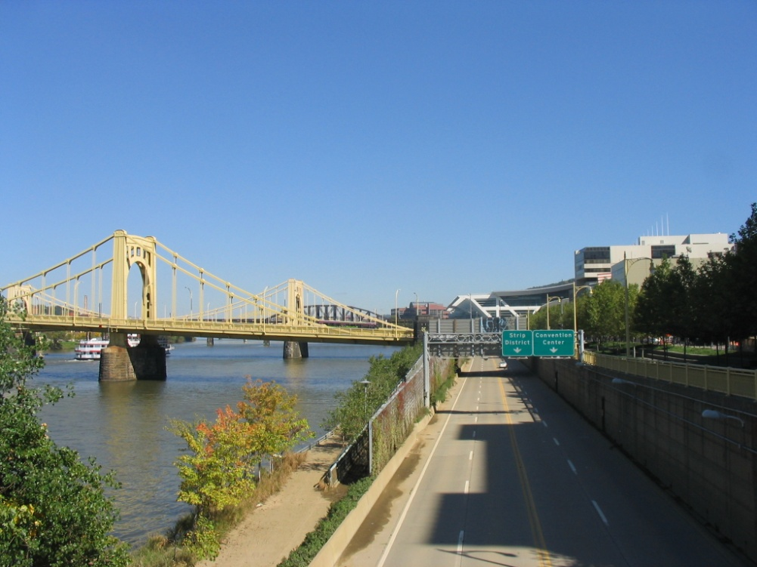
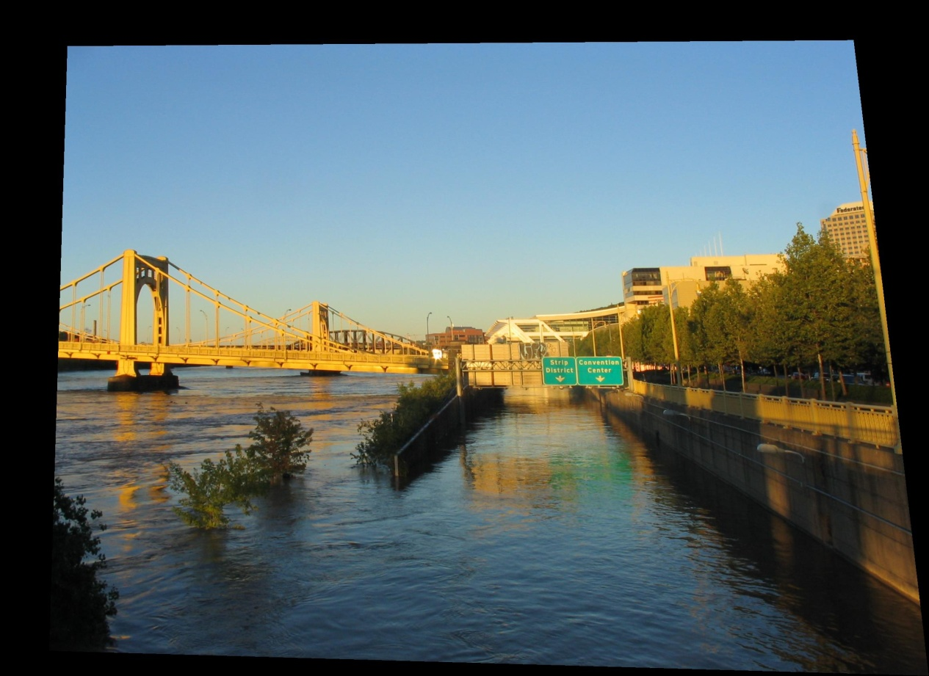
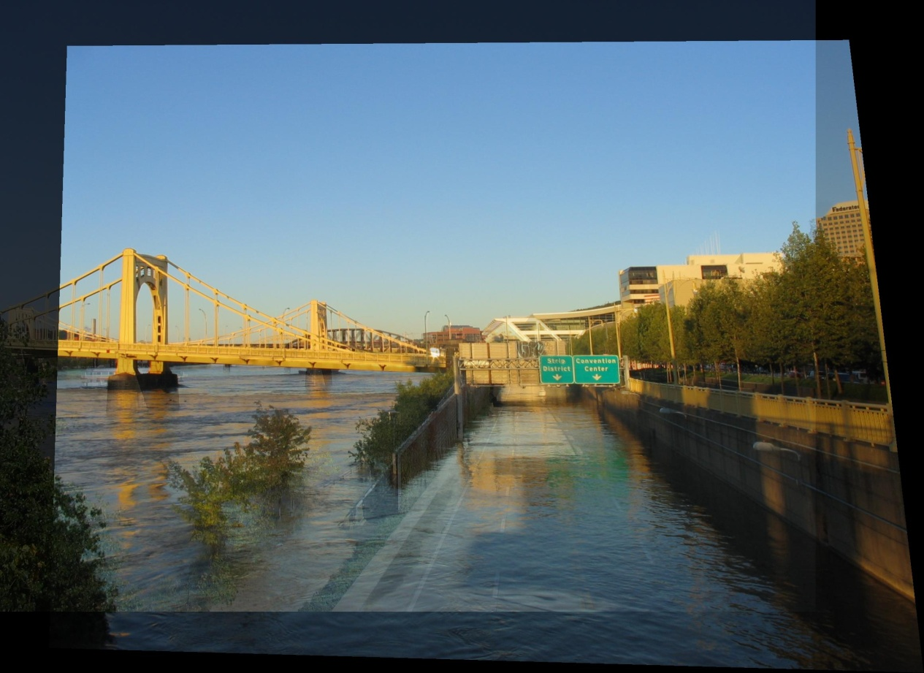
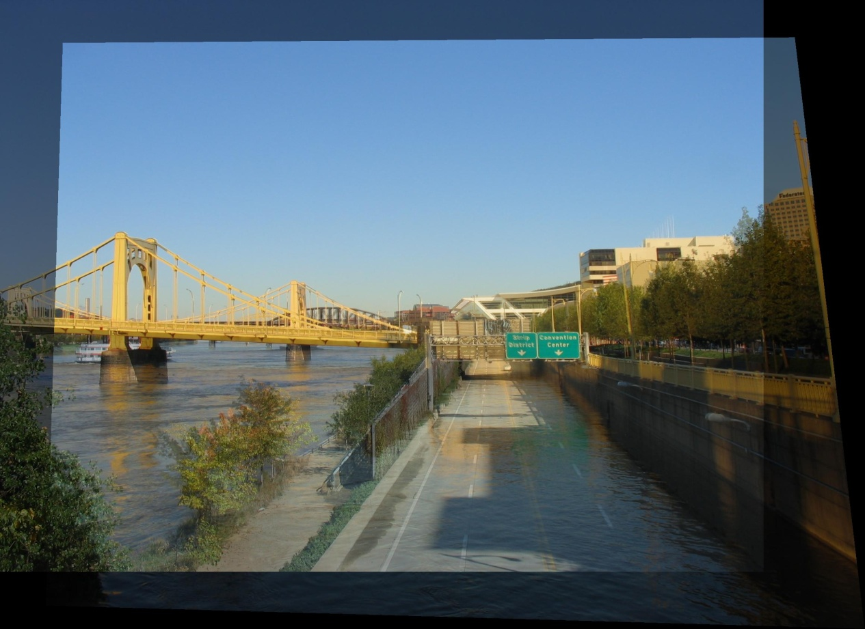
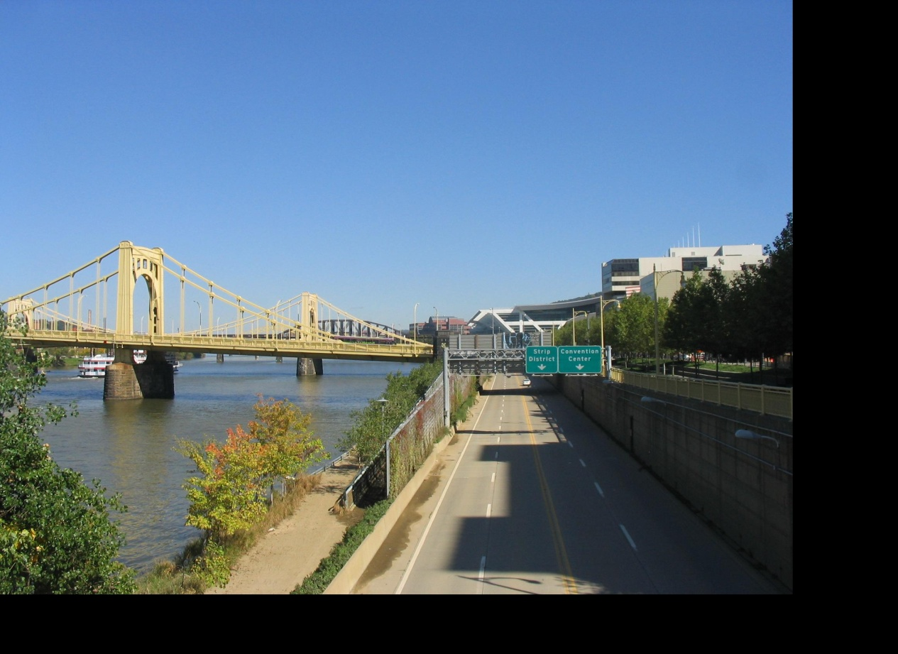
Idea #2: Align, then cross-disolve
Align first, then cross-dissolve
Alignment using global warp – picture still valid

Slide 7
Dog Averaging
What to do?
Cross-dissolve doesn’t work
Global alignment doesn’t work
Cannot be done with a global transformation (e.g. affine)
Any ideas?
Feature matching!
Nose to nose, tail to tail, etc.
This is a local (non-parametric) warp

Slide 8
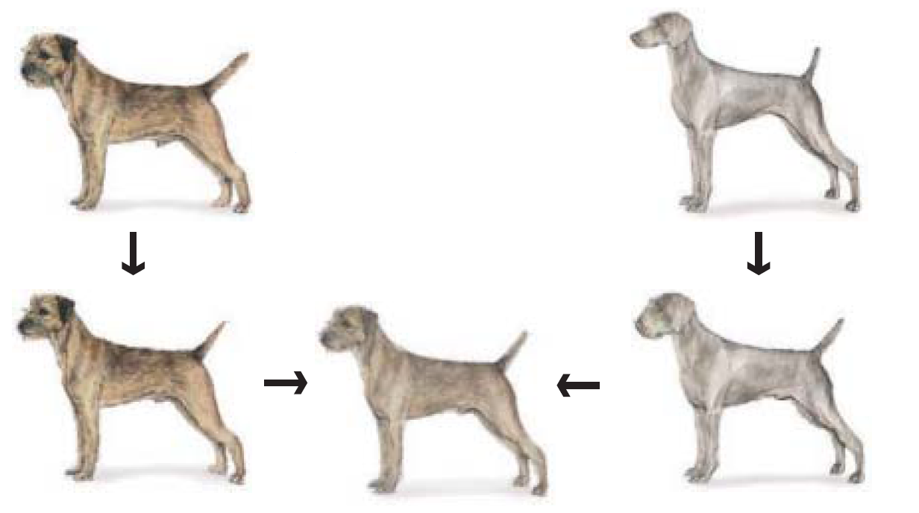
Idea #3: Local warp, then cross-dissolve
Morphing procedure
For every frame t,
Find the average shape (the “mean dog”☺)
local warping
Find the average color
Cross-dissolve the warped images

Slide 9
Local (non-parametric) Image Warping
Need to specify a more detailed warp function
Global warps were functions of a few (2,4,8) parameters
Non-parametric warps u(x,y) and v(x,y) can be defined independently for every single location x,y!
Once we know vector field u,v we can easily warp each pixel (use backward warping with interpolation)

Slide 10
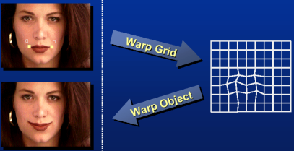
Image Warping – non-parametric
Move control points to specify a spline warp
Spline produces a smooth vector field

Slide 11
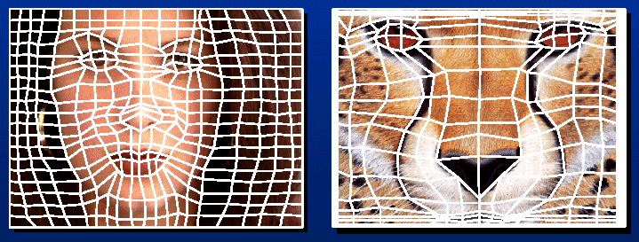
Warp specification - dense
How can we specify the warp?
Specify corresponding spline control points
interpolate to a complete warping function
But we want to specify only a few points, not a grid

Slide 12
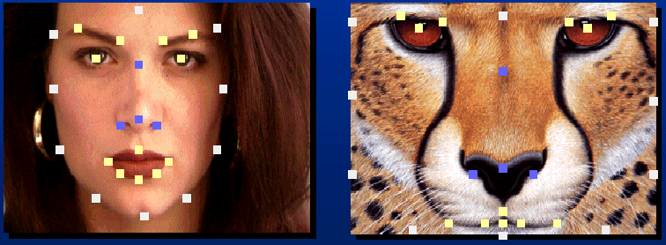
Warp specification - sparse
How can we specify the warp?
Specify corresponding points
interpolate to a complete warping function
How do we do it?
How do we go from feature points to pixels?

Slide 13
Triangular Mesh
Input correspondences at key feature points
Define a triangular mesh over the points
Same mesh (triangulation) in both images!
Now we have triangle-to-triangle correspondences
Warp each triangle separately from source to destination
Affine warp with three corresponding points

Slide 14
Triangulations
A triangulation of set of points in the plane is a partition of the convex hull to triangles whose vertices are the points, and do not contain other points.
There are an exponential number of triangulations of a point set.

Slide 15
An O(n³) Triangulation Algorithm
Repeat until impossible:
Select two sites.
If the edge connecting them does not intersect previous edges, keep it.

Slide 16
“Quality” Triangulations
Let α(T_{i}) = (α_{i1}, α_{i2} ,.., α_{i3}) be the vector of angles in the triangulation T in increasing order:
A triangulation T₁ is “better” than T₂ if the smallest angle of T₁ is larger than the smallest angle of T₂
Delaunay triangulation is the “best” (maximizes the smallest angles)
good
bad

Slide 17
Image Morphing
How do we create a morphing sequence?
Create an intermediate shape (by interpolation)
Warp both images towards it
Cross-dissolve the colors in the newly warped images

Slide 18
Warp interpolation
How do we create an intermediate shape at time t?
Assume t = [0,1]
Simple linear interpolation of each feature pair
(1-t)*p1+t*p0 for corresponding features p0 and p1

Slide 19
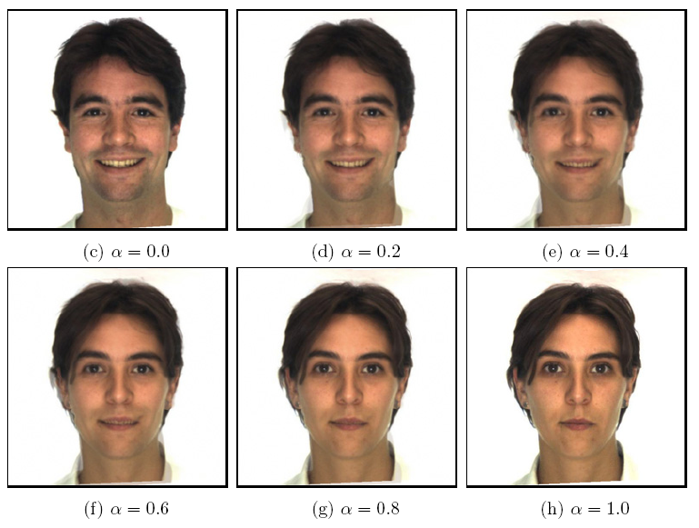
Morphing & matting
Extract foreground first to avoid artifacts in the background
Slide by Durand and Freeman

Slide 20
Dynamic Scene
Black or White (MJ):
http://www.youtube.com/watch?v=R4kLKv5gtxc
Willow morph: http://www.youtube.com/watch?v=uLUyuWo3pG0

Slide 21
Summary of morphing
Define corresponding points
Define triangulation on points
Use same triangulation for both images
For each t in 0:step:1
Compute the average shape (weighted average of points)
For each triangle in the average shape
Get the affine projection to the corresponding triangles in each image
For each pixel in the triangle, find the corresponding points in each image and set value to weighted average (optionally use interpolation)
Save the image as the next frame of the sequence

