Slide 1
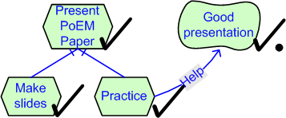

Evaluating Goal Achievement in Enterprise Modeling – An Interactive Procedure and Experiences
Jennifer Horkoff¹
Eric Yu²
¹Department of Computer Science, ²Faculty of Information,
University of Toronto
jenhork@cs.utoronto.ca, yu@ischool.utoronto.ca

Slide 2
Outline
Goal- and Agent-Oriented Modeling (GaAOM)
Example GaAOM Application
Existing Approaches to GaAOM Analysis
Goals of this Work
Example GaAOM Methodology
Qualitative, Interactive GaAOM Evaluation
Example and Implementation
Case Studies
Exploratory Experiment
Conclusions
Future Work

Slide 3
Goal- and Agent-Oriented Modeling (GaAOM)
Goal- and Agent-Oriented Modeling Frameworks capture:
  Actors and stakeholders
  Goals
  Dependencies
  Responsibilities
  Conflicts
  Alternatives
Examples Frameworks: i*, GRL, NFR, Tropos
Such modeling has typically been used as part of system development in the “Early RE (Requirements Engineering)” Stage
  Information in this stage is often incomplete and difficult to quantify
GaAOMs can be used more generally to model, understand and reason about enterprises

Slide 4
Example GaAOM Application
Not-for-profit organization
  Provides phone counseling for youth
  Wants to read more youth using the internet
Considerations:
  Online counseling can reach more kids
  Kids may have an easier time opening up online
  Counselor lose cues (voice) with online communication
  Confidentiality and privacy concerns
  Protection from child predators
  Public scrutiny over advice
  Concern for liability
How can the organization explore and evaluate options for online counseling?

Slide 5
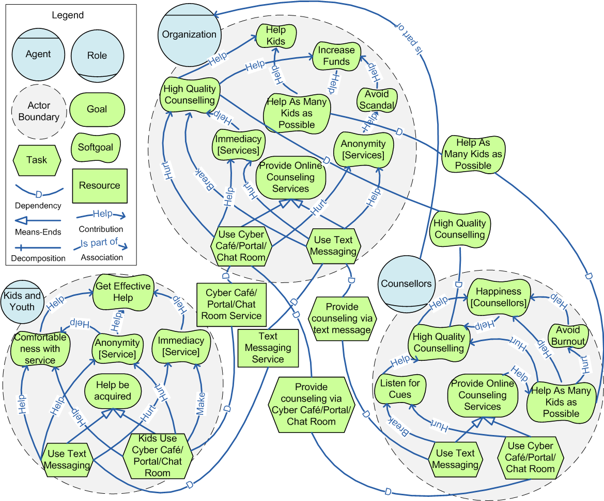
Example GaAOM Application
What if….
Reaching as many kids as possible?
We need a systematic and consistent way to evaluate the affects of alternative choices in the model…
The organization used a chat room and not text messaging?
How would this effect the happiness of counselors?
Effective help for Youth?

Slide 6
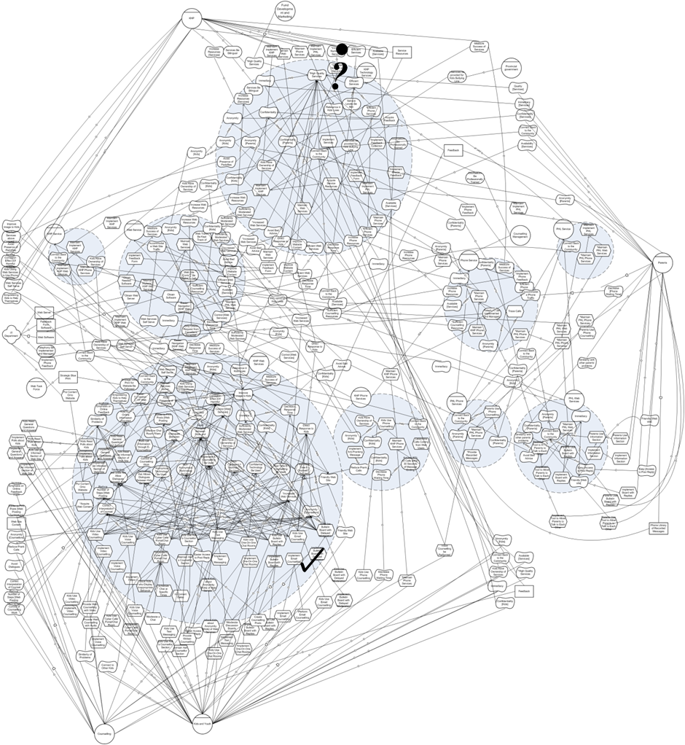
Example GaAOM Application
…especially for large models

Slide 7
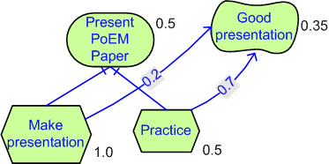
Existing Approaches to GaAOM Analysis
Existing approaches are often:
  Quantitative: Use numbers to express goal satisfaction
  Automatic: Set rules are used for all propagation
Issues:
  Where do the numbers come from? What do they mean? How are they calculated?
  Will stakeholders trust or understand results?
  Will stakeholders assign mathematical precision to numbers?
  What do we learn from the reasoning process?

Slide 8
Goals of this Work
Through analysis of GaAOM, facilitate:
  Comparison of alternatives
  Model improvement: iteration over the model
  Learning and discovery: further elicitation
Approach:
  Interactive, Qualitative Evaluation
    Interactive: compensate for incomplete nature of GaAOMs with human intervention
    Qualitative: reason in early stages of analysis before concrete, qualitative information is known

Slide 9
Example GaAOM Methodology
Suggested steps, to be performed with backtracking:
Identify scope or purpose of the modeling
Identify model sources
Identify actors and associations
Identify relevant dependencies
Identify actor intentions
  Identify intentions
  Match dependencies to intentions
  Identify relationships between intentions
Evaluate alternatives within a model
  Modify the model as necessary
  Return to the domain with further questions

Slide 10
Qualitative, Interactive GaAOM Evaluation: Overview
Initiation: Decide on an alternative and apply initial labels to the model, add labels to queue
  Iteratively, until there are no labels in the queue:
  Propagation: Propagate labels through all outgoing links, place results in softgoal “label bags” or in the label queue
  Softgoal Resolution: Softgoal “label bags” are resolved using automatic cases or human judgment, results are placed in the queue
  At any point, make necessary changes to the model or make note of important questions or missing information
Analysis: Examine results to determine impact of alternatives
Repeat with further alternatives

Slide 11





Qualitative Labels
We reuse the qualitative labels from evaluation in the NFR Framework
Full Satisfaction
Full Denial
Label Name | Satisfied | Partially Satisfied | Conflict | Unknown | Partially Denied | Denied
Symbol

Slide 12
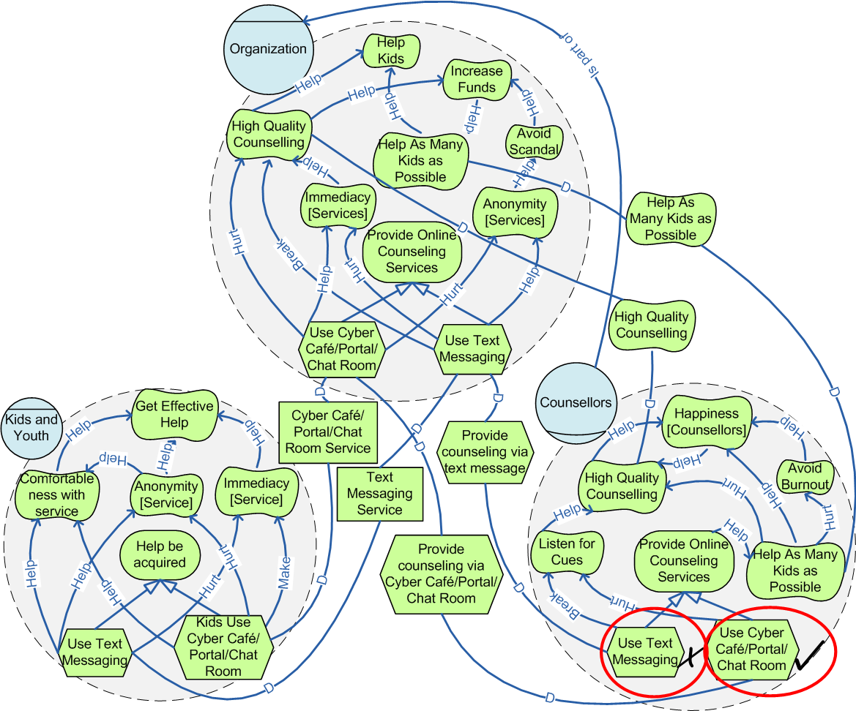
Initial Labels
Reflects an analysis question
Example “What is the effect of using a Cybercafe/Portal/Chat Room?”

Slide 13
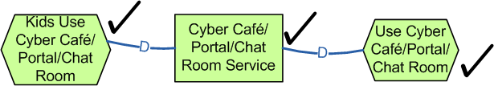
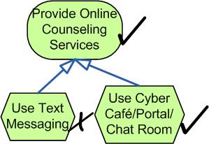
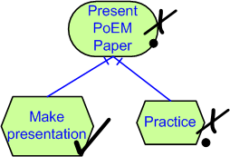
Propagation Rules
Dependency: propagate across
Means-Ends: OR, take the minimum
Decomposition: AND, take the maximum
  Ordering: > > >= > >

Slide 14
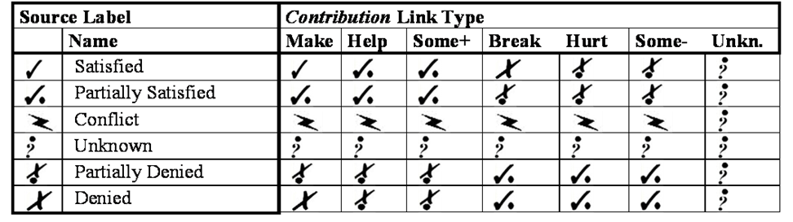
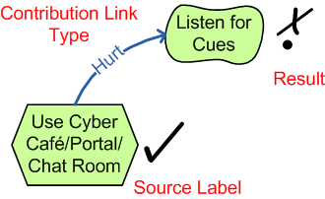
Contribution Propagation
We adopt the contribution link propagation rules from the NFR procedure
Intuitively reflect semantics of contribution links

Slide 15
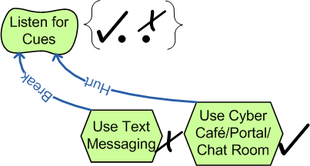
Resolving Multiple Contributions
Softgoals often receive multiple incoming labels
The resulting label is selected using either
  Automated cases
  If cases do not apply, then use human judgment

Slide 16


Human Judgment in Evaluation
Used to select a label in cases with conflicting or partial evidence
The user/evaluator selects a label based in their knowledge of the domain and the context in the model
Compensates for the inherent incompleteness of social models
Human Judgment
Listen for Cues receives the following Labels:
from Use Text Messaging
from Use Cyber Café/Portal/Chat Room
Select Label…
Select

Slide 17
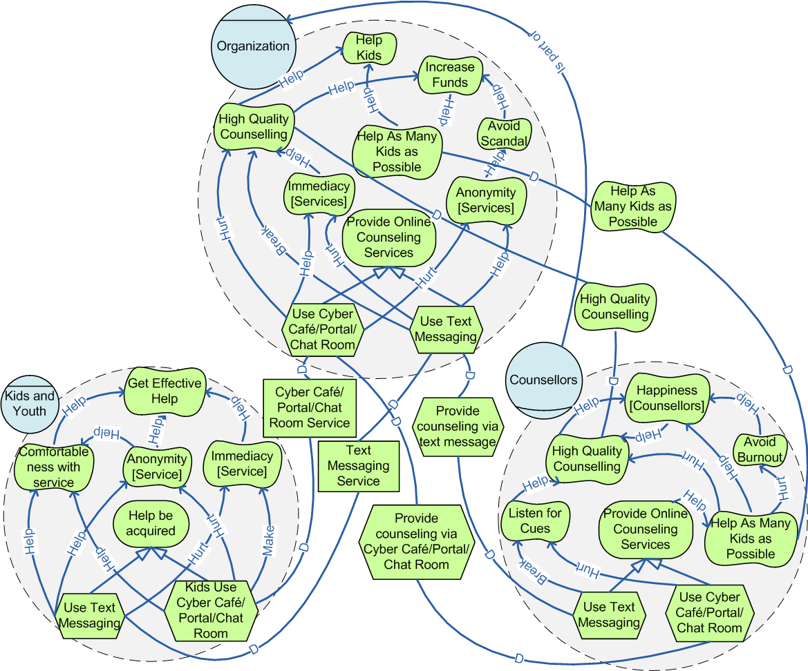
Example
Human Judgment
Anonymity receives the following Labels:
from Use Text Messaging
from Use Cyber Café/Portal/Chat Room
Select Label…
Select
Human Judgment
Listen for Cues receives the following Labels:
from Use Text Messaging
from Use Cyber Café/Portal/Chat Room
Select Label…
Select
Horkoff, Yu: Evaluating Goal Achievement in Enterprise Modeling

Slide 18
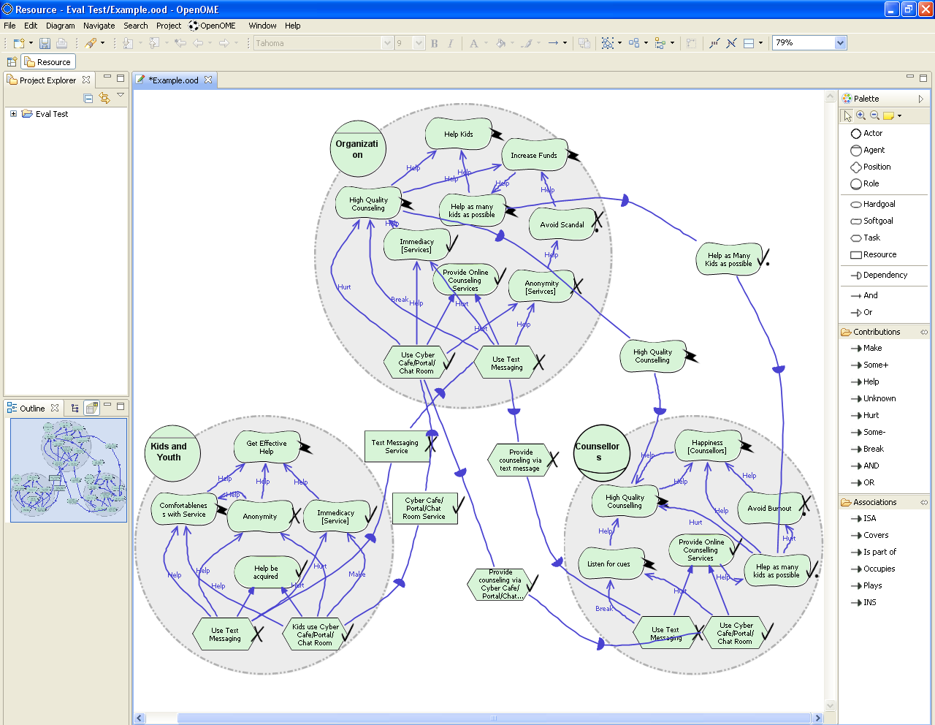
Example and Implementation
OpenOME: open-source Eclipse-based plug-in
Uses the GMF and EMF Frameworks
  Mix of automatically generated and custom code
https://se.cs.toronto.edu/trac/ome

Slide 19
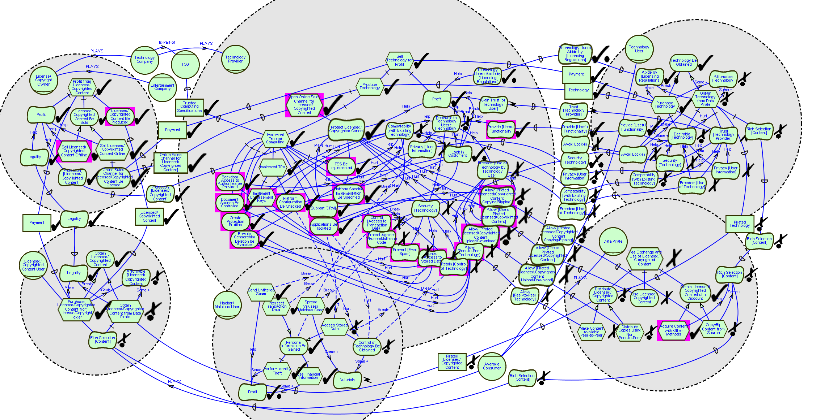
Case Studies: Trusted Computing
Evaluation used as a means of understanding, justifying, and explaining a complex situation
Demonstrated the ability of the procedure to provoke iteration

Slide 20
Case Studies: Social Service Organization
Applied in several stages, each stage using evaluation:
  Analyze and compare the effectiveness of technology options for internet counseling
  Increase the efficiency of the existing system
  Analyze knowledge management needs of the organization
  Test the application of model patterns to i*
  Result: Analysis well-received by the organization
Observations attested to model iteration provoked by the procedure
  Example: before evaluation 181 links and 166 elements, after evaluation 222 links and 178 elements

Slide 21
Exploratory Experiment
Goal-Oriented analysis was applied to analyze sustainability for ICSE
5 participants evaluated two questions over three models
  Once using the procedure, then again without the procedure
Experimental questions, the procedure:
  Leads to finding non-obvious answers to analysis questions?
    Participants made a total of 40 changes to their analysis results after applying the procedure
    Each participant made changes
  Prompts for improvements in the model?
    Participants made 71 changes without using the procedure then 40 more changes using the procedure
    3/5 participants felt that changes made improved the model
  Leads to further elicitation?
    Participants came up with 26 questions without the procedure and 19 more applying the procedure
  Leads to a better understanding of the domain?
    All 5 participants reported a better understanding of the domain using vs. not using the evaluation procedure

Slide 22
Conclusions
Systematic evaluation enhances the utility of GaAOMs
Most previous approaches to evaluation are automatic or quantitative
  Not appropriate for early stages of analysis
Developed and implemented a qualitative, interactive analysis procedure for GaAOMs
Provided a methodology for including the procedure in model creation
Explored benefits of the procedure
  Case studies
  Exploratory experiment

Slide 23
Future Work
Further case studies
  Participatory stakeholder involvement
Further experiments
  Improved design, more participants
Augment models and human judgment with textual arguments (assumptions, domain knowledge)
Facilitate “backwards”, top-down evaluation
Implementation framework

