Slide 1
AIRUS (Automatic Information Retrieval Using Speech)
Winter School `09-> Speech Track -> Group 4
Pulkit
Shantanu
Nitish
Abhilash

Slide 2
Problem Formulation
N people are discussing in a group, each has a microphone
Aim is to
Remove the crosstalk in the speeches recorded by each microphone.
Segment portions of the speech which are important or ‘relevant’. A speech is said to be ‘relevant’ when it conveys information or ideas about the topic of discussion from the speaker to the group.

Slide 3
Example Transcript:
S3- Does anyone have any immediate ideas?
S2- Do we, do we have anything for i guess a masking tape is too
S3- to kind of affix things? ®
S2- oh wow and it's two, two units per inch
S3- We'd better be really efficient with that masking tape
S1- I think a Styrofoam bowl would help ®
S3- yeah can we see the size of the styrofoam and paper bowl?
S3- hmm.. alright. so we've talked about putting some kind of a parachute on. Is that something that we could reasonably build? or ®
S2- I don't think there's anything here that's big enough and light enough
S3- well we've got a paper bag .
S3- We might be able to build it out of that ®
S1- How about a zip lock bag?
S2- but the paper bag's going to be pretty heavy ®
S2- i think I
S1- If you put the eggs inside a zip lock bag and then maybe using the rubber band we can hang it through the paper bowl as top of the parachute? ®

Slide 4
Data available:
Recordings of 2 meetings, each 30 min long.
Each involves 3 speakers
A reference transcript containing start and end times of each speakers speech.
Relevant and non relevant parts are annotated.

Slide 5
Key ideas
Learn the notion of relevance using cues from acoustic information.
Relevance of a speech signal may depend on
The preceding sequence of speeches and patterns in which the speakers take turns speaking
Duration of the speech
Variation and values of pitch and intensity in the speech
Other cues
Need to build a learning model which can incorporate these factors.

Slide 6
Recognizing the Pattern in Speech:
ABACABAD ABACABAD ABACABAD
NNNNRNN NNNNRNN NNNNRNN

Slide 7
Explain intuitively other features used
When a person is speaking longer and louder- maybe he has a point to say
More variation in pitch – speaking clearly.
Distribution of energy in different frequency bands.

Slide 8
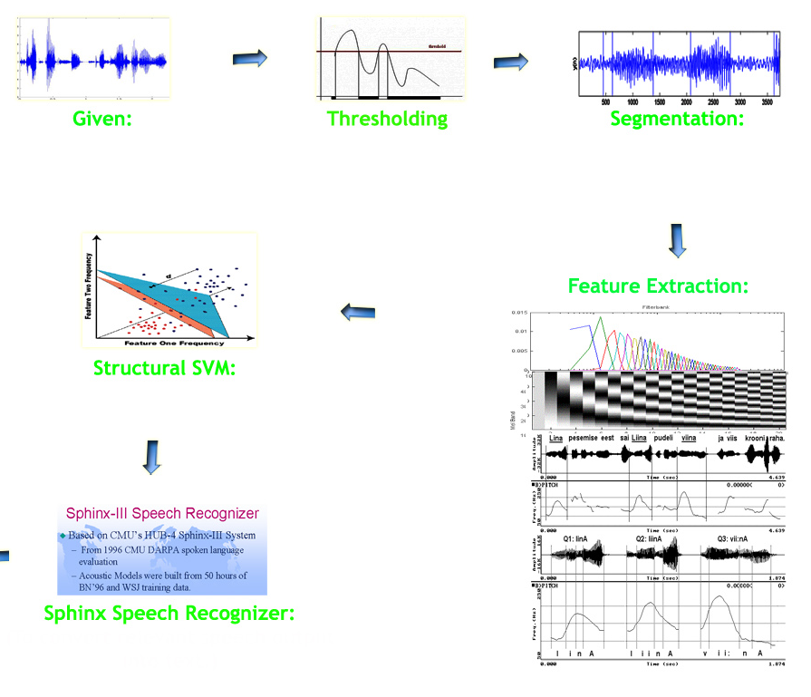
Flowchart:

Slide 9
Removing Cross-talks:
Removal of Cross-talks is done by
Setting a threshold parameter.

Slide 10
Segmenting the Speech Signal:
The signal is scanned from Left to Right by moving a window of 500ms.
The time where signal becomes non-zero is termed as `Start Time`.
The window is moved forward till every value inside window becomes zero.
Then back search is done to get possible `End Point`.

Slide 11
Start Time and End Time Stamping:
Start Time
End Time

Slide 12
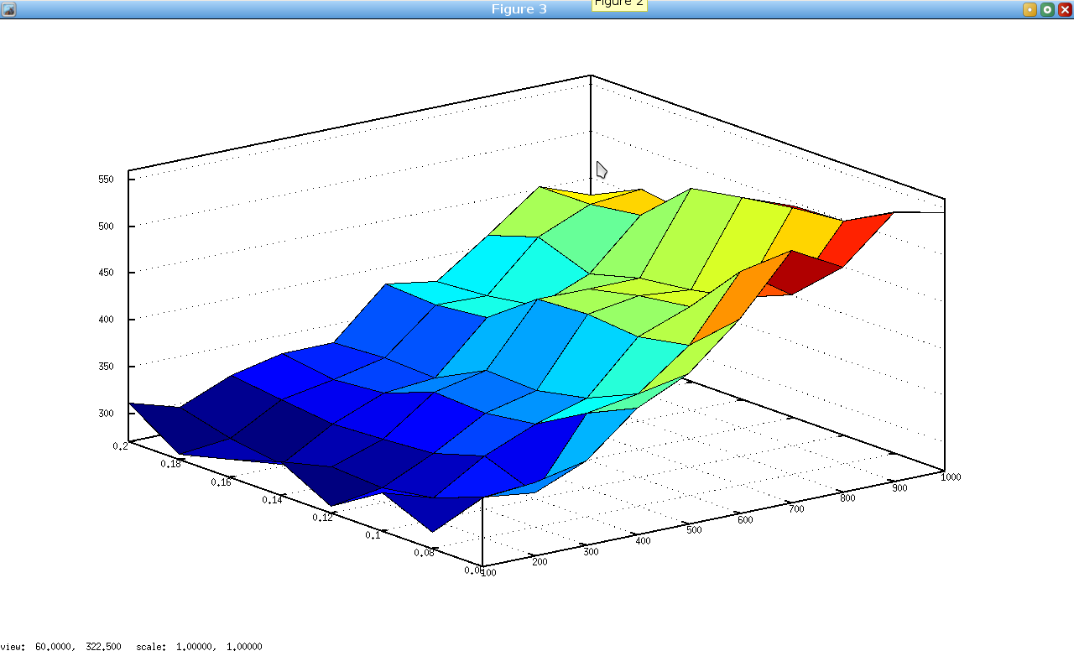
Selection of Threshold and Window Size:

Slide 13
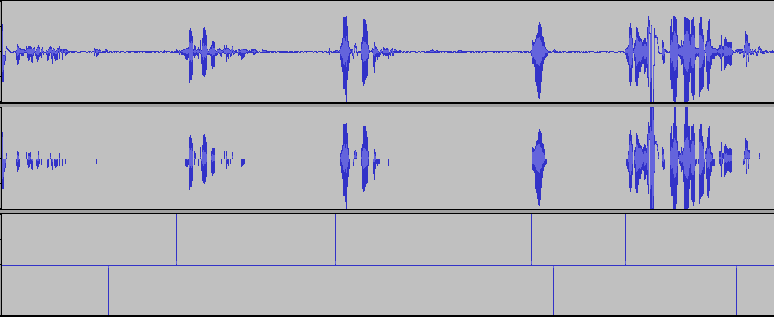
Above: Original Speech Sample
Middle: Removed Cross-talks.
Bottom: Time Stamps Indicating ‘Start time’ and ‘Stop Time’.

Slide 14
Feature Extraction
Feature Vectors are calculated for each segment of speech generated in the previous step.
Mel Frequency Cepstral Coefficients(MFCC):
It gives distribution of energy in different spectral bands.
40 MFCC Coefficients are calculated for each segment.
Principal Component Analysis(PCA) was used to obtain the best coefficients representing the feature of each speech segment.

Slide 15
MFCC
Mel Cepstrum
Dim 1
Dim 2
Dim 3
Dim 4 Dim 5
Dim 6
…
Giving one n-dimensional vector for the frame
Log Mel spectrum
Another transform (DCT/inverse DCT)
Logarithm
All weighted spectral values for each filter are integrated (added), giving one value per filter
RS- Carnegie Mellon University

Slide 16
Feature Extraction
Intensity
Pitch
Order of Speech.
Duration of Speech
Skewness (measure of asymmetry of the probability distribution)

Slide 17
Structural SVM for Learning an HMM Model:
These Features are calculated for each segment and are used as basis for prediction of relevancy of a particular text.
Features are used to train a SVM model.
The model thus predicts whether a particular speech belongs to the group of ‘Relevant Speech’ or ‘ Non Relevant Speech’.

Slide 18
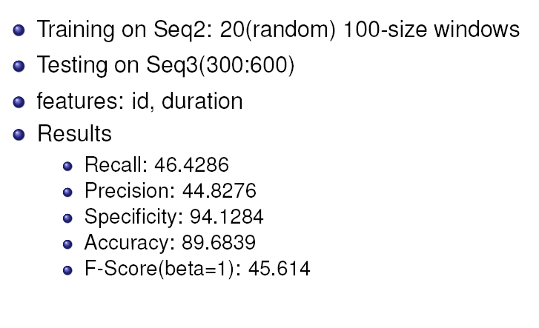
Results

Slide 19
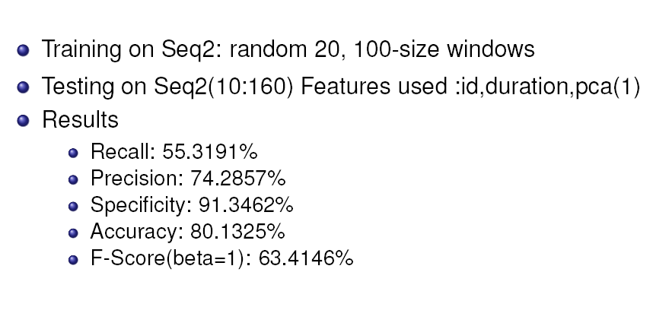
Adding First Features from PCA:

Slide 20
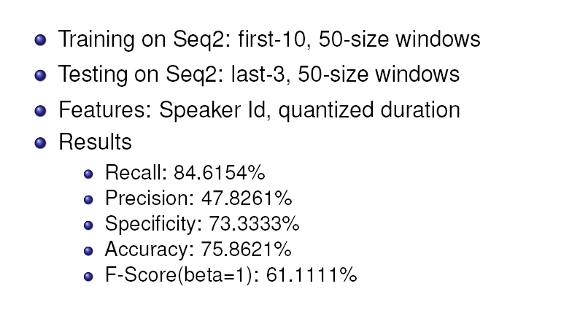
Promising Results:

Slide 21
Direction of Future Research:
Incorporative sequential information in SVM without HMM.
Use of String Prediction.

Slide 22
String Prediction..
A1
A2
Depending on Features : One of the 4 states.
Similarly for Speaker B & C
A1
A1
FEATURES
A2
A1
A2
A2

Slide 23
String Prediction..
A1
A1
B2
B1
C2
C1
R
A1
A2
?

Slide 24
Questions ? Suggestions??

Slide 25
THANK YOU..!!!

