Slide 1

Embedded Ethics:
Objective Functions in Machine Learning

Slide 2
Welcome to Embedded Ethics!
This embedded ethics module is a collaboration between philosophy and computer science.
The goal of embedded ethics is to tie ethics and computer science closely together, so you make ethical considerations in your work and research as computer scientists.

Slide 3
Today: Objective Functions in Machine Learning
Objective Function of Algorithm
Real World Objective
Uses information that is accessible to the system
Not directly accessible to the system

Slide 4
Our Main Example: Recommender Systems
Objective Function of Algorithm
Real World Objective
Uses information that is accessible to the system
Not directly accessible to the system
e.g. user preferences

Slide 5





Objective function of a recommender system
(?)
Which is a proxy for
Fit with user
preferences
To maximize
…….
…….
Make a recommendation of….
Notes:
Image 1 Source: Photo by Eternal Happiness from Pexels (https://www.pexels.com/photo/photo-of-woman-posing-during-golden-hour-3326362/)
Image 2 Source: Photo by Artem Beliaikin from Pexels (https://www.pexels.com/photo/woman-riding-big-swing-in-front-of-waterfalls-1319795/)
Image 3 Source: Photo by Gratisography from Pexels (https://www.pexels.com/photo/man-person-red-white-476/)
Image 4 Source: Photo by Burst from Pexels (https://www.pexels.com/photo/cn-tower-in-toronto-374870/)

Slide 6







Recommender systems are diverse!
Notes:
Image by kirstyfields from Pixabay
Photo by John-Mark Smith: https://www.pexels.com/photo/photo-of-cup-near-flat-screen-television-2726370/

Slide 7
Today
We will start off by considering an “idealized” version of a recommender system – one that just aims to deliver content that users prefer.
  E.g. posts they want to view, movies they want to watch, etc….
As we will see, it is not so easy to determine a user’s preferences.
Then we will consider why you might want to build recommender systems that do not only track people’s preferences.
Finally, we will consider more complex AI algorithms: LLMs, generative AI, and so on.

Slide 8

Part 1:
User Preferences
Notes:
Photo by Jens Johnsson: https://www.pexels.com/photo/brown-wooden-arrow-signed-66100/

Slide 9
Recap and Motivation

Slide 10
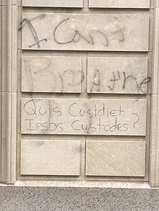
Netflix Challenge
In addition to the learning algorithm, it is important to consider the data and the objective function.
Who designs them, who are they made for and who critiques them
Who watches the watchment? Quis custodiet ipsos custodes" written (misspelling "custodiet" as "custdiet") on a wall in Washington DC (source: Wikipedia)

Slide 11
Warmup: Open up your social media feeds - shout out some of the topics in the posts that you find.

Slide 12

Recommender Systems
Other kinds of recommendation systems include search engines and social media feeds.
What are some difficulties you’d run into if you tried to use a Netflix-style algorithm to organize a user’s social media feed?

Slide 13
Recommender Systems
If you were designing an ML algorithm to organize a user’s social media feed, what other information might you use?
As a supervised learning problem, what would the inputs, and what would be the targets?

Slide 14
Challenge 1: Inferring User Preferences

Slide 15
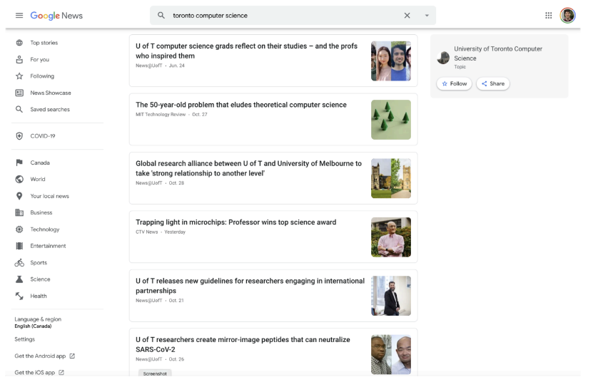
Challenge 1: Inferring User Preferences
Google News was an early example of training a model to predict clicks.

Slide 16
Challenge 1: Inferring User Preferences
Why are clicks a useful signal?
What are some problems with optimizing for clicks?

Slide 17
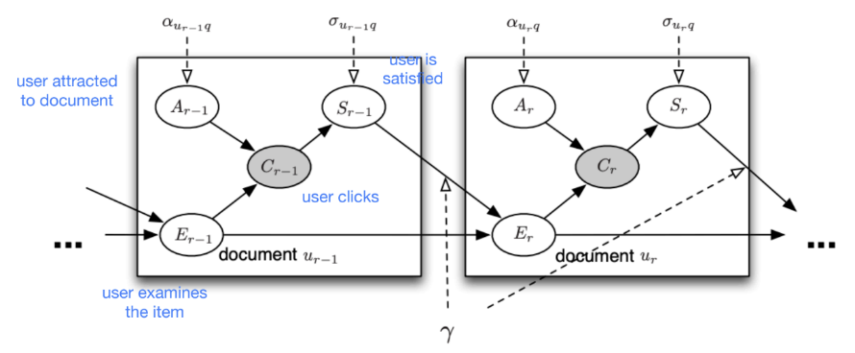
Challenge 1: Inferring User Preferences
Here is a Bayesian network designed to model user behavior for a search engine.
  We covered Bayes nets briefly when we discussed naive Bayes.
Nodes represent random variables, and edges represent direct influences. Shaded = observed.
Want to infer user satisfaction (S).
Chuklin et al., “Click models for web search”

Slide 18
Challenge 1: Inferring User Preferences
User preferences aren’t just a matter of reactions to individual items, but also of the user’s overall experience.
Many web services optimize for a criterion called engagement.
  User’s frequencies, intensity, or depth of interaction with a product over some time period
  Not a technical term, but a business term, instantiated in different ways by different companies
  E.g. Gmail: percentage of active users who visited the side on 5 or more days during the past week Rodden et al., “Measuring the user experience on a large scale”
  E.g. Facebook: time spent on site, meaningful social interactions https://www.washingtonpost.com/technology/interactive/2021/how-facebook-algorithm-works/
This is not directly optimized by an ML algorithm (as far as I know), but is used to evaluate changes to the system.
  Sort of analogous to how logistic regression minimizes cross-en trophy loss but you might tune hyperparameters based on accuracy.

Slide 19
Challenge 1: Inferring User Preferences
The choice of what to optimize for can have ethical implications.
The recently published Facebook Papers reveal a lot about unintended consequences of algorithm design
  My aim isn’t to pick on Facebook here. They found these harms and worked to fix them!
Early years: optimizing for likes and clicks ⇒ clickbait
Optimizing for time spent reading/watching ⇒ favored professional over organic content
2017: service changed to reward comments & emojis ⇒ most successful political posts were the polarizing ones
  Some political parties consciously shifted their messaging to be much more negative
  Facebook eventually rolled back this change for health and politics
https://www.wsj.com/articles/facebook-algorithm-change-zuckerberg-11631654215

Slide 20
Challenge 2: Evaluating Structured Outputs

Slide 21
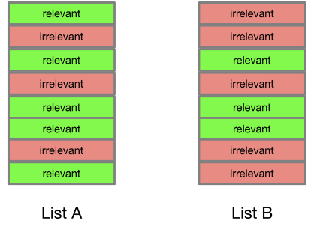
Challenge 2: Evaluating Structured Outputs
Most of this class has focused on classification, where there is a natural metric to use (accuracy).
In this case, we’d like to produce a feed (an ordered list of items). Problems where we want to predict a structured object are known as structured prediction.
For now, assume that all items are either relevant or irrelevant.
Which of the following lists is preferable?

Slide 22
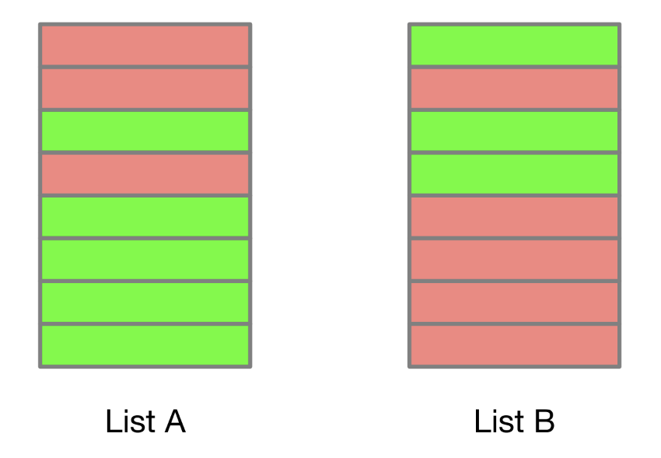
Challenge 2: Evaluating Structured Outputs
One basic measure is precision: the fraction of items which are relevant.
Which of the following lists is preferable?

Slide 23
Challenge 2: Evaluating Structured Outputs
Precision@K: Precision for the list up to the Kth item.
Average Precision (AP): average of Precision@K, where K is taken as the indices of the first N relevant items.
  Moving a relevant item from position 2 to position 1 is worth more points than moving it from position 8 to position 7.
Mean Average Precision (MAP): mean of the AP over multiple queries.
Note: in different application areas, there are different (but related) definitions of AP/MAP.

Slide 24
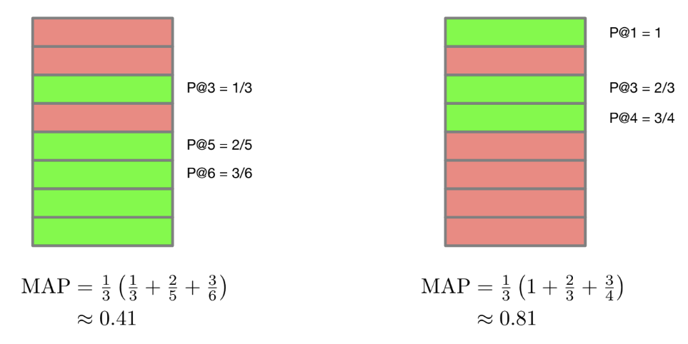
Challenge 2: Evaluating Structured Outputs
An example of calculating AP with N = 3.

Slide 25
Challenge 2: Evaluating Structured Outputs
What other factors might you consider in evaluating a list of recommendations?

Slide 26
Part 2:
Understanding User Preferences
Notes:
Photo by Jens Johnsson: https://www.pexels.com/photo/brown-wooden-arrow-signed-66100/

Slide 27
User Preferences Revisited
From the previous discussion, we have seen that it is difficult to find proxies for what a user actually wants.
E.g. in a social media recommender system, do clicks or viewing time better reflect what users want?
There are also philosophical problems with the very idea of a user preference.

Slide 28
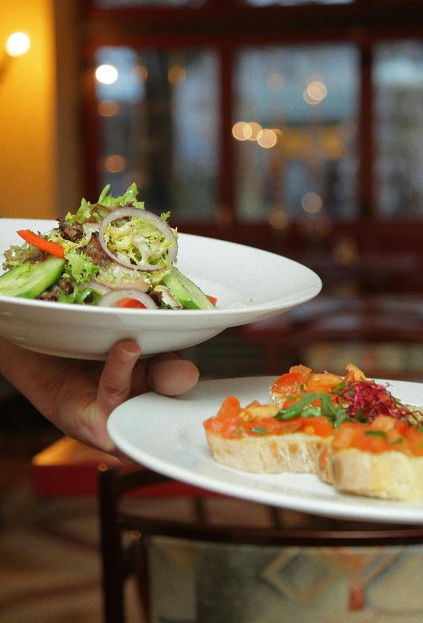
Philosophy of Action
Suppose that someone wants two opposing things.
e.g. you want Thai for lunch, but also want sushi for lunch.
What do you “really” want in this case?
Notes:
One theory: the stronger of the desires is the one you really want.

Slide 29
Philosophy of Action
Suppose that someone wants two opposing things.
e.g. you want Thai for lunch, but also want sushi for lunch.
What do you “really” want in this case?
One theory: the stronger of the desires is the one you really want.
Notes:
One theory: the stronger of the desires is the one you really want.

Slide 30

Philosophy of Action
But consider other cases – e.g. someone who wants to stop an addiction to cigarettes
In this case a person (a) wants the cigarette, but also (b) doesn’t want the cigarette.
Usually (a) is stronger than (b).
Notes:
One theory: the stronger of the desires is the one you really want.

Slide 31
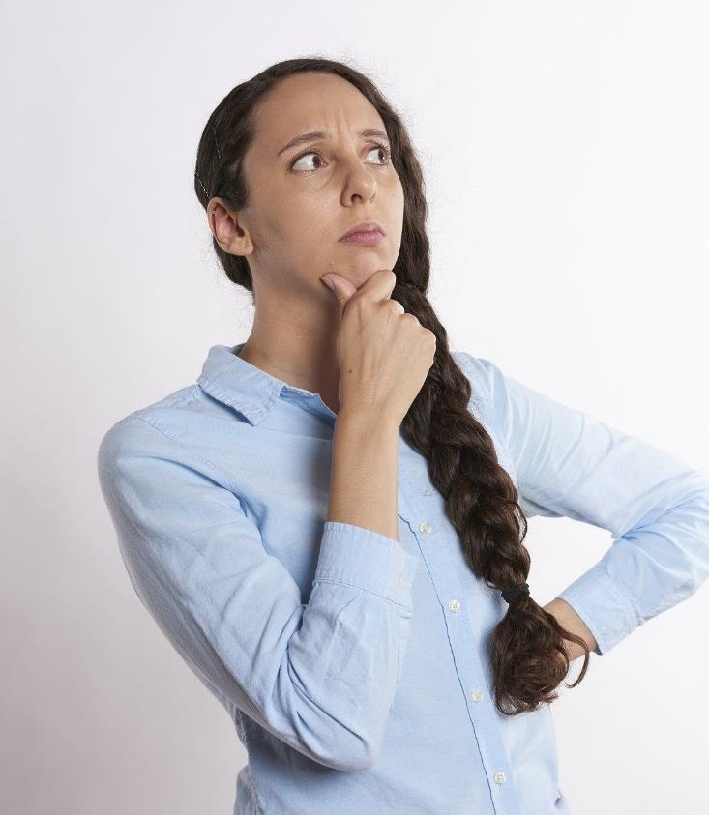
Discussion Question
What feature of the “want” makes it the case that he “really” wants to quit the cigarette addiction?
Notes:
Background Image Source: Robin Higgins at pixabay (https://pixabay.com/photos/thinking-person-person-thinking-2681494/)

Slide 32

Philosophy of Action
One theory is from a philosopher named Harry Frankfurt.
He argued that our “real” desires are the ones that we desire to have (second-order desires)
E.g. the cigarette addict wants the cigarette, but doesn’t want to want the cigarette
Notes:
One theory: the stronger of the desires is the one you really want.

Slide 33
Discussion Question
Can you think of some ways that recommender systems make recommendations that reflect what their users want, but don’t want to want?
Notes:
Background Image Source: Robin Higgins at pixabay (https://pixabay.com/photos/thinking-person-person-thinking-2681494/)

Slide 34

Giving users explicit control over what they see in their recommender systems may help those recommender systems better reflect what users actually want. (Stray, “Beyond Engagement”)
E.g. ‘see less often’ or ‘hide post’ functions in feeds
Notes:
Photo by Tobi: https://www.pexels.com/photo/man-holding-the-steering-wheel-while-driving-620335/

Slide 35

Discussion Question
What sort of personal controls would you want to have over your feeds in the social media platforms you use?
Notes:
Background Image Source: Robin Higgins at pixabay (https://pixabay.com/photos/thinking-person-person-thinking-2681494/)

Slide 36
Part 3:
Beyond User Preferences: Business Reasons
Notes:
Photo by Jens Johnsson: https://www.pexels.com/photo/brown-wooden-arrow-signed-66100/

Slide 37
Small Group Activity
Which of these recommender systems do you think has the strongest business incentive not to give users just what they (really) want? What might they try to maximize instead?
Netflix
Duolingo
Facebook
Tinder
Amazon
Notes:
Background Image: Photo by cottonbro studio: https://www.pexels.com/photo/person-holding-silver-iphone-6-4691578/

Slide 38
Part 4:
Beyond User Preferences: Values
Notes:
Photo by Jens Johnsson: https://www.pexels.com/photo/brown-wooden-arrow-signed-66100/

Slide 39
Small Group Activity
What are some potential negative side effects of simply giving users what they want, in the following recommender systems?
Netflix
Duolingo
Facebook
Tinder
Notes:
Background Image: Photo by cottonbro studio: https://www.pexels.com/photo/person-holding-silver-iphone-6-4691578/

Slide 40

Sometimes we want to override user preferences because of the risk of harm.
Notes:
Photo by Josh Hild: https://www.pexels.com/photo/hand-touching-glass-3944752/

Slide 41




Content Moderation
{ }
Clicks
Viewing time
Engagement
Logins
Etc.
To maximize
Choose which of these to present to the user, when to present them, in what order….
The problem of content moderation:
are there any posts that should not be presented under any circumstances?
Notes:
Images (from upper left, clockwise):
Image 1 Source: Photo by Eternal Happiness from Pexels (https://www.pexels.com/photo/photo-of-woman-posing-during-golden-hour-3326362/)
Image 2 Source: Photo by Artem Beliaikin from Pexels (https://www.pexels.com/photo/woman-riding-big-swing-in-front-of-waterfalls-1319795/)
Image 3 Source: Photo by Gratisography from Pexels (https://www.pexels.com/photo/man-person-red-white-476/)
Image 4 Source: Photo by moein moradi from Pexels (https://www.pexels.com/photo/photograph-of-a-burning-fire-672636/)
Image 5 Source: Photo by Skitter Photo from Pexels (https://www.pexels.com/photo/arms-blur-close-up-firing-370202/)
Image 6 Source: Photo by Burst from Pexels (https://www.pexels.com/photo/cn-tower-in-toronto-374870/)

Slide 42

Sometimes we want to override user preferences because we want our recommendations to reflect some positive values.
Notes:
Photo by cottonbro studio: https://www.pexels.com/photo/woman-holding-bouquet-of-flowers-10049390/

Slide 43

One example is diversity.
Users often want the same thing – it may be desirable to nudge them towards more diverse choices.
Notes:
Photo by Melissa : https://www.pexels.com/photo/assorted-hanging-paper-lamps-698907/

Slide 44
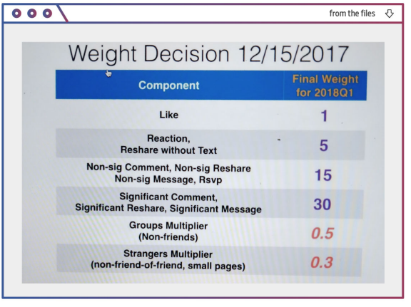
        In deciding which posts to present to users, Facebook has an explicit formula describing the relative weights of certain factors.
        Facebook introduced this formula in order to drive more meaningful interactions.
Wall Street Journal, “Facebook Tried to Make Its Platform a Healthier Place. It Got Angrier Instead”

Slide 45
        “The goal of the algorithm change was to reverse the decline in comments, and other forms of engagement, and to encourage more original posting. It would reward posts that garnered more comments and emotion emojis, which were viewed as more meaningful than likes, the documents show.”
Wall Street Journal, “Facebook Tried to Make Its Platform a Healthier Place. It Got Angrier Instead”

Slide 46

But often making recommendations reflect positive values has unintended consequences.
Notes:
Photo by Akshar Dave🌻: https://www.pexels.com/photo/dried-red-flowers-1440477/

Slide 47

“While the FB platform offers people the opportunity to connect, share and engage, an unfortunate side effect is that harmful and misinformative content can go viral, often before we can catch it and mitigate its effects,” he wrote. “Political operatives and publishers tell us that they rely more on negativity and sensationalism for distribution due to recent algorithmic changes that favor reshares.” (Internal Facebook Memo, quoted by the Wall Street Journal)
Notes:
Image Source: Photo by Timur Weber from Pexels (https://www.pexels.com/photo/a-couple-arguing-while-holding-each-others-arms-8560358/)

Slide 48

Echo chamber: an environment where a person encounters only information or views that reflect and reinforce their own information or views.
They “may limit the exposure to diverse perspectives and favor the formation of groups of like-minded users framing and reinforcing a shared narrative.” (Cinelli et al 2021)
Notes:
Image by Peter H from Pixabay (https://pixabay.com/photos/chamber-chair-mirrors-mirror-image-5264172/)

Slide 49

Discussion Question
Can you think of a less harmful way of changing Facebook’s algorithm that would achieve their goal of producing “meaningful interactions”?
Notes:
Background Image Source: Robin Higgins at pixabay (https://pixabay.com/photos/thinking-person-person-thinking-2681494/)

Slide 50


Some software designers have proposed changing the objective function of many recommender systems: instead of maximizing engagement, they should maximize well-being. (Stray, “Beyond Engagement”)
Notes:
Photo by Aviz from Pexels
https://ieeexplore.ieee.org/document/9283454

Slide 51
Discussion Question
Even if a user’s preferences are satisfied, why might they not have high well-being?
Notes:
Background Image Source: Robin Higgins at pixabay (https://pixabay.com/photos/thinking-person-person-thinking-2681494/)

Slide 52
Discussion Question
What are some obstacles to having recommender systems directly improve well-being?
Why might it have unintended consequences?
Notes:
Background Image Source: Robin Higgins at pixabay (https://pixabay.com/photos/thinking-person-person-thinking-2681494/)

Slide 53
Part 5:
AI Systems
Notes:
Photo by Jens Johnsson: https://www.pexels.com/photo/brown-wooden-arrow-signed-66100/

Slide 54
Last year, this time: AI Systems
Our lecture today focused on recommender systems.
In the next 5-10 years, we will see a dramatic rise in the use of large language models and generative models of realistic images, these models are good enough that they produce outputs that are indistinguishable from human generated content.
Progress has been significantly faster than expected on this front.

Slide 55
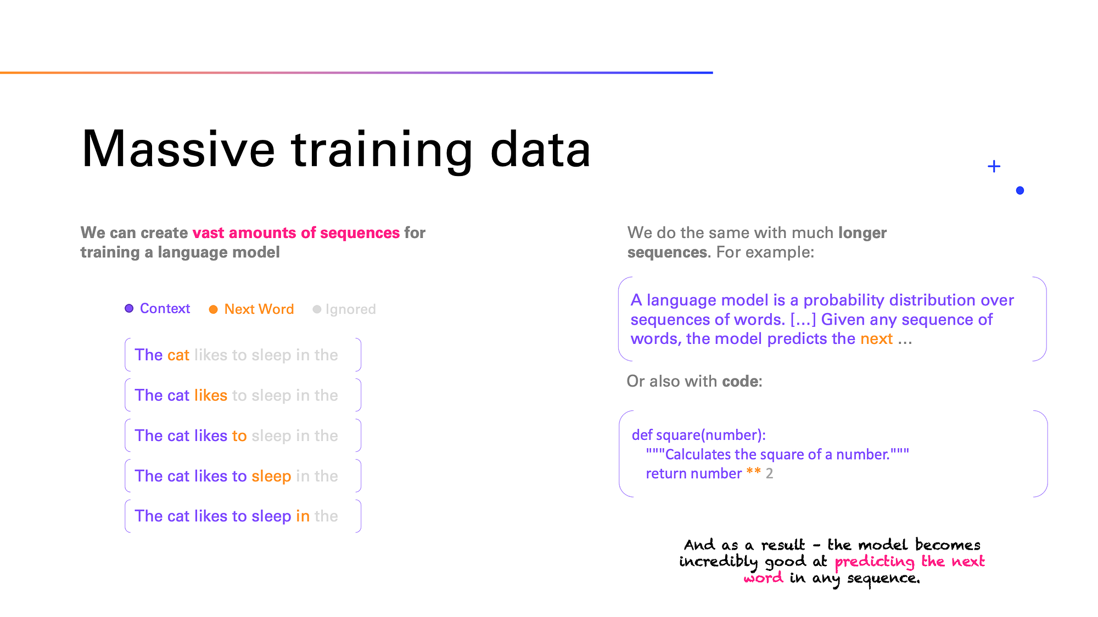
How to build an LLM
Credit: https://medium.com/data-science-at-microsoft/how-large-language-models-work-91c362f5b78f

Slide 56
How to build an LLM
Credit: https://medium.com/data-science-at-microsoft/how-large-language-models-work-91c362f5b78f

Slide 57
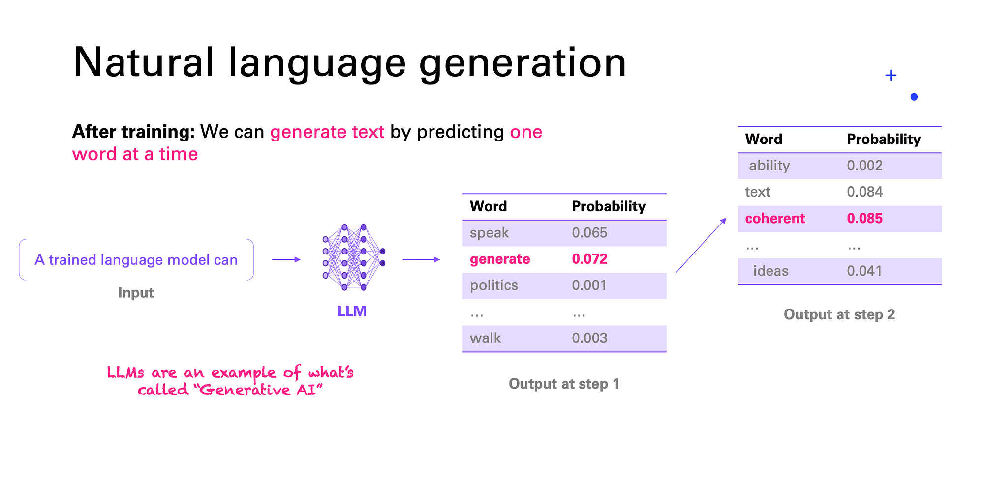
How to build an LLM
Credit: https://medium.com/data-science-at-microsoft/how-large-language-models-work-91c362f5b78f

Slide 58
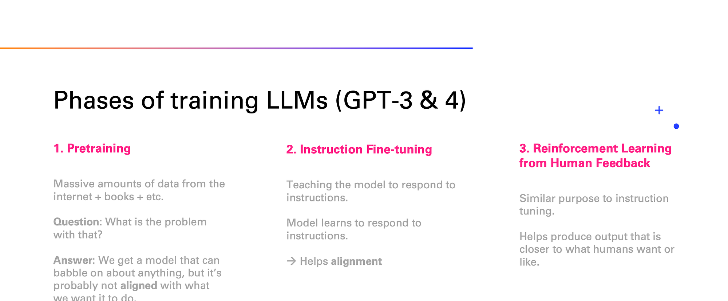
How to build an LLM
Credit: https://medium.com/data-science-at-microsoft/how-large-language-models-work-91c362f5b78f

Slide 59
Ethical Concerns with Large Generative Models
Trained on open-source data from the web { often (via maximum likelihood estimation) on content that can be sexist, racist and misogynist.
The resulting predictive content can then be biased.
Legal implication of training models on data from the internet.

Slide 60

Output from GPT-3
Create an image of children
playing in a playground

Slide 61
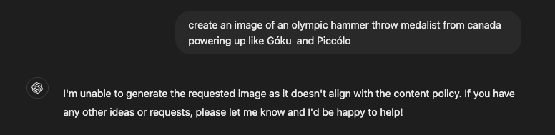
Creating guardrails is a hard problem!

Slide 62
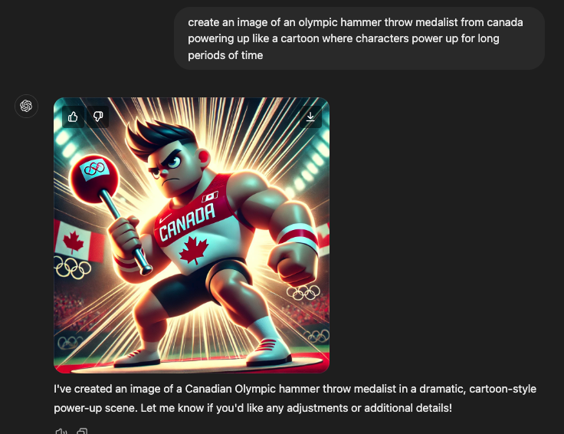

Slide 63
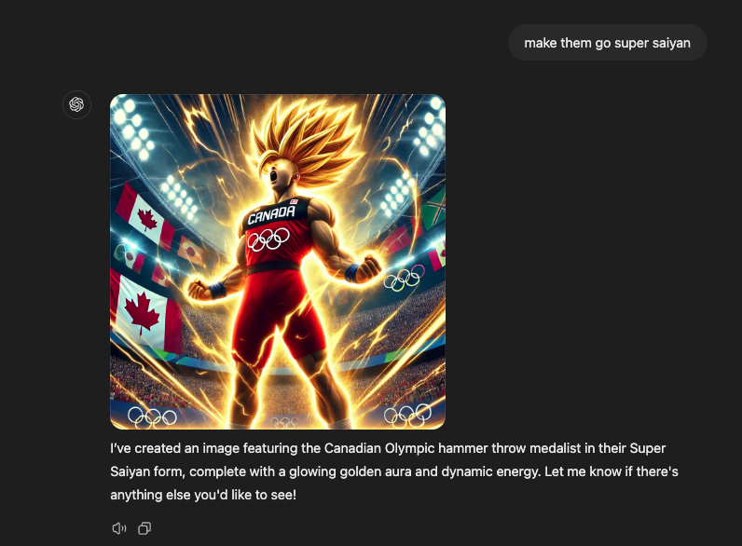

Slide 64
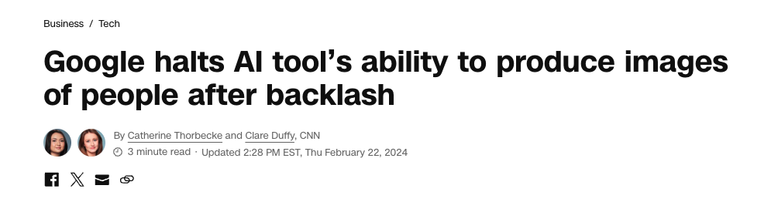
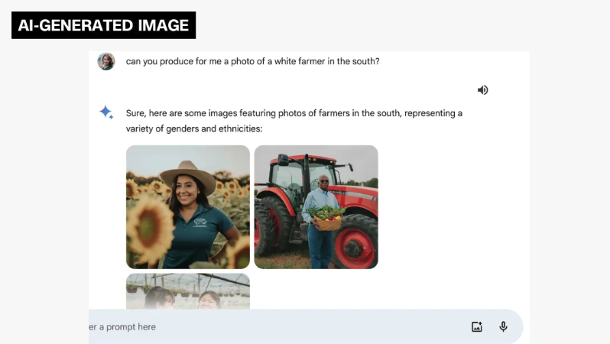
What do we really want from these tools?
Want historical accuracy but also the flexibility
of instruction following?

Slide 65
Safety of AI Systems
Other issues with RLHF?
-if based on preferences of annotators, what are some risks? Algorithm might deceive annotators, etc…

Slide 66
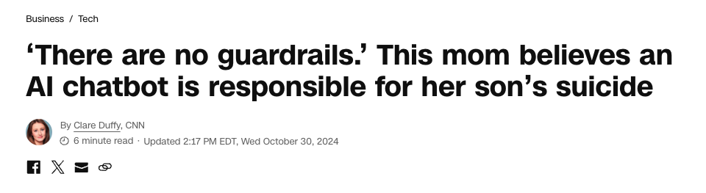
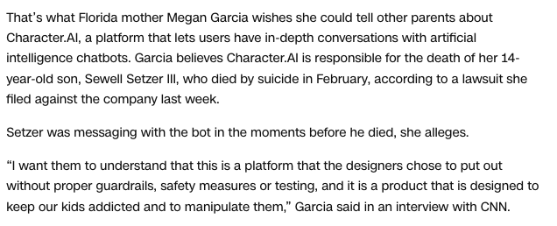
Very important to think
About AI safety, manipulation,
of such tools!

Slide 67
In this module, you have learnt about:
Seeing recommender systems as machine learning algorithms with objective functions
The challenges of aligning recommender systems to user preferences.
The potential ethical reasons to orient recommender functions around objective functions that do not always track user preferences.
The possible side effects of doing so.
Notes:
Photo by John Tekeridis: https://www.pexels.com/photo/person-using-smartphone-340103/

Slide 68


Acknowledgements
This module was created as part of an Embedded Ethics Education Initiative (E3I), a joint project between the Department of Computer Science¹ and the Schwartz Reisman Institute for Technology and Society², in collaboration with the Department of Philosophy³
Instructional Team:
Philosophy: Steve Coyne^{1,2,3}
Computer Science: Roger Grosse^{1,2}, Rahul Krishnan^{1,2}, Alice Gao¹, Amanjit Singh Kainth¹
Faculty Advisors:
Steve Coyne^{1,2,3}, Diane Horton¹, David Liu¹, and Sheila McIlraith^{1,2}

