Slide 1

Synthesizing Datalog Programs
using Numerical Relaxation
Xujie Si · Mukund Raghothaman · Kihong Heo · Mayur Naik
University of Pennsylvania

Slide 2




Background
Declarative logical rules are widely used …
Datalog $≈$First-order logical rules + Least fixed-point semantics
SociaLite
BigDatalog
Big Data Analytics
Networking
Software Analysis
Notes:
Widely used in many areas, for instance, A/B/C
All these applications use a common language called Datalog.
Roughly speaking, …

Slide 3
The Problem & Challenges
Synthesizing logical rules from relational input-output data
Inductive logic programming
Program Synthesis
Soundness
Recursion
FOIL
(Quinlan, 1990)
Constraint-based synthesis
(Albarghouthi et al, 2017)
Predicate invention
Progol, Metagol
(Muggleton, 1995, 2015)
Syntax-guided synthesis
(Si et al, 2018)
Resilience to noise
ad-hoc heuristics
“greedy”
Scalability
systematic search
“discrete combinatorial”
Notes:
We are interested in synthesizing Datalog problems, in other words, synthesizing logical rules …
There are many challenges in the following aspects: xxx
This is not new problem; in fact, there is an entire domain …
Representative pioneer work are …
Another very related line of work in PL community …

Slide 4
Central Question
Can numerical approaches help synthesize logic programs?
Notes:
Gradient-based, stochastic approaches have achieve dramatic successes in deep learning …

Slide 5

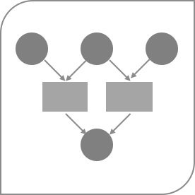
Outline
Rule Selection
Datalog Relaxation
Optimization
Evaluation
Notes:
Here is the outline for the rest of my talk

Slide 6

Rule Selection Problem
Rule generation approaches
Syntax-guided approach
Inductive bias, e.g. meta-rules
Meta-rule augmentation
path (x, y) | :- | edge (x, y).
path (x, x) | :- | edge (x, y).
path (x, z) | :- | edge (x, y), | path (y, z).
path (x, y) | :- | path (y, x).
 | …
NP-Hard
O⁺
I
O⁻⁻
Notes:
Let me concretize the actual problem we are working on, namely rule selection problem
Blablah..
And, this is NP-hard! But that is not the worst thing;
as you may wonder where these rules come from, and who should provide them?
the answer is that they are automatically generated.
So, rule selection problem is the inner loop.

Slide 7
Key idea
Inspired by the popular paradigm in mathematical optimizations
like LP relaxation, SDP relaxation, etc.
Associate each rule with a weight
Therefore each tuple will get a weight (according to the semantics)
Turn discrete combinatorial search into continuous optimization
Recover the desired logic program from the optimized weights
Notes:
explain tuple (e.g. a tuple is a fact that are derived from given input data and logical rules, Boolean => numerical)

Slide 8

Outline
Rule Selection
Datalog Relaxation
Optimization
Evaluation

Slide 9
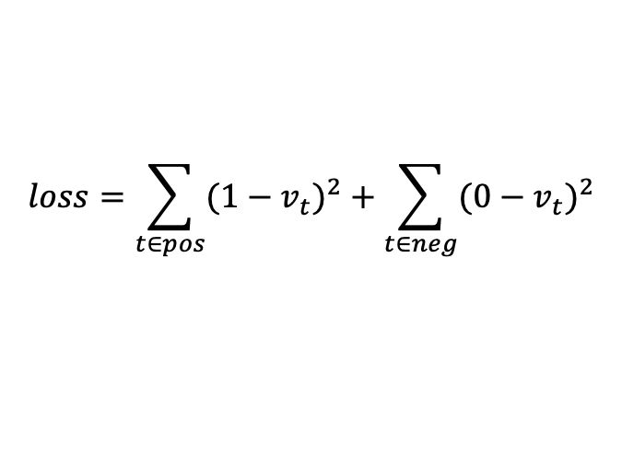




Datalog relaxation
Discrete Combinatorial Search ➔ Continuous Optimization
Parameters: $\vec{W}$
path (x, y) | :- | edge (x, y).
path (x, z) | :- | edge (x, y), | path (y, z).
path (x, x) | :- | edge (x, y).
path (x, y) | :- | path (y, x).
Find $\vec{W}$ which minimizes the loss:
0.7
0.9
0.1
0.3
$$loss=\sum_{t∈pos}{{(1−v_{t})}^{2}}+\sum_{t∈neg}{{(0−v_{t})}^{2}}$$
edge(1, 2) | edge(2, 3)
1.0 | 1.0
$$t$$
path(1, 2) | path(2, 3) | path(1, 3) | path(1, 1) | path(2, 1) | …
0.7 | 0.7 | 0.63 | 0.1 | 0.21 | …
Question: how do we compute this?
$$v_{t}$$
1 | 1 | 1 | 0 | 0 | …
Notes:
So the general idea is to turn xxx into xxx
Blahblah…
In the PBE / PBD setting, 0-loss is achievable in most cases.

Slide 10

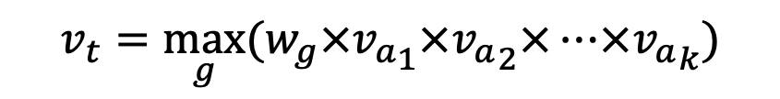








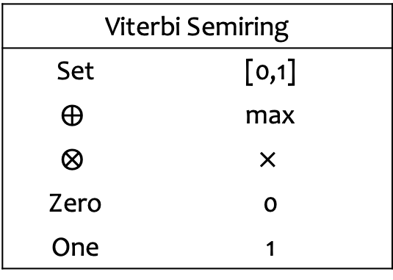

Datalog relaxation
r1:
0.7 | path (x, y) | :- | edge (x, y).
0.9 | path (x, z) | :- | edge (x, y), | path (y, z).
$$1.0$$
edge(2,3)
r2:
r1
$$0.7$$
$$1.0$$
edge(1,2)
path(2,3)
$$0.7=0.7∗1.0$$
Viterbi Semiring
Set | [0,1]
$$⨁$$ | max
$$⨂$$ | $$×$$
Zero | 0
One | 1
$$1.0$$
edge(1,3)
r2
$$0.9$$
$$0.7$$
r1
path(1,3)
$$0.63=0.9∗1.0∗0.7∗1.0$$
$$0.7=max⁡\{0.7, 0.63\}$$
$$v_{t}=\bigvee_{g}{({v_{a}}_{1}∧{v_{a}}_{2}∧…∧{v_{a}}_{k})}$$
$$v_{t}=\max_{g}{(w_{g}×{v_{a}}_{1}×{v_{a}}_{2}×…×{v_{a}}_{k})}$$
Notes:
Forget weights for a minute, …
Now we consider weights, each weight is between 0 and 1.
Note that it does NOT mean probability, which is intended. The reason will be clear in a minute.
We take the maximum, instead of computing the absolute probability for each derivation and sum up all of them.
1) Enable an elegant correspondence between Least-fixed point semantic and Viterbi semi-ring
2) More importantly, it is very efficient to maintain V semiring.
Computing probability is always intractable, and careful attention is avoid double counting issues, even worse there could be infinite number of derivations due to recursion.

Slide 11
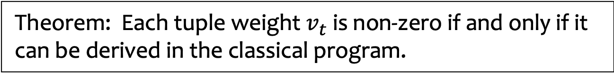
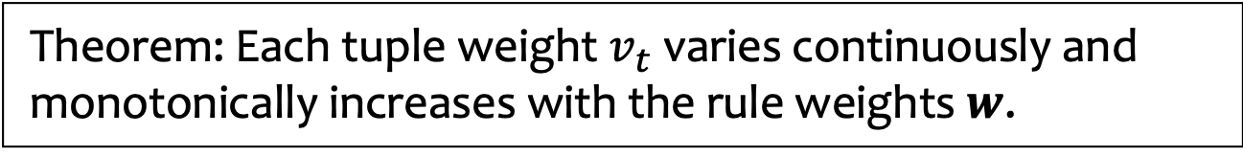
Connections to classical Datalog
Theorem: Each tuple weight $v_{t}$ varies continuously and monotonically increases with the rule weights $w$.
The loss surface is still NOT monotonic.
Theorem: Each tuple weight $v_{t}$ is non-zero if and only if it can be derived in the classical program.
This enables us to recover classical program.
Easy to modify existing Datalog solvers with only O(1) overhead.

Slide 12
Outline
Rule Selection
Datalog Relaxation
Optimization
Evaluation

Slide 13
Optimization
Newton-Raphson method + Periodic MCMC sampling
  Focus on the exact program synthesis where zero loss is achievable
  Periodic MCMC helps to escape local minimum
Early termination
  Based on a sound separation condition
Leverage parallelization
  Our approach is a type of Las Vegas algorithm

Slide 14
Outline
Rule Selection
Datalog Relaxation
Optimization
Evaluation

Slide 15
Evaluation
https://github.com/petablox/difflog
Difflog: a prototype implementation in Scala
Baseline
  ALPS, the state-of-the-art tool in C++
34 benchmark problems in three categories
  Knowledge discovery (8 tasks, up to 4 rules)
  Relational queries (15 tasks, up to 4 rules)
  Program analysis (11 tasks, up to 10 rules)
Setup
  Run in 32 parallel processes

Slide 16

Difflog vs ALPS
Converges to the global optimal quickly
Orders of magnitude faster
Search space is $2^{\#rules}$
benchmark |  | #relations | #candidate rules | Difflog #iterations (time in sec) |  | ALPS (time in sec)
Program Analysis | polysite | 6 | 552 | 17 | 27 | 84
 | downcast | 9 | 1267 | 5 | 30 | 1646
 | rv-check | 5 | 335 | 1205 | 22 | 195
 | andersen | 5 | 175 | 1 | 4 | 27
 | 1-call-site | 9 | 173 | 4 | 4 | 106
 | 2-call-site | 9 | 122 | 25 | 53 | 676
 | 1-object | 11 | 46 | 3 | 3 | 345
 | 1-type | 12 | 70 | 3 | 4 | 13
 | escape | 10 | 140 | 2 | 1 | 5
 | modref | 13 | 129 | 1 | 1 | 2836

Slide 17
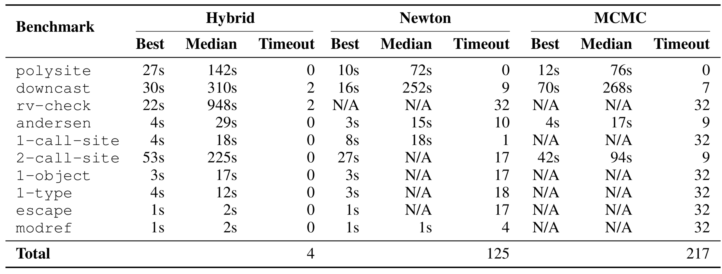
Successfully synthesize all tasks
Hybrid approach is more effective and efficient
Almost no timeout
Notes:
Timeout is 1 hour.

Slide 18
Conclusion
Numerical approaches significantly improve synthesis of logic programs
Thank you!

