Slide 1
Getting to the root of concurrent BSTs
Trevor Brown
IST Austria
http://tbrown.pro

Slide 2

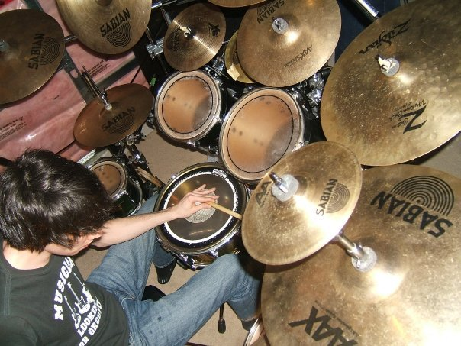
A bit about me
Postdoc at IST Austria
Starting at University of Waterloo (Canada) in September
Interests
  Fast concurrent data structures
  Memory reclamation
  Transactional memory
  Big systems
  Big numbers
  …
  Gamer
  Death metal drummer

Slide 3

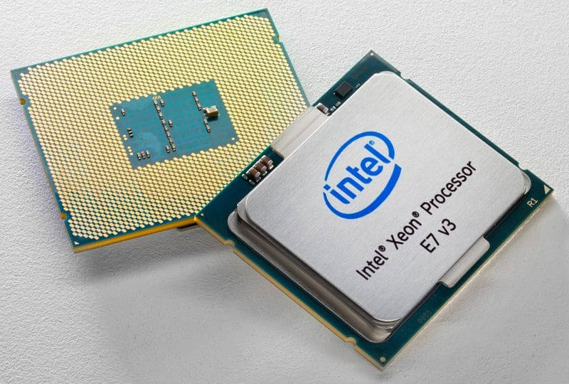
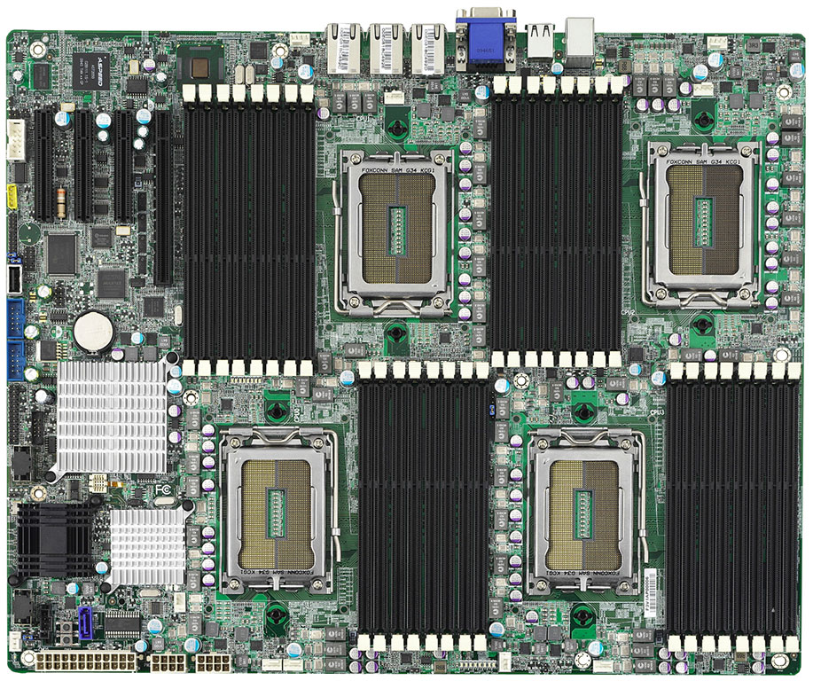
Big multicore systems
Many threads (tens to hundreds)
Threads have private memory
  Cheap to access
Shared memory (up to TBs)
  Cheap if memory is cached
  Expensive otherwise
Last-level cache is most important

Slide 4
Dictionary abstract data type
Insert(key, value)
  Inserts (key, value) if key doesn’t exist
  Replaces the value if key already exists
Delete(key)
  Removes any (key, value)
Search(key)
  Returns the value associated with key (if any)

Slide 5
Binary search trees
Internal (node-oriented)
  Typical BSTs taught in undergrad
Insert: easy
Delete leaf: easy
Delete node with one child: easy
Delete node with two children: hard
  Must find predecessor (or successor)
  How to atomically move predecessor?
5
6
Insert 7
4
8
Delete 9
Delete 8
2
5
7
9
Delete 6
Predecessor of 6

Slide 6

Atomic MOVE is hard
Delete 40
Find 37
40
23
53
17
27
Not found!
21
33
31
34
37
37

Slide 7
Binary search trees
External (leaf-oriented)
  Leaves contain real keys (and values)
  Internal nodes contain dummy keys
Insert: add leaf & internal
Delete: remove leaf & internal
Cons:
  2x as many nodes as internal BSTs
  Searches always stop at a leaf (deeper)
Pro: no need for atomic move!
6
Insert 7
Delete 2
9
4
9
2
5
7
4
5

Slide 8
Concurrent binary trees
Many approaches
  Start simple
  See if things work well enough

Slide 9

Coarse grained: global lock
a
Insert(e)
m
f
c
h
b
e

Slide 10
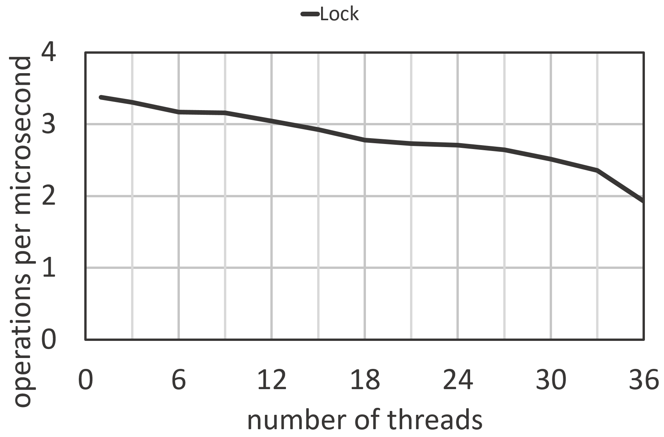
Coarse grained: global lock
BST containing 100,000 keys
n threads perform searches
Measure # searches/sec
Concurrency bottleneck!
No concurrency = no scaling

Slide 11

Coarse grained: readers / writer lock (R/W lock)
1
2
3
a
Search(c)
m
f
c
h
b

Slide 12
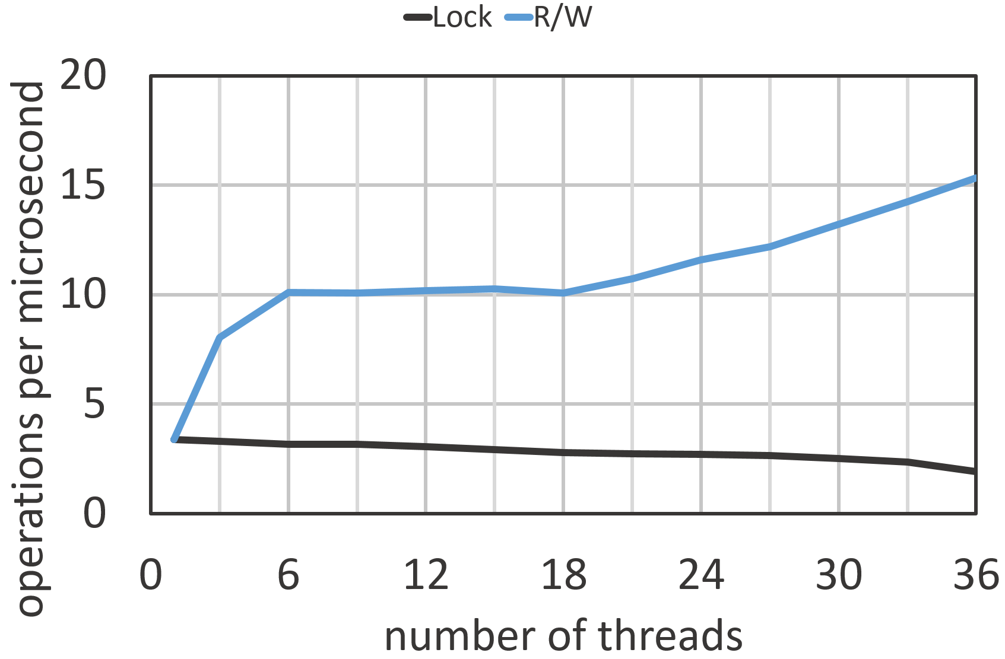
Coarse grained:
Readers / writer lock (R/w lock)
Same experiment
Much better.
Is this good enough?
How much do updates hurt?

Slide 13
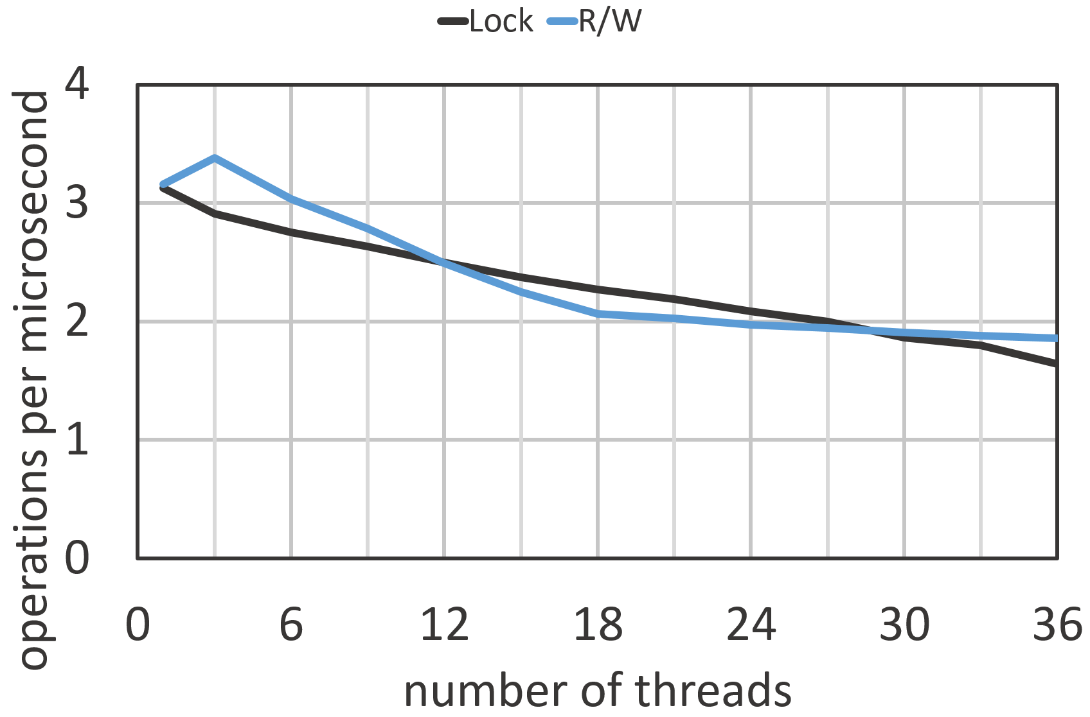
Slightly different experiment
20% updates, 80% searches
No better than a global lock!

Slide 14
Fine-grained:
Hand over hand locks
a
m
Insert(e)
f
c
h
b
e

Slide 15
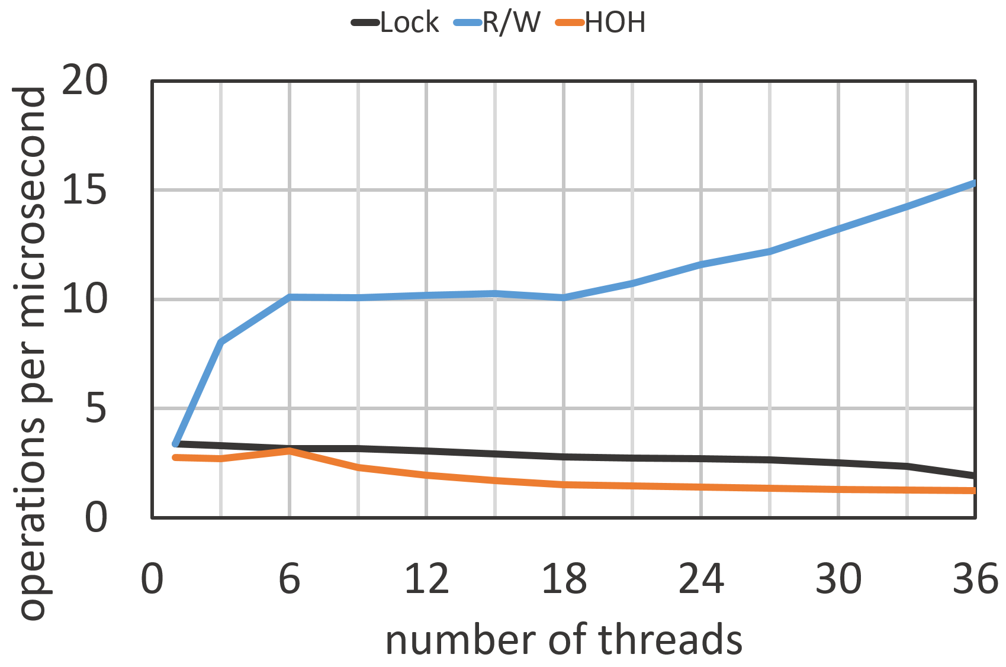
Fine-grained:
Hand over hand locks
Experiment: 100% searches
Still no real scaling!
Why?
All operations lock the root!
But they release it right away???

Slide 16
Cache coherence
Thread 1’s cache
Thread 2’s cache
w₁
w₂
w₃
w₄
w₅
w₆
w₇
w₈
S
w₁
w₂
w₃
w₄
w₅
w₆
w₇
w₈
S
X
Thread 1 reads w₂
Thread 2 reads w₇
Thread 2 writes w₇
w₁
w₂
w₃
w₄
w₅
w₆
w₇
w₈
64 byte (8 word) cache line

Slide 17
Locking and cache coherence
Evict this cache line for all threads!
a
Evict this cache line for all threads!
m

Slide 18
Achieving high performance
NO locking while searching!
How to do this correctly?
What happens if we simply:
1. search with no locks
2. lock all nodes we want to change or delete
3. make our changes
4. unlock all nodes

Slide 19
Hazard 1: accidentally changing deleted nodes
Thread 1:
Insert(e)
Thread 2:
Delete(c)
a
m
f
c
h
e

Slide 20
Hazard 2:
Observing partial changes
Thread 2:
Search(c)
Thread 1:
Right rotation
Lock f, c, b, a
f.left = b
f
f
c
h
b
h
b
a
c
a
Key c NOT FOUND!

Slide 21
Overcoming the hazards:
TGT BST
Example
  “Ticket locking” external BST of Tudor, Guerraoui and Trigonakis (TGT)
  Searches: standard BST search
  Updates
    standard BST search
    lock internal nodes that will be changed or unlinked
      (leaves are never changed)
    if a node is marked, release locks and retry
    mark nodes before unlinking
    perform update by changing one pointer
  Hazard 1 (changing deleted nodes): marking
  Hazard 2 (observing partial changes): single pointer change
6
Insert 7
9
Delete 2
4
9
2
5
7
4
5

Slide 22
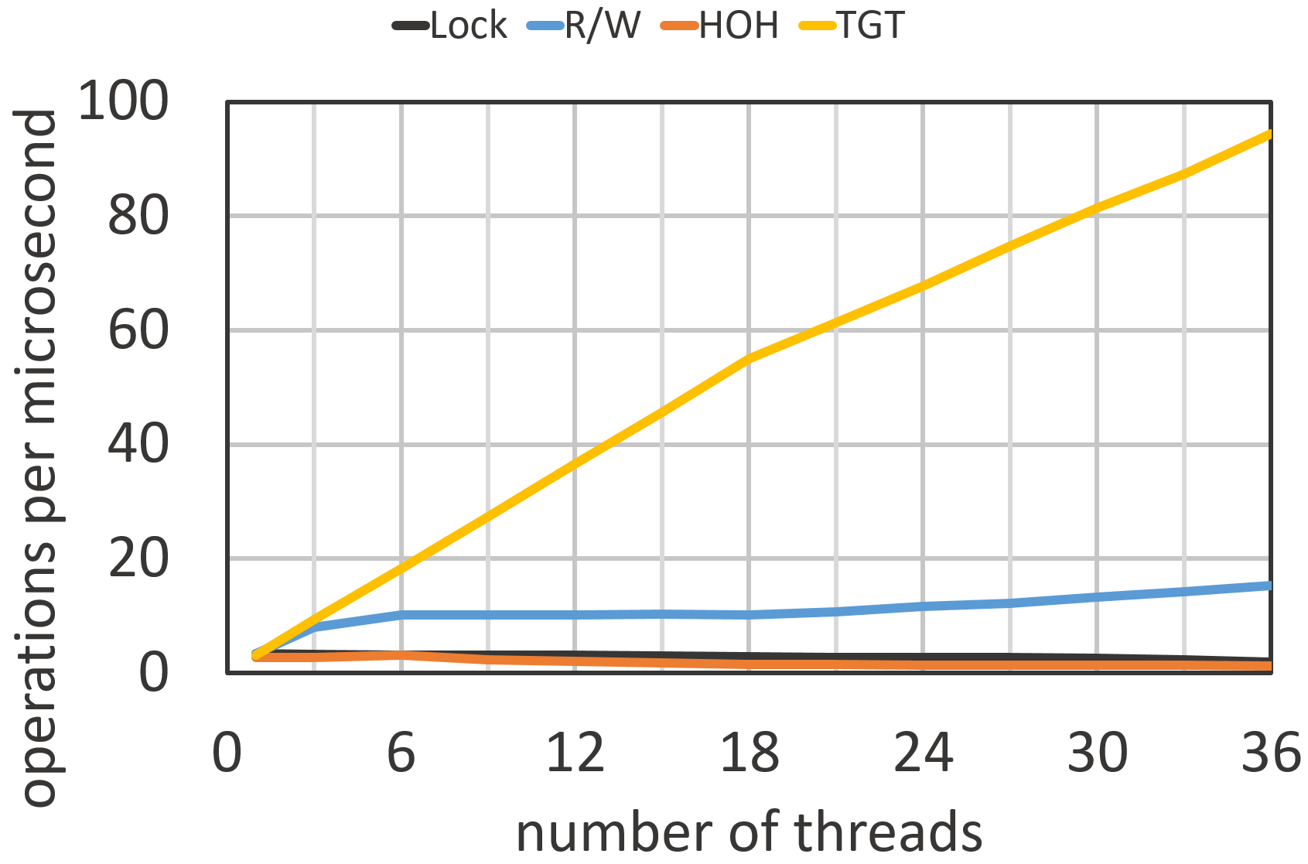
Performance of TGT Searches
Experiment: 100% searches
Recall:
  TGT does regular BST searches
  No synchronization, no writes
  This is crucial for performance!
What about BSTs with
more complex updates?

Slide 23
BCCO BST
Balanced AVL tree of Bronson, Casper, Chafi and Olukotun (BCCO)
Partially external
  Insert: same as internal
  Deletion of leaf or internal node with single child: same as internal
  Deletion of internal node with two children: logically delete and unlink later
    Logically deleted keys become dummy keys (cleaned up by rotations)
  Similar structure to an internal tree in practice (fewer nodes, better height)
  Makes the hard delete case much easier!
Uses optimistic concurrency control (OCC) techniques
to avoid locking nodes in searches

Slide 24
Another approach: see partial changes and keep going
Unbalanced external BST of Drachsler, Vechev and Yahav (DVY)
Also partially external
Locks individual edges instead of nodes
Additionally keeps all tree nodes in a doubly linked list!
Pro: fast searches (no writes or synchronization)
Con: slow updates (many pointers to change)
9
3
15
2
5
12
16
4
7

Slide 25
Delaying changes to guarantee consistency
Unbalanced internal BST of Arbel and Attiya (AA)
Uses fine-grained node locking and
Read-copy-update (RCU) primitives
  Enter: announce “I am starting a new data structure operation”
  Sync: wait until all operations started before the sync have terminated
When moving a predecessor’s key upwards,
they delay the move until searches that might miss the key have finished

Slide 26
Summary of locking techniques
BST | Balanced? | Tree type | Update sync | Search overhead
TGT |  | External | Node locks
BCCO | Y | Partially ext. | Node locks | Read per-node
DVY |  | Partially ext. | Edge locks
AA |  | Internal | Node locks & RCU | Write per-search

Slide 27
Lock-free approaches
Lock-freedom
  If threads take infinitely many steps
  Then infinitely many data structure operations complete
Equivalently
  Some thread can always make progress (complete an operation)
Progress guarantee must hold even if some threads crash (halting failure)
Cannot use locks!
  Crash while holding a lock → can block all threads forever
Allows some threads to starve (but rare in practice)
  Thread schedulers usually try to be fair

Slide 28
What to use instead of locks?
CAS: compare-and-swap(address, expected, new) atomically
  If address = expected, set address = new and return true
  Else return false
If I use CAS instead of locks, is my algorithm lock-free?
  Not necessarily
  Locks can be implemented with CAS
  Threads must not take “exclusive ownership” over any data (essentially a lock)
The blocking paradigm is usually replaced with helping

Slide 29


Helping
Suppose
  Thread p starts an operation O
  Thread q is blocked by O
Lock-based approach
  q waits for p
Lock-free approach
  q performs O on behalf of p
  How does it know how to perform O?

Slide 30
Descriptors and lock-free “locking”
Each operation creates a descriptor
Descriptor encodes how to perform the operation
Threads that encounter a descriptor d can invoke Help(d)
  Attempts to perform the operation on behalf of the thread that started it
Idea: lock-free “locking”
  Replace locks with pointers to descriptors
  Use CAS to “lock/unlock” by storing new descriptor pointers
  Storing a descriptor pointer grants exclusive ownership to the operation
    NOT TO THE THREAD
    Other threads can help

Slide 31
EFRB BST
Unbalanced external BST of Ellen, Fatourou, Ruppert and van Breugel
First provably correct lock-free BST
Uses “lock-free locks”
Two types of “lock” flag and mark
Flag: I want to change this node
Mark: I want to delete this node
  Marked nodes never change again

Slide 32

EFRB BST
Descriptor
Insert
  Regular BST search ending at leaf
  Create three new nodes
  Create descriptor
  Flag parent
  Replace leaf with the new nodes
  Unflag parent
Insert 7
target
old
new
parent
6
4
leaf
9
9
2
5
7
9
4
5

Slide 33
HJ BST
Unbalanced internal BST of Howley and Jones
First lock-free internal BST
Based loosely on the external EFRB BST
  Uses “lock-free locking,” descriptors and helping
Tackles the hard problem of atomically moving a predecessor
Prevents searches from seeing partial updates by making them help
  Adds overhead (even just to check if helping is needed)

Slide 34
NM BST
Unbalanced external BST of Natarajan and Mittal
Performs lock-free updates without creating descriptors
  Can infer what the operation to be performed is by looking at nearby nodes
  Idea: fewer memory allocations → less overhead
Flags and marks edges instead of nodes
  Idea: better concurrency with high contention
Can this be generalized to more complex data structures?

Slide 35
RM BST
Unbalanced internal BST of Ramachandran and Mittal
Ideas of the NM BST applied to an internal BST
Ensures Search(k) does not miss key k if it is moved upwards by:
  Having the search save a pointer to the successor of k.
  If it does not find the key it is looking for, it checks the successor to see if k was moved.

Slide 36
Summary of Lock-free techniques
BST | Balanced? | Tree type | Update sync | Search overhead
EFRB |  | External | Flag/mark nodes w/descriptors
HJ |  | Internal | Flag/mark nodes w/descriptors | Read per-node
NM |  | External | Flag/mark edges
RM |  | Internal | Flag/mark edges | Read per-search
My work in this area (not discussed here):
Several balanced lock-free search trees
General techniques for developing new lock-free trees
Accelerating trees with hardware transactional memory
Fast memory reclamation

Slide 37
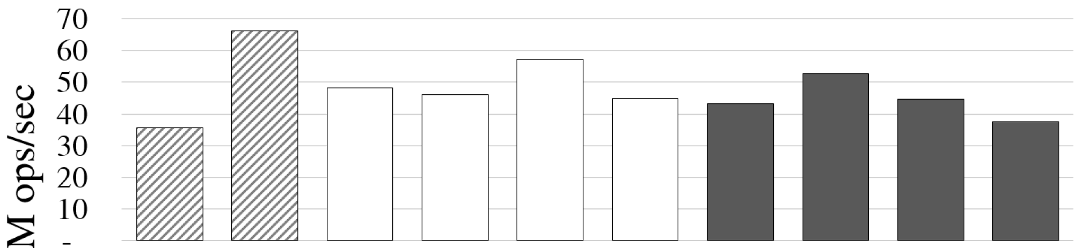
How do they perform?
Experiment: 100% searches with 64 threads
Balanced
Internal
External
BCCO1 | BCCO2 | HJ | DVY | RM | AA | NM1 | NM2 | TGT | EFRB
Read per-node | Read per-node | Read per-node |  | Read per-search | Write per-search
Search overhead

Slide 38
Performance Problems
Basic implementation problems
  Bloated nodes
  Scattered fields
  Incorrect C volatile
Memory layout issues
  Cache line crossings
  Underutilized cache sets

Slide 39
Bloated nodes
Many BSTs do not pay attention to node size
Example: BCCO (balanced, part. ext. BST with optimistic concurrency control)
  Their nodes are 112 bytes! Almost 2 cache lines!
  Pthread mutex lock is 40 bytes!
    Pthread spin-lock is only 4 bytes!
  Why does this matter?
    Larger nodes → fewer fit in cache → more cache misses
    Huge performance penalty!
  Deeper optimizations:
    Index and color store small values and are set once (combine them?)
    Are parent pointers really needed?
    Could the lock and changeOVL be combined?
struct node_t
key_t key;
val_t value;
volatile node_t * left;
volatile node_t * right;
volatile node_t * parent;
long index;
long color;
pthread_mutex_t lock;
volatile long height;
volatile long changeOVL;

Slide 40
Scattered fields
Many BSTs do not pay attention to node layout
Example: BCCO (balanced, part. ext. BST with optimistic concurrency control)
Which fields are accessed per-node by searches?
  Assume 8 byte key and value, 4 byte Pthread spin lock
  Node is 72 bytes
  Searches access 32 bytes worth of fields per node
    Easily fits in one cache line
  However, changeOVL is in a different cache line from key!
    Two cache misses per node instead of one!
  Fix: pack fields so that
    accessed close together in time → close in memory
offset
0
8
16
24
32
40
48
56
64
struct node_t
key_t key;
volatile node_t * left;
volatile node_t * right;
volatile long changeOVL;
val_t value;
volatile node_t * parent;
pthread_spinlock_t lock;
volatile long height;
long index_and_color;
struct node_t
key_t key;
val_t value;
volatile node_t * left;
volatile node_t * right;
volatile node_t * parent;
long index_and_color;
pthread_spinlock_t lock;
volatile long height;
volatile long changeOVL;

Slide 41
Incorrect C volatile
What is C’s volatile keyword?
  Informs compiler an address may be changed by another thread
  Prevents optimizations that are illegal in a concurrent setting
When do you need volatile?
  If a field can be accessed by more than one thread, and at least one of them writes to it
  Rule of thumb: each field of a node should be volatile OR only written at initialization
How do you properly define a volatile pointer to a child node in C?
  Bad: volatile node * child;
  Good: node * volatile child;
  Read right to left!
Pointer to a node that is volatile
Volatile pointer to a node

Slide 42
Occurrences of these problems
Balanced
Internal
External
BCCO1 | BCCO2 | HJ | DVY | RM | AA | NM1 | NM2 | TGT | EFRB
Read per-node | Read per-node | Read per-node |  | Read per-search | Write per-search
X |  | X | X |  | X |  | X | X | X
X |  |  | X
 |  | X | X |  | X | X | X | X | X
Search overhead
Bloated nodes
Scattered fields
Incorrect C volatile

Slide 43
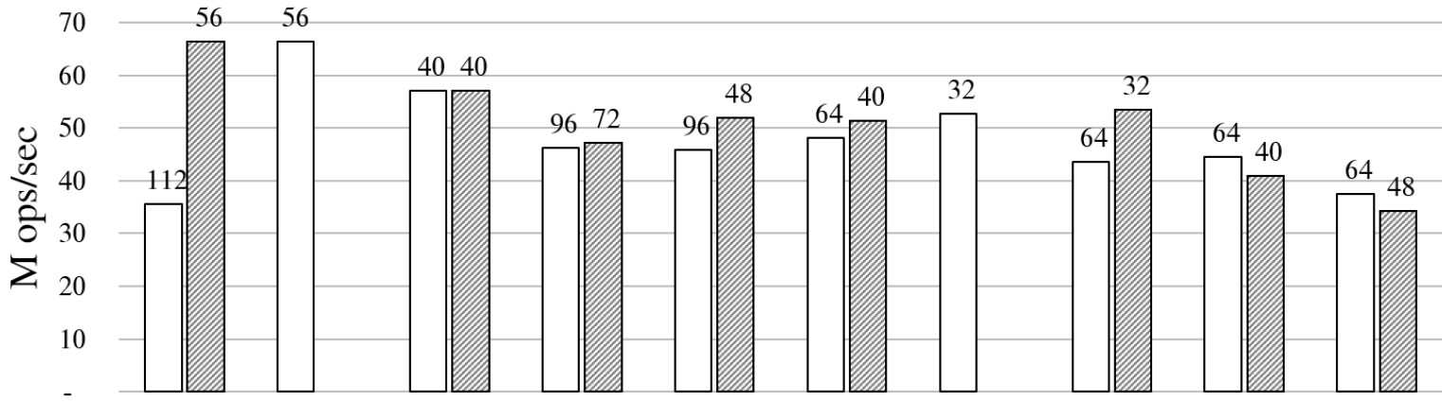

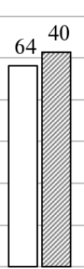


Performance impact of fixing them
Balanced
Internal
External
BCCO1 | BCCO2 | HJ | DVY | RM | AA | NM1 | NM2 | TGT | EFRB
Read per-node | Read per-node | Read per-node |  | Read per-search | Write per-search
X |  | X | X |  | X |  | X | X | X
X |  |  | X
 |  | X | X |  | X | X | X | X | X
Search overhead
Bloated nodes
Scattered fields
Incorrect C volatile

Slide 44
How a fast allocator works
Jemalloc: threads allocate from private arenas
Each thread has an arena for each size class:
  8, 16, 32, 48, 64, 80, 96, 112, 128, 192, 256, 320, 384, 448, 512
Jemalloc per-thread allocation
malloc(48)
malloc(36)
malloc(40)
malloc(44)
malloc(32)
malloc(17)
malloc(40)
…
malloc(33)
8
<---- 4096 byte page ---->
16
Arenas
0
32
32
...
48
0
48
96
144
192
4048
64

Slide 45
Cache line crossings
8
These nodes cross cache lines!
Half of nodes in the 48 byte class will cross cache lines
16
0
16
32
48
32
0
32
64
96
48
0
48
96
144
64
0
64
128
192
Cache line
Cache line
Cache line
Cache line
Not a big deal if the tree
fits in the cache
If the tree does not fit in cache,
double cache misses for these nodes!

Slide 46
cache sets
Hashing a cache line to a bucket:
1. compute its physical address PA
2. bucket = PA mod 4096
Cache is sort of like a hash table
Maps addresses to buckets (4096 for us)
Buckets can only contain up to c elements (64 for us)
If you load an address, and it maps to a full bucket
  A cache line is evicted from that bucket
The hash function that maps addresses to buckets is… interesting
  Not very random
  Patterns in allocation can lead to patterns in bucket occupancy

Slide 47
Cache set usage in HJ BST
Recall: insertion creates a node and a descriptor (to facilitate helping)
Node size class: 64 Descriptor size class: 64
100% search workload → cache will only contain cache lines w/nodes
Which cache sets will these nodes map to?
  Cache indexes used: 0, 2, 4, … (only even numbered indexes)
  Taken modulo 4096, these can only map to even numbered cache sets!
  Only half of the cache can be used to store nodes!
64
0
64
128
192
256
320
Cache line
Cache line
Cache line
Cache line
Cache line
Cache line

Slide 48
Simple fix: random allocations
Hypothesis: problem is the rigid even/odd allocation behaviour
Idea: break the pattern with an occasional dummy 64 byte allocation
Fixes the problem!
  Reduces unused cache sets to 1.6%
  Improved search performance by 41%
  … on our first experimental system, which was an AMD machine.
  However, on an Intel system, this did not improve search performance!
0
64
128
192
256
320
0
64
dummy
192
256
320

Slide 49
The difference between systems
Cache misses mean waiting for a long time
To reduce latency (waiting time), processors prefetch data
Example: for-loop reading an array
  AMD and Intel both prefetch array entries
Intel processors prefetch more aggressively
  Think you are loading just one cache line?
  Adjacent line prefetcher: always load one extra adjacent cache line
    Not always the next cache line----can be the previous one
  Smallest unit of memory loaded is 128 bytes (two cache lines)
  This is also the unit of memory contention (writes contend within 128 bytes)

Slide 50
Effect of prefetching on HJ BST
The occasional dummy allocations break up the even/odd pattern
But…
Whenever search loads a node, it also loads the adjacent cache line
  This is a descriptor or a dummy allocation!
  This is useless for the search, and takes up space in the cache
  Only half of the cache is used for nodes!
0
64
dummy
192
256
320
Fix: add padding
to nodes or descriptors
so they are in
different size classes

Slide 51
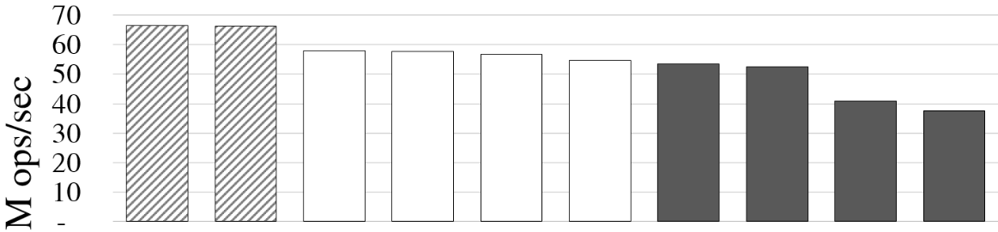
Performance after all fixes
Balanced
Internal
External
BCCO1 | BCCO2 | HJ | DVY | RM | AA | NM1 | NM2 | TGT | EFRB
Read per-node | Read per-node | Read per-node |  | Read per-search | Write per-search
Search overhead
node size class
32 bytes
node size class
48 bytes
Much more fits in cache.
Fewer cache misses!

Slide 52
Recommendations
Avoid the basic implementation problems
When designing and testing a data structure
  Understand your memory layout!
  How are nodes laid out in cache lines? Pages?
  What types of objects are near one another?
When adding a data structure to a program
  You are merging two memory spaces
  Understand your new memory layout!
Other issues: false sharing! Unknown unknowns?
Hypothesize and explore! Performance results are the beginning.
http://tbrown.pro
Tutorials, code, benchmarks
Companion talk:
Good data structure experiments are R.A.R.E

